Slide 1


.NET Internals, IL Generation & Code Analysis
Andrej Čižmárik

Slide 2
Motivation
Analyzers
PEVerify, ILVerify, VS profiler
Aspect Weavers
PostSharp, Fody
(De-)compilers
(De-)obfuscators
Some instructions / constructs are not directly available from C#
CPBLK, CALLI, LDFTN, prefix .NO(nullcheck, typecheck, rangecheck), …
fault blocks – these are actually available in VB.NET
Testing and Coverage
NUnit, OpenCover
Tracers
AppDynamics, Dynatrace

Slide 3

Common Language Infrastructure (CLI)
Technical specification proposed by Microsoft
ECMA-335 (6th edition from June 2012)
Implementations: .NET Core, .NET Framework, Mono…
We are mainly interested in the virtual execution system (VES) and the common intermediate language (CIL)
Main features of the CoreCLR (VES for .NET Core):
Garbage collection: mark & sweep with generational heuristic
Safety: verifiable code (memory safety + type safety)
High-level languages: C#, F#, VB.NET

Slide 4
Execution of a .NET Program (1)
.NET programs are compiled into bytecode (CIL) against an abstract stack machine
Abstract means there is HW implementation
void Method()
{
Sum(3, 26);
}
int Sum(int a, int b)
{
return a + b;
}
// Method body of Program::Sum
IL_0000: ldarg.1
IL_0001: ldarg.2
IL_0002: add
IL_0003: ret
Evaluation stack

Slide 5
Execution of a .NET Program (2)
.NET programs are compiled into bytecode (CIL) against an abstract stack machine
Abstract means there is HW implementation
void Method()
{
Sum(3, 26);
}
int Sum(int a, int b)
{
return a + b;
}
3
// Method body of Program::Sum
IL_0000: ldarg.1
IL_0001: ldarg.2
IL_0002: add
IL_0003: ret
Evaluation stack

Slide 6
Execution of a .NET Program (3)
.NET programs are compiled into bytecode (CIL) against an abstract stack machine
Abstract means there is HW implementation
void Method()
{
Sum(3, 26);
}
int Sum(int a, int b)
{
return a + b;
}
26
3
// Method body of Program::Sum
IL_0000: ldarg.1
IL_0001: ldarg.2
IL_0002: add
IL_0003: ret
Evaluation stack

Slide 7
Execution of a .NET Program (4)
.NET programs are compiled into bytecode (CIL) against an abstract stack machine
Abstract means there is HW implementation
void Method()
{
Sum(3, 26);
}
int Sum(int a, int b)
{
return a + b;
}
29
The last item on the stack is the return value
How is this translated to the native code?
// Method body of Program::Sum
IL_0000: ldarg.1
IL_0001: ldarg.2
IL_0002: add
IL_0003: ret
Evaluation stack

Slide 8
Execution of a .NET Program (5)
.NET programs are compiled against an abstract stack machine
Abstract means there is HW implementation
Bytecode is compiled to native code using the JIT compiler
Alternatively, we can create a native image using either CrossGen or CoreRT
The CoreCLR always prefers execution of native images compared to JIT-compiling
int Sum(int a, int b)
{
return a + b;
}
IL_0000: ldarg.1
IL_0001: ldarg.2
IL_0002: add
IL_0003: ret
// RyuJIT of .NET Core 3.1 for AMD64
// Generated in Release mode
L0000: lea eax, [rdx+r8]
L0004: ret

Slide 9
Offline IL Generation /w Mono.Cecil / Dnlib
Both are well-tested and used libraries for IL generation
Mono.Cecil has better documentation and more active community
Dnlib has more features
Supports also mixed-mode assemblies
Supports even constructs that do not strictly follow ECMA-335 specification
Can work also with obfuscated assemblies
In this presentation, we will from now on use Dnlib

Slide 10
Example #1: Let’s Start with a Hello World!
We want to create a simple console application HelloWorld.dll
What does this application consists of?
Assembly: HelloWorld
// Saved as HelloWorld.dll
public class Program
{
public static void Main(string[] args)
{
Console.WriteLine(“Hello World!”);
}
}
Module: HelloWorld.dll
(the only module of assembly)
Type: Program
Method: Program::Main(string[])
(annotated as an entrypoint)

Slide 11

SharpLab
Whenever we want to inject some code, we can write it in C# and observe what would Roslyn generate and replicate it
Reason:
We are able to write more complex IL than C# allows / uses
JIT compiler recognizes and optimizes common IL patterns
The code Roslyn generates should be safe to use ☺
There is a great utility for this: https://sharplab.io/

Slide 12
Example #1: Let’s Start with a Hello World!
To create a method definition above, we need to import:
System.Console.dll (new assembly reference)
System.Console (new type reference)
WriteLine(string) (new method reference)
What is the difference between a reference and a definition?
IL_0000: ldstr "Hello World!“
IL_0005: call void [System.Console]System.Console::WriteLine(string)
IL_000a: ret

Slide 13
Example #2: Simple IL Rewriting (1)
Suppose we have an existing .NET Core console application
How can we implement simple logging using IL rewriting?
Let’s try to modify method definitions
Inject custom prolog – at the beginning of each method
Inject custom epilog – before every ret instruction
Question: Does this work for every method?

Slide 14
Example #2: Simple IL Rewriting (2)
Suppose we have an existing .NET Core console application
How can we implement simple logging using IL rewriting?
Let’s try to modify method definitions
Inject custom prolog – at the beginning of each method
Inject custom epilog – before every ret instruction
Does this work for every method?
No, however, it works for all managed methods that are JIT compiled ☺
We can force JIT compilation of methods using COMPlus_Ready2Run = 0

Slide 15
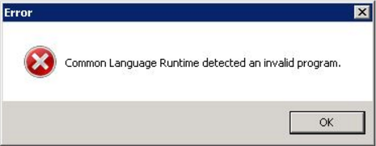
Common Problems: InvalidProgramException?!
This is thrown whenever the JIT compiler tries to compile a method with a major flaw (i.e. the compilation could not continue)
Often caused by issues like a stack underflow
This exception is deterministic
Runtime specifies which method is problematic
Usually not too hard to fix

Slide 16

Common Problems: ExecutionEngineException?!
Thrown whenever the CoreCLR discoveres that something has been corrupted and the execution can not continue
Generally non-deterministic
Exception might be thrown much later than the error occurred or not at all
Can be hard to pinpoint the source of the issue
Sometimes it can be hard to even observe the problem
What can we do about these problems?
Remedy: static analysis and IL verification

Slide 17
PEVerify and ILVerify
We need a tool to verify safety properties of our code
For example:
Stack underflow can not happen for any execution path
Types on the evaluation stack match method / instruction signatures
Code does not perform potentially unsafe operations
Many others…
Solution: static code analysis on bytecode level
PEVerify: when working with .NET Framework
ILVerify: modern tool that supports also .NET Core

Slide 18
Why is it possible to write dangerous IL?
All possible IL constructs
All valid IL constructs
All type-safe IL constructs
All verifiable IL constructs

Slide 19
Example #3: Instruction throw Throwing non-compliant object/value
Instruction throw
Specification states that throw should be used only with Exceptions
Reference: ECMA-335, Common Language Spec., CLR Rule 40 (page 63)
Question: What happens if we try to throw a null?
Question: What happens if we try to throw a string? (reference type)
Question: What happens if we try to throw an integer? (value type)
Instruction type | OpCode | Stack behavior
Object model instruction | 0x7A | Pop 1 reference, push nothing

Slide 20
Example #3: Instruction throw Throwing non-compliant object/value
Test subject | Where can we throw it from? | Where can we catch it? | Runtime health | Effects
null | C# / IL Verifiable code | C# / IL Verifiable code | OK | No special effect (same as throwing NRE)
string | IL Violation: type safety | C# / IL Verifiable code | OK | Thrown object is wrapped using an Exception
int | IL Violation: invalid code | C# / IL Verifiable code | Broken | Probably heap corruption or segmentation fault

Slide 21
Example #4: Hello World with a Twist (1)
Let’s try to guess what will be the output of the following program

Slide 22
Example #4: Hello World with a Twist (2)
Let’s try to guess what will be the output of the following program
Were you correct? ☺
How is this possible?
Hint 1: env. variables TRUSTED_PLATFORM_ASSEMBLIES, APP_PATHS
Hint 2: Code Access Security (CAS) is deprecated in .NET Core

Slide 23
Observing execution of .NET programs (1)
.NET exposes Profiling API
Consumed by various diagnostics tools
Provides precise information about execution
Analysed Process
Profiler-frontend Process
Target
(assembly.dll)
Profiler attached
Thread created
Method JIT compiled
Method called
Object allocated
GC started
GC ended
…
Inter-process
communication
middleware
Runtime
(CoreCLR)
Profiler-backend
(libProfiler.dll)
Host app
(dotnet.exe)

Slide 24
Observing execution of .NET programs (2)
Sadly, profilers can not be implemented within managed code or call any managed code of the same process…
Question: Why is this restriction necessary?

Slide 25
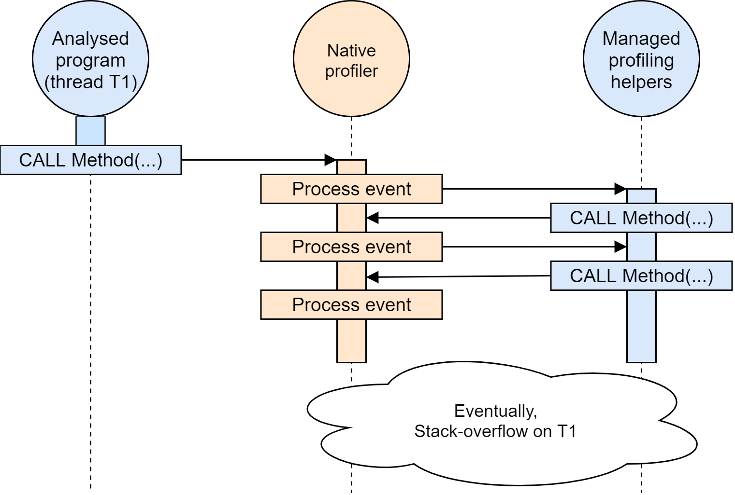
Observing execution of .NET programs (3)
Generally, undefined behaviour
Due to this reason:
Separate analysis process
Memory/code not shared
Profilers implemented in object-oriented native languages (C++, Rust, Object Pascal…)

Slide 26

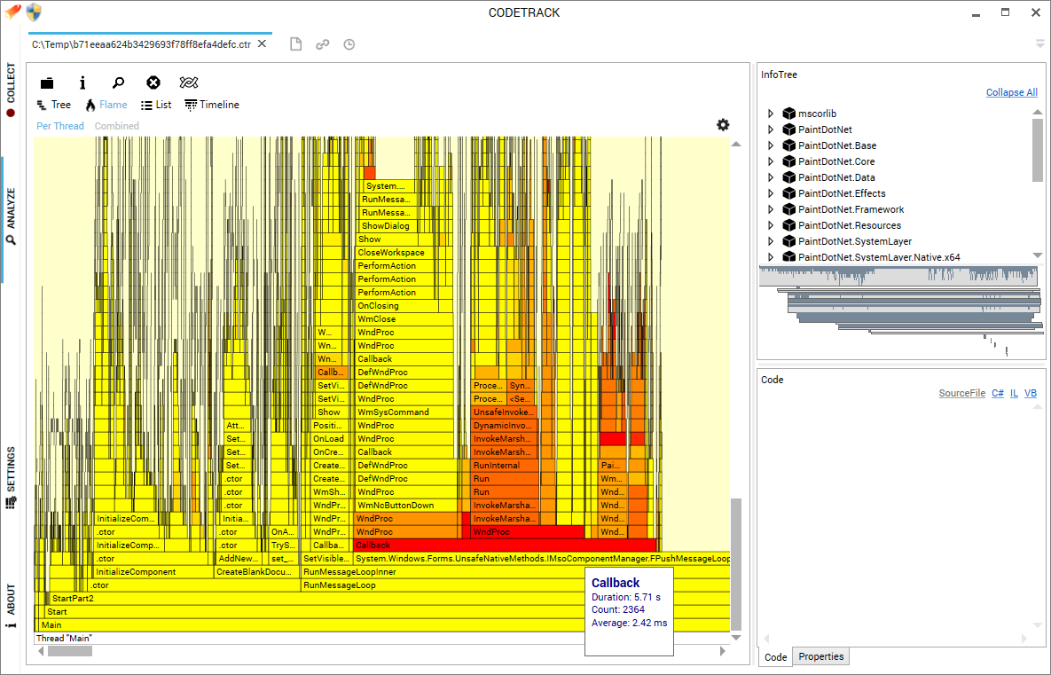
Utility: CodeTrack
Free, standalone and extendable profiler
Supports:
.NET Framework
.NET Core
IIS hosted applications
Code execution analysis
Better than VS Profiler

Slide 27
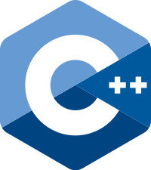
Example #5: Simple Profiler Unmanaged implementation
Derive from ICorProfilerCallback*
Override callbacks as required by a specific analysis

Slide 28
Online IL Rewriting Dynamic Code Generation
CoreCLR issues callback JITCompilationStarted
Resolve FunctionID to mdMethodDef (metadata token)
Obtain information about the method definition (signature, RVA…)
Rewrite IL of the method
Set new method implementation
Return and let JIT compile rewritten method
Ugh that’s a lot of steps… but I promise it is going to be fun ☺

Slide 29
Example #6: Another Evil Hello World
Try to guess what will be the output of the following program…
We are going to execute a regular HelloWorld.dll using the following scripts:
dotnet ./HelloWorld.dll
SET CORECLR_PROFILER={cf0d821e-299b-5307-a3d8-b283c03916dd}
SET CORECLR_ENABLE_PROFILING=1
SET CORECLR_PROFILER_PATH=D:\WorkspaceBiz\SampleProfiler\ClrProfiler.dll
dotnet ./HelloWorld.dll

Slide 30
Example #7: Dynamic Analysis for .NET
Profiling API provides precise information about execution of analyzed .NET programs
We always analyze a single execution path
The path is determined by the subject program / given test
We also get full information about threading, compared to static analysis or discontinued .NET Code Contracts
Question: Can we use this information to search for bugs?

Slide 31
Conclusion
The CoreCLR is a powerful and modern runtime
We can generate new and rewrite existing code for .NET programs
It does not need to be hard with the right tooling
We can build powerful tools
Static / dynamic analysis and aspect-weaving frameworks!

Slide 32
References
Recommended: The Book of the Runtime: https://github.com/dotnet/runtime/blob/master/docs/design/coreclr/botr/README.md
DnSpy: https://github.com/0xd4d/dnSpy
Dnlib: https://github.com/0xd4d/dnlib
Mono.Cecil: https://github.com/jbevain/cecil
SharpLab: https://sharplab.io/
Pro .NET Memory Management by Konrad Kokosa

