Slide 1
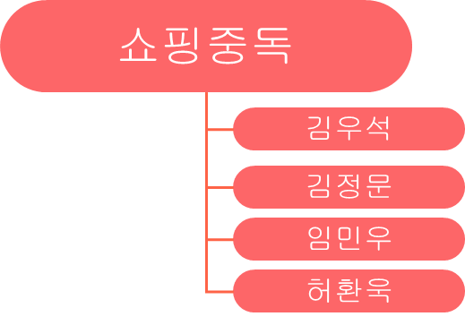
Shopping Category classification AI model project

Slide 2
Contents
01. Purpose
02. Data crawling
03. Preprocessing
04. Learning
05. Result
06. Q&A

Slide 3

01.
Purpose

Slide 4

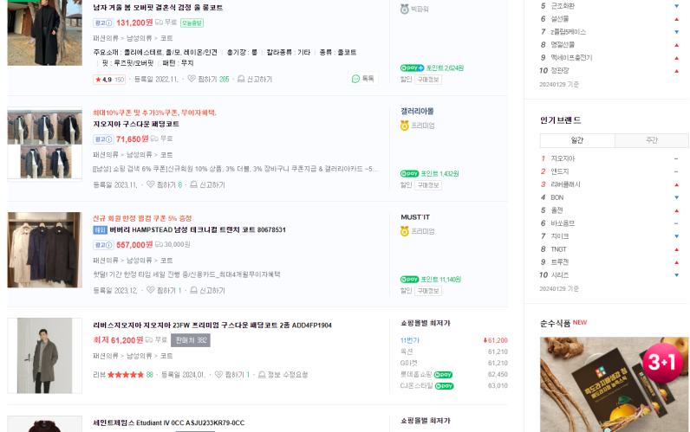

01.
Purpose
Data preprocessing
Crawling
Learning
Shopping category predict AI

Slide 5

01.
Purpose
What is this?
Clothes!
Shopping category predict AI

Slide 6
02.
Data crawling

Slide 7





02.
Data crawling
Category
Fashion
Beauty
Furniture
Digital
Food

Slide 8
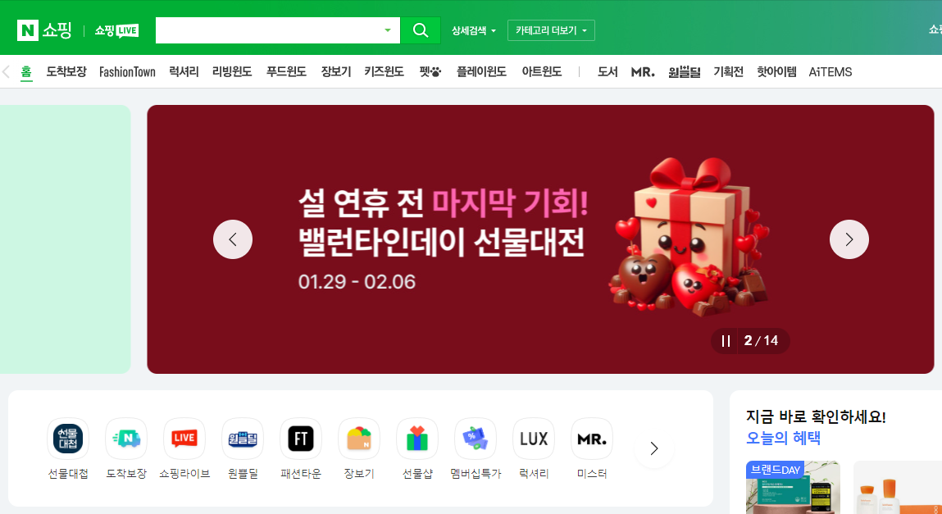
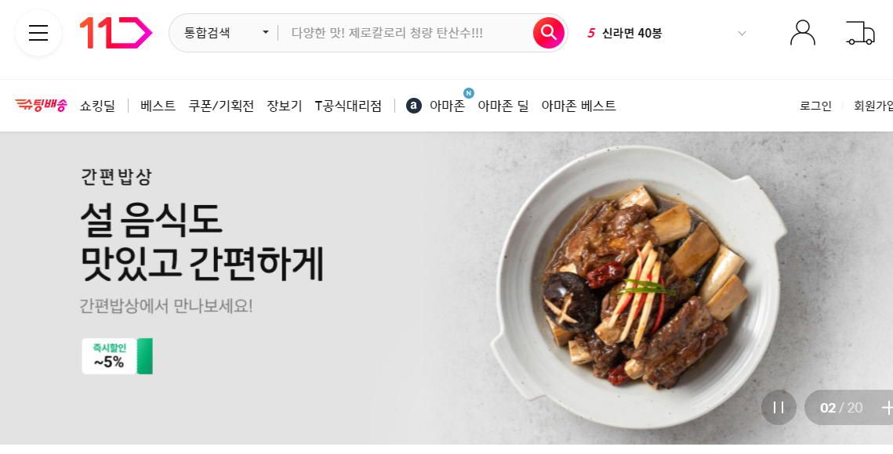
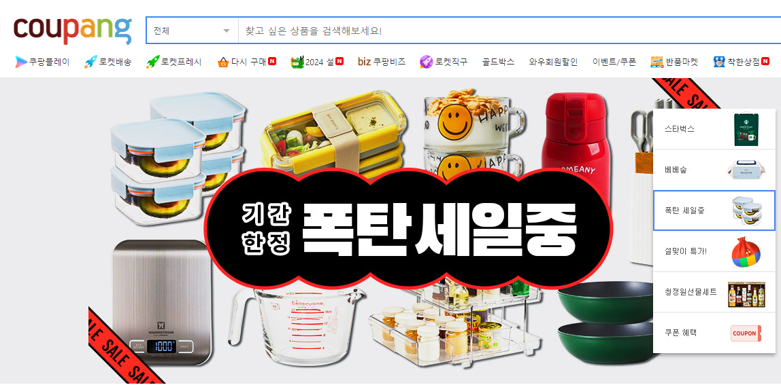
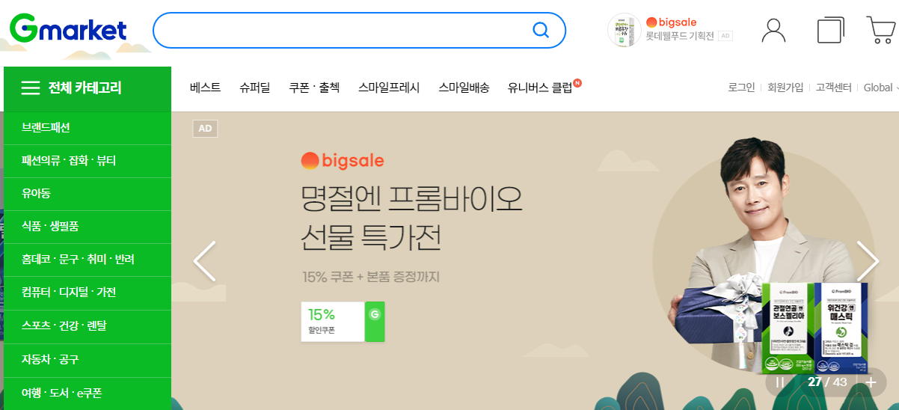
02.
Data crawling
Naver
11st
Coupang
Gmarket

Slide 9




02.
Data crawling
Naver
Coupang
Organized address and xpath
Block request from server

Slide 10

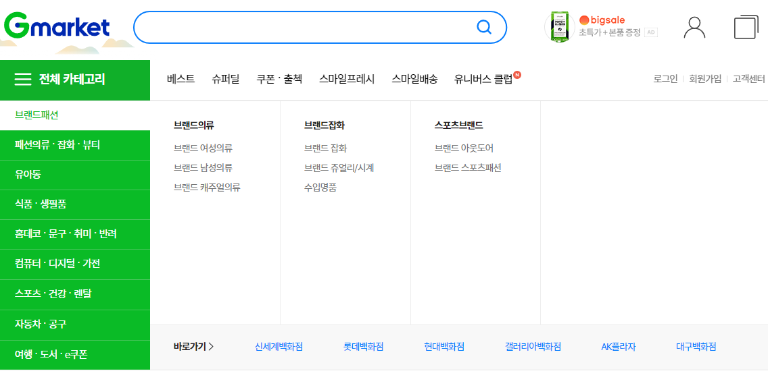
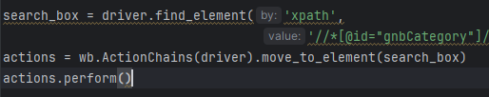
02.
Data crawling
Irregular address and xpath
11st
Gmarket

Slide 11
03.
Preprocessing

Slide 12
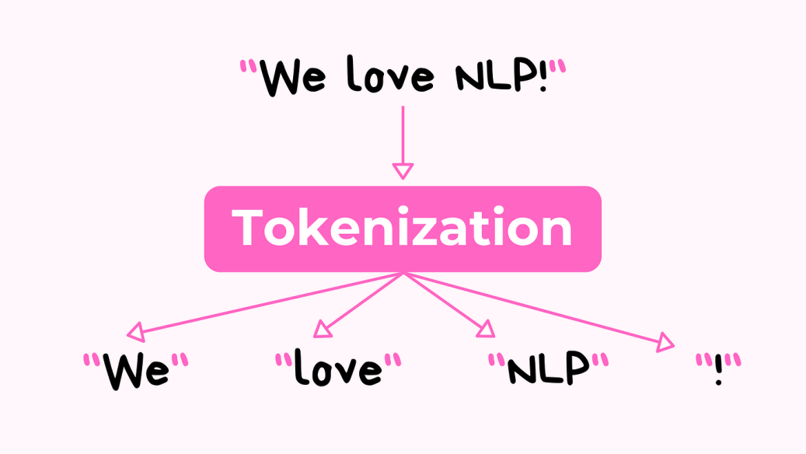
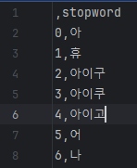
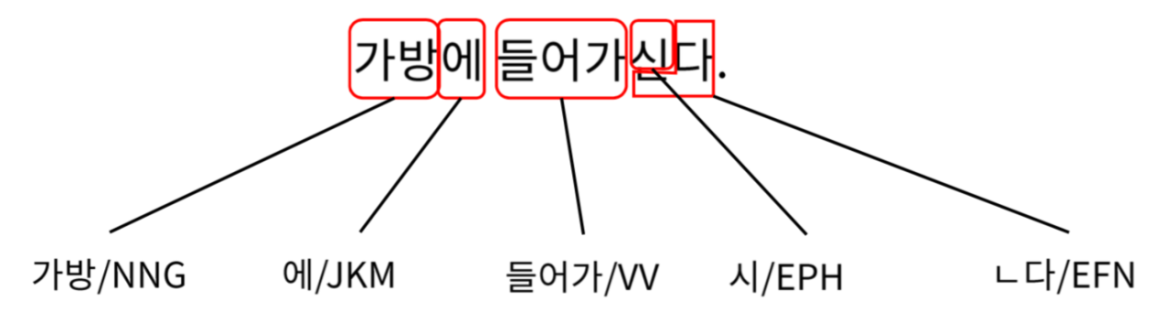
03.
Preprocessing
Morpheme separation
Remove stop words

Slide 13
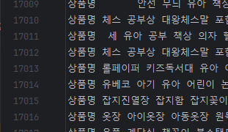
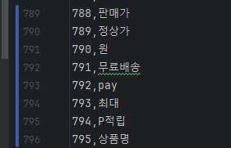
03.
Preprocessing
Remove stop words
Combining morphemes
And
Tokenization

Slide 14
04.
Learning

Slide 15
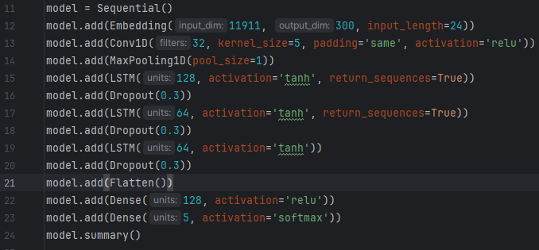
04.
Learning
Learning using RNN

Slide 16
05.
Result

Slide 17


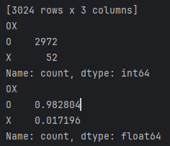
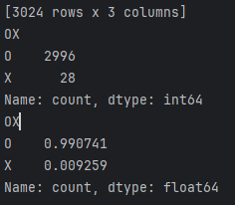
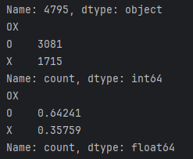
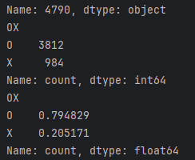
05.
Result
Coupang Data
AI model
Coupang Data
AI model
First prediction
+Second prediction
First prediction
+Second prediction

Slide 18



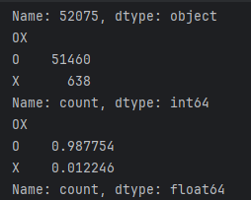
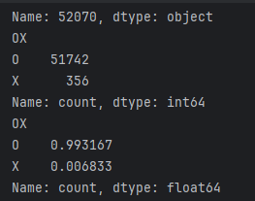
05.
Result
Total Data AI model
First prediction
+Second prediction

Slide 19
06.
Q&A

Slide 20
Thanks !

