Slide 1
Source filter processing
Part II
Ziwen

Slide 2
vocoding/Cross-synthesis
Derive filter coefficients from musical instrument
Apply voice/other signal as input

Slide 3
Filter representation
the channel vocoder uses the weighted sum of filtered bandpass signals
the LPC calculates an IIR filter
and even the cepstrum method can be seen as a circular convolution with an FIR filter
Notes:
Although spectral estimation is well represented by its amplitude versus frequency representa- tion, most often it is the filter representation that can be a help in the application of this spectral envelope

Slide 4
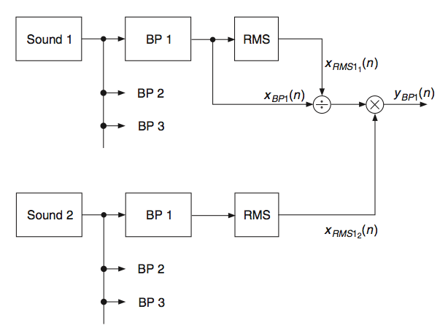

Channel vocoder
Notes:
x_{BP1} (bandpass signal) is divided by the RMS value of this channel, and then multiplied by the RMS
value of the other sound.
Sound2’s envelope is added to whitened sound 1
Confused with RMS , why a filter in the codes??
Epsi: whitening indicator, the less, the whiter

Slide 5
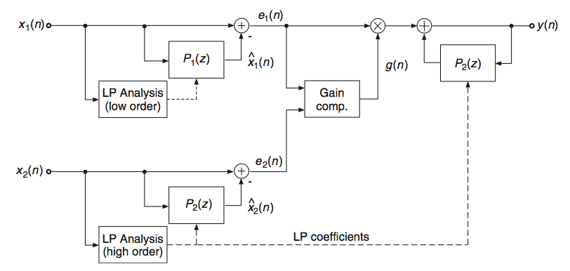
Linear Prediction

Slide 6
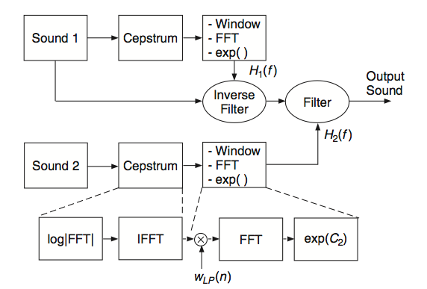
Cepstrum

Slide 7
Formant changing
Special cross-synthesis
The modifier(env) comes from an interpolated version of the original sound

Slide 8
Review cross synthesis with two sounds
Notes:
x_{BP1} (bandpass signal) is divided by the RMS value of this channel, and then multiplied by the RMS
value of the other sound.
Sound2’s envelope is added to whitened sound 1
Confused with RMS , why a filter in the codes??
Epsi: whitening indicator, the less, the whiter

Slide 9
Review cross synthesis with two sounds

Slide 10
Review cross synthesis with two sounds

Slide 11
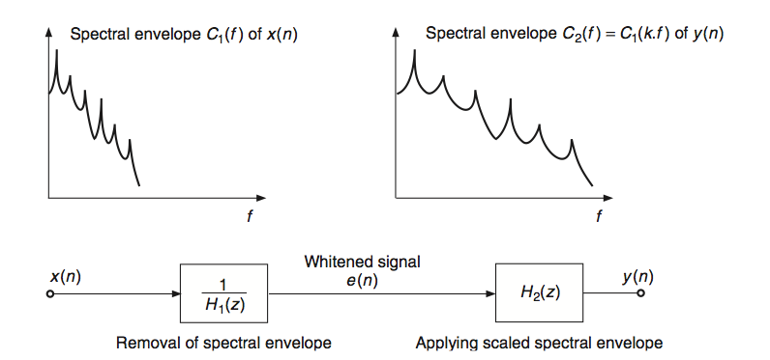
One input, interpolate to generate x₂(n)

Slide 12
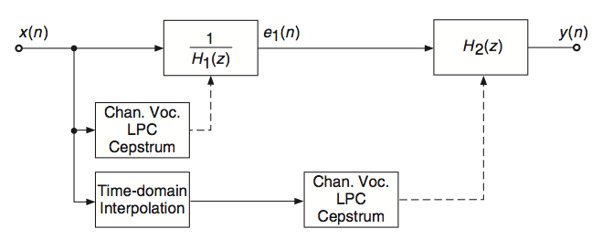
Notes:
General process of Formant changing by time-domain processing.

Slide 13
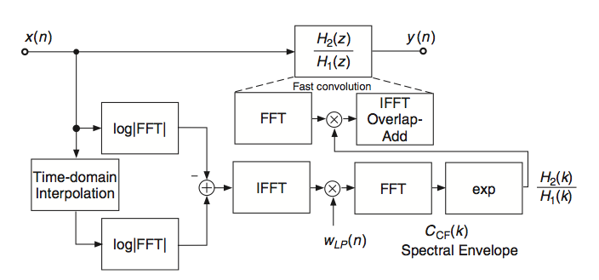
Taking cepstrum as example
Notes:
Next page talk about time domain interpolation

Slide 14
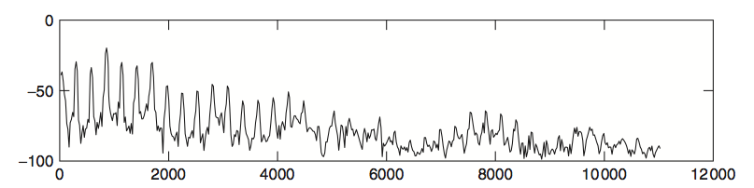
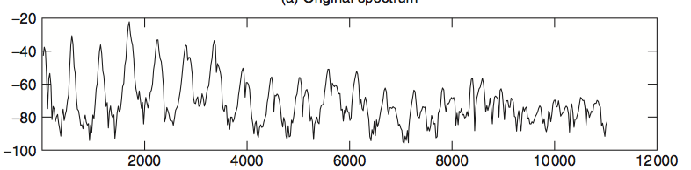
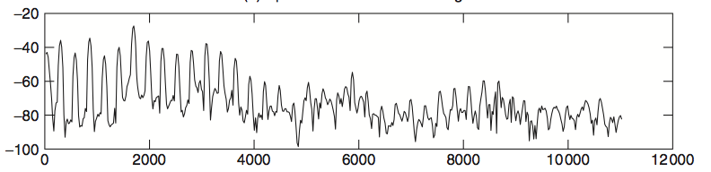
Notes:
original ->interpolated ->formant changed spectrum
Show demo

Slide 15
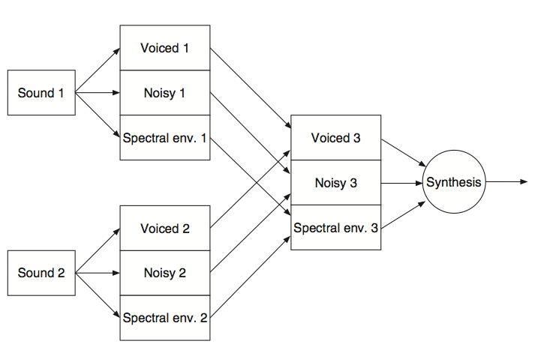
Spectral interpolation
Notes:
If we have the decomposition of sound grains in the frequency domain according to E (f ) · H (f ), where E (f ) represents the Fourier transform of the excitation and H (f ) is the spectral envelope (H (f ) = exp[C (f )]), we can perform spectral interpolation between two sounds by mixing according to
Y (f ) = [e1E1(f ) + e2E2(f )] · [c1H1(f ) + c2H2(f )].

