Slide 1

Assignment 2 CNN
Code
https://github.com/Brotherhood94
Alessandro berti
MSC ICT SOLUTIONS ARCHITECT

Slide 2


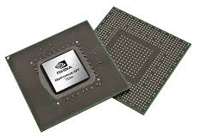

A very first result…
Cuda 10.1
GeForce 750M
Ubuntu
TensorFlow

Slide 3

Format SSD

Slide 4
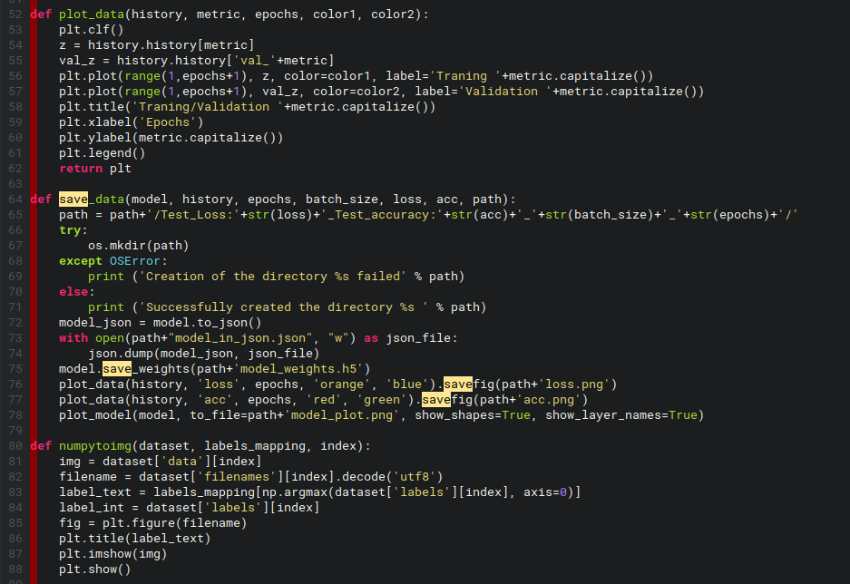
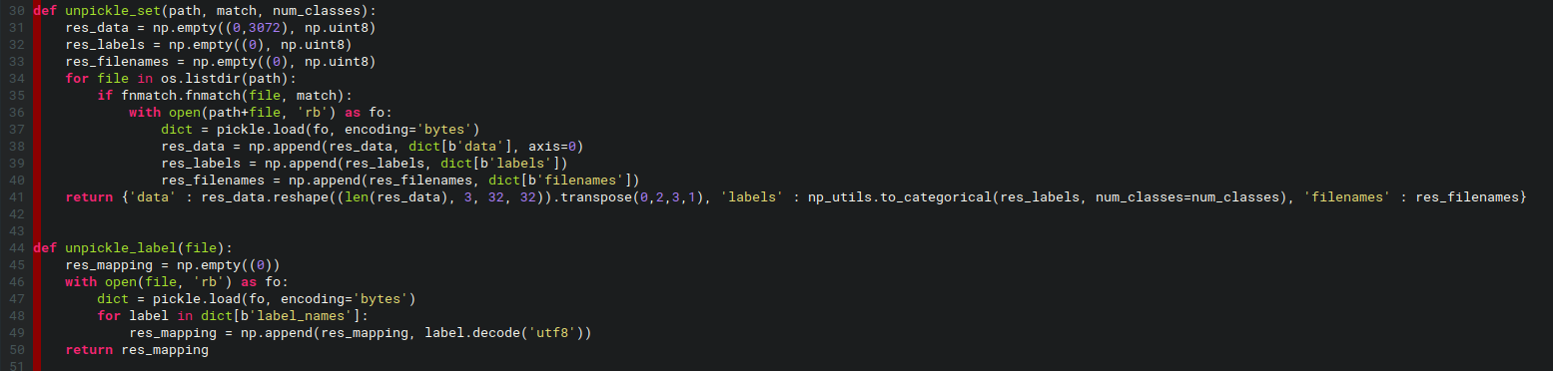
Some Code

Slide 5
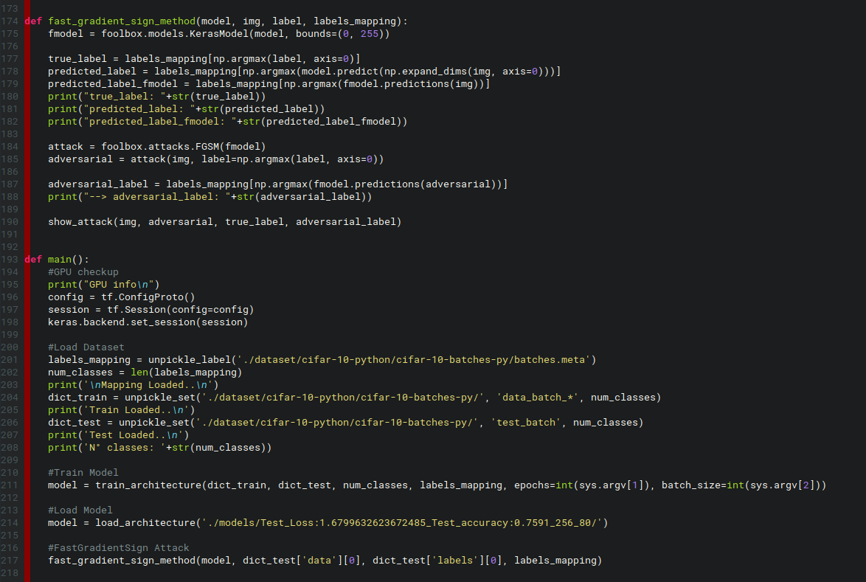

Some Code

Slide 6
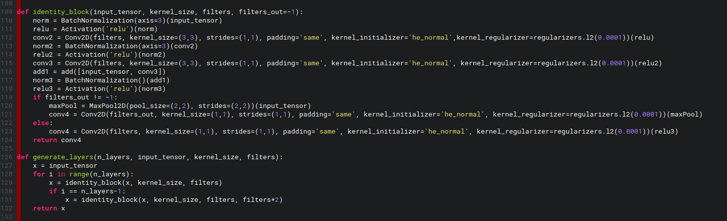
Some Code

Slide 7
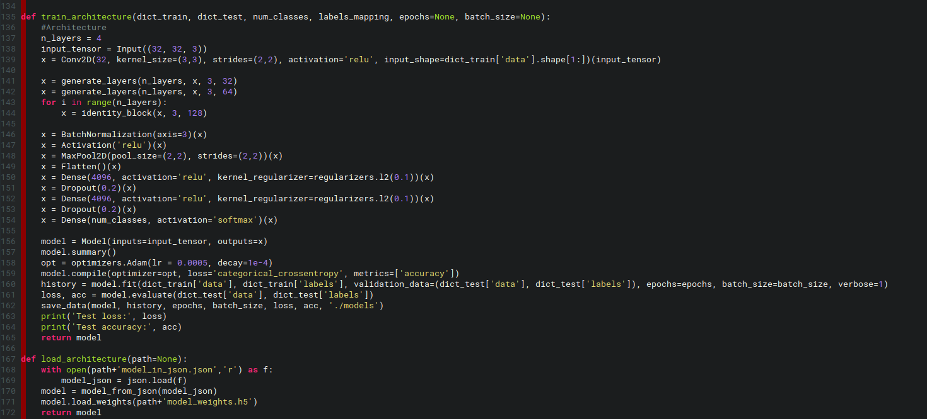
Some Code

Slide 8
The Architecture
MaxPool(2x2,2x2)
MaxPool(2x2,2x2)
MaxPool(2x2,2x2)
32
64
128
256
BatchNorm
Activation(«relu»)
-------------------------
Conv2D(1x1,1x1)
BatchNorm
Activation(«relu»)
-------------------------
Conv2D(3x3,1x1)
BatchNorm
Activation(«relu»)
Add(…)
-------------------------
Conv2D(1x1,1x1)
*
Dense(4096)
Dropout(0.4) Dense(4096)
Dropout(0.4)
Conv2D(3x3, 1x1)
Flatten
SoftMax(10)

Slide 9
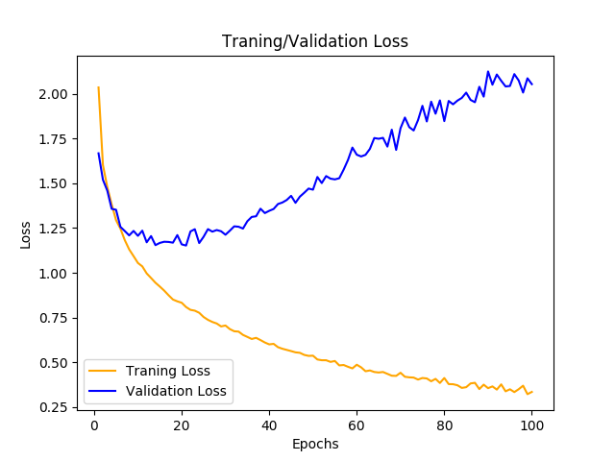
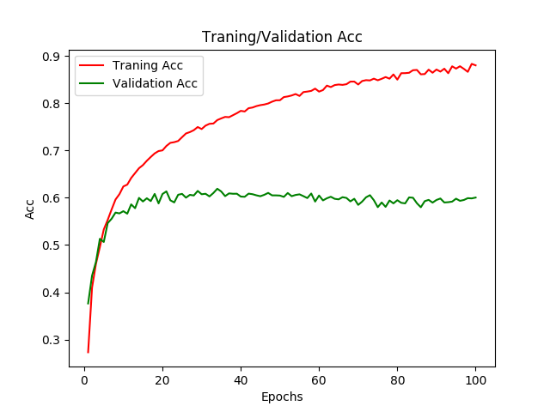
But Before the ResNet…

Slide 10
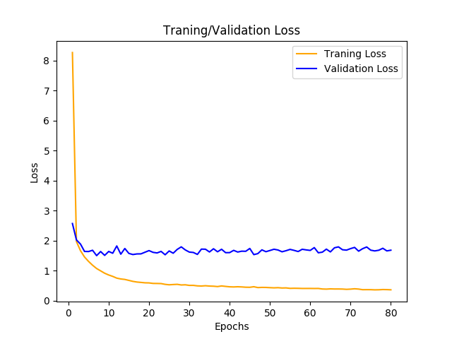
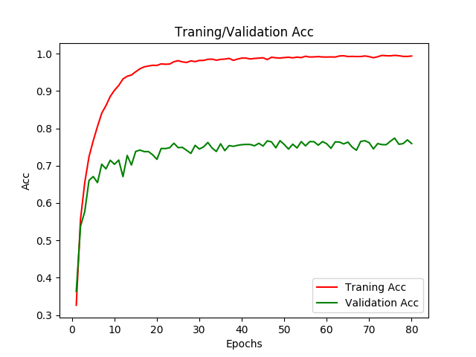
Results

Slide 11
FGSM - Foolbox

Slide 12
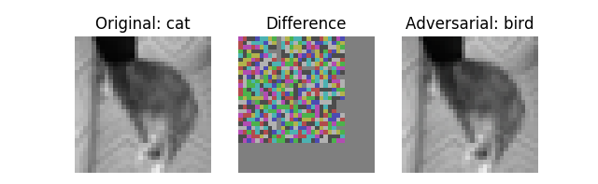
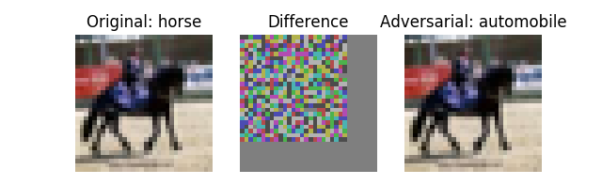
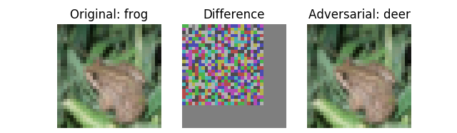
FGSM What?

Slide 13
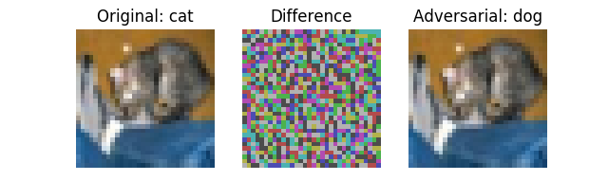
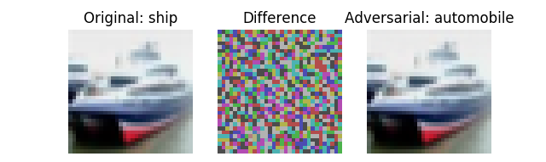
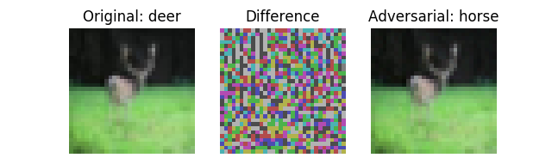
FGSM

Slide 14
THANKS
Code
https://github.com/Brotherhood94
Alessandro Berti
MSC ICT SOLUTIONS ARCHITECT

