Slide 1
AquaCascade AI
Prioritizing lead service-line investigation under the EPA Lead & Copper Rule Improvements
Moise Tchivwila | Texas A&M AI Venture Velocity Challenge — Stage 2 Progress
Every figure in this deck is cross-validated and reproducible from one command.

Slide 2
THE PROBLEM
A federal mandate with one unsolved bottleneck
LCRI (Oct 2024) requires every U.S. community water system to resolve and replace lead service lines within ~10 years. The unknown lines — not the known ones — are the binding constraint.
49,387
2.96 M
22.5 M
7.6×
community water systems analyzed
lead + galvanized lines to replace (~$16.7B)
lead-status-UNKNOWN lines (~$4.5B to investigate)
unknowns vs. the known lead problem
Investigation is ~$200/line; replacement ~$4,700/line. No operational tool decides which unknowns to investigate first. That is the gap.
AquaCascade AI
2

Slide 3
LEARNING
We followed the evidence, not the original idea
Stage 1 idea
Network “cascade” risk between water utilities.
What we did
Built the true service-area-polygon adjacency graph and tested multi-hop propagation.
What the data said
Systems are geographically separate; the graph is too sparse — propagation gave no lift and hurt.
Decision
Rejected inter-utility cascade. Moved to the real, mandated, unsolved problem: unknown-line triage.
Rejecting a hypothesis on evidence is a result, not a failure.
AquaCascade AI
3

Slide 4
FOUNDATION
Real EPA data, reproducible by anyone
53-quarter panel
EPA Water System Summary 2013Q1–2026Q1, plus SDWIS service-line inventory, lead/copper samples, site visits, and the wholesale buyer→seller network.
Real labels
Ground truth is what 1,935 systems actually did when they resolved unknowns — observed reclassification, never synthetic.
Leakage controlled
Predictors strictly precede the target window; an audit caught and corrected an earlier temporal leak (0.727 → 0.683).
One-command reproduction
Every input is SHA-256 hashed with row counts; library versions and seed pinned in a manifest.
AquaCascade AI
4

Slide 5
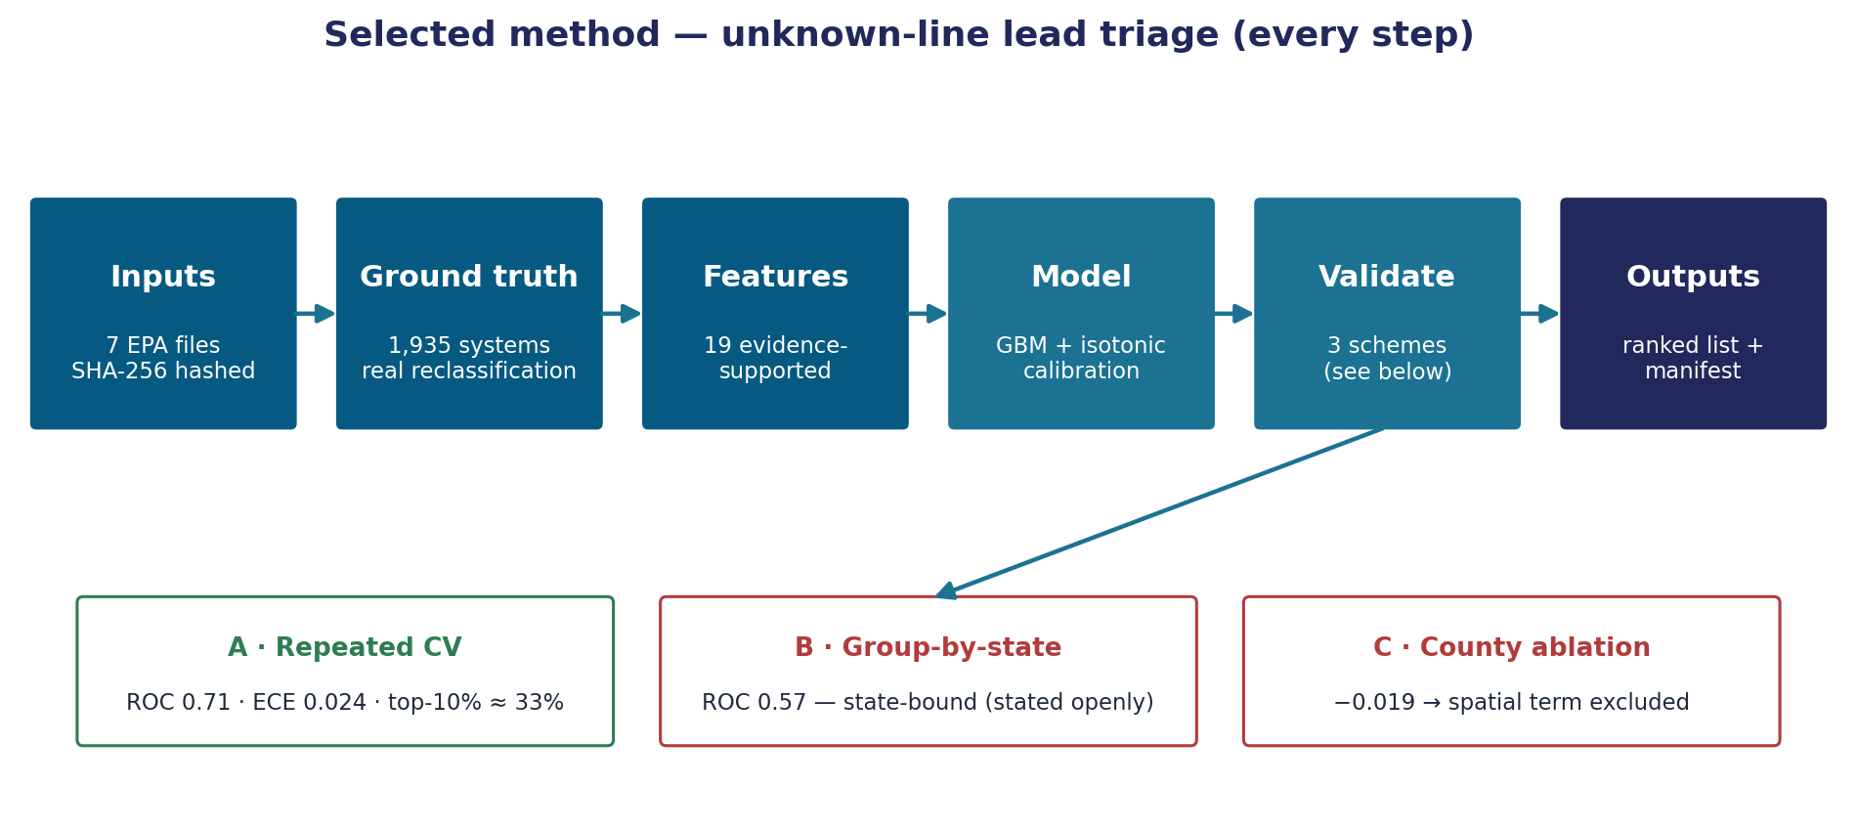
THE METHOD
The selected pipeline, step by step
Depth and stochastic-calculus choices were settled by experiment, not assumption (next slides).
AquaCascade AI
5

Slide 6
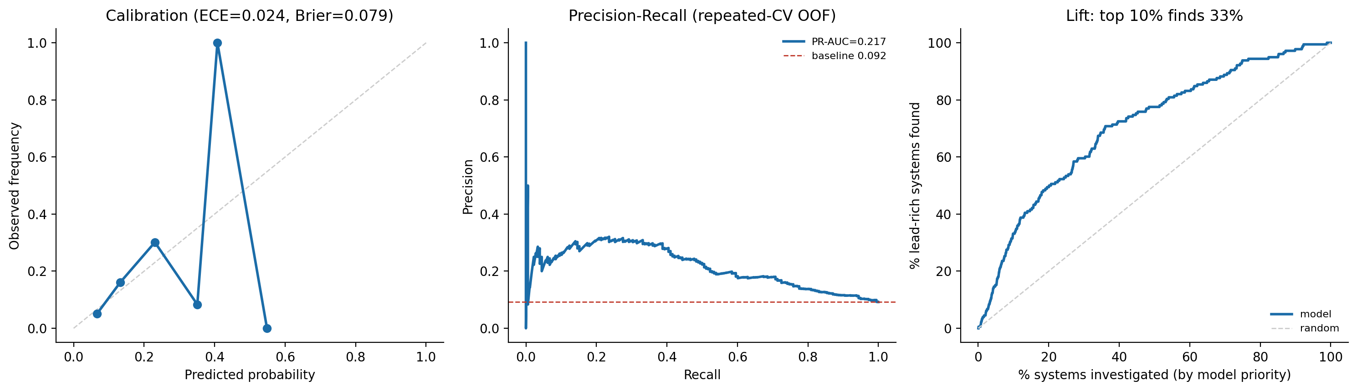
RESULT
Calibrated, honestly validated
0.71
0.024
≈33%
1,935
ROC-AUC (repeated CV, 95% CI 0.705–0.716)
Expected Calibration Error (well-calibrated)
of lead-rich systems in the top 10% (~3.3×)
real ground-truth systems
Calibration · precision–recall · investigation-lift, out-of-fold.
AquaCascade AI
6

Slide 7
THE LIMITATION WE DO NOT HIDE
It does not yet generalize to unseen states
Within-distribution ROC-AUC
0.71
Cold-start on a NEW state
0.57
→
It learns state- and program-specific patterns. So we scope it honestly: a tool for systems and state programs using their own historical data — not a nationwide cold-start oracle. The gap defines our next experiment.
AquaCascade AI
7

Slide 8
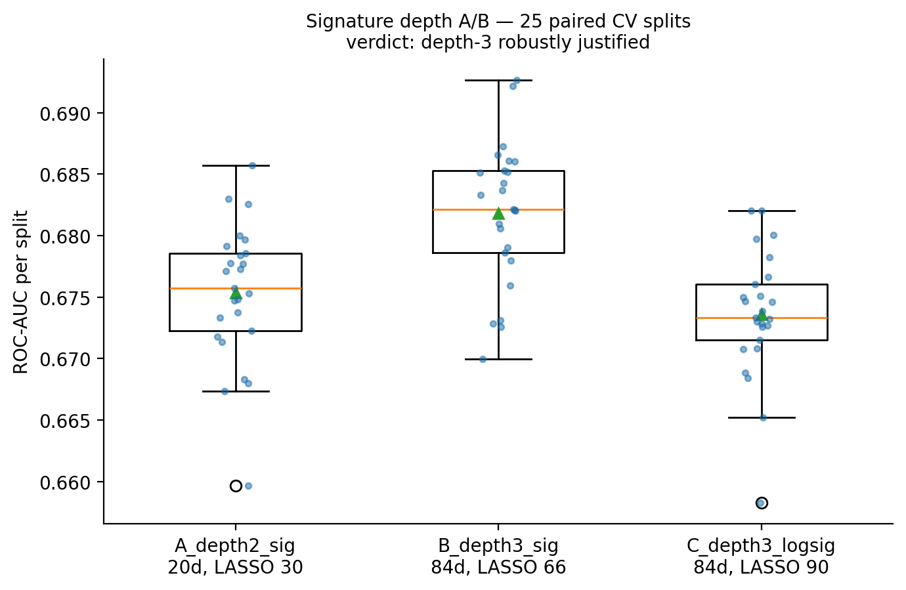
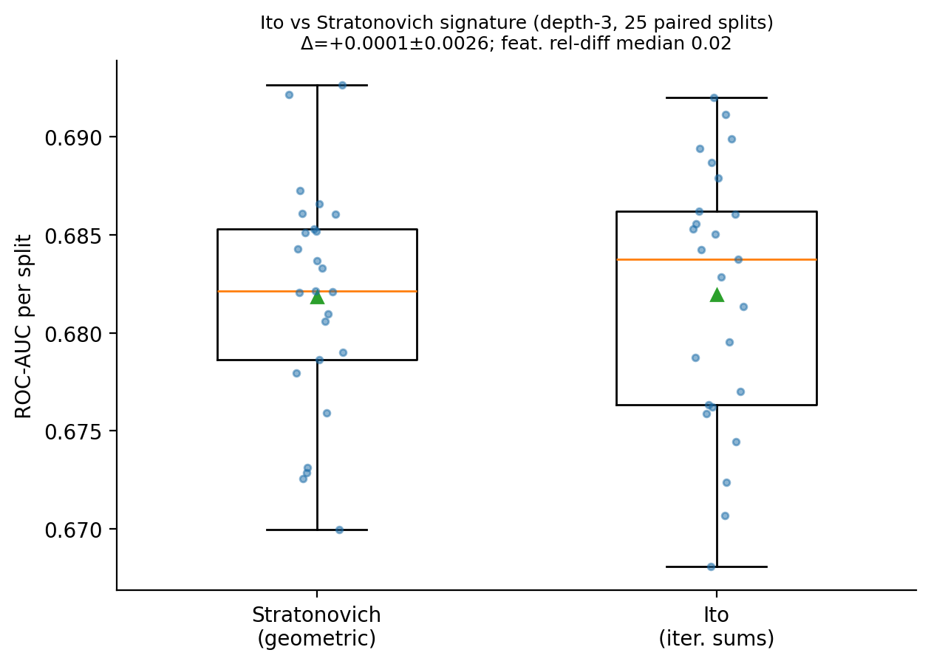
RIGOR
Modeling choices decided by experiment
Depth 3 > depth 2: +0.0065 ROC on 100% of 25 paired CV splits.
Itô vs Stratonovich: indistinguishable (Δ +0.0001) — kept Stratonovich on principle.
AquaCascade AI
8

Slide 9
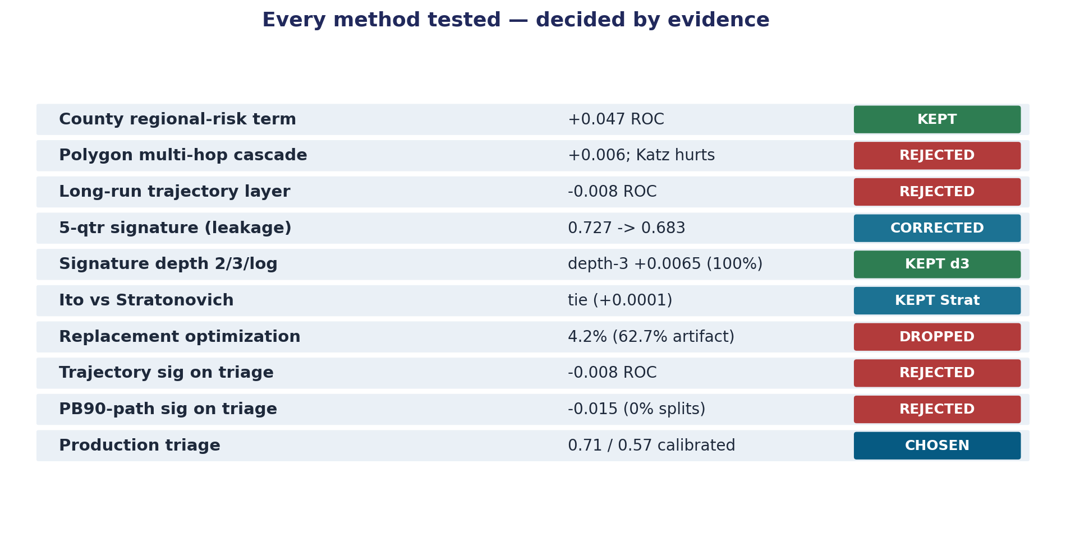
EXPERIMENTATION RIGOR
What we tested and threw away
Velocity is measured in experiments killed, not lines of code written.
AquaCascade AI
9

Slide 10
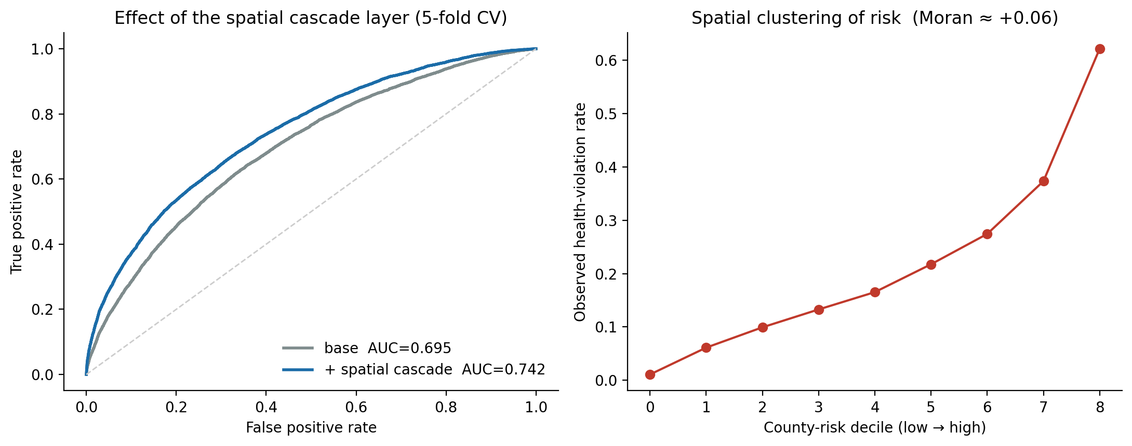
WHAT DOES HOLD
Risk is strongly clustered by region
A leakage-safe county-risk term lifts the risk model +0.047 ROC-AUC (0.695 → 0.742); systems in high-risk counties run from ~1.5% to ~61% violation rate. This is regional correlation (shared regulator, source water, environment) — not physical cascade.
AquaCascade AI
10

Slide 11
WHY YOU CAN TRUST THESE NUMBERS
Verifiability is the moat
Leakage found and corrected
An optimistic 0.727 was traced to a temporal-ordering flaw and reported honestly as 0.683.
No fabricated traction
No invented interviews, pilots, or pipeline. Every claim computes from public EPA data.
Reproducible
Hashed inputs, pinned versions and seed; one command regenerates every figure bit-for-bit.
Limits stated up front
The state-generalization gap is on its own slide, not buried.
AquaCascade AI
11

Slide 12
WHAT'S NEXT
Experiments defined by the evidence
1
Recover cross-state generalization
Test a hierarchical / state-aware model and per-state calibration. Success criterion fixed in advance: group-by-state ROC materially above 0.57.
2
Customer-discovery validation
Not yet done — stated honestly. Structured interviews with state drinking-water programs and mid-size utilities to test the budget pain and trust threshold.
3
Equity layer
Integrate EPA Census-linked service-area demographics to weight disadvantaged communities — an explicit LCRI requirement.
AquaCascade AI
12

Slide 13
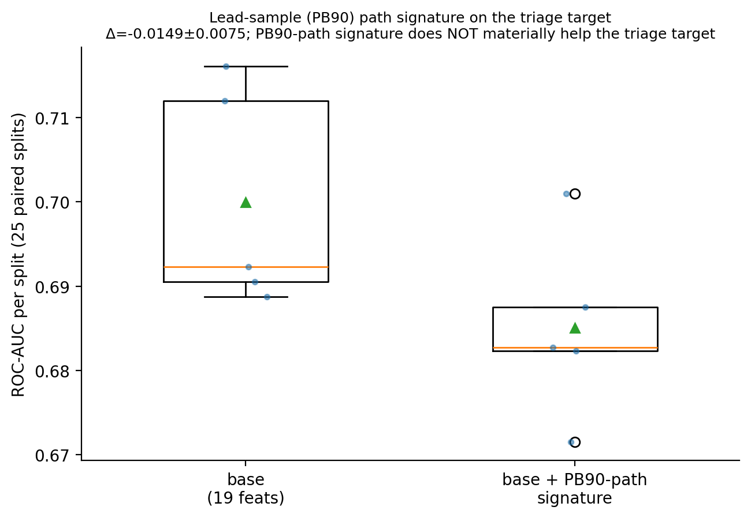
METHOD HONESTY
Were signatures useful for the selected method?
Signatures apply to any path — the data being non-Brownian was never the reason.
They are central to and HELP the Track-1 risk model.
Tested on the triage target three ways, all rejected on evidence:
distress-trajectory signature: −0.008 ROC
composition path: circular (label is that change) — excluded
lead-sample (PB90) path: −0.015 ROC, 0% of 25 splits help
Reason: lead-pipe material is structural (install era / codes), not trajectory-driven.
Newest test: lead-sample PB90 path signature (25 paired CV).
AquaCascade AI
13

Slide 14
EXPERIMENTATION RIGOR
Full experiment ledger — every test
Method | Result | Decision
County regional-risk term | +0.047 ROC-AUC | Kept (regional corr.)
Polygon multi-hop cascade | +0.006; Katz hurts | Rejected
Long-run trajectory layer | −0.008 ROC | Rejected
Original 5-qtr signature model | 0.727 (leakage flaw) | Corrected → 0.683
Signature depth 2 / 3 / log | depth-3 +0.0065 (100% splits) | depth-3 kept
Itô vs Stratonovich | Δ +0.0001 (tie) | Stratonovich kept
Process diagnostics | drift-dominated; non-anticipative | Informed design
Replacement cost-optimization | 4.2% (62.7% was artifact) | De-prioritized
Trajectory signature on triage | −0.008 ROC | Rejected
PB90-path signature on triage | −0.015 ROC (0% splits) | Rejected
Production unknown-line triage | 0.71 within / 0.57 cross-state | CHOSEN
AquaCascade AI
14

Slide 15
THE SELECTED METHOD
Every step and the result it produced
Step | Method | Result
Inputs | 7 EPA files SHA-256-hashed; versions + seed pinned | Reproducible manifest
Ground truth | resolved ≥10 unknowns; y = lead-yield ≥10% | 1,935 systems, 9.2% positive
Features | 19 evidence-supported; rejected ideas excluded | 19 feats, 44 states
Model | HistGradientBoosting + isotonic calibration (nested) | Calibrated probabilities
Validation A | Repeated 5×5 stratified CV | ROC 0.71; ECE 0.024; top-10% ≈ 33%
Validation B | Group-by-state CV (unseen states) | ROC 0.57 — state-bound
Validation C | Leakage-safe county-rate ablation | −0.019 → excluded
Outputs | Metrics JSON, manifest, ranking CSV, figure | One-command reproducible
Market context | Real EPA counts of unresolved unknowns | 14,113 systems / 22.5M lines
AquaCascade AI
15

Slide 16
A calibrated, reproducible triage tool — honest about where it works.
Helps a water system or state program spend the cheap investigation dollars on the unknown lines most likely to be lead — using its own historical EPA data.
Moise Tchivwila · AquaCascade AI · Texas A&M AI Venture Velocity Challenge

