Slide 1
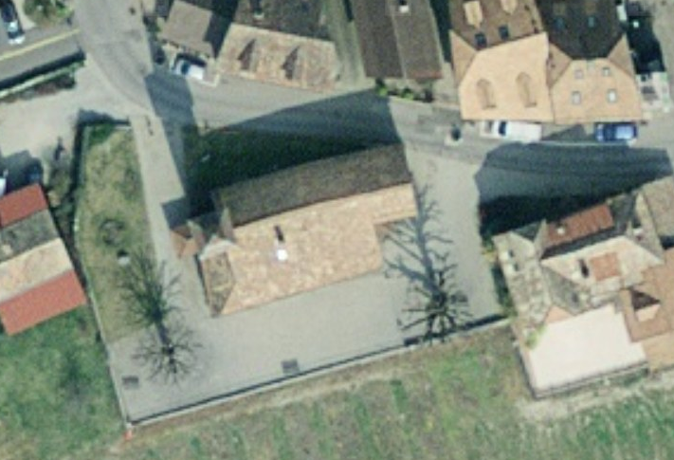
Points calages (damier)
Station Faro

Slide 2
Points calages (damier)
Station Faro

Slide 3
Points calages (damier)
Station Faro

Slide 4
Points calages (damier)
Station Faro

Slide 5
Points calages (damier)
Station Faro

Slide 6
Points calages (damier)
Station Faro

Slide 7
Points calages (damier)
Station Faro

Slide 8
Points calages (damier)
Station Faro

