Slide 1
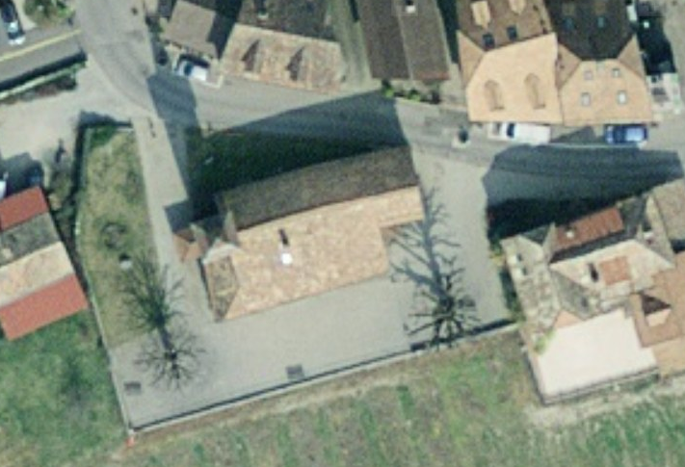
Points calages (damier)
Station P40

Slide 2
Points calages (damier)
Station P40

Slide 3
Points calages (damier)
Station P40

Slide 4
Points calages (damier)
Station P40

Slide 5
Points calages (damier)
Station P40

Slide 6
Points calages (damier)
Station P40

Slide 7
Points calages (damier)
Station P40

