Slide 1
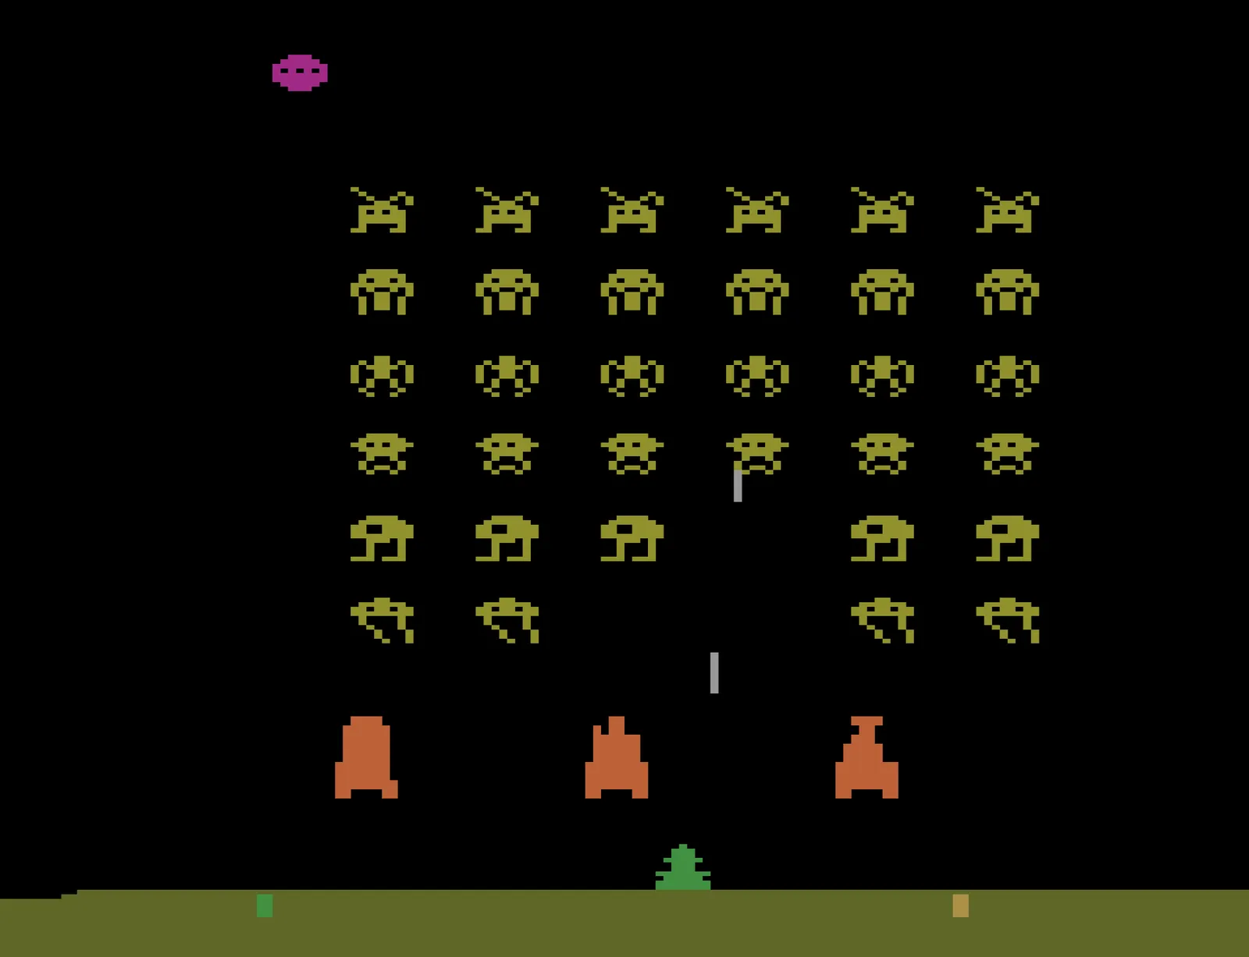
Deep Learning
Day 30: Tabular Methods of RL
CSCI 1470
Eric Ewing
Friday,
4/11/25
Space Invaders, Atari

Slide 2
RL vs. Other Deep Learning
This class has mostly focused on data (e.g., framing as supervised or unsupervised problem, adapting to new modalities) and architectures
In RL, the data and architectures matter less than the algorithms we use to update our networks
Sometimes RL algorithms compute the gradients directly
Determining the proper loss function is harder than just choosing between MSE or Cross Entropy.
More time on the blackboard than other topics

Slide 3

Markov Decision Process (MDP) Review
Consist of:
States: Set of all possible ways the world can be
Actions: Set of all actions the agent can take
Reward: Function mapping states to reward values
Transitions: Function mapping (state, action) pairs to a distribution over next states.
Seek a policy $π$ that maps states to actions

Slide 4
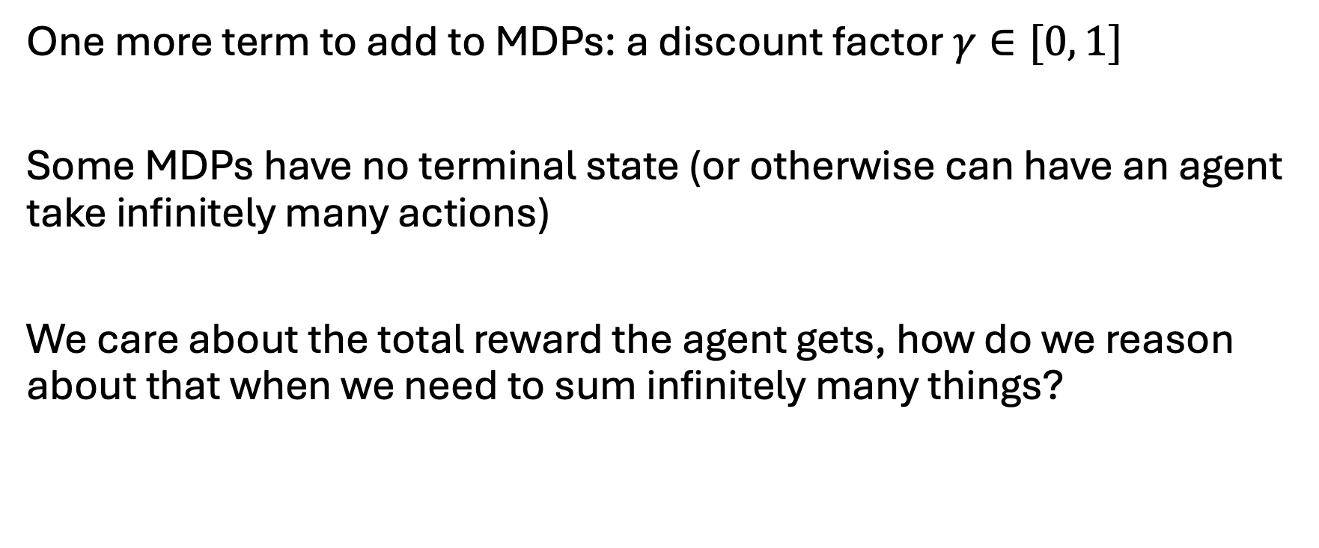
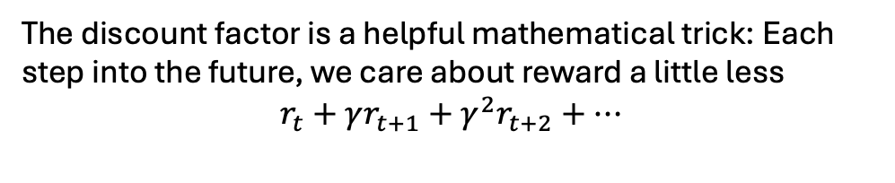
Gamma
One more term to add to MDPs: a discount factor $γ∈[0, 1]$
Some MDPs have no terminal state (or otherwise can have an agent take infinitely many actions)
We care about the total reward the agent gets, how do we reason about that when we need to sum infinitely many things?
The discount factor is a helpful mathematical trick: Each step into the future, we care about reward a little less
$$r_{t}+γr_{t+1}+γ^{2}r_{t+2}+…$$
This sum is never infinite if r is bounded

Slide 5
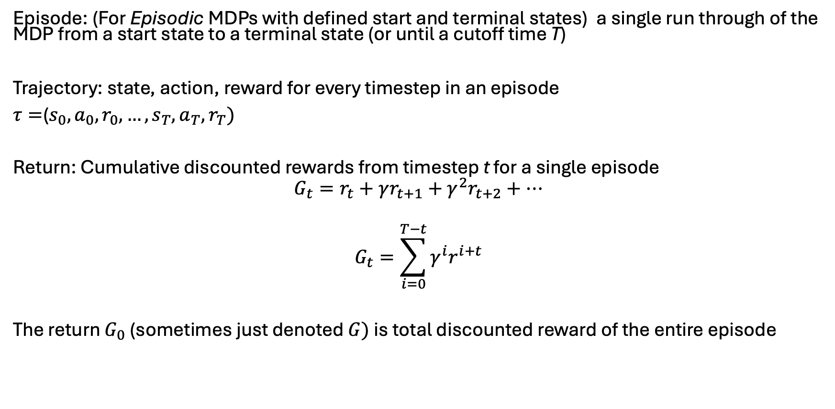
Key Terms
Episode: (For Episodic MDPs with defined start and terminal states) a single run through of the MDP from a start state to a terminal state (or until a cutoff time T)
Trajectory: state, action, reward for every timestep in an episode
$τ=$($s_{0},a_{0},r_{0},…,s_{T},a_{T},r_{T})$
Return: Cumulative discounted rewards from timestep t for a single episode
$$G_{t}=r_{t}+γr_{t+1}+γ^{2}r_{t+2}+…$$
$$G_{t}=\sum_{i=0}^{T−t}{γ^{i}r^{i+t}}$$
The return $G_{0}$ (sometimes just denoted $G)$ is total discounted reward of the entire episode

Slide 6
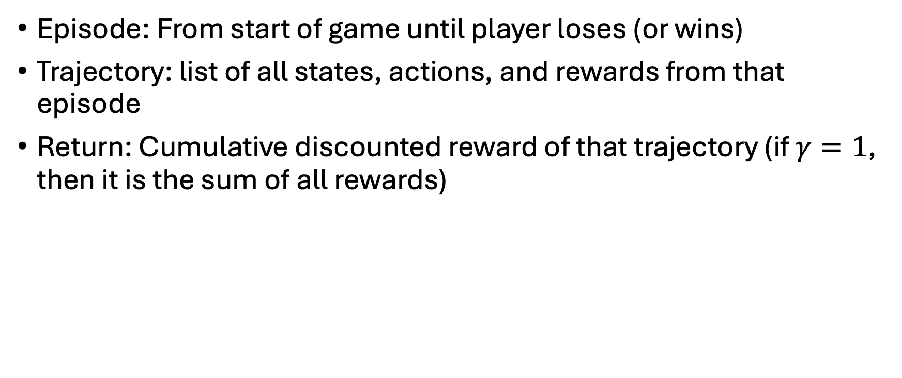
Breakout Example
Episode: From start of game until player loses (or wins)
Trajectory: list of all states, actions, and rewards from that episode
Return: Cumulative discounted reward of that trajectory (if $γ=1$, then it is the sum of all rewards)

Slide 7
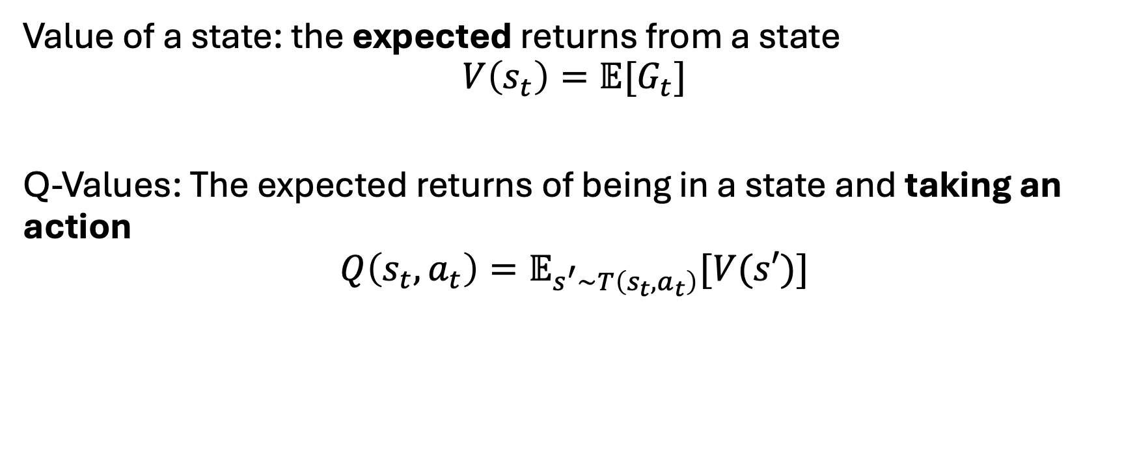
Key Terms
Value of a state: the expected returns from a state
$$V\left(s_{t}\right)=𝔼[G_{t}]$$
Q-Values: The expected returns of being in a state and taking an action
$$Q\left(s_{t},a_{t}\right)=𝔼_{s^{′}\sim T\left(s_{t}, a_{t}\right)}[V(s′)]$$

Slide 8
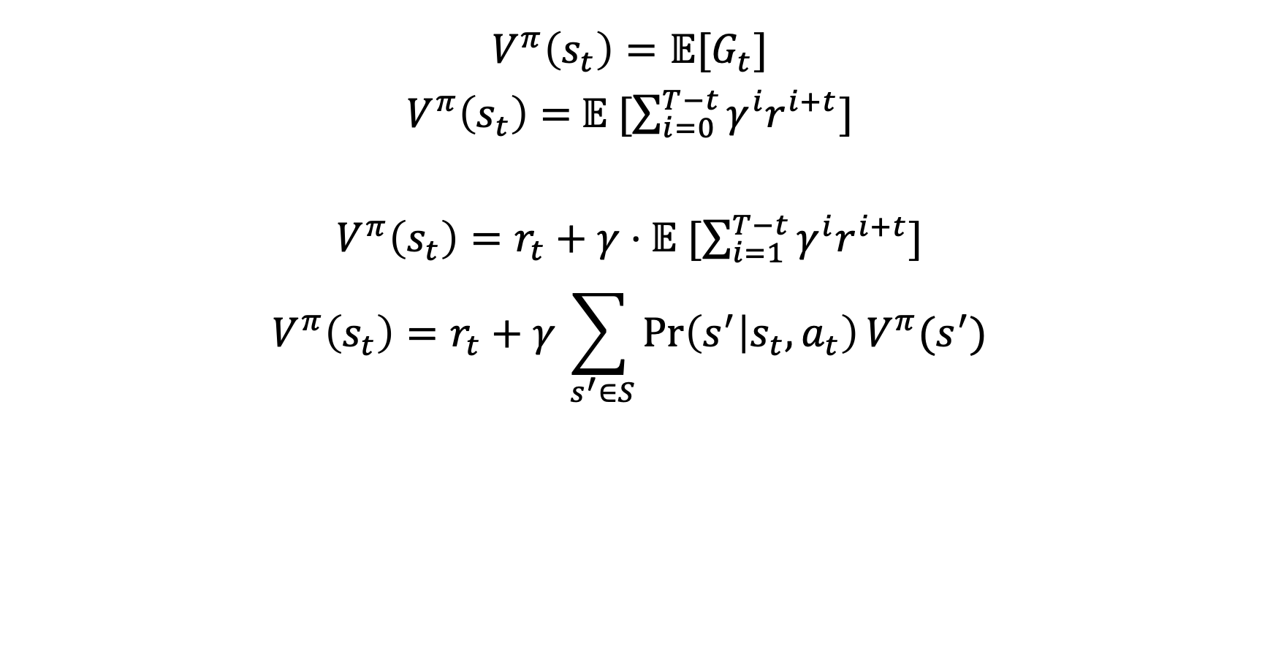

Value Function
A value function is defined for a specific policy $π$!
(If you have a bad policy, you expect your values to be smaller)
$$V^{π}\left(s_{t}\right)=𝔼[G_{t}]$$
$V^{π}\left(s_{t}\right)=$ $𝔼 [\sum_{i=0}^{T−t}{γ^{i}r^{i+t}]}$
$V^{π}\left(s_{t}\right)=r_{t}+γ⋅$ $𝔼 [\sum_{i=1}^{T−t}{γ^{i}r^{i+t}]}$
$$V^{π}\left(s_{t}\right)=r_{t}+γ\sum_{ s^{′}∈S}{\operatorname{Pr}\left(s^{′} | s_{t}, a_{t}\right)V^{π}(s^{′})}$$
This is called policy evaluation
We can the value function as a recursive formula:
How good it is to be in a state is the immediate reward
for being in that state + the expected returns for future states

Slide 9
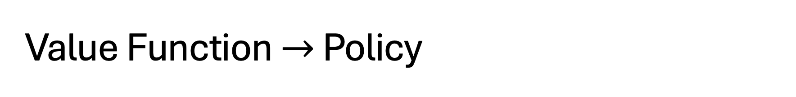
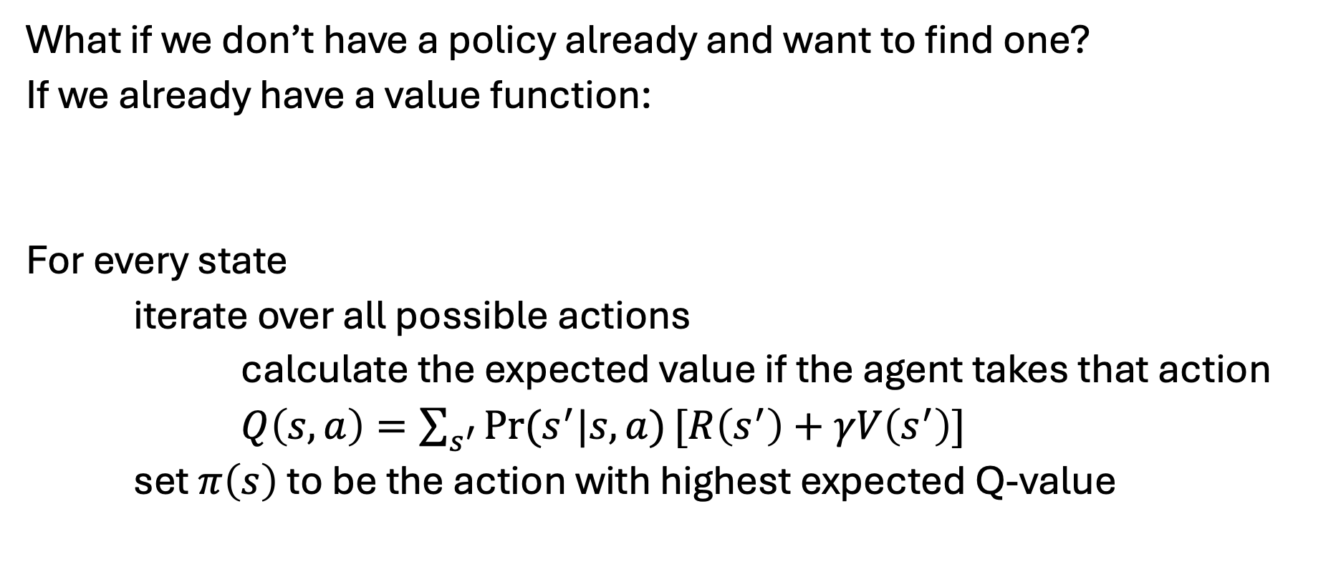
Value Function $→$ Policy
What if we don’t have a policy already and want to find one?
If we already have a value function:
For every state
iterate over all possible actions
calculate the expected value if the agent takes that action
$Q\left(s, a\right)=\sum_{s^{′}}{\operatorname{Pr}{(s^{′}|s,a)}[R\left(s^{′}\right)+γV\left(s^{′}\right)] }$
set $π\left(s\right)$ to be the action with highest expected Q-value
This is called policy improvement

Slide 10
Value Iteration
Start with a random Value function V
Run Policy Improvement to determine best actions at each state
Run Policy Estimation to determine the new values with the updated policy
Repeat

Slide 11
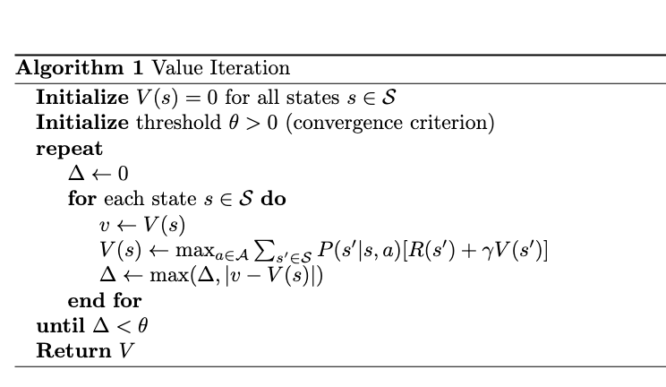
Value Iteration
Repeatedly apply Policy Estimation and Policy improvement steps
Run until convergence (i.e., estimates of V no longer changes)

Slide 12
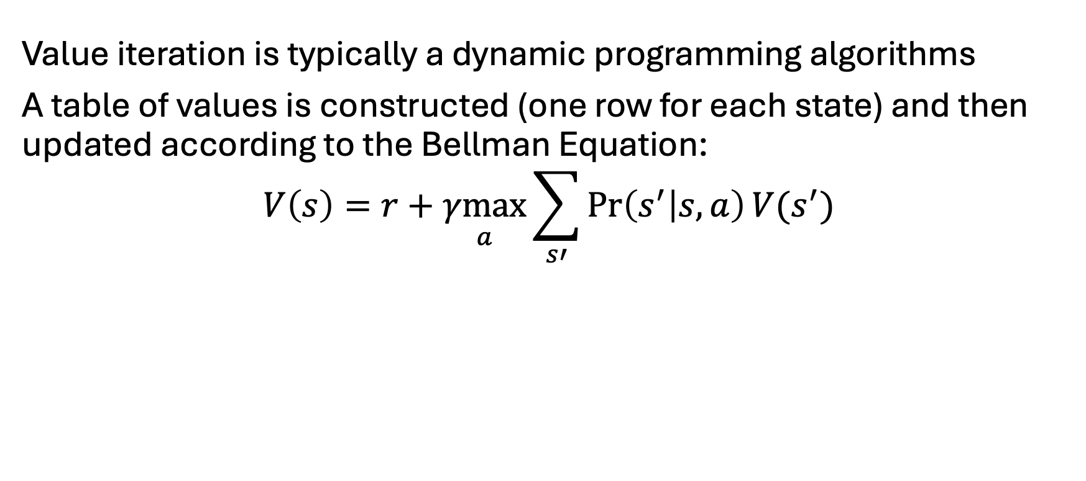
Tabular Value Iteration
Value iteration is typically a dynamic programming algorithms
A table of values is constructed (one row for each state) and then updated according to the Bellman Equation:
$$V\left(s\right)=r+\underset{a}{γmax}{\sum_{s′}{\operatorname{Pr}\left(s^{′} | s, a\right)V(s^{′})}}$$

Slide 13
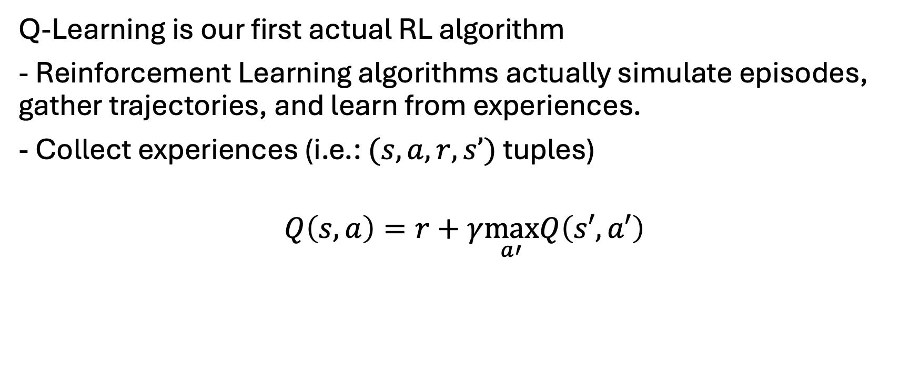
Q-Learning
Q-Learning is our first actual RL algorithm
- Reinforcement Learning algorithms actually simulate episodes, gather trajectories, and learn from experiences.
- Collect experiences (i.e.: $(s, a, r, s’)$ tuples)
$$Q\left(s,a\right)=r+γ\max_{a′}Q\left(s′,a′\right)$$

Slide 14
Q-Learning
Q-Learning is our first actual RL algorithm
- Reinforcement Learning algorithms actually simulate episodes, gather trajectories, and learn from experiences.
- Collect experiences (i.e.: $(s, a, r, s’)$ tuples)
$$Q\left(s,a\right)=r+γ\max_{a′}Q\left(s′,a′\right)$$
Important:
How do we collect experiences (i.e., how do we select what action to take)?
How do we update our estimates of Q?

Slide 15
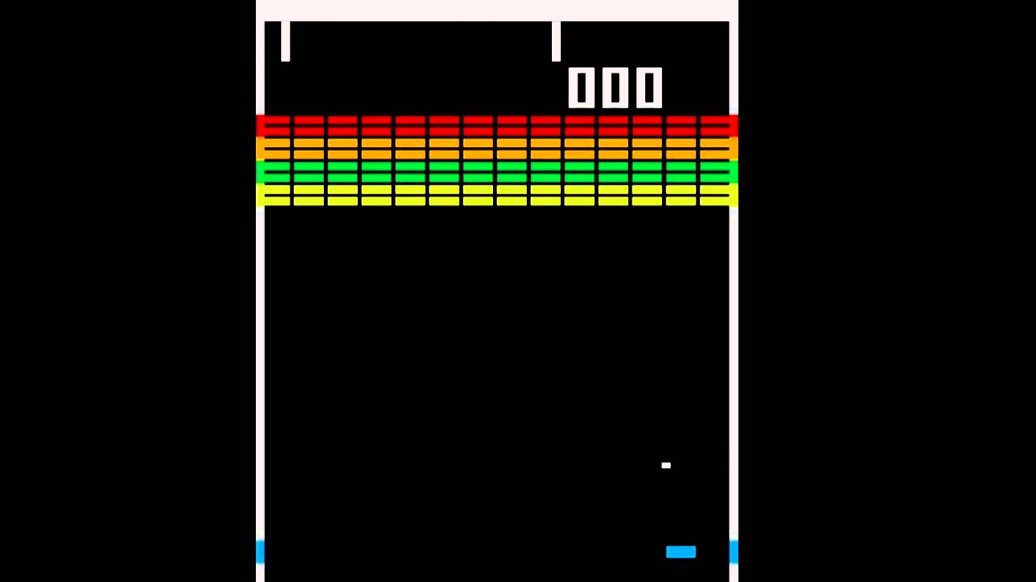
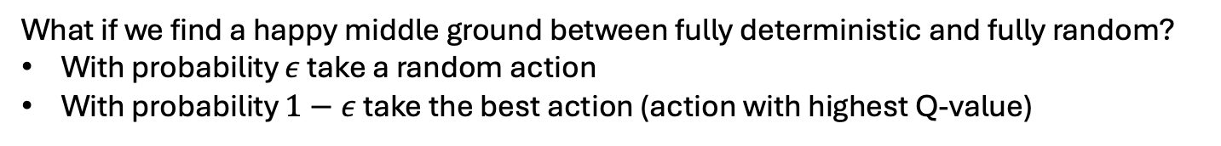
Collecting Experiences
$$Q\left(s,a\right)=r+γ\max_{a′}Q\left(s′,a′\right)$$
What if we always took the action go-right?
We’d update our estimates for go-right, but never go-left
What if we take uniform random actions?
We’d update estimates for both right and left, but we’d be unlikely to get too far into the game
What if we find a happy middle ground between fully deterministic and fully random?
With probability $ε$ take a random action
With probability $1−ε$ take the best action (action with highest Q-value)
$ε$-greedy Algorithm for balancing exploration in RL

Slide 16


Updating estimates of Q-values
$$Q\left(s,a\right)=r+γ\max_{a′}Q\left(s′,a′\right)$$
$$0=[r+γ\max_{a′}Q\left(s′,a′\right)] −Q(s,a)$$
Q-learning:
Maintain estimates of Q(s, a) for all (s, a) pairs
Collect experiences, update Q estimates with:
$$Q\left(s,a\right)←Q\left(s,a\right)+α[r+γ\max_{a^{′}}Q\left(s^{′},a^{′}\right) −Q(s,a)]$$
Learning rate
Current estimate
Error in estimate (Temporal Difference Error)

Slide 17
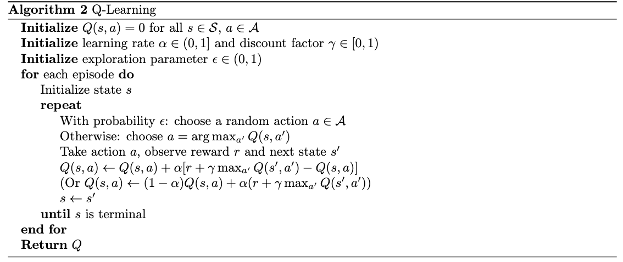
Tabular Q-Learning

Slide 18
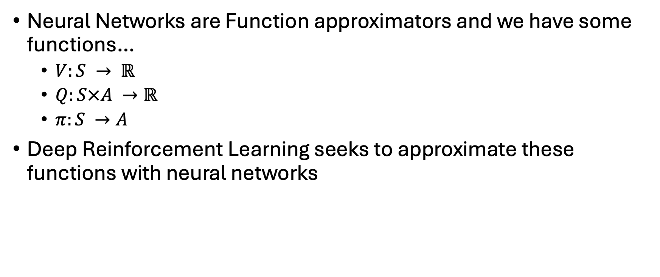
Where’s the Deep Learning part of this?
Neural Networks are Function approximators and we have some functions…
$V:S → ℝ$
$Q:S×A →ℝ$
$π:S →A$
Deep Reinforcement Learning seeks to approximate these functions with neural networks

Slide 19
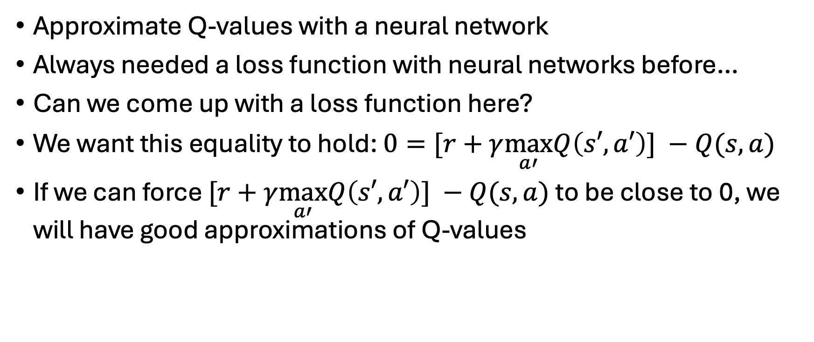
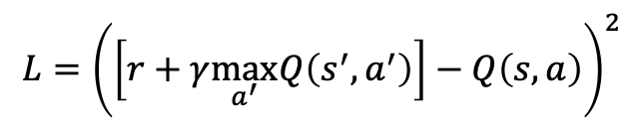
Deep Q-Learning
Approximate Q-values with a neural network
Always needed a loss function with neural networks before…
Can we come up with a loss function here?
We want this equality to hold: $0=[r+γ\max_{a′}Q\left(s′,a′\right)] −Q(s,a)$
If we can force $[r+γ\max_{a′}Q\left(s′,a′\right)] −Q(s,a)$ to be close to 0, we will have good approximations of Q-values
$$L={\left(\left[r+γ\max_{a^{′}}Q\left(s^{′},a^{′}\right)\right]−Q\left(s,a\right)\right)}^{2}$$

Slide 20
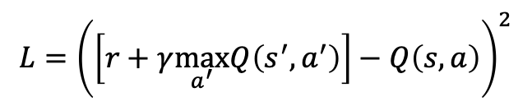
Q-Learning
How to update tabular Q-learning to be deep Q-learning
$$L={\left(\left[r+γ\max_{a^{′}}Q\left(s^{′},a^{′}\right)\right]−Q\left(s,a\right)\right)}^{2}$$
Can’t just update outputs of a NN directly…
Instead, compute loss and run a step of SGD

Slide 21
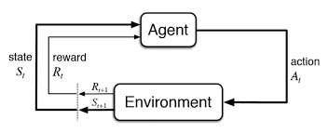

Recap
Important RL Notation: V, Q, G, $π$
Value Iteration
Q-Learning
Up Next: Deep-Q Learning tips, tricks, and variants

