Slide 2
Die Kontamination
Aussterben der Erdbevölkerung mit Ausnahme der „außerwählten“ im Wohnkomplex lebenden
Immer wieder werden neue überlebende gefunden & eingegliedert
Kein Körperkontakt, keine Fortpflanzung erlaubt
Großes Ziel jedes überlebenden?
Die Insel

Slide 4
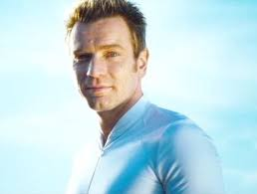
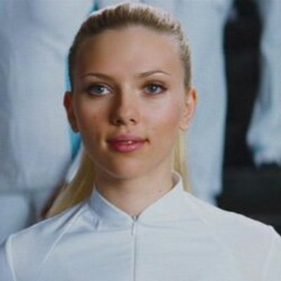
Charaktere Lincoln Six Echo Jordan Two Delta

Slide 5
Handlung
Lincoln Six Echo fängt an zu hinterfragen, sein Umfeld folgt

Slide 7
Handlung II
Ausbruch mit Jordan Two Delta, aufsuchen ihres Sponsors mit Hilfe von Jordans Freund, McCord (informierter Techniker)
Kampf mit Jordans Sponsor, einnehmen seiner Position, aber Rückkehr um die „defekten“ Delta und neuer Generationen zu retten

Slide 8
Technische Setting
Im Komplex, Wohnbereich: Stets aufgeräumt, leicht futuristisch (Wer legt meine Socken zurück?)
Im Komplex, Technikbereich: Zutritt verboten, Schmutzig, Erdnah (Kontaminationsgefahr, Alkohol, Motte,…)
Die äußere Welt: Leicht futuristisch, normale Weltordnung & Standards, Großkonzern von Dr. Merick (Lebensversicherung)
Menschen beliebigen Alters züchtbar!

Slide 10
Teil 2 - Steven Hawking (& Musk)

Slide 11
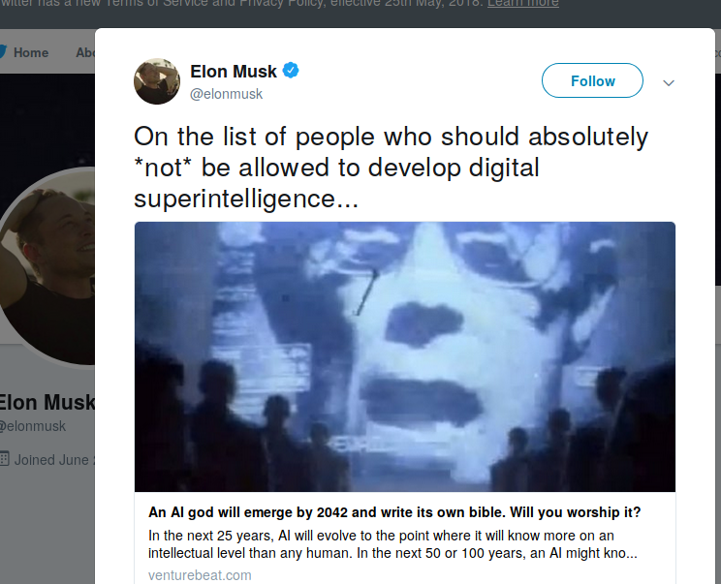
Probleme mit AI

Slide 13
Hawking:
“If people design computer viruses, someone will design AI that improves and replicates itself. This will be a new form of life that outperforms humans.”
Earlier this year, he called for technology to be controlled in order to prevent it from destroying the human race, and said humans need to find a way to identify potential threats quickly, before they have a chance to escalate and endanger civilisation.
Back in 2015, he also expressed fears that AI could grow so powerful it might end up killing humans unintentionally.
(interview with WIRED magazine.)

Slide 14
Background
“Since civilisation began, aggression has been useful inasmuch as it has definite survival advantages,”
“It is hard-wired into our genes by Darwinian evolution. Now, however, technology has advanced at such a pace that this aggression may destroy us all by nuclear or biological war. We need to control this inherited instinct by our logic and reason.”
(Interview with The Times.)

Slide 15
Hawking - Konsequenzen:
"I believe we have reached the point of no return. Our earth is becoming too small for us, global population is increasing at an alarming rate and we are in danger of self-destructing."
Speaking at the launch of Cambridge University's artificial intelligence centre last year Prof Hawking said: "I believe there is no deep difference between what can be achieved by a biological brain and what can be achieved by a computer.
"It therefore follows that computers can, in theory, emulate human intelligence – and exceed it.
He went on: "The potential benefits of creating intelligence are huge. We cannot predict what we might achieve, when our own minds are amplified by AI.
"Perhaps with the tools of this new technological revolution, we will be able to undo some of the damage done to the natural world by the last one - industrialisation.
"And surely we will aim to finally eradicate disease and poverty. Every aspect of our lives will be transformed, In short, success in creating AI, could be the biggest event in the history of our civilisation."
JustGiving page for stabbing victim raises thousands
He added: "But it could also be the last, unless we learn how to avoid the risks. Alongside the benefits, AI will also bring dangers, like powerful autonomous weapons, or new ways for the few to oppress the many."

