Slide 1


5 Corners
Adam Seyfarth
Sam Bateman

Slide 2
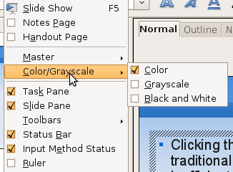
Problem
Clicking through traditional menus is inefficient
Difficult for disadvantaged users
Easy to mis-click

Slide 3
Problem
What makes it difficult?
  Distance from the cursor
  Small target size
These observations can be exploited...

Slide 4
Principles of 5 Corners
Set distance from cursor to 0
  e.g. Right-clicking

Slide 5
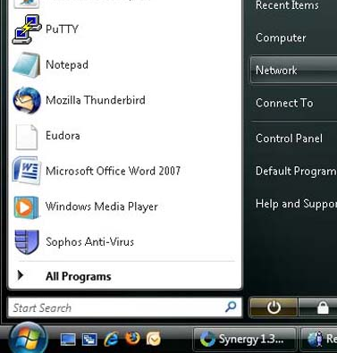
Principles of 5 Corners
Set target size to infinity
  Trap cursor in x and y directions
  e.g. Start menu

Slide 6
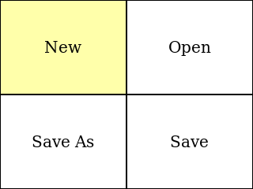
User Interface
A popup window traps the cursor
The window contains four menu items
Left-clicking in a quadrant activates that item
Right-clicking anywhere goes back

Slide 7
User Interface
Right-clicking anywhere in the main window opens the popup window
Popup window is centered on the cursor
Popup window closes when:
  User selects an action
  User right-clicks all the way out

Slide 8
User Interface
Menu items can have keyboard shortcuts
Shortcuts are configurable with config files in ~/.5corners/ directory

Slide 9
User Interface
Demonstration

Slide 10
Library Interface
C++ using FLTK graphics library
3 primary classes
  Fl_5C_Popup_Window
  Fl_5C_Tree
  Fl_5C_Item
1 primary function
  fl_popup_5c_window

Slide 11
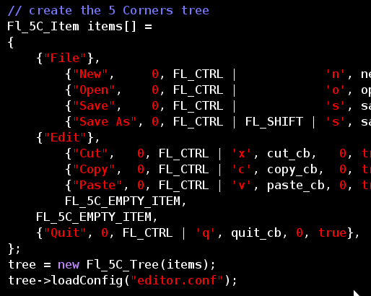
Library Interface
Create an array of Fl_5C_Item
Use it to initialize an Fl_5C_Tree

Slide 12
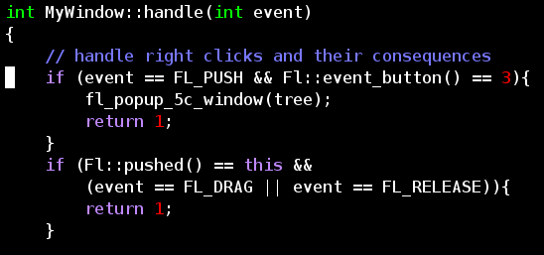
Library Interface
Intercept right-clicks and call fl_5c_popup_window with the tree

Slide 13
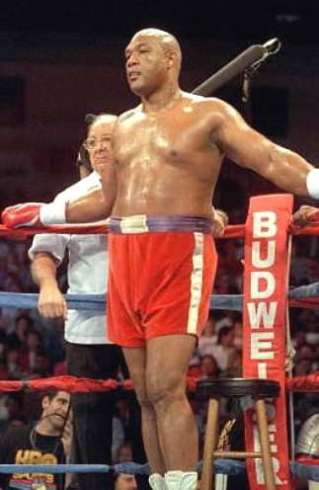
Conclusion
5 Corners
Throwing lefts out the corner
Like ”Big” George Foreman
Any questions?

