Slide 1


Class 5
Engine Optimizations

Slide 2
Spatial organization
Standard collision detection is O(n²)
Too slow for large game worlds
Solution: spatially organize to discard far-away data
Other game objects
Pieces of static geometry
Many approaches
Bounding volumes
Bounding volume hierarchy
Uniform grid
Hierarchical grid
Octree
K-D Tree
BSP tree

Slide 3
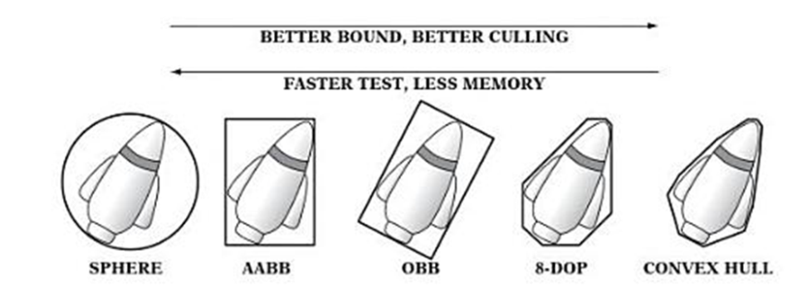
Bounding volumes
Wrap objects in simple geometry (bounding volumes) to speed up collisions
If objects are far apart, their bounding volumes won’t collide, and the detailed test is not needed
Doesn’t solve O(n²) runtime alone

Slide 4
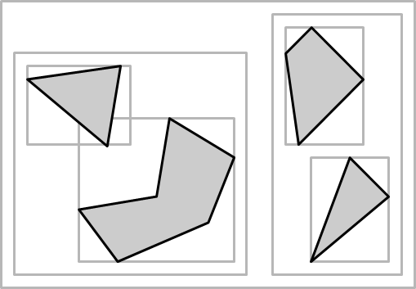
Bounding volume hierarchy (BVH)
Parent volumes contain child volumes
Sibling volumes may overlap (not spatial partitioning)
Speeds up collisions between dynamic entities
Also speeds up rendering

Slide 5
BVH construction
Top-down construction easier than bottom-up
Start with a volume containing all objects
Find a partition via some heuristic
Sort objects into two sub-volumes and discard partition
Repeat recursively

Slide 6
BVH construction
buildBVH(node, objects):
// fit bounding volume of node to objects
...
if numObjects <= minObjectsPerLeaf:
node.objects = objects
else:
// partition objects according to a heuristic
...
buildBVH(node.left, leftObjects)
buildBVH(node.right, rightObjects)

Slide 7
BVH construction heuristics
Difficult to choose good partitioning axes
Goals
Minimize node volume
Keep branches balanced
Minimize sibling overlap
Strategies
Median-cut (divide into equal-size parts with respect to a selected axis)
Minimize sum of child volumes
Maximize separation of child volumes

Slide 8
BVH queries
collideBVH(object, volume):
if volume.isLeaf:
for object2 in volume.children:
collide(object, object2)
else:
for child in volume.children:
collideBVH(object, child)

Slide 9
Uniform grid
Speeds up collisions between dynamic entities
Axis-aligned cube cells (voxels)
Each cell has list of objects
May be dense (array) or sparse (hash-based)
Each frame: update cells for objects that moved

Slide 10
Uniform grid
Pros
Simple to generate and modify
Good for static and dynamic objects
O(1) access to neighbors
Cons
Not appropriate for objects of greatly varying sizes
Dense representation wastes memory in empty regions

Slide 11
Hierarchical grid
Hierarchy of differently-sized uniform grids
N levels, cells at top level are big enough to cover bounding box of largest game object
Each sub-level’s cells are half the scale
Inserting objects
Find the level where cells are big enough to fit it fully
In that level, insert into the cell that contains its center
1D example on right
4 | B
3 |  |  |  |  |  |  |  |  | D
2 | A |  |  |  |  |  |  |  |  |  |  |  | E
1 |  |  |  |  |  |  |  | C |  |  |  |  |  |  | F
A
B
C
D
E
F

Slide 12
Hierarchical grid queries
Traverse over all levels
Test cells containing object’s bounding box and neighboring cells
1D example: colliding object E
4 | B
3 |  |  |  |  |  |  |  |  | D
2 | A |  |  |  |  |  |  |  |  |  |  |  | E
1 |  |  |  |  |  |  |  | C |  |  |  |  |  |  | F
4 | B
3 |  |  |  |  |  |  |  |  | D
2 | A |  |  |  |  |  |  |  |  |  |  |  | E
1 |  |  |  |  |  |  |  | C |  |  |  |  |  |  | F
A
B
C
D
E
F

Slide 13
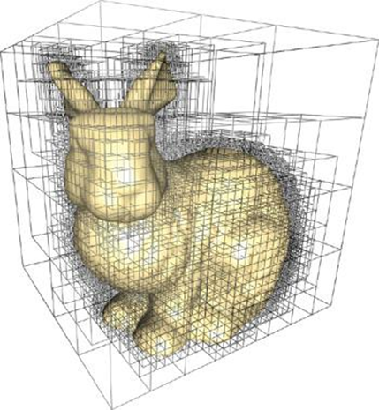
Octree
Axis-aligned hierarchical partitions
Hierarchical grid with one top-level cell
Each node is split into eight child nodes
Pros:
Simple construction for static scenes
Easy collision tests: all AABBs
Cons
Traversing tree is expensive if the tree is deep or unbalanced

Slide 14
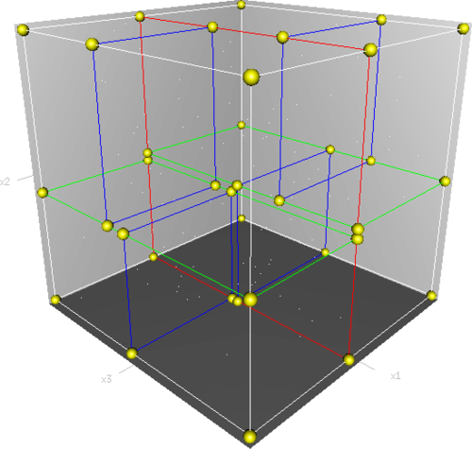
K-D Tree
Axis-aligned binary tree
At each node we select one axis to split along (usually we cycle through the dimensions down the tree)
Need to use some heuristic like median-cut in order to choose where we split
Special case of BSP trees (up next)

Slide 15
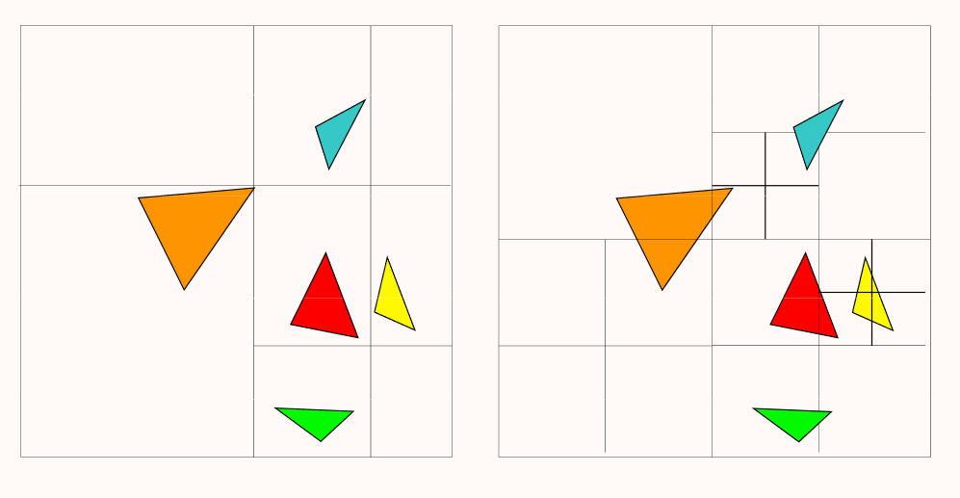
K-D Tree vs. Octree
kd-tree
octree

Slide 16
BSP Tree
g
Binary Space Partitioning Tree
Hierarchy of planar half-spaces (not necessarily axis-aligned like in a k-d tree)
Each node has a plane, divides the space of the parent in two
Models solid vs. empty space
Leaves represent convex polytope
Some solid, some empty
Some have infinite area/volume
Works best for indoor environments (flat, man-made surfaces)
Used by original Doom and Quake
Still used today (Source, Unreal, Call of Duty IW engine)
h
f
a
e
b
d
c
a
b
g
c
e
h
d
f

Slide 17
BSP tree construction
g
Recursively pick a triangle according to a heuristic, split scene along that plane
Tree needs to be balanced for good performance
h
f
a
e
b
d
c
a
b
g
c
e
h
d
f

Slide 18
BSP tree querying
g
To test if a point is inside or outside:
Start at root
Visit front child if point in front of plane, otherwise visit back child
If the point is in front of a leaf node, it is outside, otherwise it is inside
h
f
a
e
b
d
c
a
a
b
b
g
c
e
e
h
d
f
f

Slide 19
BSP tree ray traversal
Given ray (P,D) and root
If P is behind plane
Recursively traverse back node
Hit-test polygons on plane
Recursively traverse front node if D • N > 0
If P is in front of plane
Recursively traverse front node
Hit-test polygons on plane
Recursively traverse back node if D • N < 0
Front
Back
P
D

Slide 20
BSP tree pros & cons
Pros:
Because it’s a binary tree, most tests O(log n)
Easy collision detection and raycasting
Cons:
Very expensive to build (optimal is NP-complete!)
Not suitable for dynamic objects
Numeric stability can be tricky

Slide 21
Class 5
Rendering Chunks

Slide 22
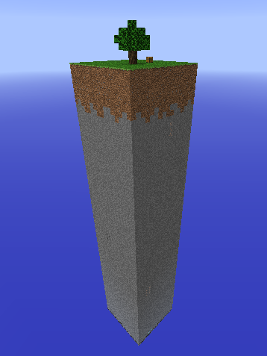
Drawing Things
We have a ton of walls and floors and roofs, so how should we go about drawing them?

Slide 23
Attempt #1
We’ll loop through each wall, set the material, and then draw each wall individually.
But each time we draw a wall, we have to send information from the CPU over to the GPU.

Slide 24
Attempt #1
For each of these walls, a draw call needs to travel to the GPU for that wall to be rendered
And this would happen on every frame
Sending data to the GPU is a huge bottleneck for drawing

Slide 25
Attempt #2: Storing Shapes
Solution: Create and store shape for entire pieces of static geometry
In our case, we’ll create one Shape per chunk
Pack everything you need into a single Shape and draw it once
Only a single draw call per chunk

Slide 26
Why bother?
While fairly time-consuming to set up, the speed increase is incredible
Only a single draw call
Don't have to change texture for each block (even if they should be colored differently)
More on this later

Slide 27
How to do it
Create each chunk shape:
Create a Shape (see helper classes)
Generate the Shape based on the chunk’s walls
Store the Shape
When drawing, iterate over each chunk:
Draw the Shape

Slide 28
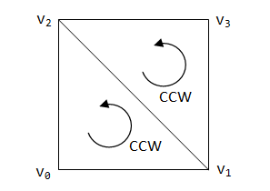
Generating the Shape (Faces)
For each face, need to specify:
Vertices of that face
Triangles of that face
Notes:
* Enable backface culling to debug

Slide 29
Generating the Shape (Vertices)
For each vertex, you need to specify:
Position (self-explanatory)
Normal (the perpendicular to the cube face)
Texture coordinates (more on this next)
Store all vertices in a vector of floats
8 floats total per vertex
3 for position
3 for normal
2 for texture
4 vertices total per face
It's a quad
Notes:
* Enable backface culling to debug

Slide 30
Generating the Shape (Triangles)
Store all triangles in a vector of ints
3 ints per triangle
Specify vertices in counter-clockwise order
Int corresponds to position of the vertex in the vertex array
Two triangles per face
It's a quad
Notes:
* Enable backface culling to debug

Slide 31
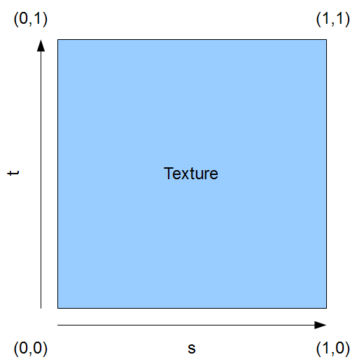
Textures
Quick recap …
Textures are basically just images
Can use “texture coordinates” to specify what part of an image to texture a triangle with
(0.0, 0.0) corresponds to upper left of image
(1.0, 1.0) corresponds to lower right of image
We specify the “texture coordinates” for vertices of triangle
Texture coordinates for in between points interpolated between these

Slide 32
Texture Atlasing
When rendering chunks, we bind a single image (the texture atlas) which is used to texture all of the terrain
Can specify texture coordinates for each face individually
The texture coordinates are defined such that they map to subimages of the atlas
~10 fps boost (compared to binding an unbinding individual images)

Slide 33
Texture Atlasing
You need to know the dimensions of your texture atlas first
Maybe the size of the textures too (if they’re uniformly sized)
Ours is a 256x256 image of 16x16 textures
Subimages will likely be specified in pixels
So we need to convert pixel positions to OpenGL texture coordinates

Slide 34


Coordinate Conversion
(100, 300)
= (0.25, 0.75)
400px
400px

Slide 35
Pseudocode
For each chunk:
Initialize the following:
A vector of floats that could hold ALL of your vertices
A vector of ints that can hold all of your triangles
A counter to keep track of the number of vertices
A Shape to hold the chunk’s shape
For each wall:
Is the wall visible? If so, add all vertices and triangles to your array, increment counter
Otherwise, skip the wall
Repeat for floors and ceilings
Create a shape using the vertices and triangles
std::shared_ptr<Shape> shape = std::make_shared<Shape>(vertices, triangles);

Slide 36
Tips
Remember to use counter-clockwise order for triangle vertices!
Notes:
* Enable backface culling to debug

Slide 37
Class 5
Frustum Culling

Slide 38
THE VIEW FRUSTUM
Frustum Culling

Slide 39
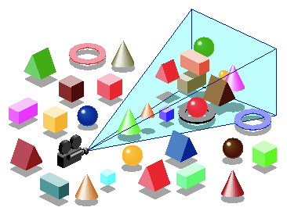
What is it?
The volume of world objects that can actually be seen by the camera
Shaped like a pyramid, bounded by:
Far plane (the “base” of the frustum)
Near plane (the “cap” of the frustum)
Field of view/viewport size (determine the “walls” of the frustum)

Slide 40
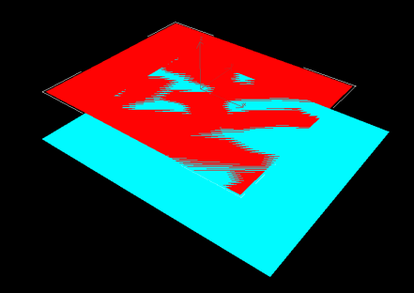
What we’re doing now…
During onDraw():
We tell OpenGL to render every single object
Regardless of whether or not it will appear in the scene
Can we avoid drawing some things?

Slide 41
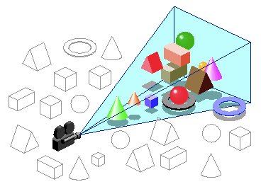
What we should do…
Instead of telling OpenGL to draw everything, why don’t we avoid sending what we know won’t be drawn?
What doesn’t need to be drawn?
Anything not in the view frustum!
Only good if we can do this faster than it would take for OpenGL to draw everything

Slide 42
Extracting the View Frustum
Frustum is defined by 6 planes
Planes can be derived directly from the rows of our camera matrices
You can get this using
camera->getProjection() * camera->getView()
Gives us a glm matrix
Be careful
glm uses column-major order, so use the coordinates given here to access the given cells / rows
0,0
1,0
2,0
3,0
r0
0,1
1,1
2,1
3,1
r1
0,2
1,2
2,2
3,2
r2
0,3
1,3
2,3
3,3
r3
Projection matrix • view matrix

Slide 43
Extracting the View Frustum
Plane equation is given by a 4D vector (a,b,c,d):
ax + by + cz + d = 0
The 6 clip planes of the frustum are defined below!
0,0
1,0
2,0
3,0
r0
0,1
1,1
2,1
3,1
r1
0,2
1,2
2,2
3,2
r2
0,3
1,3
2,3
3,3
r3
Projection matrix • view matrix
Clipping plane | −x | −y | −z | +x | +y | +z
Plane equation | r3 − r0 | r3 − r1 | r3 − r2 | r3 + r0 | r3 + r1 | r3 + r2

Slide 44
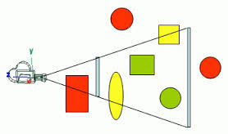
Frustum Culling Test - General
Compute 6 plane equations
Should be updated whenever the camera changes!
For each piece of scene geometry:
Does the entire shape fall behind one of the planes?
Skip rendering, it can’t be seen!

Slide 45
Frustum Culling Test - AABB
AABB (axis-aligned bounding box)
Faces parallel to xy, xz, and yz planes
Defined by a position and dimensions (convenient!)
Rejection test: are all 8 corners behind any one plane?
For point (x,y,z), behind plane if ax + by + cz + d < 0

Slide 46

Frustum Culling Test - Sphere

Slide 47
Implementation Notes
Storing the r vectors
In the camera?
Only re-compute when camera changes
Somewhere else?
Up to you
Design decisions – yay!
Notes:
* Maybe associate camera with graphics object

Slide 48
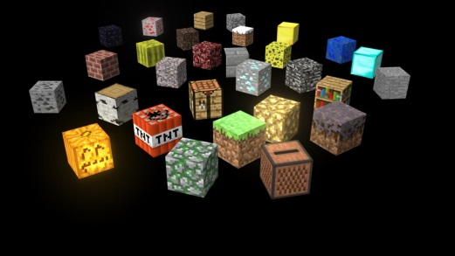
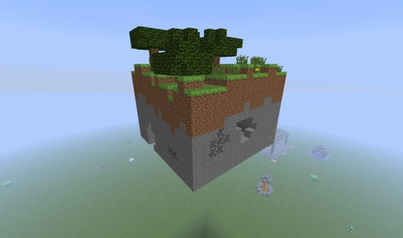
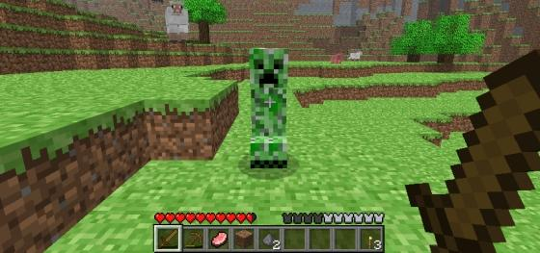
Implementation Notes
What should we cull?
Individual blocks?
Fine-grained
Faster to just draw everything
Whole chunks?
Coarse-grained
Far fewer culling tests
Non-environment entities?
Depends on # vertices
If we have AABB’s for them, depends on how many

Slide 49
Class 5
Chunk Streaming

Slide 50
Memory troubles
We want our worlds to be “infinite”
So big that reaching the end is unreasonable during standard play
But we don’t have infinite memory…

Slide 51
What should we forget?
Solution: store only in memory what the player is likely to interact with
Two parts:
Load chunks only as the player approaches them
Unload chunks when the player has moved significantly far away from them

Slide 52
Chunk Streaming
Dynamic World Loading

Slide 53
Chunk streaming
Only store chunks within a distance from the player
AABB or sphere around player
Update when player moves between chunks
Remove chunks that went out of range
Add chunks that came into range

Slide 54
Chunk streaming
In range at t2 only
What if the player transitions from chunk (x, y, z) to chunk (x+1, y+1, z+1)
If view distance is 5 chunks on each side of the player, need to stream in more than 50 chunks
Too much work for a single frame
Simplest solution: queue of added chunks
Dequeue one chunk per frame
Build chunk’s Shape when it’s dequeued
t2
t1
In range at t1 only

Slide 55
More Complicated Solutions
Use several worker threads
Cannot access OpenGL in other threads
Shape initializations still need to be spread out across frames
Many functions aren’t thread-safe (like srand() and frand())
Don’t purge chunks in the world until they are (1+radius) away instead of (radius) away
Loading chunks into memory is hard, so keep them there for a little while longer
Keeps you from having to reload chunks when players jump back and forth across a chunk border (“thrashing”)
We prefer “flailing”

Slide 56
Saving and loading
With chunk streaming, modifications to chunks are lost when it goes out of the player’s view range
Could try to save all modifications in memory
Danger of running out of memory for very long play sessions
Doesn’t provide persistence across play sessions
Solution: Save chunks to disk as they stream out, load them from disk as they stream in
How to efficiently save and load so much data?
Design decisions

Slide 57
Class 5
C++ Tips

Slide 58
Static
Very helpful C/C++ keyword
Behavior of static can vary a lot depending on use
Member variable vs namespace variable vs local variable causes different results

Slide 59
More Static
Static variables exist for the "lifetime" of the translation unit that it's defined in
Translation unit: simplest unit of compilation
Consists of the contents of a single source file, plus the contents of any header files directly or indirectly included
Result: static variables have a single instance (usually)

Slide 60
Namespace Static
If variable is outside of any functions or class, it can't be accessed from any other translation unit
This is known as "internal linkage"
NEVER do this in headers
you end up with a separate variable in each translation unit (i.e., every time you include the header)
static int x;
class Foo { public: void bar();
};
Notes:
Extern keyword instead

Slide 61
Member Variables and static
A static member variable is shared between all instances of the class
Important: you need to both declare and define static member variables

Slide 62
Bad Good
//in .h file
class Foo {
public:
static int x;
void bar();
};
//in .cpp file
void Foo::bar(){
Foo::x = 10;
};
//in .h file
class Foo {
public:
static int x;
void bar();
};
//in .cpp file
int Foo::x = 0;
void Foo::bar(){
Foo::x = 10;
};

Slide 63
Static functions
Less confusing
Same as in Java
A static function can be called without an instance of a class
Cannot access non-static member variables
class Foo
{
private:
static int value;
public:
static int getValue()
{
return value;
}
};

Slide 64
Const
Another very helpful keyword
Declares a constant
int x = 4; //normal int
const int y = x; //value of y cannot be changed
const int* foo = &y; //can’t change value of y
int *const bar = &x; //can’t reassign bar
const int *const yum = foo; //can’t change anything

Slide 65
Const++
Const member functions
void Entity::draw() const { … // can’t change Entity
Very, very good style
Using const references in functions
void Entity::accelerate(const vec3 &acc) { …
Only const functions can be called on const references
Much cheaper than accelerate(vec3 acc)
Notes:
Declare a member function const for the compiler to ensure that it doesn’t change its object

Slide 66
C++ Templates!
C++ templates are an extremely powerful tool for generic programming
Allows you to reuse the same code without losing any type specificity
Can be tricky to figure out though—it’s okay if you get lost!
Notes:
You’ve probably already used templates, even if you don’t know it—any data type with <> is a templated class!

Slide 67
Without templates
#include <iostream>
using namespace std;
int square (int x)
{
return x * x;
};
float square (float x)
{
return x * x;
};
double square (double x)
{
return x * x;
};
main()
{
int i, ii;
float x, xx;
double y, yy;
i = 2;
x = 2.2;
y = 2.2;
ii = square(i);
xx = square(x);
yy = square(y);
}
Notes:
We have to write three separate square classes, even though they all do the exact same thing

Slide 68
With templates
template <class T>
inline T square(T x)
{
T result;
result = x * x;
return result;
};
main()
{
int i, ii;
float x, xx;
double y, yy;
i = 2;
x = 2.2;
y = 2.2;
ii = square<int>(i);
xx = square<float>(x);
yy = square<double>(y);
}

Slide 69
Template Classes
In addition to have a templated function, we can have a entire templated class
This is how things like vectors, maps, and the like are implemented
#include <iostream>
using namespace std;
template <class T>
class mypair {
T a, b;
public:
mypair (T first, T second)
{a=first; b=second;}
T getmax ();
};
template <class T>
T mypair<T>::getmax ()
{
T retval;
retval = a>b? a : b;
return retval;
}

Slide 70
What are Templates Good For?
Use Case #1:
Generic methods for adding / getting / removing components!
class GameObject {
template <class T>
void addComponent(T std::shared_ptr<T> comp)
{
…
};
}
class GameObject {
template <class T>
std::shared_ptr<T> getComponent(…)
{
…
};
}

Slide 71
What are Templates Good For?
Use Case #2:
Generic methods for adding / getting / removing systems!
class GameWorld {
template <class T>
void addSystem(T std::shared_ptr<T> sys)
{
…
};
}
class GameWorld {
template <class T>
std::shared_ptr<T> getSystem(…)
{
…
};
}

Slide 72
Class 5
Good luck on Platformer 2!

