Slide 1
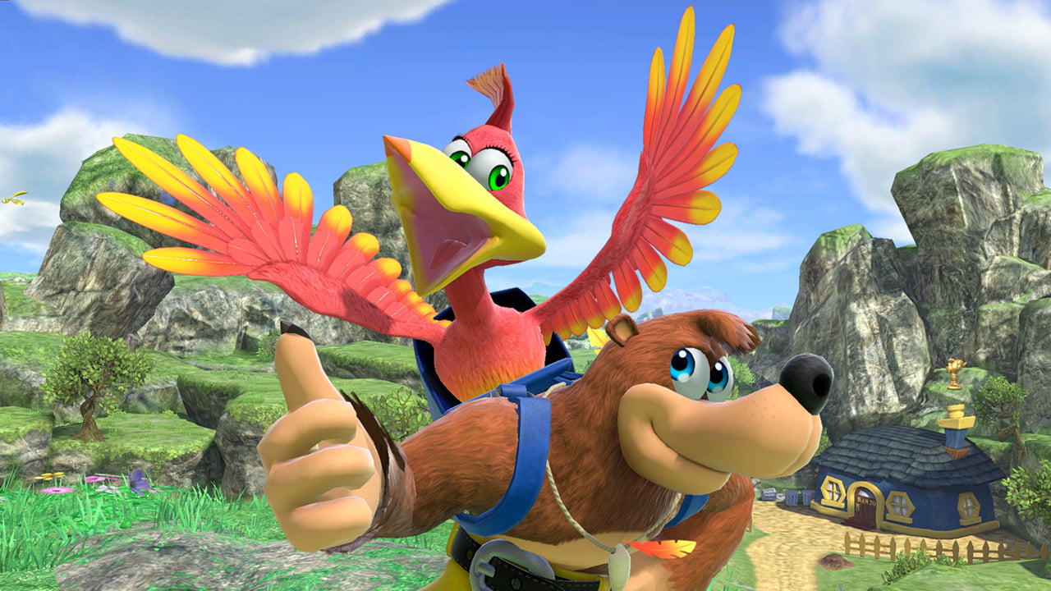
Class 6
Pathfinding and AI

Slide 2
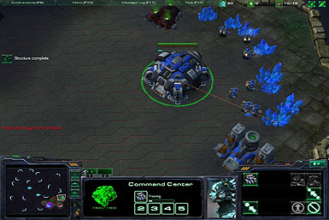
Game A.I.
Artificial Intelligence is what makes computer-controlled entities in a game behave reasonably
Can be used to control enemy entities, or used to support the human player
Usually, we want AI-controlled entities to behave as if a human is controlling them
The goal of game AI is to provide a fun challenge, not necessarily to make optimal decisions

Slide 3
Pathfinding
Pathfinding is the most common primitive used in game AI
A path is a list of instructions for getting from one location to another
Not just locations: instructions could include “jump” or “climb ladder”
A hard problem!
Bad path planning breaks the immersive experience
Many games get it wrong

Slide 4
3D world representation
Need an efficient encoding of relevant information in the world
Navigable space
Important locations (health, safety, bases, mission objective)
Graph-based approaches
Waypoints
Navigation meshes

Slide 5
Decision Making
World is represented as a graph
Nodes represent open space
Edges represent ways to travel between nodes
Use graph search algorithms to find paths
Two common types
Waypoint graphs
Navigation meshes

Slide 6
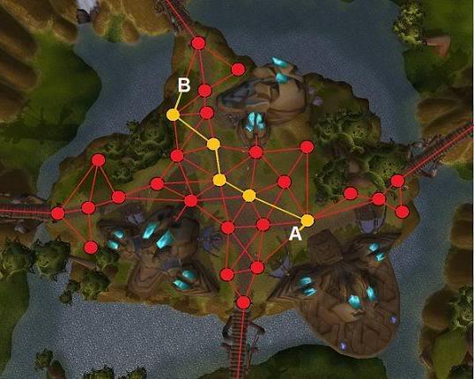
Waypoint graphs
Represents a fixed set of paths through the world
Nodes are waypoints
Edges represent a path between adjacent nodes

Slide 7
Disadvantages of waypoint graphs
Optimal path is likely not in the graph
Paths will zig-zag to destination
Good paths require huge numbers of waypoints and/or connections, which can be expensive
No model of space in between waypoints
No way of going around dynamic objects without recomputing the graph
Awkward to handle entities with different radii
Have to turn off certain edges and add more waypoints

Slide 8
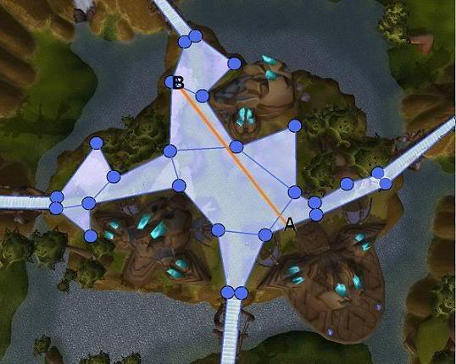
Navigation meshes
Convex polygons as navigable space
Nodes are polygons
Edges show which polygons share a side

Slide 9
Advantages of navigation meshes
More efficient and compact representation
Equivalent waypoint graph would have many more nodes and would take longer to traverse
Models entire navigable space
Can plan path from anywhere inside nav mesh
Paths can be planned around dynamic obstacles
Zig-zagging can be avoided
Naturally handles entities of different radii
Don't go through edges less than 2 * radius long
Leave at least a distance of radius when moving around nav mesh vertices

Slide 10
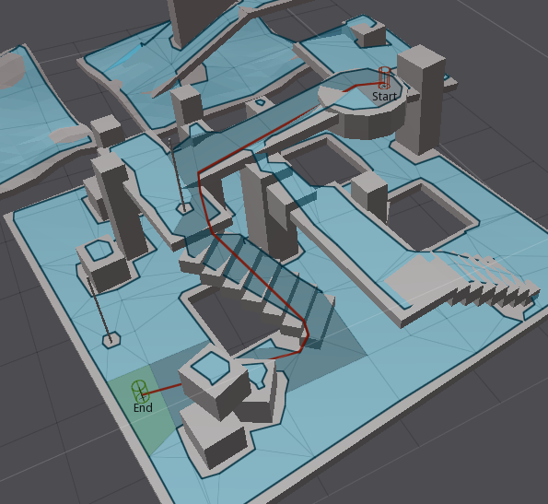
Navigation meshes
Different from collision mesh
Only contains walkable faces
Stairs become a single, rectangular polygon
Polygons are usually smaller to account for player radius

Slide 11
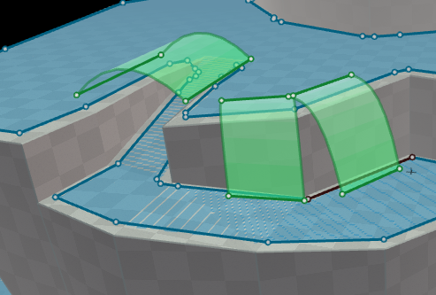
Navigation meshes
Annotate special regions
Can have regions for jumping across, falling down, crouching behind, climbing up, ...
Regions are usually computed automatically

Slide 12
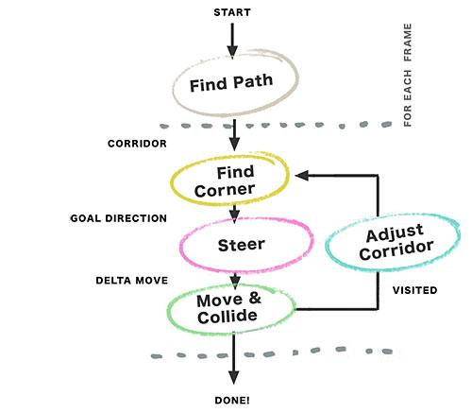
Navigation loop
Process for robust path navigation on a navigation mesh:
Find sequence of polygons (corridor) using graph algorithm
Find corner using string pulling (funnel algorithm)
Steer using smoothing
Actually move/collide entity
Find Corridor

Slide 13
Graph search
First step in finding a path
Graph search problem statement
Given starting point A, target point B and a nav mesh
Generate a list of nav mesh nodes from A to B (called a corridor)
Simplest approach: Breadth-first search
Keep searching until target point is reached
Each edge has equal weight
Most common approach: A-star
Variable edge weights (mud or steep surfaces may have higher cost)
Uses a heuristic to arrive at an answer faster

Slide 14
Class 6
Generating a Path

Slide 15
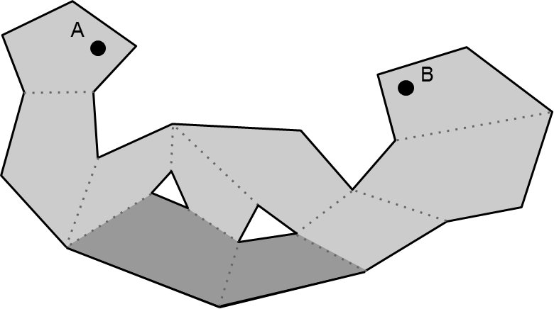
Path generation: problem statement
Given a list of polygons (output of a graph search)
The light polygons
Construct the shortest path for the agent
Where a path is a sequence of connected segments
The path must lie entirely in the list of polygons

Slide 16
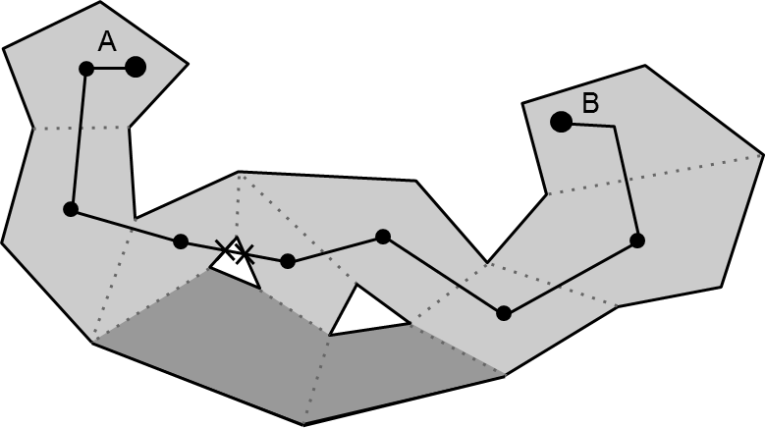
Path generation: first attempt
Can we just connect polygon centers?
No: the path might not even be within the polygons
Polygons’ convexity only tells us that any 2 points in a single polygon can be connected with a segment

Slide 17
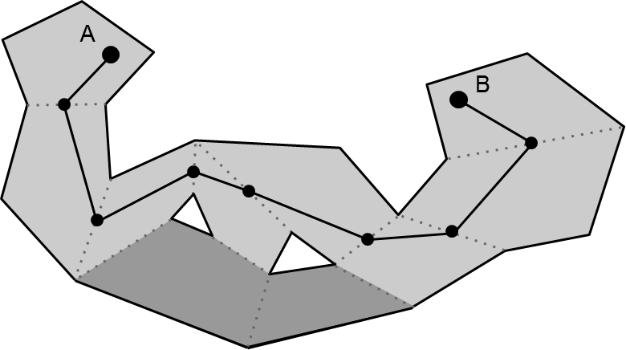
Path generation: second attempt
Can we just connect centers of polygon sides?
This always produces a valid path (within the polygons)
But not always the optimal path (zig-zagging)
This is just a waypoint graph!

Slide 18

Path generation: third attempt
The Funnel algorithm finds the optimal path
Hugs corners
Is like “pulling a string” that connects A and B until it is taut

Slide 19
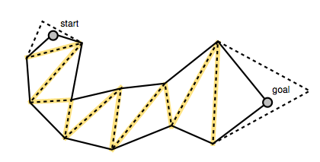
Funnel algorithm
Traverses through a list of polygons connected by shared edges (portals)
Keeps track of the leftmost and rightmost sides of the "funnel" along the way
Alternates updating the left and right sides, making the funnel narrower and narrower
Add a new point to the path when they cross
Funnel

Slide 20
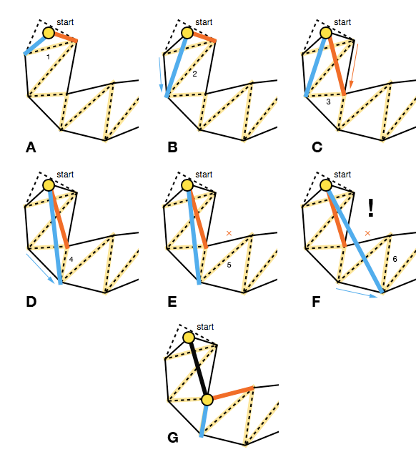
Funnel Algorithm

Slide 21
Funnel Algorithm
Start
Apex point = start of path
Left and right points = left and right vertices of first portal
Step
Advance to the next portal
Try to move left point to left vertex of next portal
If inside the funnel, narrow the funnel (C-D in previous slide)
If past the right side of the funnel, turn a corner (E-G in previous slide)
Add right point to path
Set apex point to right point
Restart at portal where right point came from
Try to move right point to right vertex of next portal
Similar to left point

Slide 22
Edge cases
Zero-length funnel side (portals that share a vertex)
Always use left*0.99+right*0.01 for the left and left*0.01+right*0.99 for the right (shrinks portal slightly)
End iteration of the funnel algorithm
End point is portal of size 0, need to check for potential restart like other portals

Slide 23
Funnel algorithm example
Don't restart search from any of these points
Restart search from here (apex)

Slide 24
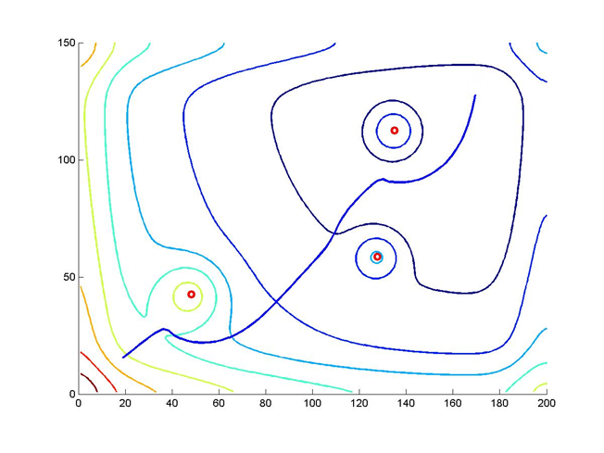
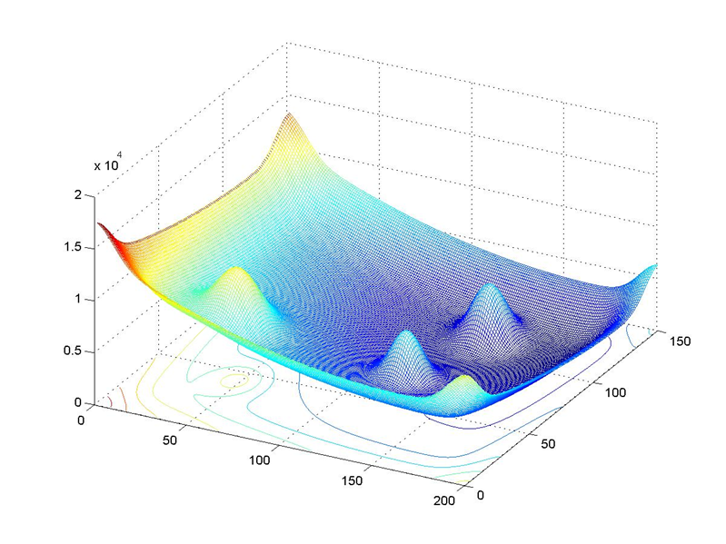
Pathfinding with potential fields
Potential field: a region of potential values
Usually a 2D grid in games
Good paths can be found by hill climbing
The potential at a location represents how desirable it is for the entity to be there
Obstacles have low potential
Desirable places have high potential

Slide 25
Potential fields: algorithm details
On startup
Generate potential fields for static objects
Periodically (~5 times a second)
Generate potential fields for dynamic objects
Sum static and dynamic potential fields to get the final potential field
Each tick (~60 times a second)
Pathfinding entities move towards direction of greatest potential increase (hill climbing)

Slide 26
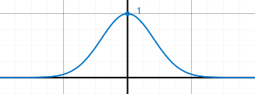
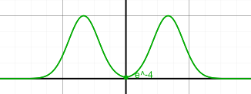
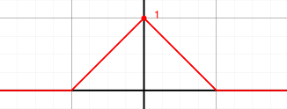
Choosing a potential function
Potential function for a single entity
Usually defined radially
Non-radially symmetric ones useful too
Example: cone of negative values ahead of player to encourage enemies to stay out of view
Example potential functions (radial):

Slide 27
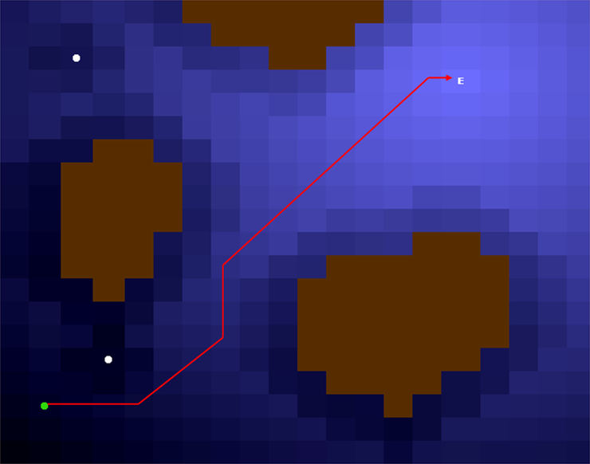
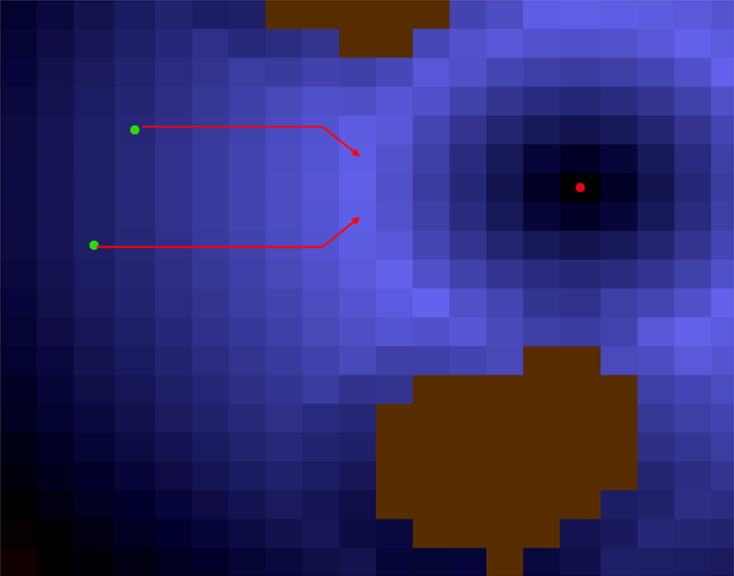
Choosing a potential function
Potential functions don't need linear falloff
Linear falloff leads to a target
Rise then fall leads ranged units to a safe distance away

Slide 28
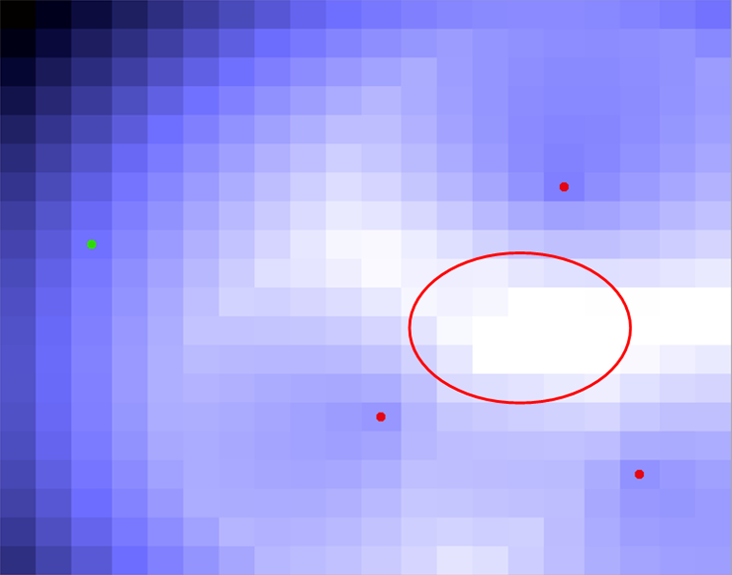
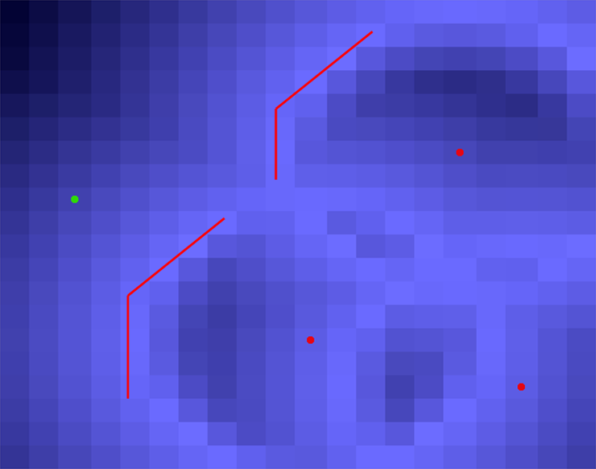
Pathfinding with Potential Fields
Multiple ways of combining potentials
Maximum sometimes works better than sum
Summing creates false desirable spot for ranged units
Maximum correctly identifies desirable areas for ranged units

Slide 29
Pros and cons of potential fields
Advantages
Able to represent fully dynamic world
Hill climbing doesn't need to generate and store the entire path
Naturally handles moving obstacles (crowds)
Can be efficiently implemented on the GPU
Drawbacks
Tuning parameters can be tricky
Hill climbing can get stuck in local maxima
Local maximum
Agent
Global maximum

Slide 30
Avoiding local maxima
Agents drop negative-potential "pheromone trail"
Bulge behind them pushes them forward
Doesn't prevent agents from turning around in corners
Still doesn't avoid all local maxima
Potential fields are better suited for dynamic worlds with large open areas
Classical graph-based pathfinding works better for complex terrain with lots of concave areas

Slide 31
Reconsidering potential fields
Not actually used in many real games
We couldn't find any commercial releases that use them
But there are at least custom Starcraft bots that do
Instead, most games use graph-based path planning

Slide 32
Class 6
Obstacle Avoidance

Slide 33
Steering
There are many different ways for an entity to move towards a point
Moving in straight lines towards each destination gives a robotic look
Many alternatives exist: which to use depends on the desired behavior
Seek, arrive, wander, pursue, etc.
Steering behaviors may be influenced by a group
Queue, flock, etc.

Slide 34
Steering example: arrival
When approaching the end of a path, we may want to naturally slow to a halt
Arrival applies a deceleration force as the entity approaches its destination

Slide 35
Moving and Colliding
If there are no collisions, moving and colliding is as simple as using the destination and steering to move
Collisions can cause a variety of issues
May need to re-plan path if a collision is impeding movement
Can detect getting stuck if the entity stays in roughly the same spot for a few seconds

Slide 36
Obstacle avoidance
Static obstacles can be avoided by generating the right navigation mesh
Dynamic obstacles are trickier
Baseline approach for dynamic obstacles
Use raycast or sweep test to determine if in obstacle is in the way
Apply steering force away from obstacle
Adjust force based on distance to obstacle

Slide 37
Dynamic obstacle avoidance
If we consider each obstacle individually, this is purely local avoidance
Can easily get stuck in local minima
Remember, this step is added on top of global path planning
We need an approach between purely local and global for handling temporary obstacles
Will not perfectly handle all cases
Only perfect solution is to adjust navigation mesh
Example approach: "Very Temporary Obstacle Avoidance" by Mikko Mononen

Slide 38
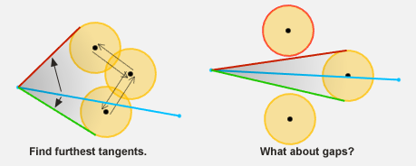
Very Temporary Obstacle Avoidance
For the obstacle blocking the path
Calculate tangent points
Choose tangent that generates a shorter path from the start position to the goal through the tangent
Cluster overlapping objects into one object

Slide 39
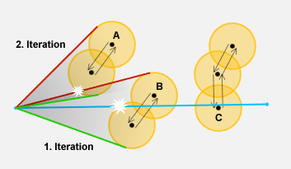
Very Temporary Obstacle Avoidance
Handling multiple obstacles
Check for obstacles on newly chosen path
Iterate until path is clear
Might take many iterations to converge
Only run 2-4 iterations, usually good enough

Slide 40
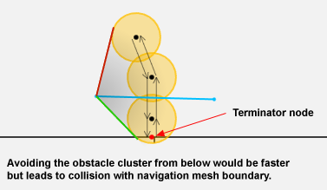
Very Temporary Obstacle Avoidance
Handling objects along walls
Check for intersections along navigation mesh boundary
If one is hit, exclude that path

Slide 41

Very Temporary Obstacle Avoidance

Slide 42
Robustness
Can't find path from off the navigation mesh
Clamp agents inside boundary of navigation mesh
Special-case climbing up ledges
Crowds can't all follow the same path
Don't precompute the path, assume it's wrong
Use a more loose structure of path (polygons)
Just navigate to the next corner
Use local object avoidance to handle crowds

Slide 43
Class 6
Finite/Hierarchical State Machines

Slide 44
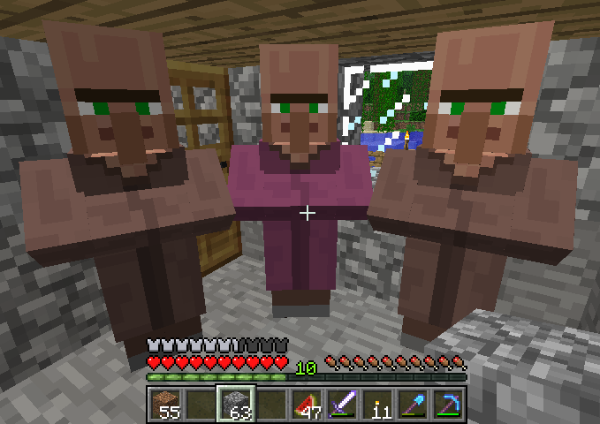
Decision Making
NPC’s should do something, but what?
Could hardcode the logic
Game-specific
Likely involves copied code
We want a structured way for NPC’s to make decisions
Based on game state, unit state, random values, etc…

Slide 45
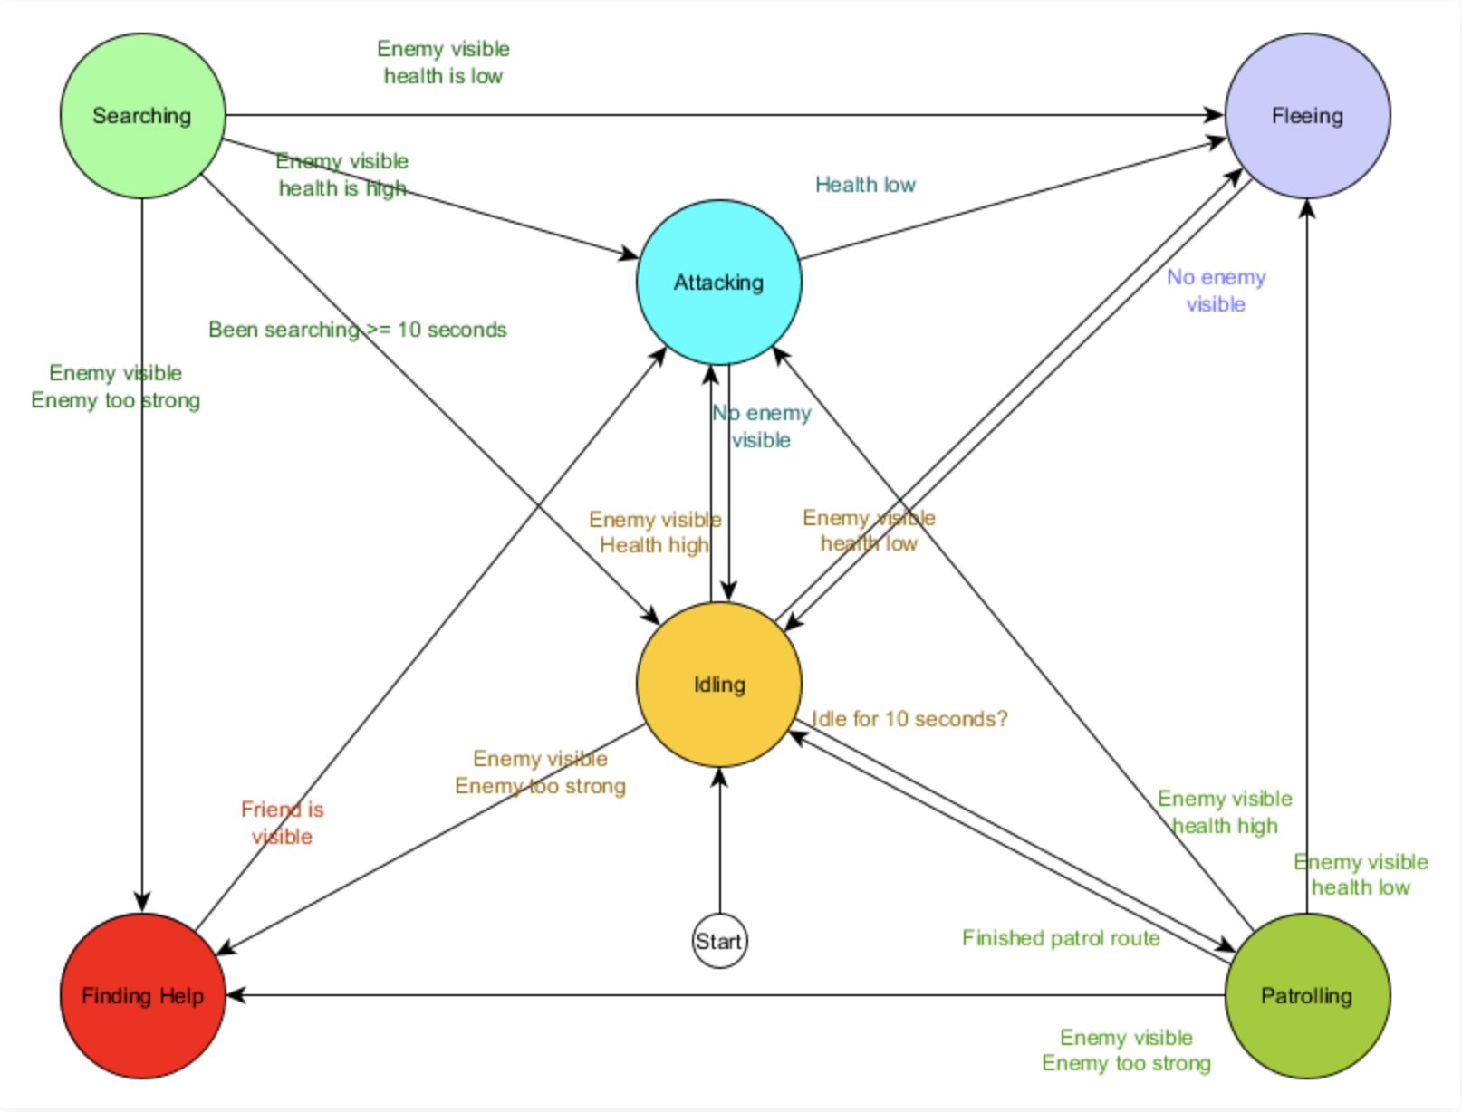
Finite State Machines
A finite state machine (FSM) defines a set of states for an entity and the conditions that cause the entity to change states
The FSM can be represented by a directed graph where the nodes are states and the edges are transitions between states
At every tick, we check whether we need to move to a different state given the state we are currently in and the transitions to other states that we have defined

Slide 46
Finite State Machine Example
This is an FSM for a patrolling guard AI
Note how a lot of logic is copied between the edges in the graph
To implement this FSM, we would have to do a lot of copy-and-pasting and hardcoding
Can we formulate a better approach that creates the same behavior?
Image from: https://www.gamedev.net/tutorials/programming/artificial-intelligence/the-total-beginners-guide-to-game-ai-r4942/

Slide 47
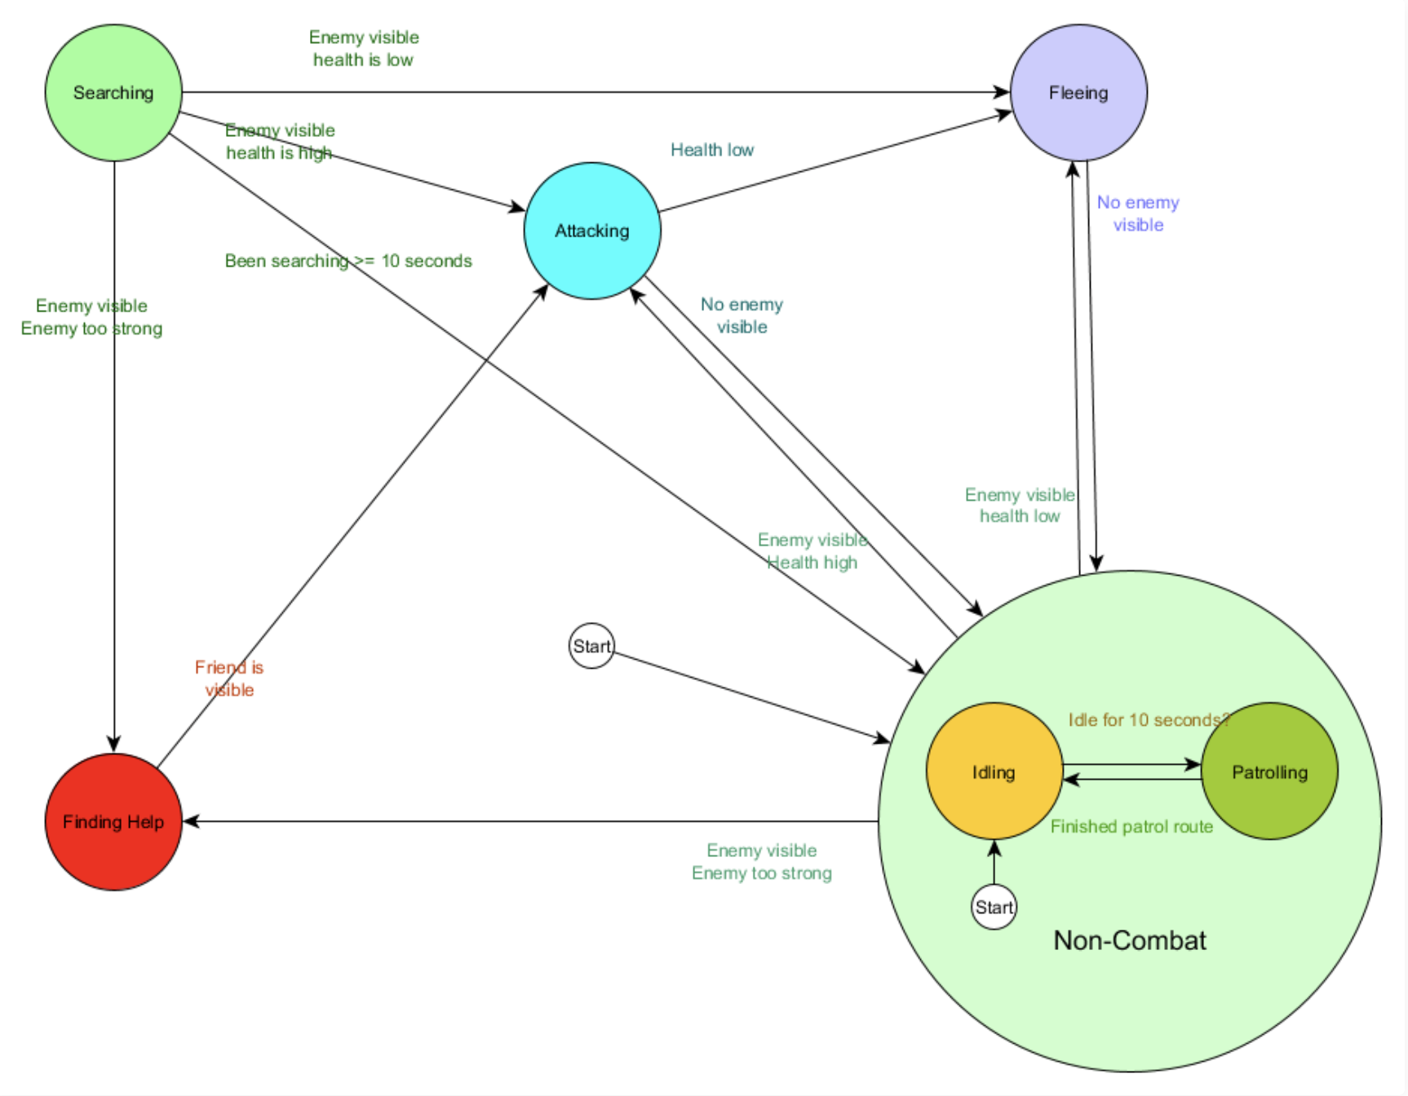
Hierarchical State Machines
A hierarchical state machine (HSM) defines a state hierarchy
States may have substates within them, (which also may have substates within them)
Transitions between states are defined between nodes in the hierarchy (non-combat) as well as leaf substates (attacking, idling)
It is easier to have an entity perform two behaviors at once if we use an HSM rather than a FSM

Slide 48
Hierarchical State Machine Example
The is an HSM describing the same functionality as the FSM for the patrolling guard
Notice how using an HSM simplifies the transitions in the graph
We still would have to define a lot of functionality game-side to make this work
Image from: https://www.gamedev.net/tutorials/programming/artificial-intelligence/the-total-beginners-guide-to-game-ai-r4942/

Slide 49
Class 6
Behavior Trees

Slide 50
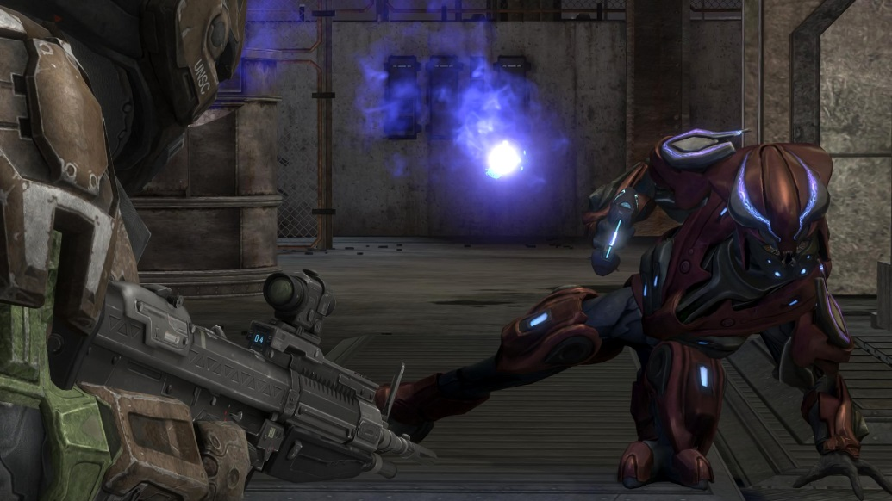
Behavior Trees
Popularized by Halo 2
Core functionality is engine-general!

Slide 51
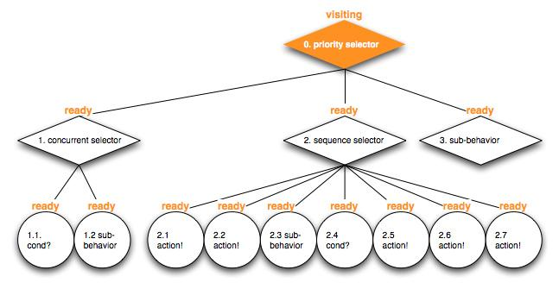
Structure
It’s a tree!
Every tick, the root node is updated
Each node returns a status when it’s updated
SUCCESS, FAIL, RUNNING
Nodes will update their children and return a status based on responses

Slide 52
The Leaves
Leaf nodes of the tree are Actions and Conditions
Actions do things
Make a unit move or attack
Return SUCCESS or FAIL based on result of Action
Return RUNNING if Action is still if progress
Conditions check some game state
Returns SUCCESS if the condition is true, or FAIL if the condition is false
Eat
Action
Sleep
Action
Party!
Action
Enemy near?
Condition
Is it daytime?
Condition

Slide 53
The Internal Nodes
Internal nodes are Composites and Wrappers/Decorators
Composites have multiple children nodes
Wrappers wrap a single child node and execute their child if they succeed
Composites and Wrappers dictate the traversal of the tree on an update
Wrapper
Composite
Condition
Node
Composite
Action

Slide 54
The Composites
Maintain a list of children nodes
Update by updating the children nodes (usually in a particular order)
Return RUNNING if a child returns RUNNING
Return SUCCESS/FAIL under other circumstances depending on the type of composite

Slide 55
The Selector
On update, updates each of its children in order until one of them *doesn’t* fail
Hence “select”, as this child has been “selected”
Returns FAIL only if all children fail
Kind of like an if else statement or block of or’s
If child 1 succeeds, else if child 2 succeeds, etc…
Friday night
Do 1971
Sleep
Party!
Notes:
Priority

Slide 56
The Sequence
On update, updates each of its children in order until one *does* fail
Returns SUCCESS if the entire sequence completes, else FAIL
If one behavior fails then the whole sequence fails, hence “sequence”
Similar to a bunch of and’s
Implement Wiz
Implement viewports
Implement the rest
Implement better viewports

Slide 57
Other Nodes
Wrappers contain a single child and modify its behavior. Examples include:
Invert child
Repeatedly update child X times until FAIL or SUCCESS
Random Selectors update its children in random order
For unpredictable behavior
Harder to debug though
Some engines define composites that allow for multiple tasks to be executed simultaneously

Slide 58
Behavior Tree Node
Just needs to be updated and reset
Sample contract:
enum Status { SUCCESS, FAIL, RUNNING };
class BTNode {
public: virtual Status update(float seconds) = 0;
virtual void reset() = 0;
}

Slide 59
Composites
Needs a list of children
Also should keep track of what child was running
Sample contract:
class Composite: public BTNode { std::vector<BTNode *> m_children;
BTNode *m_lastRunning;
}

Slide 60
Note about Composites
Sequences start updating from the previously RUNNING child
Previously running child should be left intact after returning, unless the entire sequence was completed
Goal is to complete the entire sequence – “I was in the middle of something and should continue where I left off”
Selectors should always update from the first child
Should reset the previously running child if a child before it starts RUNNING
Children have priority – “I should always go back to defend my base, even if I’m in the middle of an offensive sequence”

Slide 61
QUESTIONS?
Behavior Trees

Slide 62
Example
Root
Selector
Defend
Sequence
Offense
Sequence
Enemy Near?
Condition
Setup Defense
Action
Army Large Enough?
Condition
Go to enemy base
Action
Siege Base
Action

Slide 63
Example
Root
Selector
update
Defend
Sequence
Offense
Sequence
Enemy Near?
Condition
Setup Defense
Action
Army Large Enough?
Condition
Go to enemy base
Action
Siege Base
Action

Slide 64
Example
Root
Selector
update
Defend
Sequence
Offense
Sequence
update
Enemy Near?
Condition
Setup Defense
Action
Army Large Enough?
Condition
Go to enemy base
Action
Siege Base
Action

Slide 65
Example
Root
Selector
update
Defend
Sequence
Offense
Sequence
update
Enemy Near?
Condition
Setup Defense
Action
Army Large Enough?
Condition
Go to enemy base
Action
Siege Base
Action

Slide 66
Example
Root
Selector
update
Defend
Sequence
Offense
Sequence
update
Enemy Near?
Condition
Setup Defense
Action
Army Large Enough?
Condition
Go to enemy base
Action
Siege Base
Action

Slide 67
Example
Root
Selector
update
Defend
Sequence
Offense
Sequence
Enemy Near?
Condition
Setup Defense
Action
Army Large Enough?
Condition
Go to enemy base
Action
Siege Base
Action

Slide 68
Example
Root
Selector
update
Defend
Sequence
Offense
Sequence
update
Enemy Near?
Condition
Setup Defense
Action
Army Large Enough?
Condition
Go to enemy base
Action
Siege Base
Action

Slide 69
Example
Root
Selector
update
Defend
Sequence
Offense
Sequence
update
Enemy Near?
Condition
Setup Defense
Action
Army Large Enough?
Condition
Go to enemy base
Action
Siege Base
Action

Slide 70
Example
Root
Selector
update
Defend
Sequence
Offense
Sequence
update
Enemy Near?
Condition
Setup Defense
Action
Army Large Enough?
Condition
Go to enemy base
Action
Siege Base
Action

Slide 71
Example
Root
Selector
update
Defend
Sequence
Offense
Sequence
update
Enemy Near?
Condition
Setup Defense
Action
Army Large Enough?
Condition
Go to enemy base
Action
Siege Base
Action

Slide 72
Example
Root
Selector
update
Defend
Sequence
Offense
Sequence
update
Enemy Near?
Condition
Setup Defense
Action
Army Large Enough?
Condition
Go to enemy base
Action
Siege Base
Action

Slide 73
Example
Root
Selector
update
Defend
Sequence
Offense
Sequence
Enemy Near?
Condition
Setup Defense
Action
Army Large Enough?
Condition
Go to enemy base
Action
Siege Base
Action

Slide 74
Example
Root
Selector
Defend
Sequence
Offense
Sequence
Enemy Near?
Condition
Setup Defense
Action
Army Large Enough?
Condition
Go to enemy base
Action
Siege Base
Action

Slide 75
Example
Root
Selector
update
Defend
Sequence
Offense
Sequence
Enemy Near?
Condition
Setup Defense
Action
Army Large Enough?
Condition
Go to enemy base
Action
Siege Base
Action

Slide 76
Example
Root
Selector
update
Defend
Sequence
Offense
Sequence
update
Enemy Near?
Condition
Setup Defense
Action
Army Large Enough?
Condition
Go to enemy base
Action
Siege Base
Action

Slide 77
Example
Root
Selector
update
Defend
Sequence
Offense
Sequence
update
Enemy Near?
Condition
Setup Defense
Action
Army Large Enough?
Condition
Go to enemy base
Action
Siege Base
Action

Slide 78
Example
Root
Selector
update
Defend
Sequence
Offense
Sequence
update
Enemy Near?
Condition
Setup Defense
Action
Army Large Enough?
Condition
Go to enemy base
Action
Siege Base
Action

Slide 79
Example
Root
Selector
update
Defend
Sequence
Offense
Sequence
update
Enemy Near?
Condition
Setup Defense
Action
Army Large Enough?
Condition
Go to enemy base
Action
Siege Base
Action

Slide 80
Example
Root
Selector
update
Defend
Sequence
Offense
Sequence
update
Enemy Near?
Condition
Setup Defense
Action
Army Large Enough?
Condition
Go to enemy base
Action
Siege Base
Action

Slide 81
Example
Root
Selector
update
Defend
Sequence
Offense
Sequence
Enemy Near?
Condition
Setup Defense
Action
Army Large Enough?
Condition
Go to enemy base
Action
Siege Base
Action

Slide 82
Example
Root
Selector
update
Defend
Sequence
Offense
Sequence
Enemy Near?
Condition
Setup Defense
Action
Army Large Enough?
Condition
Go to enemy base
Action
Siege Base
Action

Slide 83
Example
Root
Selector
Defend
Sequence
Offense
Sequence
Enemy Near?
Condition
Setup Defense
Action
Army Large Enough?
Condition
Go to enemy base
Action
Siege Base
Action

Slide 84
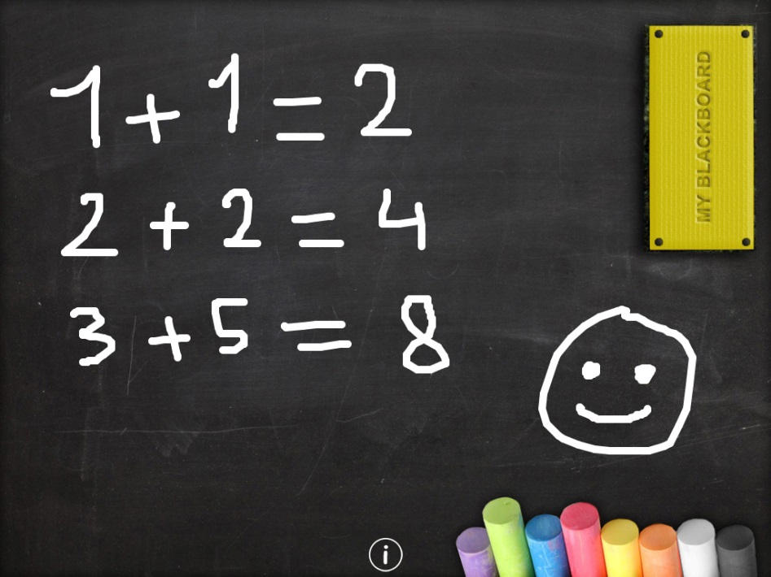
Data Persistence
Your behavior tree nodes might need to communicate somehow
Finding a target, going to the target are separate nodes
How to share data?
Blackboard: shared object that holds information, that nodes can write and read from
Minimally, a map<string, ???>
Certain groups of nodes can share different blackboards

Slide 85
In Summary
Interfaces/abstract classes for:
BTNode
Composite
Condition/Action
Full classes for:
Sequence
Selector
Other wrappers
Game-specific classes extending Condition/Action

Slide 86
Class 6
Goal-Oriented Action Planning (GOAP)

Slide 87
Issues with BTs
Behavior trees aren’t perfect
Lots of enemies
Too much work to code each
Minor tweaks change a lot of code
Procedurally generated enemies
Behavior trees usually aren’t expressive enough

Slide 88
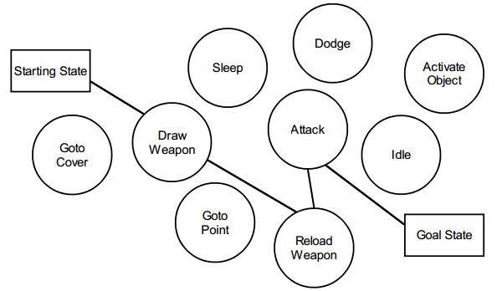
What is GOAP?
GOAP is a graph of game states
We can search over it
A*

Slide 89
The Nodes
Each node is a GameState
GameStates are probably a map of string tags to booleans or integers
The tags and their meaning are determined game-side
class GameState {
std::map<std::string, int> m_props;
}

Slide 90
The Edges
Each edge is an Action the AI can take
Each Action has a cost and a Condition
Actions also change the GameState
class Action {
public:
virtual void changeState(GameState &s) = 0;
private:
std::vector<Condition *> m_conditions;
float m_cost;
}

Slide 91
Planning
Goal
Generate a plan or “path” of actions
This plan should take you from start state to end state
Just use A* !

Slide 92
Planning contd.
Start at a state
Add neighboring states to priority queue
Go through all actions
All actions whose conditions are true from the current state are allowed
Generate a neighbor for each by applying the corresponding action to a copy of the game state
Pop lowest cost state from priority queue
Continue
Return “path” or list of actions that took you from start to end state

Slide 93
Actions
Just like behavior trees, GOAP has actions
Actions are much simpler in GOAP
Change one or more of the tags in the game state

Slide 94
Conditions
Just like behavior trees, GOAP has conditions
Conditions are also much simpler
Return true or false
Determined entirely by GameState

Slide 95
Conditions
class Condition {
public:
virtual bool is_met(GameState &s) = 0;
}

Slide 96
GOAP
The game defines a start state based on the current game world
The game also defines a goal (Condition)
Once the search is done, you need to map the list of actions to some real game effect
Usually only the first action is executed before GOAP is run again
The action might not be completed before a new plan is generated
E.g., following the player

Slide 97
QUESTIONS?
Goal Oriented Action Planning

Slide 98
Problems
Depending on the Actions available, GOAP can generate an infinite graph without any goal states
This can be handled by any of the following:
Allow each action to be used once/max # of times
Specify a maximum cost

Slide 99
Problems
With lots of actions and a distant goal, GOAP can be really slow
GOAP is best used to solve small problems

Slide 100
Problems
GOAP optimizes over a single parameter (time, cost, etc.)
GOAP is good for short, discrete problems:
Which combo should I use?
Which route should I take?
GOAP is bad for long-term, strategic problems:
How do I optimize my economy?
Which item will maximize my options next level?

Slide 101
Mix and Match
Behavior trees and GOAP don’t have to be mutually exclusive
Behavior tree can determine the strategy (setting up which actions are available, how much each is weighted, what the goal is, etc.)
GOAP can determine the plan to execute that strategy
Behavior tree turns that plan into concrete actions
e.g., sequence

Slide 102
Class 6
Good luck on Platformer 3!

