Slide 1
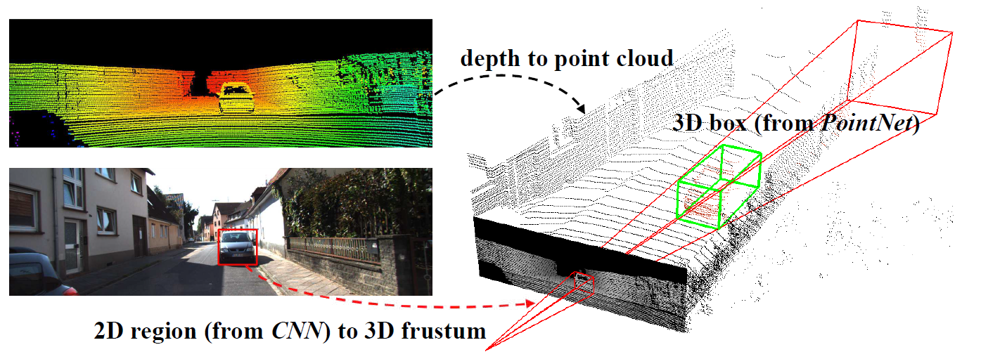

Qi et al. (2018)
Qi et al. (2017)

