Slide 1
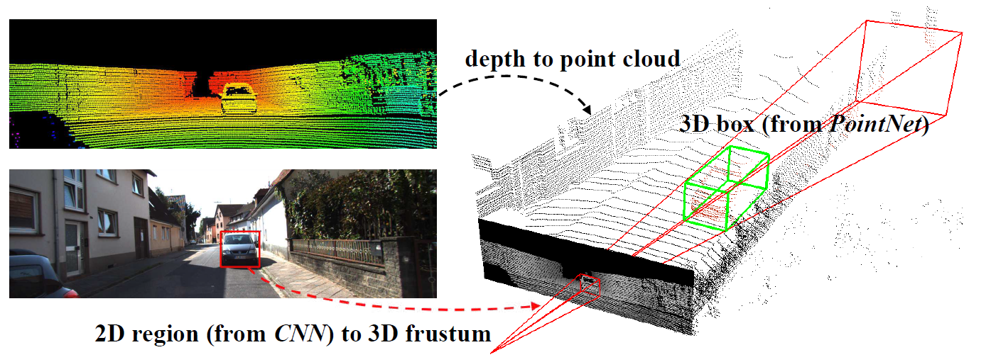
Qi et al. (2018)

