Slide 1

Mathematical Programming and Constrained Optimization in AI
Eric Ewing

Slide 2
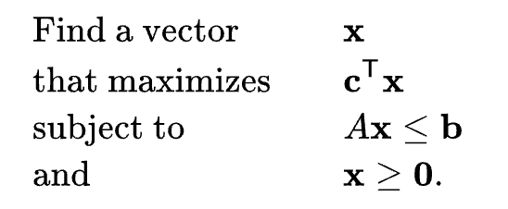
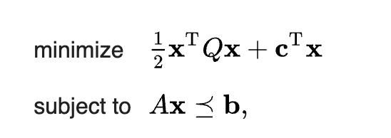
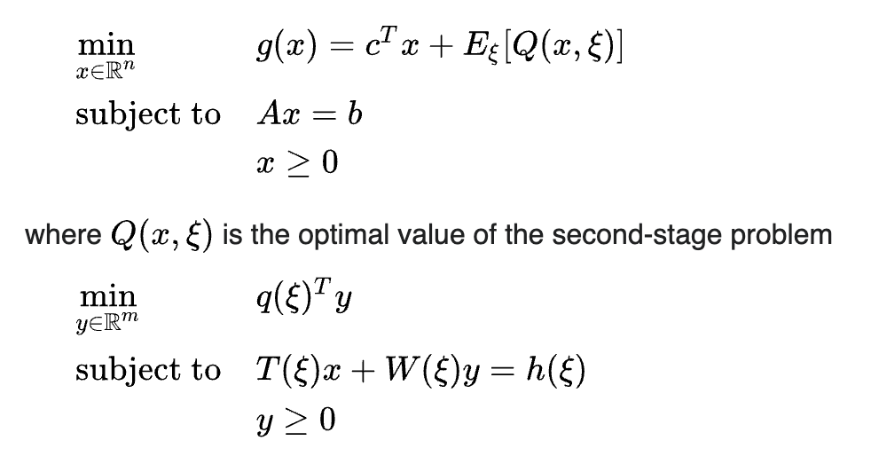
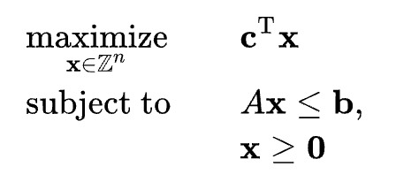
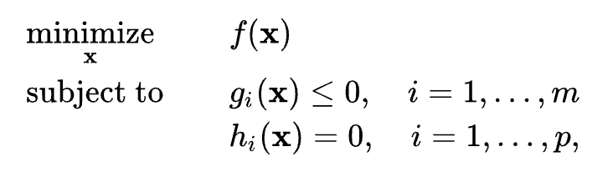
Mathematical Programming
Linear Program
Quadratic Program
Stochastic Program
Integer (Linear) Program
Convex Program
f, g are all convex functions and h is affine (linear)

Slide 3
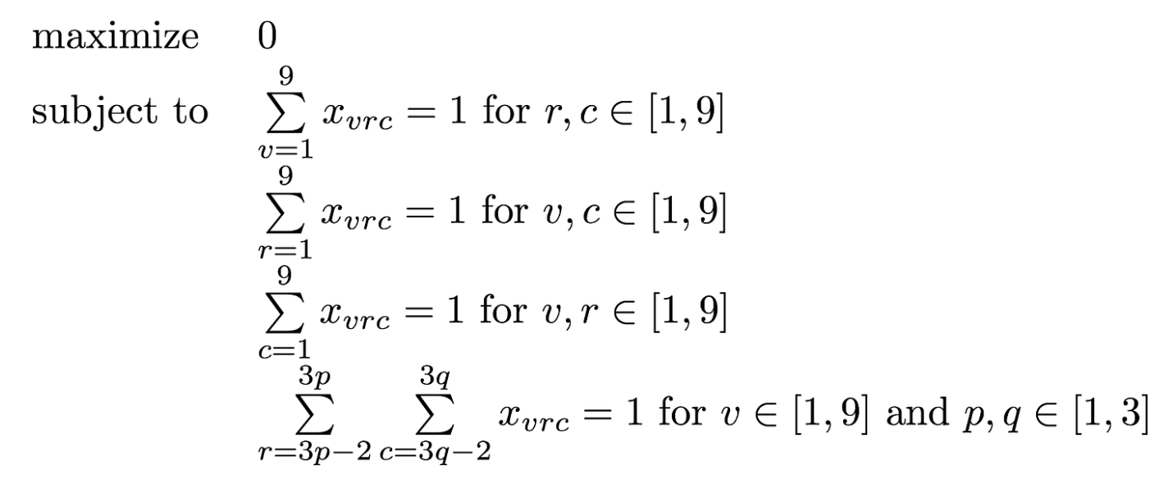

Sudoku ILP
$$x_{vrc}∈\{0,1\}$$
Variables in each cell add up to 1
Variables in each row add up to 1
Variables in each column add up to 1
Variables in each sub-grid add up to 1

Slide 4
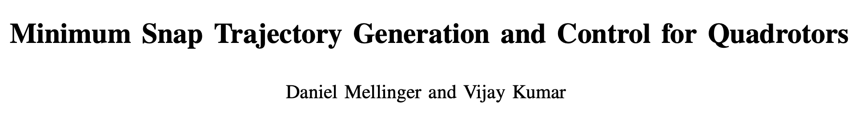
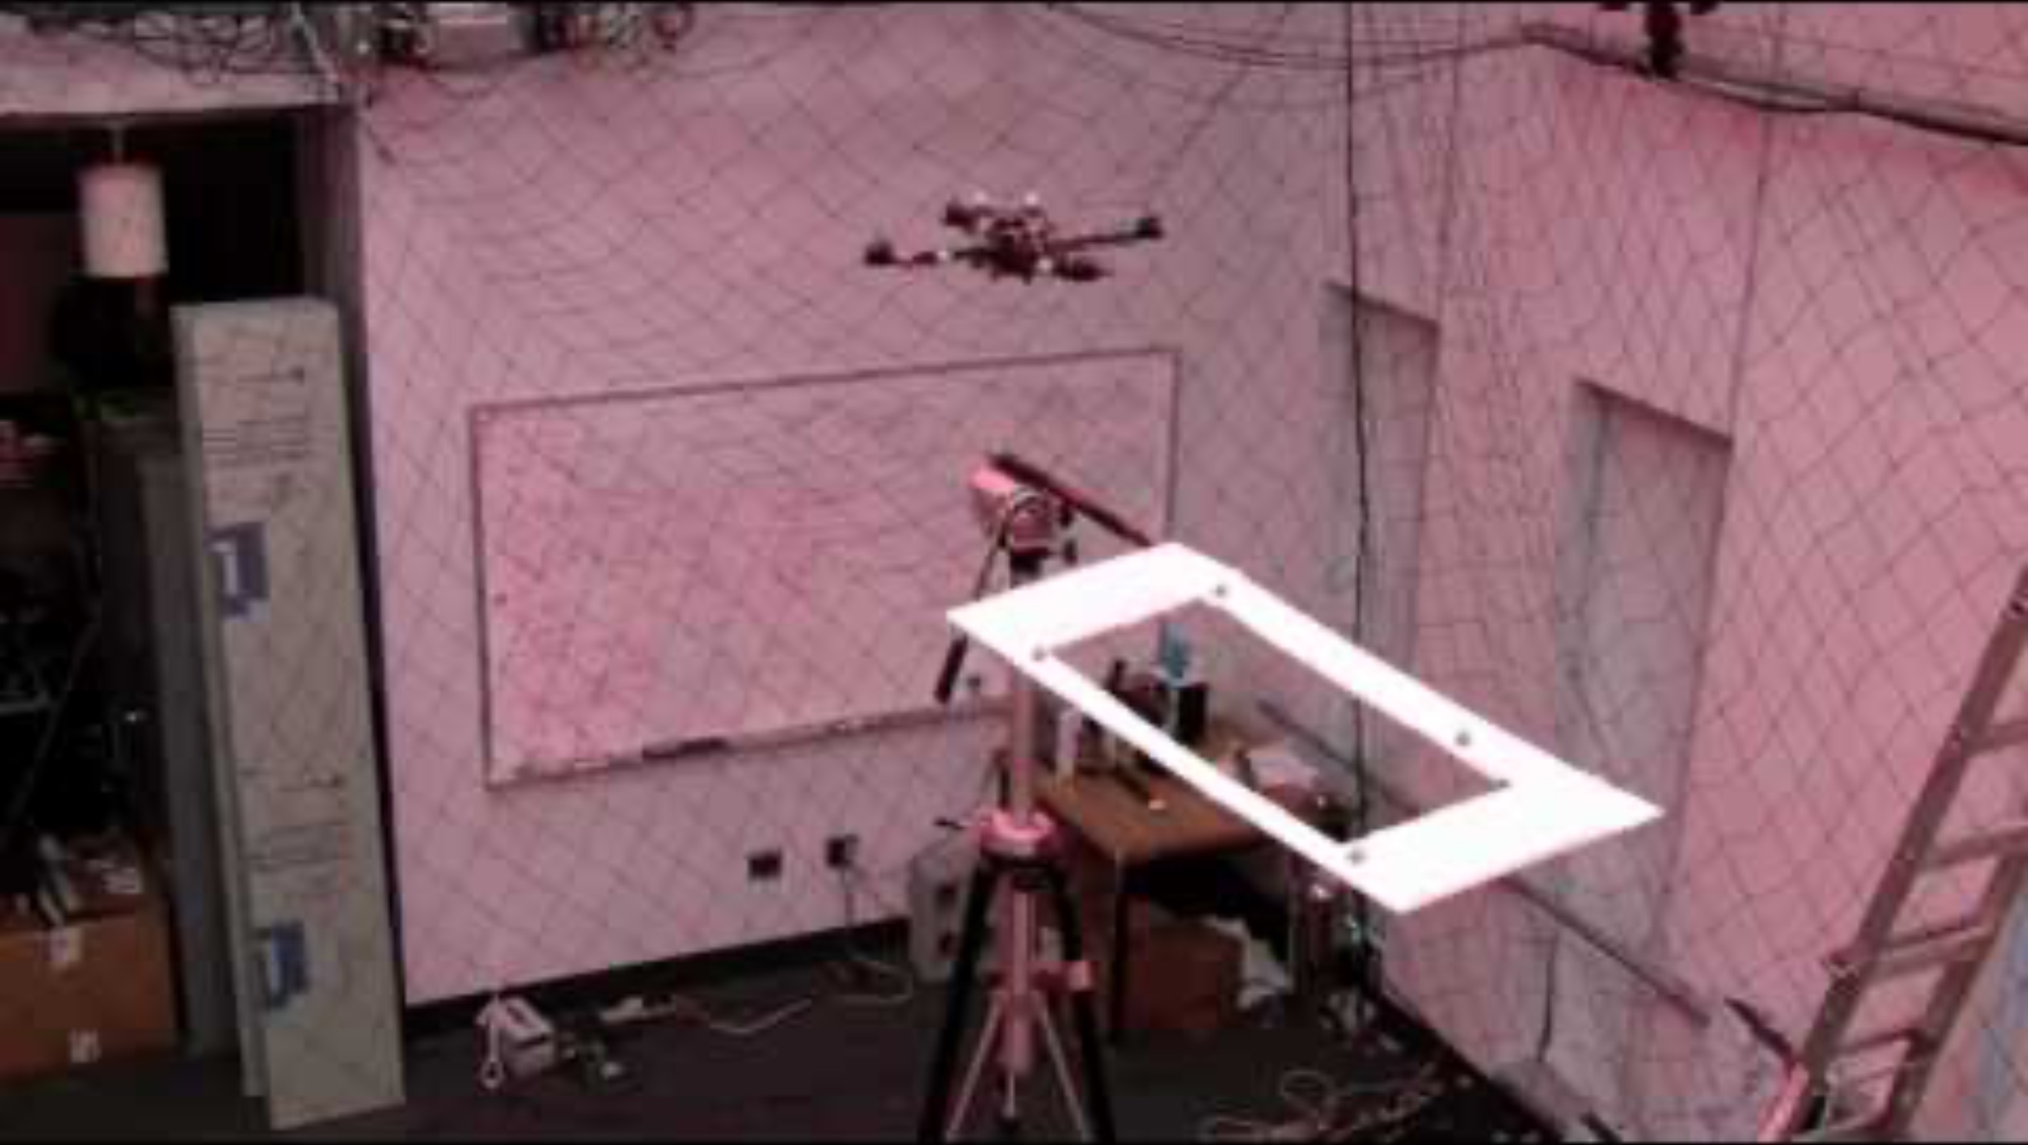
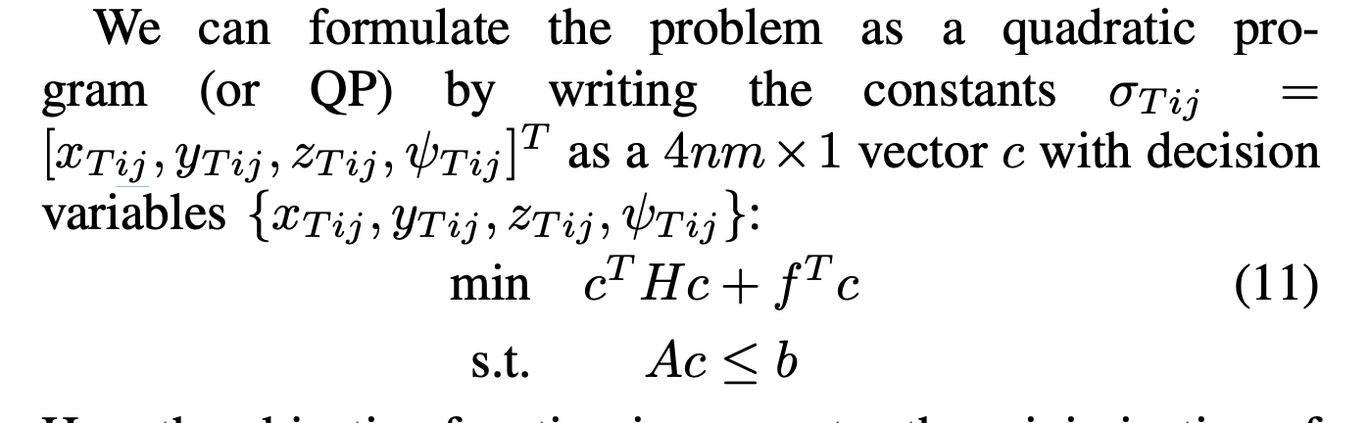

Slide 5
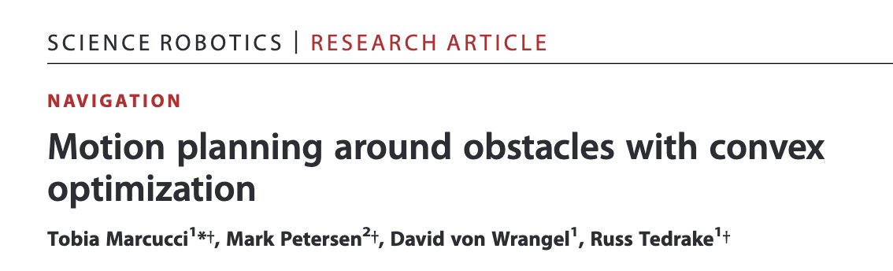
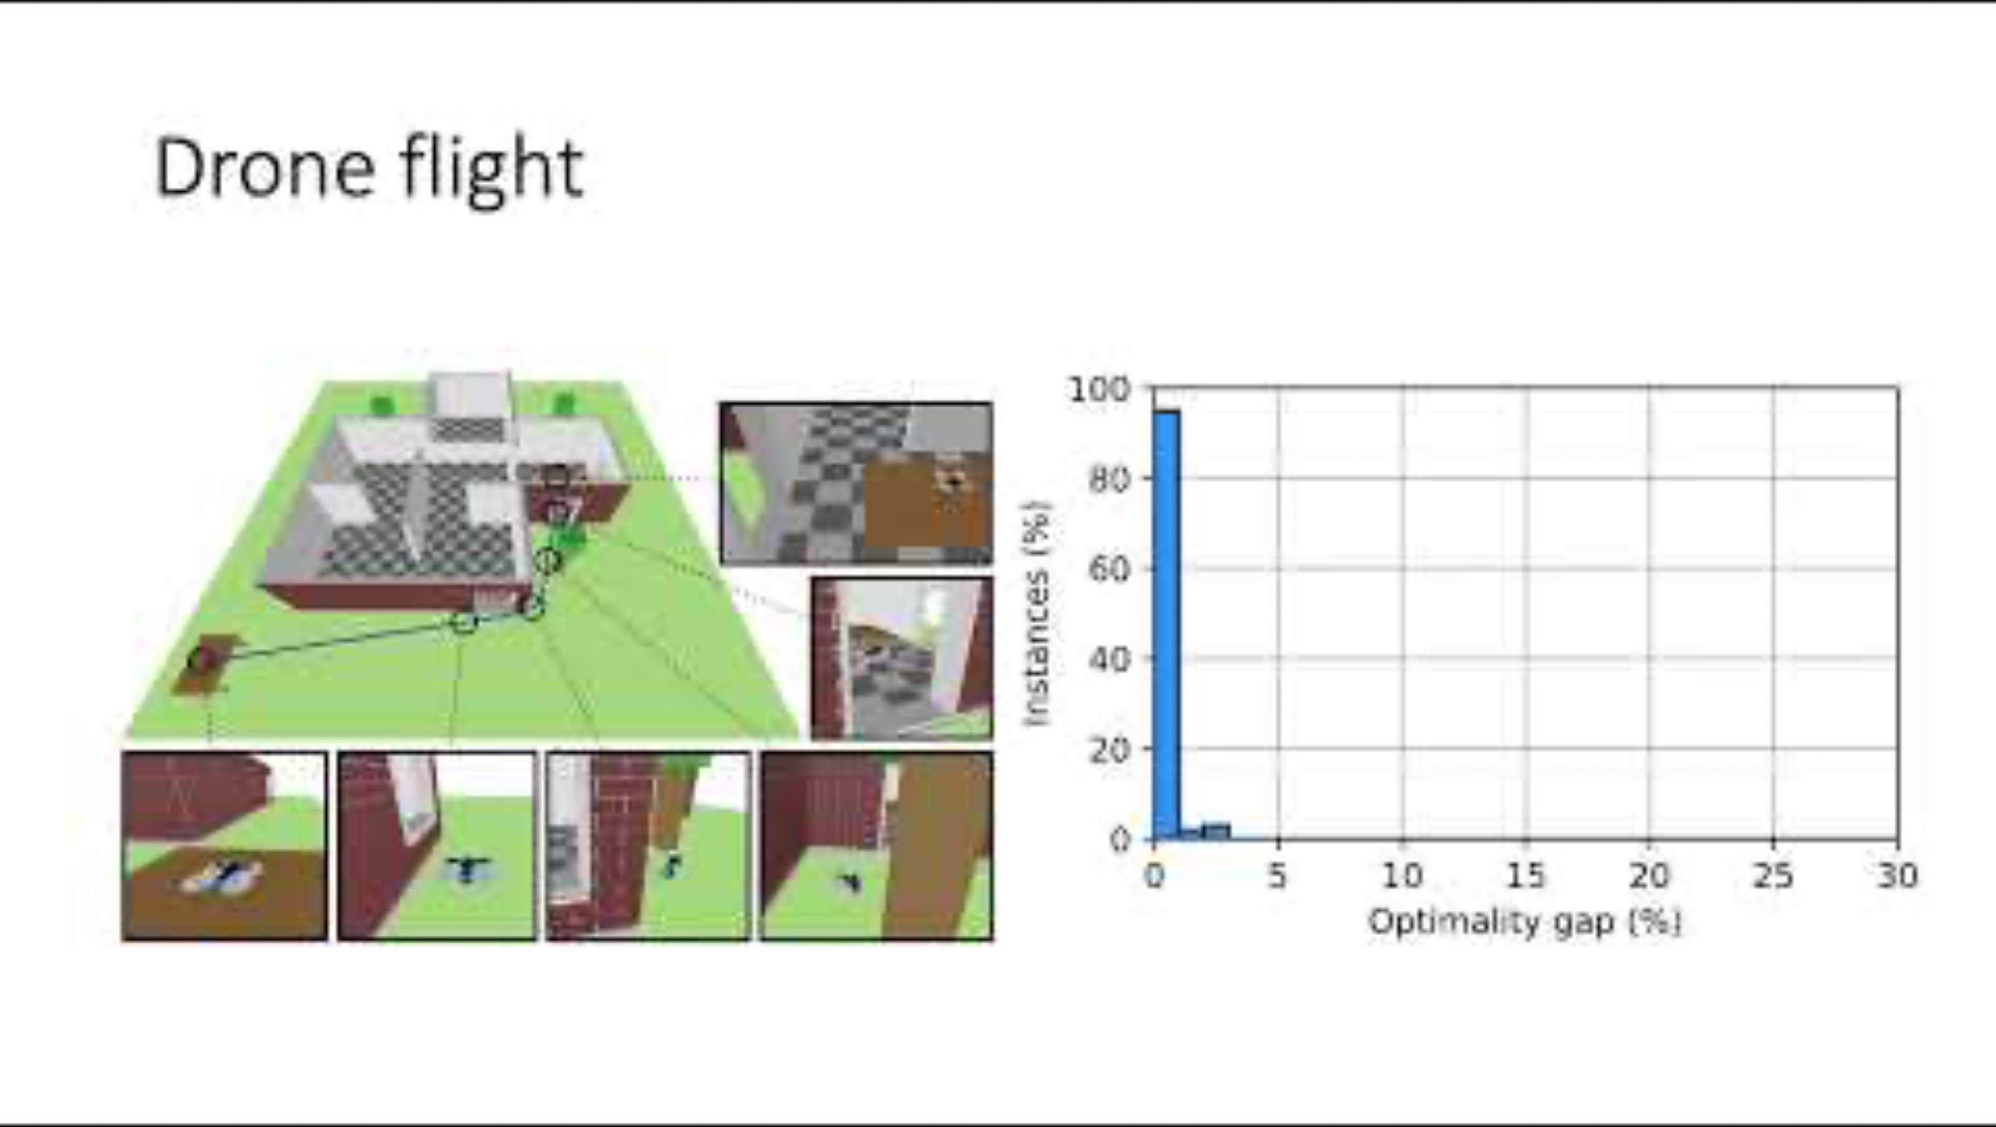
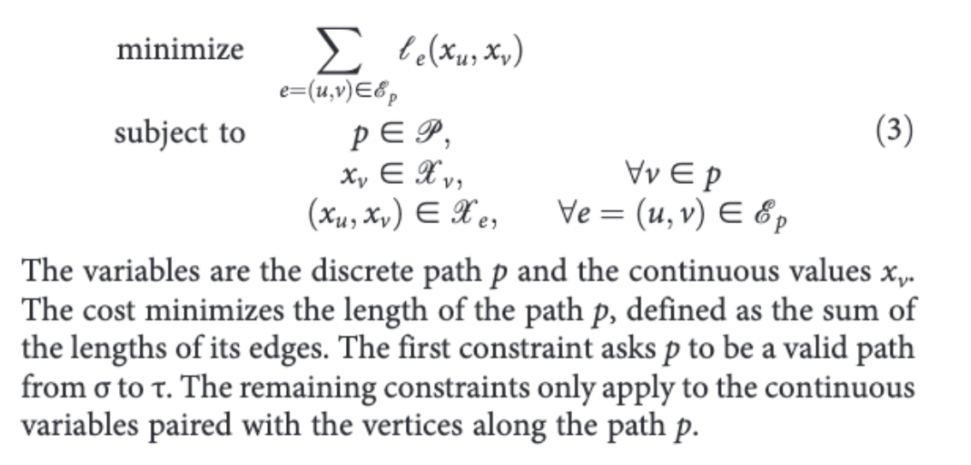

Slide 6
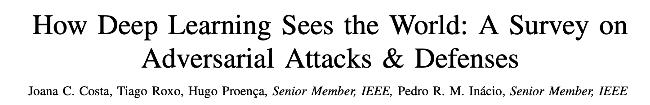
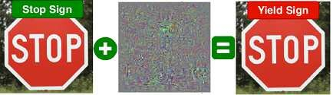
Adversarial Examples
Objective: Maximize Neural Network’s error by perturbing the input image
Constraint: That perturbation is small

Slide 7
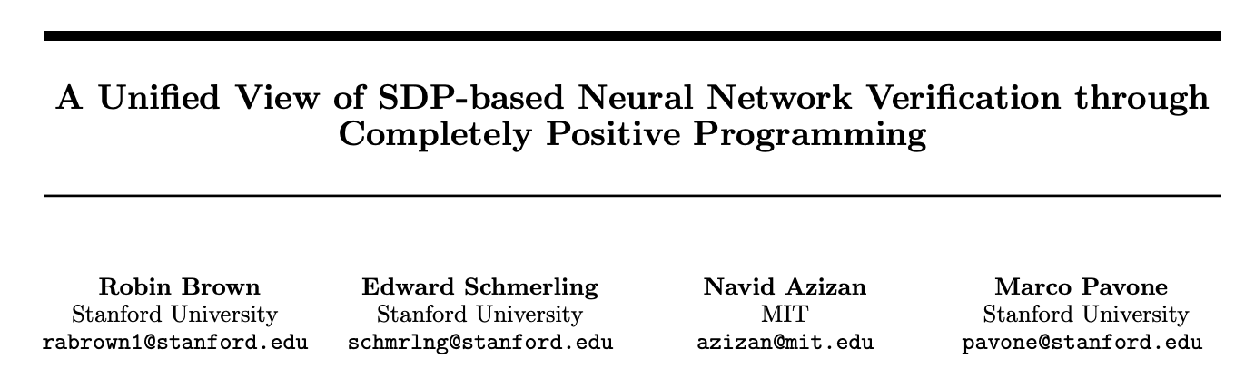
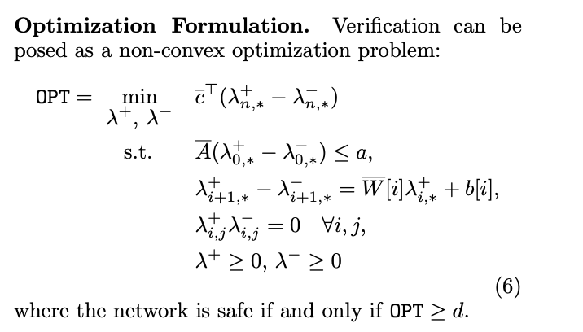
Neural Network Verification

Slide 9
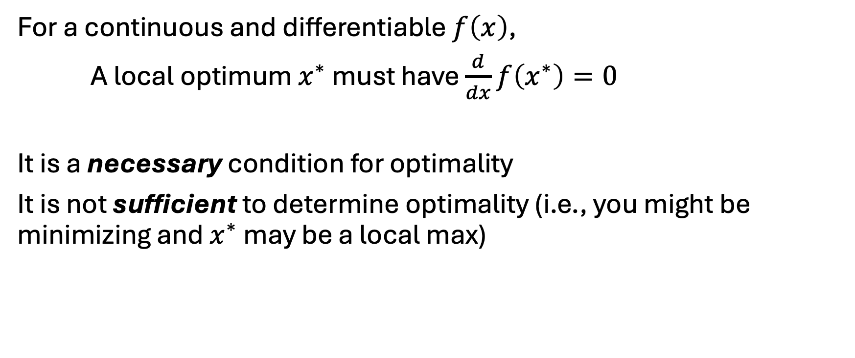
Conditions for Optimality
For a continuous and differentiable $f\left(x\right)$,
A local optimum $x^{∗}$ must have $\frac{d}{dx}f\left(x^{∗}\right)=0$
It is a necessary condition for optimality
It is not sufficient to determine optimality (i.e., you might be minimizing and $x^{∗}$ may be a local max)

Slide 10
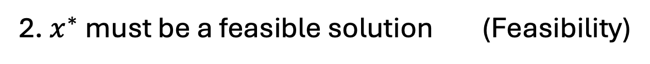
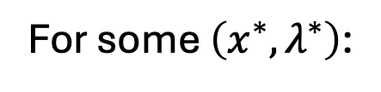
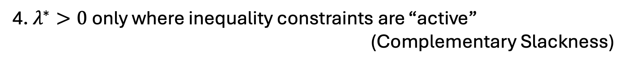
Conditions for Optimality (Constrained)
Karush-Kuhn-Tucker (KKT) Conditions
For some $\left(x^{∗},λ^{∗}\right)$:
1. $∇ℒ\left(x^{∗},λ^{∗}\right)=0$ (Stationarity)
2. $x^{∗}$ must be a feasible solution (Feasibility)
3. $λ^{∗}≥0$ (Dual Feasibility)
4. $λ^{∗}>0$ only where inequality constraints are “active”
(Complementary Slackness)

