Slide 1
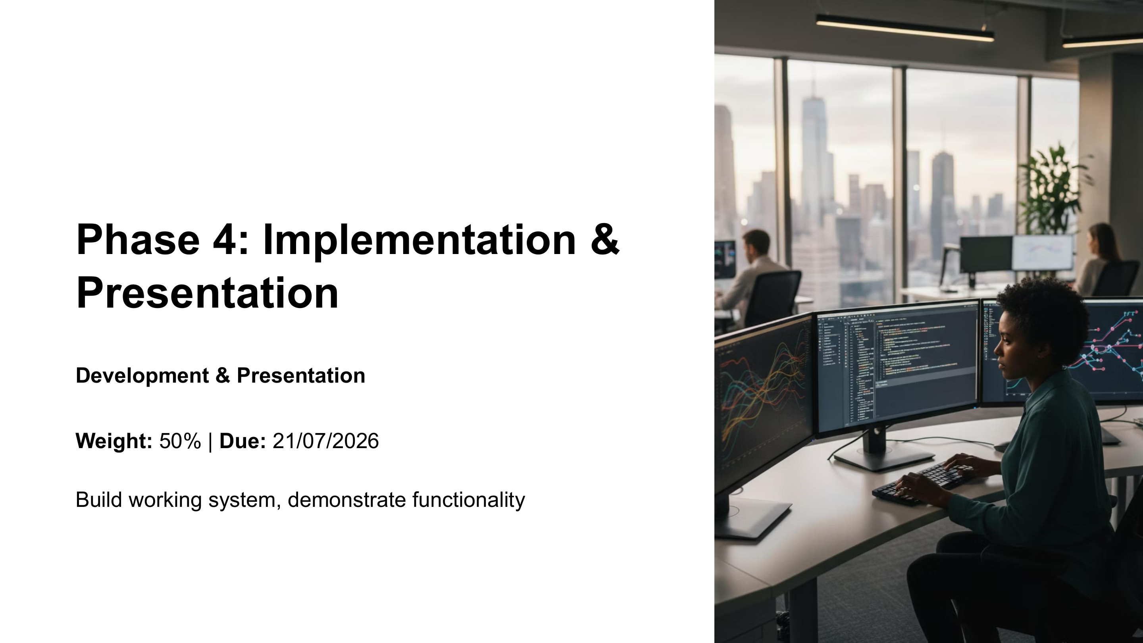
NPRT630 PROJECT
Final Project Phase 4
Implementation, Submission & Live Assessment Briefing
ICT 3rd Year • October 2026
Focus now: complete the working system, submit the established artefacts, and be ready to verify and explain what your group has built.
Phase 4 anchor slide from lecturer guidance
01

Slide 2
Official framing: what this briefing clarifies
The remaining work is a continuation of the established module structure.
1
2
3
4
Phase 1
Phase 2
Phase 3
Phase 4
Project Proposal
Requirements Specification
Design Specification
Implementation & Presentation
10%
20%
20%
50%
Course outcomes reinforced here
Phase 4 is not a new project. It is the implementation and presentation of the system developed through the earlier phases.
• structured software-development process
• problem decomposition and critical evaluation
• appropriate tools for real-world problems
• effective teamwork and technical communication
NPRT63 Project | Final Phase Briefing
02

Slide 3
Phase 4: Implementation & Presentation
The official Phase 4 focus is to build a working system and demonstrate functionality.
We are now completing the final phase of the year project.
The focus is to:
✓
Complete the working system
✓
Demonstrate its functionality
✓
Submit the required project artefacts
✓
Present and explain the completed solution
No new project scope or requirements are being introduced. Continue with the project requirements already established during the year.
Lecturer guidance: Phase 4 — Implementation & Presentation
NPRT63 Project | Final Phase Briefing
03

Slide 4
What Phase 4 already requires
These are the established Phase 4 expectations students should now complete.
01
Technology Stack
02
Code Quality
03
Demonstration
04
Final Report
• Java programming — prescribed
• Oracle or SQL database connectivity
• All features from Phases 2–3 implemented
• Clean, well-documented code
• Comprehensive testing performed
• Error handling implemented
• Pre-recorded presentation
• Feature walkthrough
• Technical
decisions explained
• Q&A with supervisor
• Consolidates all four phases
• Reflection on achievements
• Comprehensive documentation
NPRT63 Project | Final Phase Briefing
04

Slide 5
What does “implemented” mean?
A system should not only open — it should work as the designed system.
Your final system should demonstrate that:
Phase 4 is the implementation of the system you specified and designed in Phases 2 and 3.
✓
The application runs
✓
Database connectivity works
✓
Important functionality from Phases 2–3 is implemented
Requirements
Design
Implementation
Major workflows operate from beginning to end
Phase 2
Phase 3
Phase 4
✓
✓
Different parts of the system work together
✓
The completed system reflects the earlier analysis and design
The goal is not to redesign the project now; it is to complete and evidence the implementation of the agreed system.
NPRT63 Project | Final Phase Briefing
05

Slide 6
Code quality & system behaviour
The code and the running system both provide evidence of implementation quality.
Submitted code
System behaviour
✓
Understandable and reasonably organised
✓
Testing performed
✓
Appropriately documented
✓
Error handling implemented
✓
Not dominated by broken/abandoned code
✓
Invalid/unexpected input handled reasonably
✓
Reasonable separation of responsibilities
✓
Application can be reliably executed
✓
Readable naming and structure
✓
Functionality can be demonstrated live
Expectation: appropriate quality for a third-year undergraduate software project, not an industrial production system.
NPRT63 Project | Final Phase Briefing
06

Slide 7
Final report
The final report brings the four project phases together.
The report should:
The earlier phases are not being restarted or separately re-marked.
✓
Consolidate all four project phases
✓
Represent the final completed solution
However, the final implementation should reasonably correspond with the requirements and design developed during the earlier phases.
✓
Provide comprehensive project documentation
✓
Reflect on what the group achieved
The final report is the final consolidated record of the project and its implementation.
NPRT63 Project | Final Phase Briefing
07

Slide 8
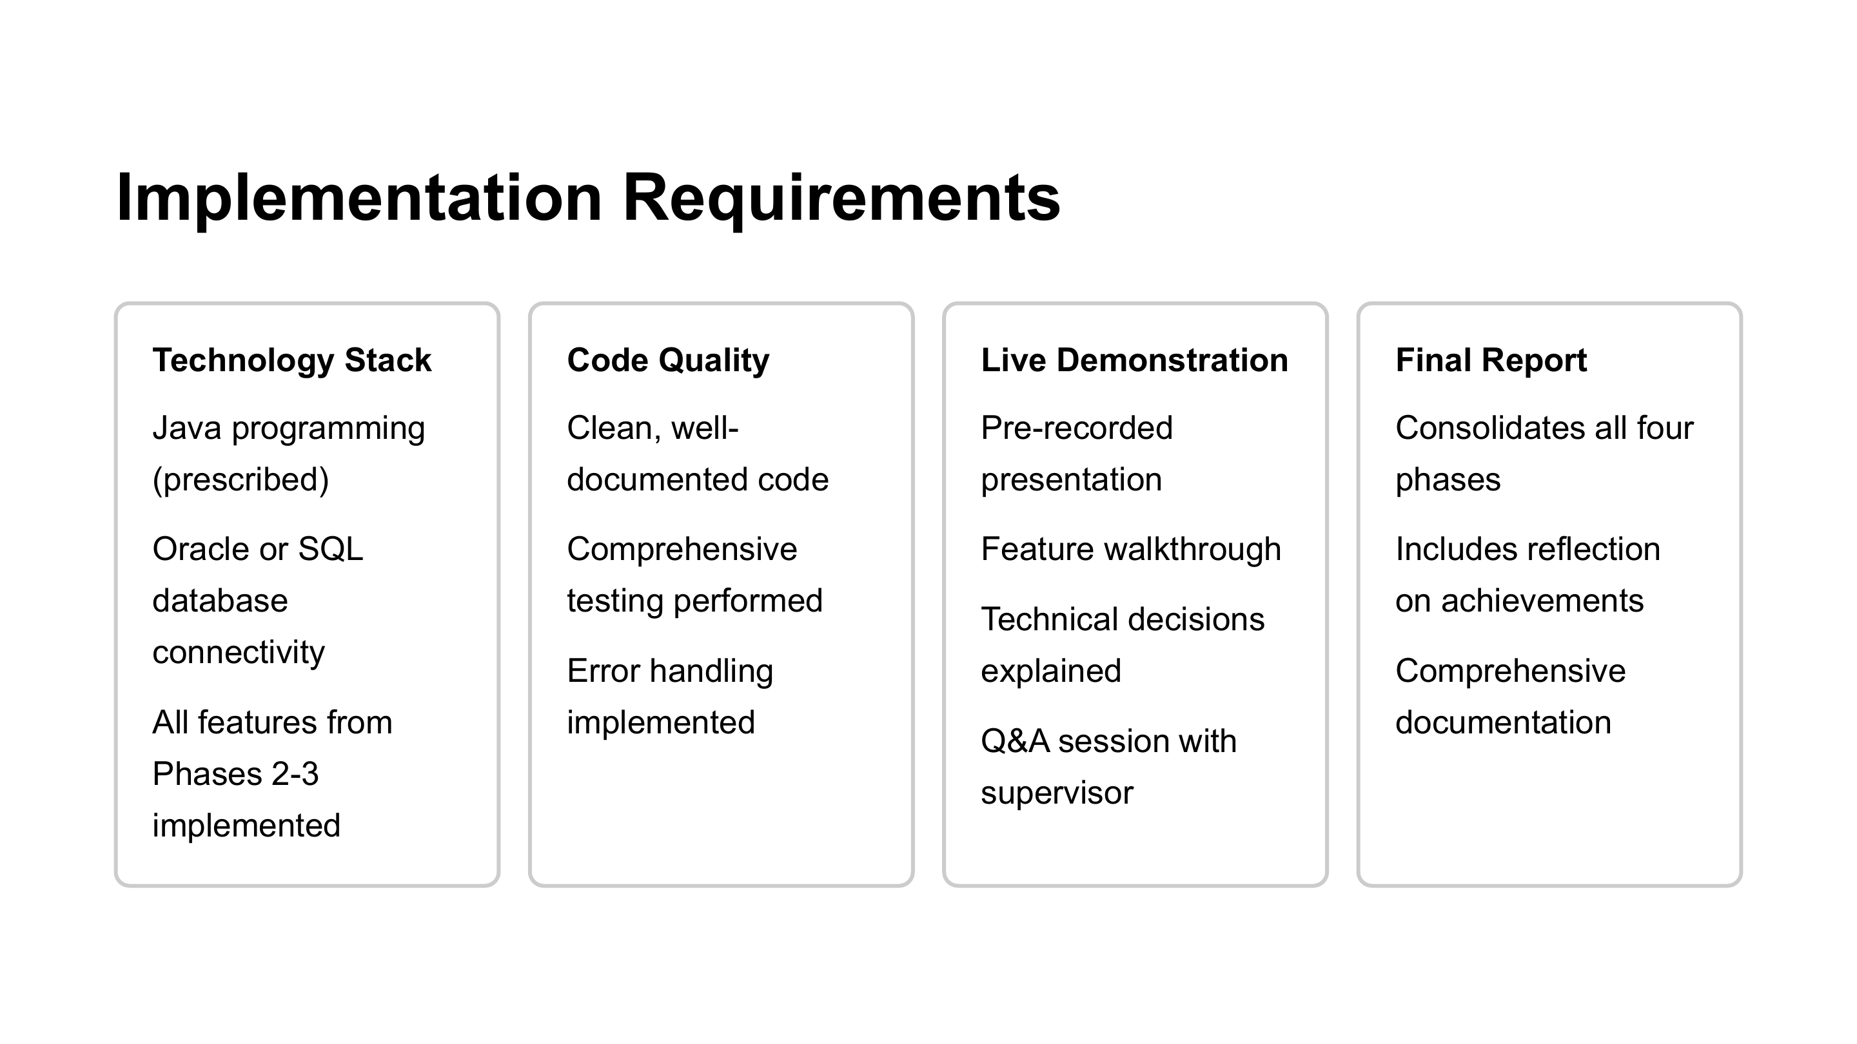
Pre-recorded presentation
The recording is the prepared presentation and structured project walkthrough.
Use the recording to:
You will not repeat the entire prepared presentation during the live session.
✓
Introduce the problem and solution
✓
Present the completed artefact
Walk through important functionality
The live session will be used to verify the system and engage technically with the group.
✓
✓
Explain important technical decisions
✓
Demonstrate what the group developed
Existing Phase 4 requirements include pre-recorded presentation, feature walkthrough, technical decisions, and Q&A.
NPRT63 Project | Final Phase Briefing
08

Slide 9
Final live assessment: 15 minutes per group
Because the presentation is recorded, the live slot focuses on verification and engagement.
≈ 5 MINUTES
≈ 10 MINUTES
Live system verification
Q&A and technical engagement
• Open and run the submitted system
• Demonstrate selected features
• Perform a requested workflow
• Create, retrieve or modify information
• Show database interaction or a particular system behaviour
• Implementation decisions
• How features work
• Database interaction
• Testing and error handling
• Integration between components
• Challenges and individual understanding
Objective: verify and understand the submitted implementation — not to watch the recording again.
NPRT63 Project | Final Phase Briefing
09

Slide 10
Group project, individual understanding
The project is submitted by a group, but learning and explanation cannot be outsourced to one member.
01
Understand the overall system
02
Explain your own contribution
03
Understand integration
• What problem does it solve?
• What are the major components?
• What are the main workflows?
• What did you work on?
• How does it work?
• What decisions were involved?
• How does your part connect?
• What data or services are involved?
• How does it fit the complete solution?
Questions may be directed to any member of the group. One person should not answer all technical questions for everyone.
You are not expected to know every line of code written by others, but you should understand the overall solution and your place within it.
NPRT63 Project | Final Phase Briefing
10

Slide 11
Evidence considered and existing grading language
The assessment evidence comes from the submitted artefacts, recorded presentation and live engagement.
Main evidence sources
Grading scale communicated
✓
Submitted source code
80–100
Exceeds rubric requirements; creativity
✓
Running system / demonstration
All rubric requirements fulfilled completely
70–79
✓
Demo folder and pre-recorded presentation
60–69
Most requirements fulfilled adequately
✓
Final report and documentation
50–59
Many requirements not fulfilled
✓
Git repository link where required
<50
Failed to follow rubric requirements
✓
Q&A and technical engagement
NPRT63 Project | Final Phase Briefing
11

Slide 12
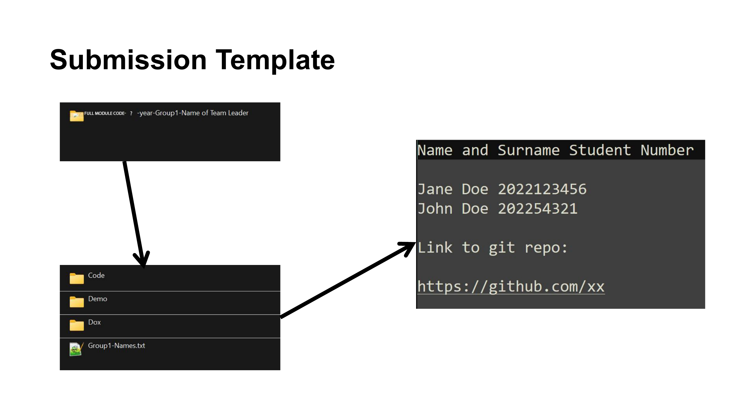
Final submission
Submit exactly according to the existing structure already communicated.
Final submission date
Monday, 12 October 2026
Use the existing submission structure:
FULL-MODULE-CODE-3rd-year-GroupX-TeamLeader
│
├── Code
├── Demo
├── Dox
└── GroupX-Names.txt
GroupX-Names.txt must include names, student numbers, and the Git repository link. Ensure all files and links are accessible.
Existing submission template
NPRT63 Project | Final Phase Briefing
12

Slide 13
Do you need a final consultation?
Every group will have the opportunity for one final 30-minute consultation.
Consider requesting one if:
The consultation is NOT for:
• important functionality is incomplete
• the application is not running reliably
• database or integration problems remain
• features specified earlier are not implemented
• testing or error-handling gaps are significant
• you are not confident that you can demonstrate the system
• you need clarification on final submission
• changing the project topic
• redesigning the entire project
• introducing substantial new requirements
• starting a different implementation
Purpose: help you complete the established Phase 4 requirements, not introduce new project requirements.
NPRT63 Project | Final Phase Briefing
13

Slide 14
Consultation arrangements
First indicate what your group needs; then the timetable will be constructed from actual demand.
Step 1: Tell me what your group needs
✓
Do you require a final consultation? Yes / No
•
✓
Preferred format: face-to-face / online / either
The consultation timetable will be constructed after the actual demand is known.
✓
Normal working-hours availability
✓
Online availability after 17:00
✓
Saturday availability if necessary
✓
Which alternatives are acceptable
NPRT63 Project | Final Phase Briefing
14

Slide 15
Final programme
The remaining period separates consultation, submission, preparation and live assessment.
2–4 Oct
Consultation preferences and scheduling
Final priority: complete the system you already designed, make sure it works, understand what your group built, submit it correctly, and be ready to demonstrate and explain it.
5–10 Oct
Final consultation period
12 Oct
FINAL PROJECT SUBMISSION
13 Oct
Presentation preparation / assessment buffer
Presentation slots will be released separately for groups to select.
14–16 Oct
FINAL LIVE ASSESSMENT SESSIONS
Live session format: 15 minutes per group — verification + Q&A, not a repeat of the recording.
19 Oct
Examinations begin
NPRT63 Project | Final Phase Briefing
15

