Slide 1
Home Insurance

Slide 2
Agenda
Background
Data exploration and key features
Modelling and business value
What drives lapses
Conclusions and extra knowledge
Questions

Slide 3
Background
28 % of policies lapse, which leads to a big revenue loss
With policy data, can it be predicted more accurately which policies will lapse and why?
Can this information be used to drive business decisions going forwards to focus on customer retention

Slide 4
Data Exploration
What are the key variables and how do they drive policy lapse?
Can we add new variables to deepen understanding?
Is there redundant data?

Slide 5
Data Exploration
Is there redundant data?
What are the key variables and how do they drive policy lapse?
Can we add new variables to deepen understanding?

Slide 6
Data Exploration
What are the key variables and how do they drive policy lapse?
Can we add new variables to deepen understanding?
Is there redundant data?

Slide 7
Data Exploration – Redundant data
Removed rows around Policy lapse which were NULL or Unknown
Removed redundant columns with high % NULL values
Removed columns with only one answer

Slide 8
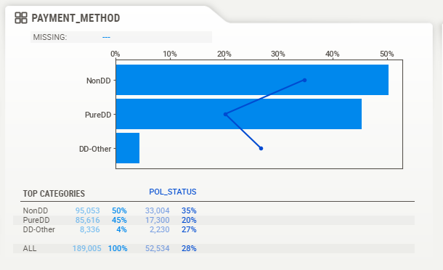
Data Exploration – Payment Type

Slide 9
Data Exploration – Feature Engineering
Date column feature engineering
Combination of pre/post renewal questions
Re-coding columns

Slide 10
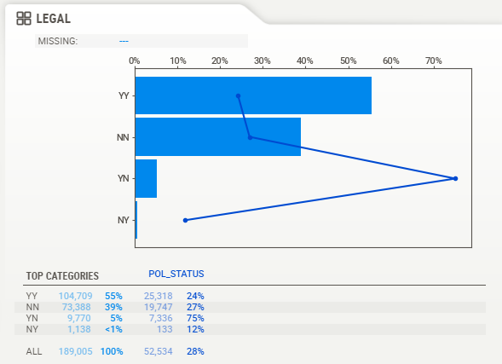
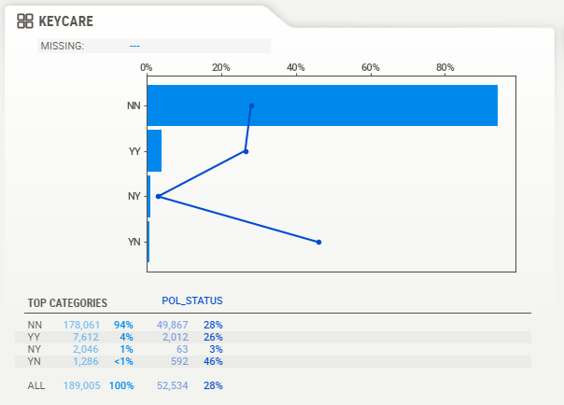
Data Exploration – Post renewal removal
Lapses increase when addons are removed after 1st renewal
Legal addon
Keycare addon

Slide 11
Modelling – XGB choice
Since it was a binary classification problem, it lent itself to one of the standard classification algorithms
The dataset itself is fairly large and logistic regression performed poorly, F1 scores of 0.60 and 0.63 when passed through PCA
This led to a tree implementation being preferred due to their robustness to outliers and no need for the data to be standardised
XGB was chosen over random forest due to it’s harsher regularisation capabilities which would allow it to remove unnecessary features

Slide 12
Modelling – Process
Final implementation used an XGB algorithm to predict policy lapse
This uses a "binary:logistic“ objective function
The process followed a stratified, three-fold cross validated approach to tune the hyper-parameters
These were then used to build the final prediction model which was then run against a test dataset
Model performance verification was undertaken using a confusion matrix

Slide 13
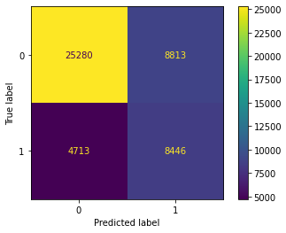
Modelling - Results
Without a model would select a lapsed policy 28%
F1 score of 0.724
Recall of 0.642
Precision of 0.489
52% of people need to be reached

Slide 14
Modelling – What drives lapses
Removal/addition of benefits as defined by YN options
Payment method not being pure direct debit
As risk rating increases so does its driver for lapsing
Additional Buildings cover being yes

Slide 15
Modelling – What drives lapses
Could be removing options due to financial struggles and is then a precursor to lapsing
Can we offer incentives to setup direct debit payments
Should we assess how competitive our pricing is for higher risk ratings
Should we offer more options for additional buildings cover other than 0 or 1 million

Slide 16
Extra knowledge
Policy reinstatement and whether this could help reduce lapsing
There were scenarios which looked anomalous, such as negative premiums, more domain knowledge of the dataset would have been helpful to know if they were actually anomalous or expected
Lapse date and policy change information

Slide 17
Questions?

