Slide 1



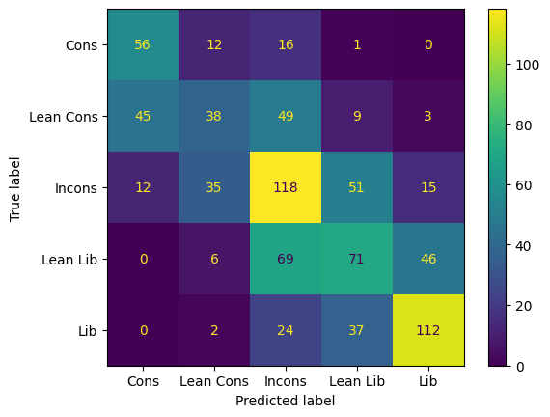
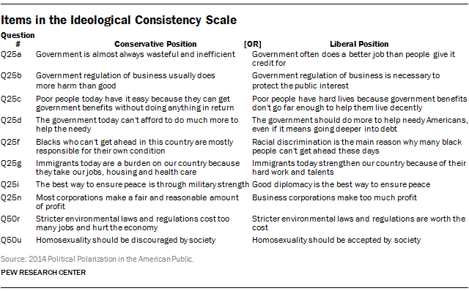

Media and Political Polarization: Ideological Classification
Jacob Dahlkvist, Alex Zhang, Patrick Wang
jad7543@utexas.edu, alex.zhang@utexas.edu, patrick.lee.wang@utexas.edu
Abstract
Feature Selection and Process
Results
We propose an algorithm to predict ideological leanings across a conservative-liberal spectrum based on the trust or distrust of subset of media outlets to identify political polarization. Our model utilizes one hot encoding and logistic regression to classify survey participants into five distinct groups. We also identify which features most heavily correlate with different viewpoints.
The goal of our model is to be not only accurate at classifying survey respondents into categories, but also be explainable. Therefore, we used heuristics based off of the observations identified by Pew Research Center.
Using the observation that consistent liberals “have less media loyalty” and “express more trust” than consistent conservatives [1], we selected survey features that most represented these traits. Specifically, we encoded the survey answers regarding trust and distrust of a variety of news sources with the belief that these features would capture the relationships identified by the researchers.
Using one-hot encoding, we binarized the categorical features and performed multiple logistic regression on the data, classifying each participant into five categories: Consistent conservative, lean conservative, inconsistent, lean liberal, and consistent liberal.
Hypothesis
We hypothesize that certain patterns in media usage based on a person’s trusts and distrusts of a media source correlates with their political views. If we are able to separate people into different ideological camps and accurately predict future respondents, then we have evidence for political polarization, as no difference in media trust/distrust across ideological groups indicates no polarization
Methods
Figure 2: The confusion matrix corresponding to the test set. The model performs well at predicting consistent conservatives and liberals, but falls short in identifying inconsistent survey respondents. This changes depending on the class weight.
Dataset: Our dataset is taken from the American Trends Panel Wave 1 Dataset from Pew Research Center, conducted in Spring of 2014. The data consists of 3308 surveys each with 379 selections, which we further reduced to 73 questions relating to news and media consumption. Our category of interest is the political ideology of the respondent: five labels ranging from consistent conservative to consistent liberal. [1]
One-hot encoding: One-hot encoding is a technique used to convert categorical data values into binary values (1 or 0) in order to prepare the data for machine learning algorithms and improve prediction accuracy. For instance, in a dataset with values of "conservative" and "liberal," one-hot encoding would convert these categories into binary vectors. This process involves assigning a unique integer value to each category (such as 1 and 2 for "conservative" and "liberal," respectively) and then converting the integer variable into a binary column. [2]
Multinomial Logistic Regression: Logistic regression is a statistical model used to classify data. It estimates the probability of an event happening based on a dataset and predicts a probability between 0 and 1. To achieve this, a logit transformation is applied to the odds. The optimal beta parameter is determined using maximum likelihood estimation to fit the log odds. This coefficient is then used to calculate the conditional probabilities for each observation, resulting in a predicted probability. [3] Multinomial logistic regression is an extension to the standard logistic regression, where the difference is that multinomial will predict multiple classes rather than just two output classes. [4]
 | Precision | Recall | F1-score | Support
Consistent Cons | 0.50 | 0.66 | 0.57 | 85
Lean Cons | 0.41 | 0.26 | 0.32 | 144
Inconsistent | 0.43 | 0.51 | 0.47 | 231
Lean Lib | 0.42 | 0.37 | 0.39 | 192
Consistent Lib | 0.64 | 0.64 | 0.64 | 175
Accuracy |  |  | 0.48 | 827
Macro avg | 0.48 | 0.49 | 0.48 | 827
Weighted avg | 0.47 | 0.48 | 0.47 | 827
Figure 3: The classification report corresponding to the test set. The report shows a higher precision and recall for the 2 consistent classes despite having lower support. This demonstrates a success in terms of classifying positive/negative cases, and we can use a centered class weighting to achieve better performance for inconsistent cases.
Figure 1: Each survey respondent is classified on the ideological consistency scale, placing each respondent corresponding to the number of conservative or liberal answers selected: difference 2 or less = Inconsistent, 3-6 = Lean, 7-10 = Consistent
Insights and Next Steps
Important Features
Overall, our model was successfully able to classify survey participants into ideological groups. Many of the important coefficients correspond heavily to media outlets on either end of the ideological spectrum. Thus it is reasonable to expect that either expressing trust or distrust in these outlets be a strong indicator of ideological leanings.
Our next step is to use older survey data and determine if the same trend holds. If our model fails hold for older data, this implies that the correlation between media and ideological viewpoints is a new development in the political landscape.
Our model identified several features that were important in classifying ideological leanings for each respondant:
Coefficient Importance | Consistent Cons | Lean Cons | Inconsistent | Lean Liberal | Consistent Liberal
1st | Not Distrust Fox News | Distrusted The Blaze | Not Distrusted The New Yorker | Not Trusted Breitbart | Not Distrusted ThinkProgress.org
2nd | Distrusted Mother Jones | Distrusted Daily Kos | Not Distrusted Breitbart | Distrusted Fox News | Distrusted Rush Limbaugh
3rd | Distrust MSNBC | Distrusted Ed Schultz | Not Distrusted ThinkProgress.org | Distrusted The Economist | Refused Answer Ed Schultz
4th | Refused Answer Rush LImbaugh | Proportion Distrust | Distrusted Google News | Not Trusted Fox News Cable Channel | Trusted Ed Schultz
5th | Trusted Rush Limbaugh | Distrusted ThinkProgress.org | Proportion Trust | Proportion Distrust | Distrusted Fox News
References:
[1]Mitchell, A., Gottfried, J., Kiley, J. and Matsa, K.E. (2014). Political Polarization & Media Habits. [online] Pew Research Center’s Journalism Project. Available at: https://www.pewresearch.org/journalism/2014/10/21/political-polarization-media-habits/.
‌
[2]Fawcett, A. (2021, February 11). Data Science in 5 Minutes: What is One Hot Encoding? Educative: Interactive Courses for Software Developers. https://www.educative.io/blog/one-hot-encoding
‌[3]IBM (2022). What is Logistic regression? | IBM. [online] www.ibm.com. Available at: https://www.ibm.com/topics/logistic-regression.
[4]Team, G.L. (2021). Multinomial Logistic Regression - Great Learning. [online] GreatLearning Blog: Free Resources what Matters to shape your Career! Available at: https://www.mygreatlearning.com/blog/multinomial-logistic-regression/.
‌
‌

