Slide 1




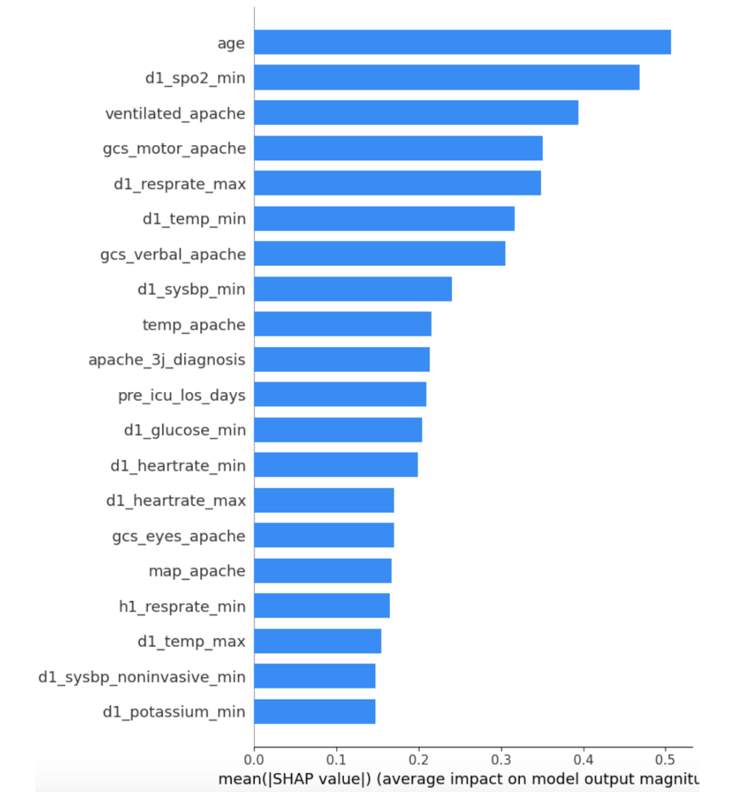
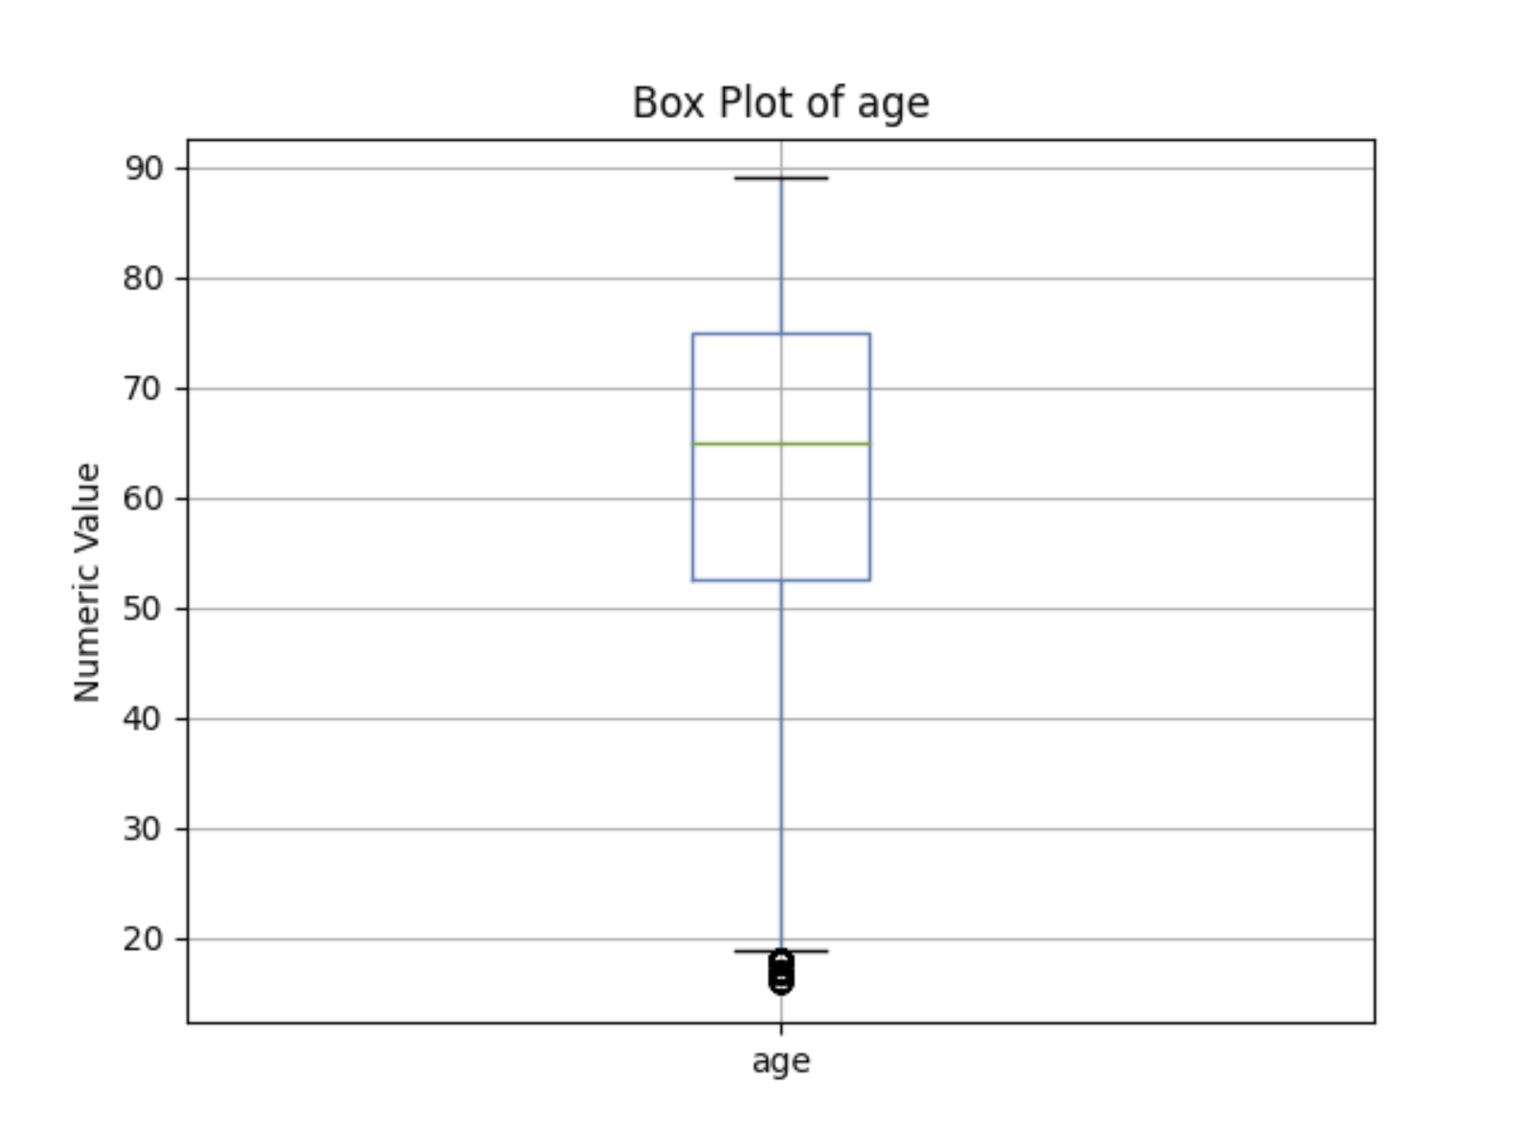
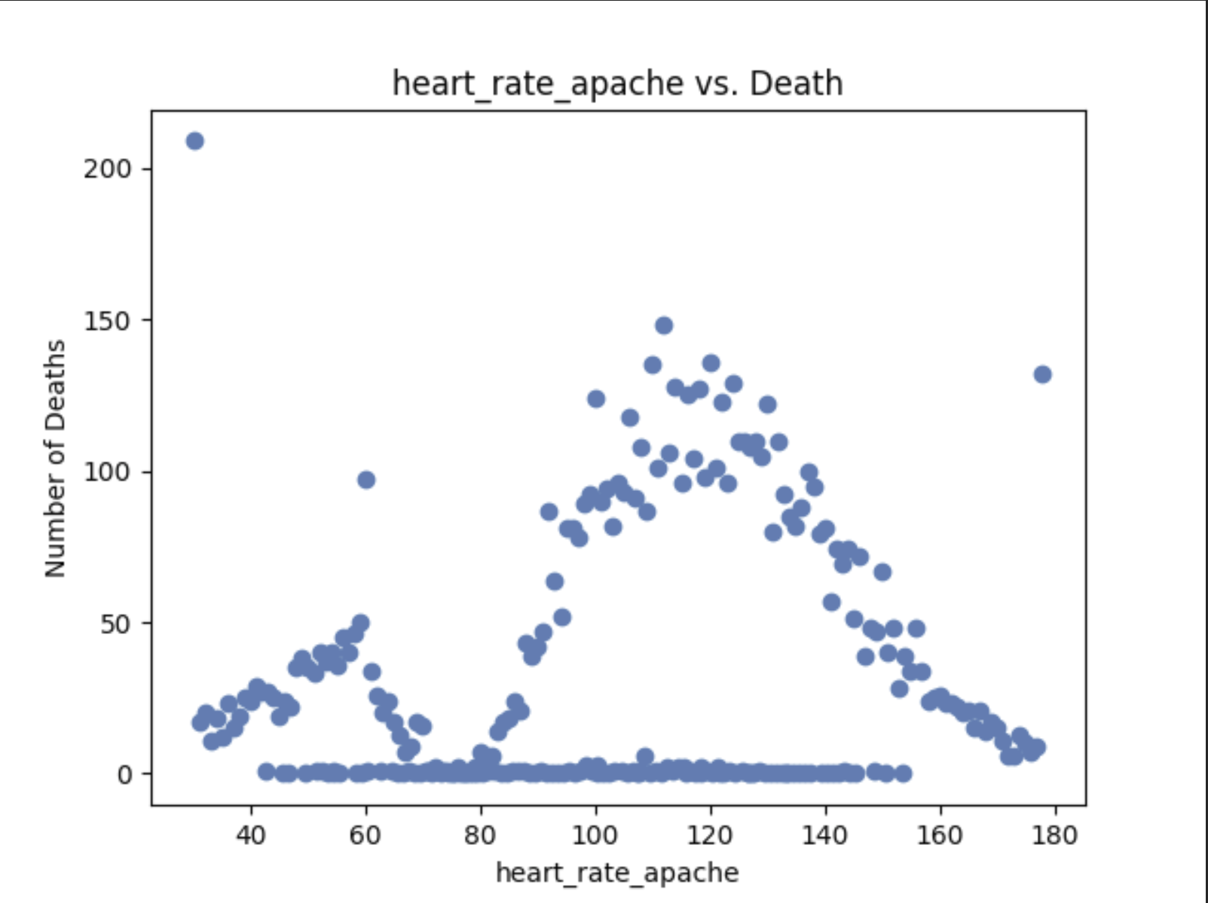
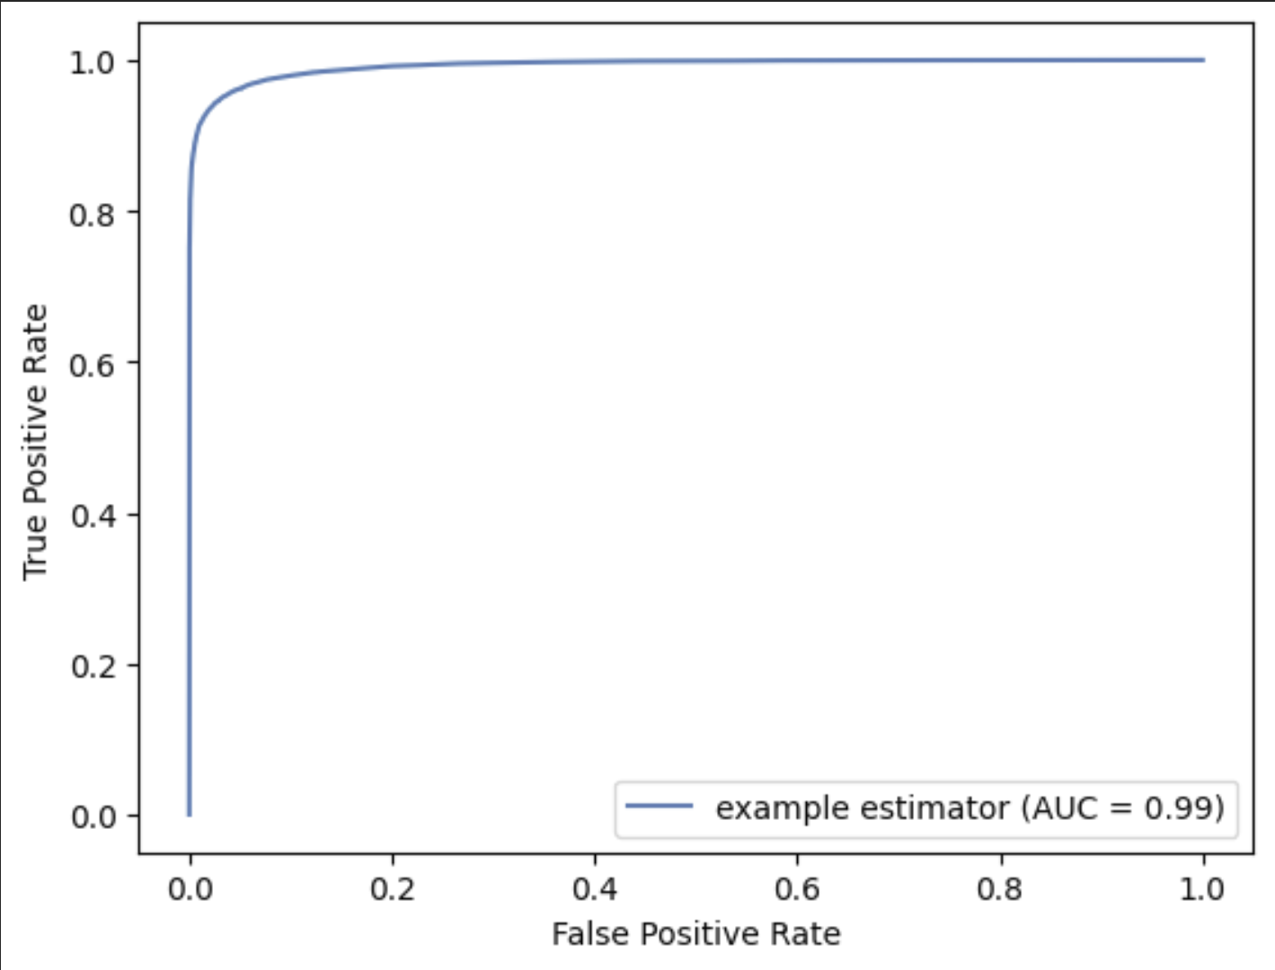
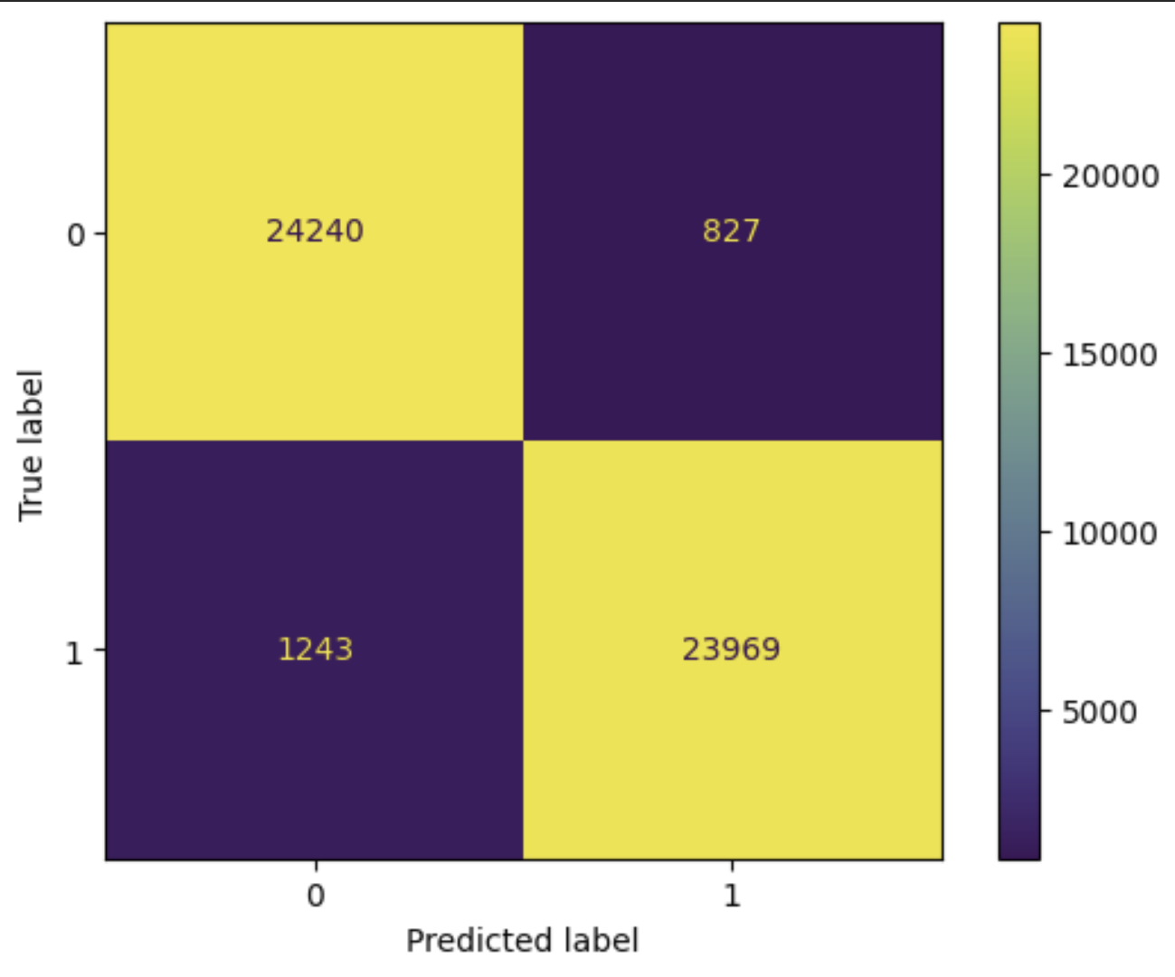
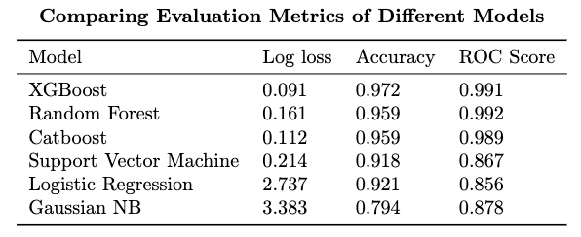
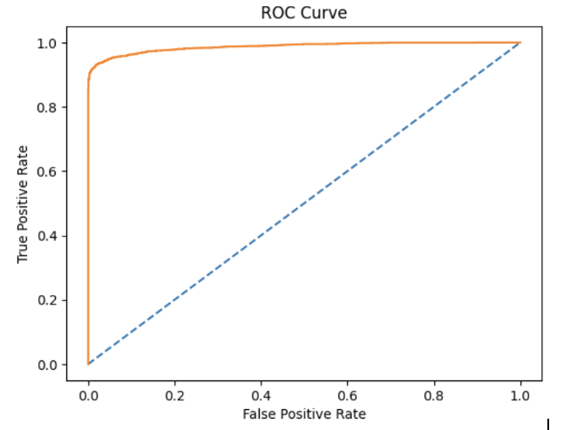
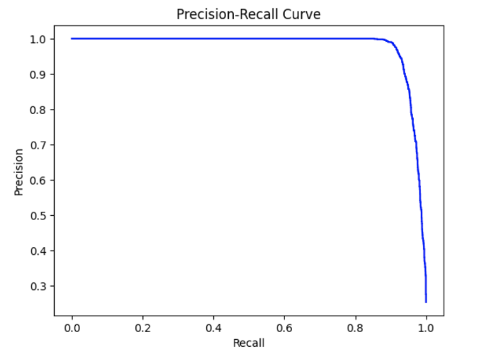
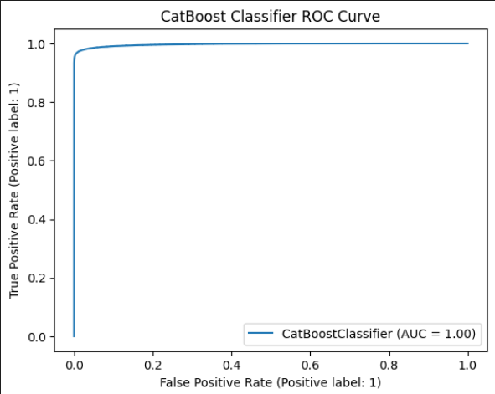
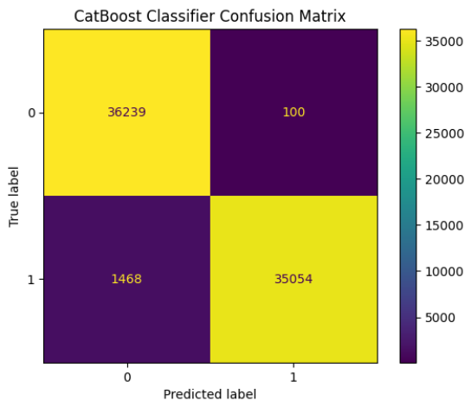
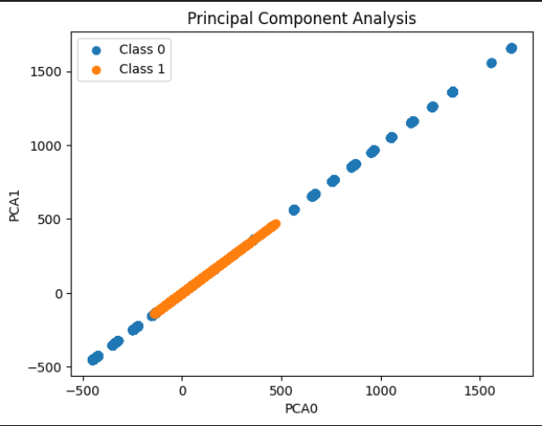
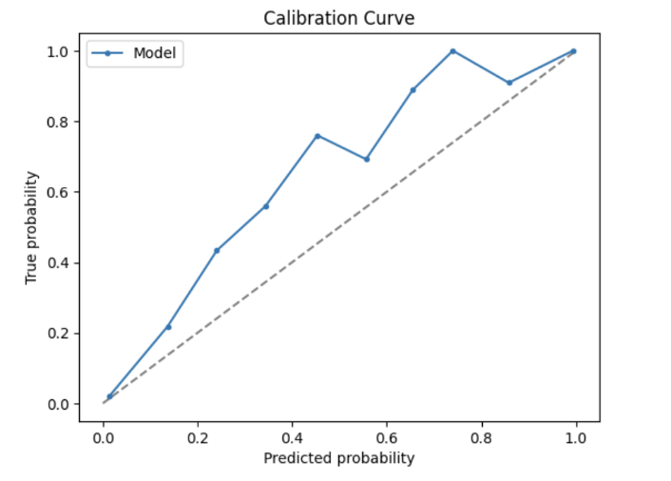
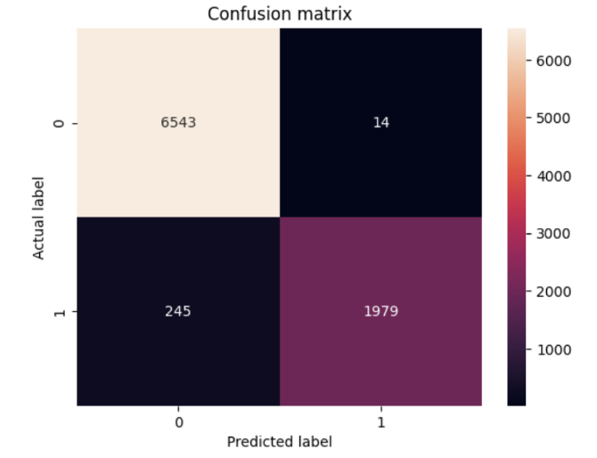
Predicting Obesity Risk Levels from Physical Activity and Nutritional Habits
Brandon Nguyen, Richard Nguyen, Emin Ersus
email@utexas.edu, email@utexas.edu, ee8943@utexas.edu
Abstract
Models/Evaluation
Conclusion/Results
Obesity is a major global issue, with its rates rising and posing significant challenges to healthcare systems. This study explores how eating habits and physical activity levels influence the risk of obesity. Using data analysis and machine learning methods, we developed a model that predicts an individual's likelihood of developing obesity based on their dietary choices and exercise patterns. Our findings shed light on the significant impact of lifestyle factors on obesity.
Evaluation: We used multiple metrics typically used to evaluate models. This includes ROC AUC, Log Loss, Precision-Recall, Confusion Matrices, Calibration, and Accuracy. We put particular focus on the Precision-Recall curve due to our data having imbalance classes along with ROC AUC as these metrics are typically better for model evaluation than simple accuracy.
Feature Importance: The features that explain the most variability were determined by the forward feature selection technique. Prior to training the model, it was shown that d1_spo2_min. D1_resprate_min, h1_resprate_min, resprate_apache, and temp_apache features were most important. After the model training, another method called SHAP (Shapely Additive Explanations) was used. The features that had the greatest contribution on the test set can be seen.
XGBoost: Originally, a Grid Search using XGBoost was run without any class balancing techniques. Similar variations of this model were trained (choosing to not remove outliers and correlated features, etc), but all resulted around similar accuracy scores of 0.92. After experimenting with class imbalance techniques, the model that performed the best was the XGBoost trained on a dataset that was curated with SMOTE synthetic sampling. The graphs showing the performance of XGBoost can be found as Figure 7 and 8.
Data Analysis/Pre-Processing
Data Analysis: First, univariate analysis helped to observe the trends and traits of single features, specifically including measures like mean, median, and standard deviation, but also visual mediums like boxplots that show data distribution and outliers. Through this, decided if features would benefit from scaling. Likewise, multivariate analysis helped determine feature distribution amongst each other, especially useful to find the relationship between a feature and its target, patient death. The methods analyzed were scatterplots of a feature against the target and the correlation matrix of all features. Observing the correlation matrix revealed most variables uncorrelated, save for more obvious options (like systolic and diastolic blood pressure). The scatterplots also revealed interesting traits like inverse or non-linear relationships with death.
Random Forest: Random Forest creates an ensemble of decision trees training random samples, introducing additional randomness by choosing a random set of samples. By bootstrap-aggregating these decision trees along with SMOTE, the model was accurately able to predict the label with over 99% accuracy. Since the data had prominent outliers, missing values, and noise, using decision trees handled these values well while quickly optimizing the model.
Figure 5. Feature average impact magnitude as evaluated by SHAP
Final Predictor: The best models were between Random Forest and XGBoost trained on the SMOTE balanced dataset. Although Random Forest had better calibration, XGBoost had better accuracy and log loss. The best metrics, parameters, and precision-recall curve are shown for XGBoost
.
Figure 3. Random Forest Classifier ROC curve and Random Forest Classifier Confusion Matrix
Figure 6: A table comparing the performance of models tested across a variety of metrics
Catboost: For classification, gradient boosting decision trees are known to be one of the most powerful tools available. From previous experience, CatBoost and XGBoost had been found to be typically the most powerful GBDT models available. Grid search was attempted with CatBoost, but surprisingly the default parameters were found to yield the best results. After training with default parameters on the dataset with SMOTE, CatBoost performed very well.
Figure 1. Box Plot of Age and Plot of Apache Heart Rate vs. Number of Deaths
Oversampling: The original dataset was highly imbalanced, with a greater number of samples corresponding to class 0. SMOTE (Synthetic Minority Oversampling Technique) was used to generate synthetic samples of the minority class using interpolation, which led to a more balanced dataset and significantly improved performance on our models [1].
Scaling: Given individual feature characteristics, we experimented with standardization and normalization. Normalization was helpful for data like age that is not near Gaussian, since the effect of outliers is reduced and data is prevented from skewing. Standardization, however, places data points on a common scale, eg. [0,1], beneficial to data with different scales like a boolean value compared to height.
Figure 7: Our best model, XGBoost, can be clearly seen having exceptional scores in both ROC AUC and Precision-Recall which indicates that good performance even on imbalanced classes.
PCA: To determine which features had the greatest impact on the variance of our data, we performed principal component analysis on two features. These features explained approximately 55% of the variance in our data
Figure 4. CatBoost Classifier ROC Curve and CatBoost Classifier Confusion Matrix
Support Vector Machine: A SVM is a binary classifier that attempts to separate data by finding a hyperplane of the largest margins between separate classes. Since this model performs much stronger with scaling, we trained our model on data that was scaled and filtered with SMOTE. Since there were many features in the dataset, SVM performed well, but the noise in the dataset kept it from competing with other top models.
Logistic Regression: Logistic regression is a prediction model typically used to classify dichotomous situations.Using sklearn GridSearch, the model was best fit with no class_weight and with fit_intercept. The model performed fairly well, but detection of actually positive data was fairly poor likely due to class imbalance.
Figure 8: The following figures show XGBoost’s calibration curve and confusion matrix.
Figure 2. Distribution of Classes According to Principal Components
Correlation: Ultimately, correlated features were not removed. Features such as age and weight are correlated, but both features are necessary in assessing a patient’s probability of survival. For example, a 180 lb 30 year old man poses less health risks than a 180 lb 10 year old boy.
References:
[1] J. Brownlee, “SMOTE for Imbalanced Classification with Python,” Machine Learning Mastery, 17-Jan-2020. [Online]. Available: https://machinelearningmastery.com/smote-oversampling-for-imbalanced-classification/. [Accessed: 17-Apr-2023].
[2] M. Agarwal, “Patient Survival Prediction,” Kaggle, 2021. [Online]. Available: https://www.kaggle.com/datasets/mitishaagarwal/patient. [Accessed: 17-Apr-2023].
Gaussian NB: Gaussian NB uses Bayes’ Theorem, an event’s probability based on prior knowledge, to determine the probability of a conditional event occurring. Since a patient will have many independent medical traits, we considered that Gaussian NB could perform strongly. However, this model was subpar to others.

