Slide 1

FINAL PRESENTATION ✦ MOBILE DEVELOPMENT
Scripture
Android App
& Light
Java
"Read. Reflect. Grow. Anywhere."
7 Bible Books
Presented by PromptMaxxing
Daily Verse Reminder
Codera, Neil Ryan B. · Mariscal, Psych Edsheil G. · Ponce, John Bryan · Yap, David

Slide 2
Contents
01
App Overview
02
Core Features
What is Scripture & Light?
What the app can do
03
App Screens
04
Design & Implementation
Home · Search · Read · Settings
UI choices, architecture, data flow
05
Insights & Recommendations
06
Conclusion
Limitations and future roadmap
Summary and closing

Slide 3

01
App Overview
What is Scripture & Light?
SECTION
Mobile Bible App · Java · Android

Slide 4

APP OVERVIEW
What is Scripture & Light?
A native Android Bible reading application
Built with Java
Covers 7 books: Genesis, Psalms, Proverbs, John, Matthew, Acts, Romans
"Read. Reflect.
Grow. Anywhere."
No login required · Works fully offline
Daily verse notification every morning
Scripture & Light
PromptMaxxing · 2025
Daily verse reminder notification

Slide 5




CORE FEATURES
What the App Can Do
Bible Reading
Multi-Book Library
Daily Verse
7 books — Genesis, Psalms, Proverbs, John, Matthew, Acts, Romans
7 curated books available
Push notification reminders
Search
Settings
Offline & Private
Search across all 7 featured books
Theme, font size & preferences
No login · No data collected

Slide 6




APP SCREENS
Four Screens, One Purpose
ACT_HOME — Home
ACT_SEARCH — Search
Daily verse card, quick access to 7 featured books
Full-text search across all 7 books with instant results
ACT_READ — Read
ACT_SETTINGS — Settings
Chapter reader with verse-by-verse navigation
Theme (Light/Dark/Sepia), font size, notification preferences

Slide 7
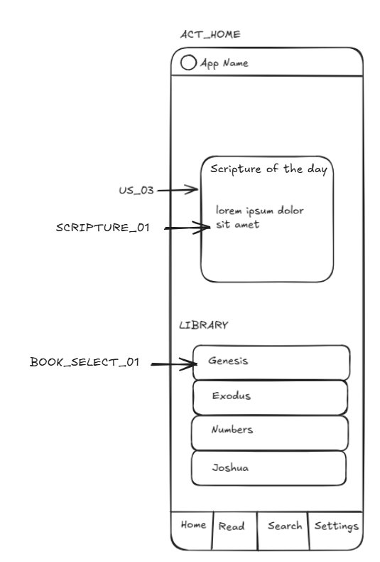
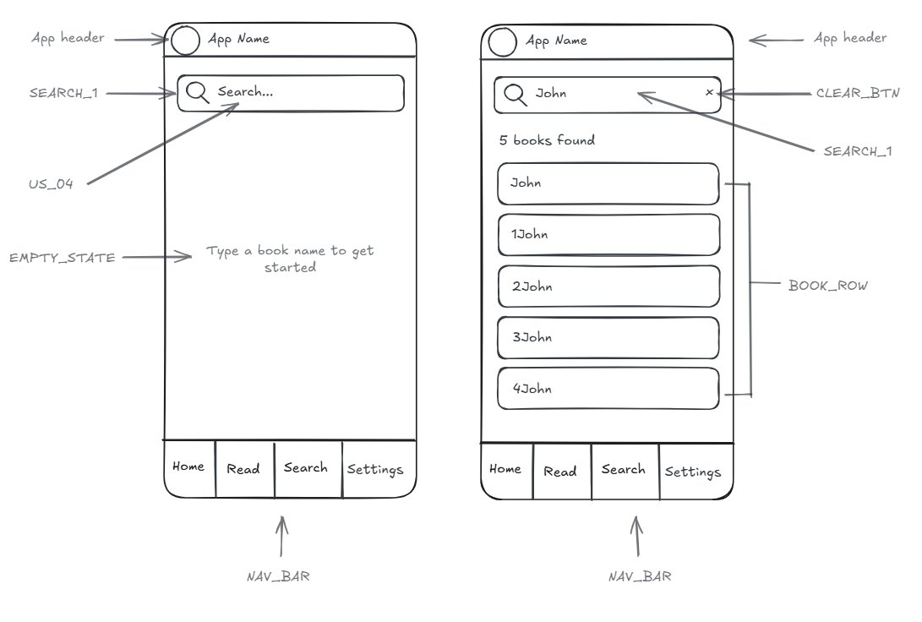
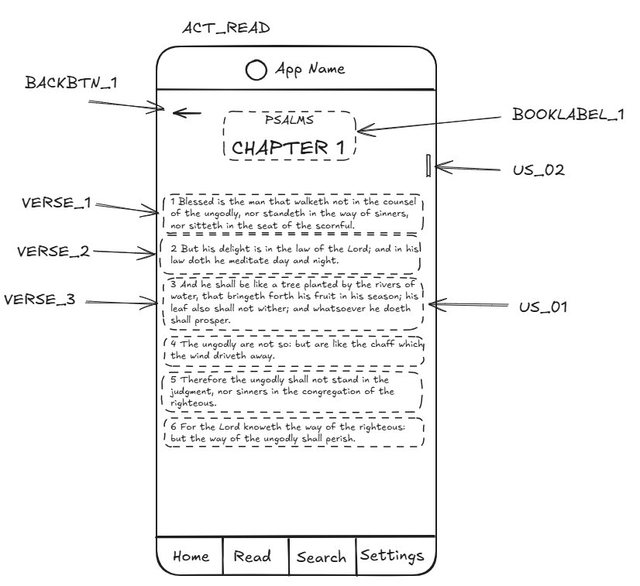
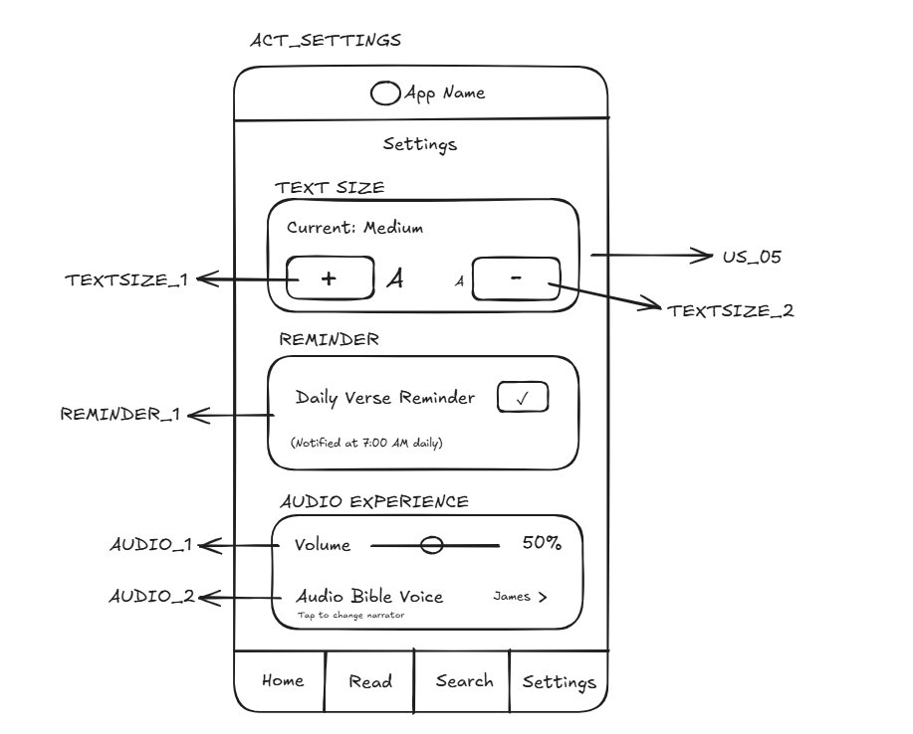
DESIGN & IMPLEMENTATION
Screen Wireframes
Hand-drawn wireframes created before any code was written — one per Activity
ACT_HOME
ACT_SEARCH
Scripture of the Day + Library
Search bar + Book results list
Components: US_03 · SCRIPTURE_01 · BOOK_SELECT_01 · NAV_BAR
Components: US_04 · SEARCH_1 · CLEAR_BTN · BOOK_ROW · EMPTY_STATE
ACT_READ
ACT_SETTINGS
Chapter reader + Verse rows
Text size & Daily Verse Reminder
Components: US_01 · US_02 · BACKBTN_1 · BOOKLABEL_1 · VERSE_1–3
Components: US_05 · TEXTSIZE_1–2 · REMINDER_1

Slide 8








DESIGN & IMPLEMENTATION
Technical Stack
Language
UI Framework
Architecture
Java
Java (Android SDK)
MVVM
Navigation
Bible Data
Bible Books
Navigation Compose
7 Books: Genesis–Romans (local)
Genesis, Psalms, Proverbs, John, Matthew, Acts, Romans
Notifications
Min Android
Test Device
WorkManager + AlarmManager
API 21 (Android 5.0+)
Medium Phone

Slide 9




DESIGN & IMPLEMENTATION
UI Design Decisions
Color Scheme
Typography
Amber / Gold primary · Warm neutral backgrounds
Material Design 3 type scale — clean and accessible
Theme Support
Font Control
Light | Dark | Sepia — user controlled
S | M | L | XL — adjustable in Settings
Book Library
Navigation
7 curated books — Genesis, Psalms, Proverbs, John, Matthew, Acts, Romans
Bottom Nav — 4 tabs always visible

Slide 10
DESIGN & IMPLEMENTATION
Navigation & Data Flow
Navigation Routes
Data Flow
ACT_HOME
/home
1
User taps verse
ACT_SEARCH
/search
2
SearchActivity.kt (UI Layer)
ACT_READ
/read/{bookId}
3
ReadActivity.kt (handles state)
ACT_READ
/read/{bookId}/{chapter}
4
BibleRepository.kt (data ops)
ACT_SETTINGS
/settings
5
DataStore (local persistence)

Slide 11
INSIGHTS & RECOMMENDATIONS
Insights — What's Not Yet Done
⚠ Partial Bible Coverage
→ Full Bible text can be loaded into BibleData.kt in future iterations.
7 books included: Genesis, Psalms, Proverbs, John, Matthew, Acts & Romans.
⚠ Single Translation
→ KJV/NIV/ESV data files can be added per book without architectural changes.
The UI supports translation switching but only one translation dataset is loaded.
⚠ Android Only
→ Future: Flutter or React Native for cross-platform deployment.
No iOS support currently; the app is native Android with Java.

Slide 12




INSIGHTS & RECOMMENDATIONS
Recommendations — Future Roadmap
Add all 66 Bible books to complete the Scripture coverage
Load real translation data — NIV, ESV, NLT alongside KJV
Expand library to all 66 Bible books for complete coverage
Daily reading plan with progress tracking and streaks
Optional cloud sync for bookmarks and personal notes
iOS support via Flutter or React Native

Slide 13

CONCLUSION
Scripture
& Light
"Read. Reflect.
Grow. Anywhere."
Built with Java
Android · Personal Use · Fully Offline
Covers 7 Bible books
PromptMaxxing
Daily verse push notifications
Codera · Mariscal · Ponce · Yap
Daily verse push notifications
Mobile Development · 2025

