Slide 1

FINAL PRESENTATION ✦ MOBILE DEVELOPMENT
Scripture
Android App
& Light
Kotlin + Java
"Read. Listen. Reflect. Anywhere."
2 Bible Books
Presented by PromptMaxxing
Audio Experience
Codera, Neil Ryan B. · Mariscal, Psych Edsheil G. · Ponce, John Bryan · Yap, David

Slide 2
Contents
01
App Overview
02
Core Features
What is Scripture & Light?
What the app can do
03
App Screens
04
Design & Implementation
Home · Search · Read · Settings
UI choices, architecture, data flow
05
Insights & Recommendations
06
Conclusion
Limitations and future roadmap
Summary and closing

Slide 3

01
App Overview
What is Scripture & Light?
SECTION
Mobile Bible App · Kotlin + Java · Android

Slide 4

APP OVERVIEW
What is Scripture & Light?
A native Android Bible reading application
Built with Kotlin + Java
Covers Genesis & John — focused and intentional
"Read. Listen.
Reflect. Anywhere."
No login required · Works fully offline
Background worship music while reading
Scripture & Light
PromptMaxxing · 2025
Daily verse reminder notification

Slide 5





CORE FEATURES
What the App Can Do
Bible Reading
Ambient Audio
Daily Verse
Genesis & John — full chapters
Background worship music
Push notification reminders
Search
Settings
Offline & Private
Search within Genesis & John
Theme, font size & preferences
No login · No data collected

Slide 6




APP SCREENS
Four Screens, One Purpose
ACT_HOME — Home
ACT_SEARCH — Search
Daily verse card, quick access to Genesis & John, app welcome banner
Full-text search within Genesis and John with instant results
ACT_READ — Read
ACT_SETTINGS — Settings
Chapter reader with ambient audio toggle and verse navigation
Theme (Light/Dark/Sepia), font size, notification preferences

Slide 7
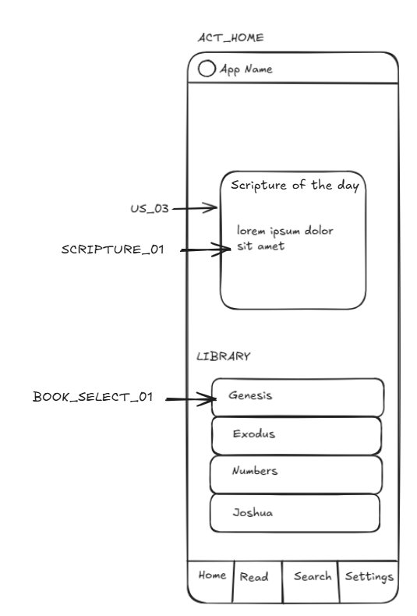
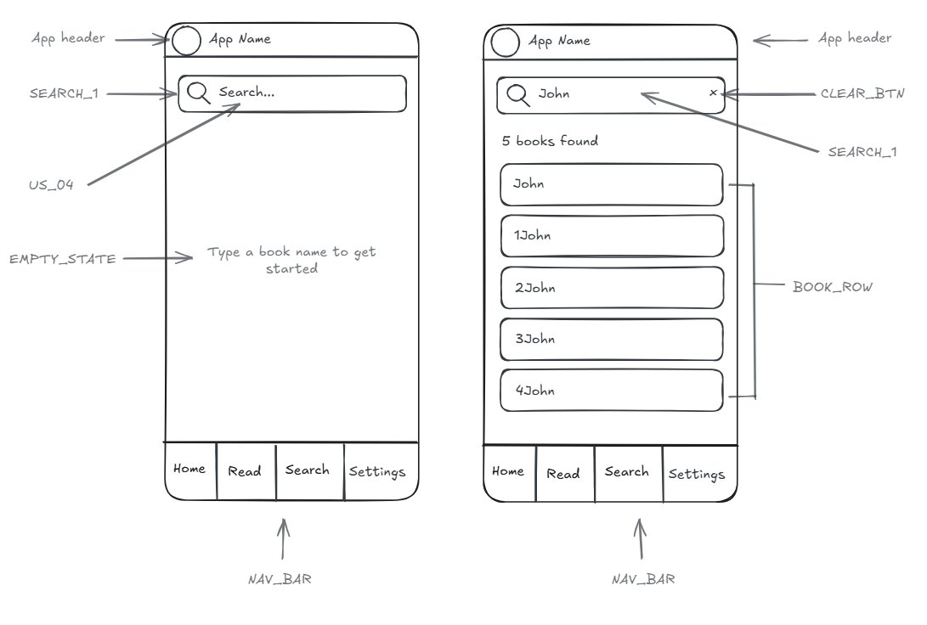
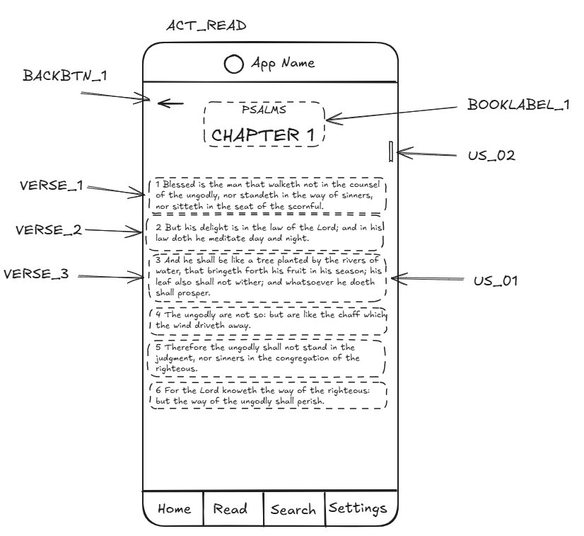
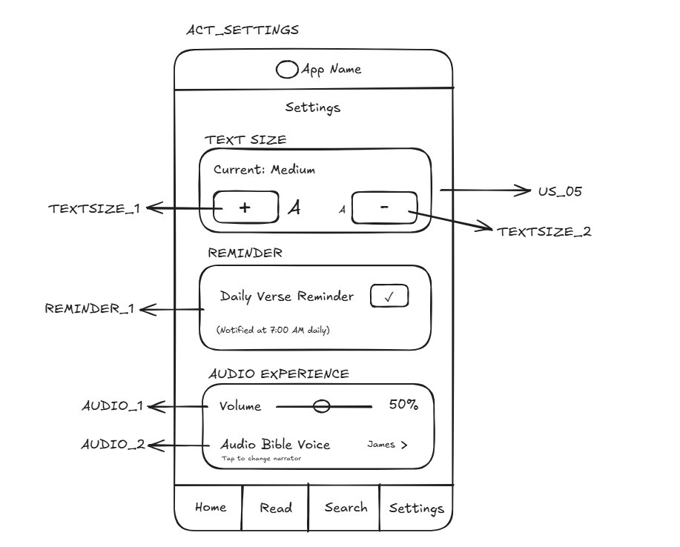
DESIGN & IMPLEMENTATION
Screen Wireframes
Hand-drawn wireframes created before any code was written — one per Activity
ACT_HOME
ACT_SEARCH
Scripture of the Day + Library
Search bar + Book results list
Components: US_03 · SCRIPTURE_01 · BOOK_SELECT_01 · NAV_BAR
Components: US_04 · SEARCH_1 · CLEAR_BTN · BOOK_ROW · EMPTY_STATE
ACT_READ
ACT_SETTINGS
Chapter reader + Verse rows
Text size, Reminder & Audio
Components: US_01 · US_02 · BACKBTN_1 · BOOKLABEL_1 · VERSE_1–3
Components: US_05 · TEXTSIZE_1–2 · REMINDER_1 · AUDIO_1–2

Slide 8

FEATURE SPOTLIGHT — AUDIO EXPERIENCE
Worship While You Read
Background ambient / worship music plays while reading
Non-intrusive — music fades into the reading experience
Toggle on or off with a single tap
🎵 Now Playing
Ambient Worship Mix
Designed to create a calm, focused reading atmosphere
2:14
4:33
Music persists across chapter navigation
Genesis 1:1

Slide 9








DESIGN & IMPLEMENTATION
Technical Stack
Language
UI Framework
Architecture
Kotlin
Java (Android SDK)
MVVM
Navigation
Bible Data
Audio
Navigation Compose
Genesis & John (local)
MediaPlayer / ExoPlayer
Notifications
Min Android
Test Device
WorkManager + AlarmManager
API 21 (Android 5.0+)
Medium Phone

Slide 10




DESIGN & IMPLEMENTATION
UI Design Decisions
Color Scheme
Typography
Amber / Gold primary · Warm neutral backgrounds
Material Design 3 type scale — clean and accessible
Theme Support
Font Control
Light | Dark | Sepia — user controlled
S | M | L | XL — adjustable in Settings
Audio Toggle
Navigation
Persistent music toggle in the Reader screen
Bottom Nav — 4 tabs always visible

Slide 11
DESIGN & IMPLEMENTATION
Navigation & Data Flow
Navigation Routes
Data Flow
ACT_HOME
/home
1
User taps verse
ACT_SEARCH
/search
2
SearchActivity.kt (UI Layer)
ACT_READ
/read/{bookId}
3
ReadActivity.kt (handles state)
ACT_READ
/read/{bookId}/{chapter}
4
BibleRepository.kt (data ops)
ACT_SETTINGS
/settings
5
DataStore (local persistence)

Slide 12
INSIGHTS & RECOMMENDATIONS
Insights — What's Not Yet Done
⚠ Limited Bible Coverage
→ Full Bible text can be loaded into BibleData.kt in future iterations.
Only Genesis & John are included. The remaining 64 books are not yet in scope.
⚠ Single Translation
→ KJV/NIV/ESV data files can be added per book without architectural changes.
The UI supports translation switching but only one translation dataset is loaded.
⚠ Android Only
→ Future: Flutter or React Native for cross-platform deployment.
No iOS support currently; the app is native Android with Kotlin + Java.

Slide 13




INSIGHTS & RECOMMENDATIONS
Recommendations — Future Roadmap
Add all 66 Bible books to complete the Scripture coverage
Load real translation data — NIV, ESV, NLT alongside KJV
Expand audio: add Text-to-Speech Bible narration
Daily reading plan with progress tracking and streaks
Optional cloud sync for bookmarks and personal notes
iOS support via Flutter or React Native

Slide 14

CONCLUSION
Scripture
& Light
"Read. Listen.
Reflect. Anywhere."
Built with Kotlin + Java
Android · Personal Use · Fully Offline
Covers Genesis & John
PromptMaxxing
Ambient worship audio experience
Codera · Mariscal · Ponce · Yap
Daily verse push notifications
Mobile Development · 2025

