Slide 1

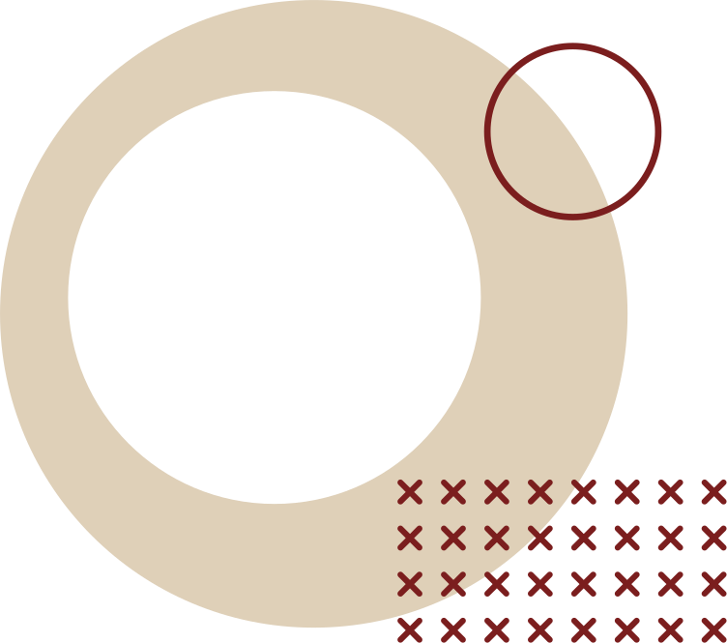
SDLC MODEL

Slide 2
AT THE END OF THE SESSION, STUDENTS ARE EXPECTED TO:
  Identify the different SDLC Models
  Determine the applications of these models in software development
  Apply these models in developing the design of a software project

Slide 3
WHAT IS SDLC
The Software Development Life Cycle (SDLC) is a systematic process used by software engineers and developers to design, develop, test, and deploy high-quality software applications. It provides a structured approach to ensure that the final product meets user requirements and is delivered on time and within budget.

Slide 4
IMPORTANCE OF SDLC
  Provides a clear roadmap for software development.
  Ensures better project management and resource allocation.
  Helps in reducing risks and errors.
  Ensures quality and reliability of software.
  Makes development cost-effective and time-efficient.

Slide 5
PHASES OF SDLC
  Planning – Define the project goals, feasibility, resources, and risks.
  Requirement Analysis – Gather and analyze user needs and system requirements.
  Design – Create the architecture, database structure, and user interface design.
  Development (Implementation) – Actual coding of the software using programming languages.

Slide 6
PHASES OF SDLC
  Testing – Verify that the software works correctly, identify and fix bugs.
  Deployment – Release the software to the users or production environment.
  Maintenance – Provide updates, bug fixes, and improvements after deployment.

Slide 7
DIFFERENT SDLC MODEL
  Waterfall model
  Iterative model
  Spiral model
  V-shaped model
  Agile model

Slide 8
WATERFALL MODEL
  The Waterfall model is a step-by-step (cascade) SDLC approach where each phase (analysis, design, development, testing, implementation, support) is completed before moving to the next. It emphasizes strict documentation and predefined requirements, making it suitable for complex projects by ensuring control and reducing mistakes.

Slide 9
ADVANTAGE
  Simple to use and understand
  Management simplicity thanks to its rigidity: every phase has a defined result and process review
  Development stages go one by one
  Perfect for the small or mid-sized projects where requirements are clear and not equivocal
  Easy to determine the key points in the development cycle
  Easy to classify and prioritize tasks

Slide 10
DISADVANTAGE
  The software is ready only after the last stage is over
  High risks and uncertainty
  Not the best choice for complex and object-oriented projects
  Inappropriate for the long-term projects
  The progress of the stage is hard to measure while it is still in the development
  Integration is done at the very end, which does not give the option of identifying the problem in advance

Slide 11
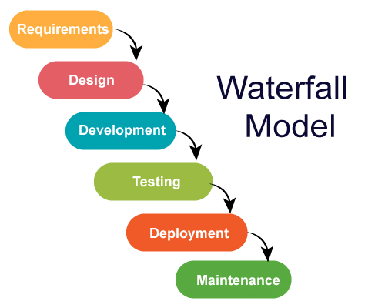

Slide 12
ITERATIVE MODEL
  The Iterative model is similar to the Waterfall model but breaks the project into smaller cycles (iterations). Instead of planning and building everything at once, developers create a few features per iteration, passing through all SDLC phases each time. This allows the system to grow gradually, with requirements added or refined as the project progresses. Each cycle delivers a new, improved version of the product until the final system is complete.

Slide 13
ADVANTAGE
  Some functions can be quickly developed at the beginning of the development lifecycle
  The paralleled development can be applied
  The progress is easy measurable
  The shorter iteration is – the easier testing and debugging stages are
  It is easier to control the risks as high-risk tasks are completed first
  Flexibility and readiness to the changes in the requirements

Slide 14
DISADVANTAGE
  Iterative model requires more resources than the waterfall model
  Constant management is required
  Issues with architecture or design may occur because not all the requirements are foreseen during the short planning stage
  Bad choice for the small projects
  The process is difficult to manage
  The risks may not be completely determined even at the final stage of the project
  Risks analysis requires involvement of the highly-qualified specialists

Slide 15
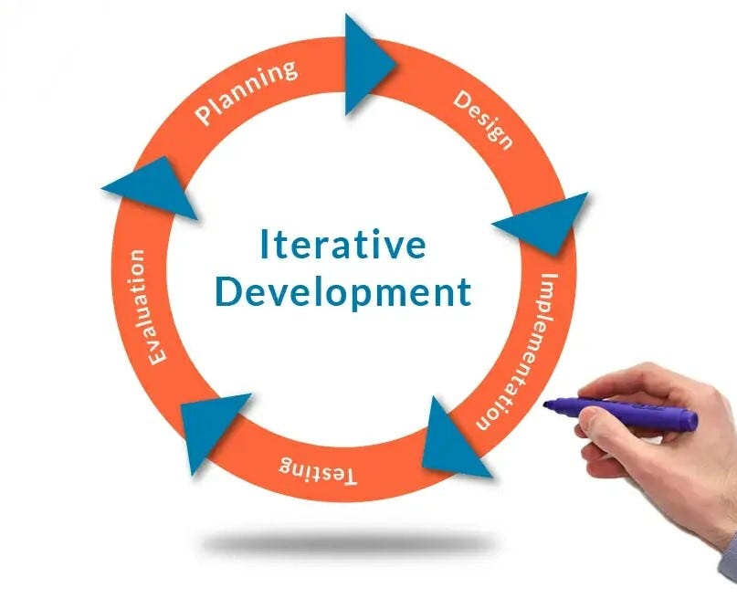

Slide 16
SPIRAL MODEL
  Spiral model is a combination of the Iterative and Waterfall SDLC models with a significant accent on the risk analysis. The main issue of the spiral model is defining the right moment to take a step into the next stage. The preliminary set timeframes are recommended as the solution to this issue. The shift to the next stage is done according to the plan, even if the work on the previous step isn’t done yet. The plan is introduced based on the statistical data received in the last projects and even from the personal developer’s experience.

Slide 17
ADVANTAGE
  Lifecycle is divided into small parts, and if the risk concentration is higher, the phase can be finished earlier to address the treats
  The development process is precisely documented yet scalable to the changes
  The scalability allows to make changes and add new functionality even at the relatively late stages
  The earlier working prototype is done – sooner users can point out the flaws

Slide 18
DISADVANTAGE
  Can be quite expensive
  The risk control demands involvement of the highly-skilled professionals
  Can be ineffective for the small projects
  Big number of the intermediate stages requires excessive documentation

Slide 19
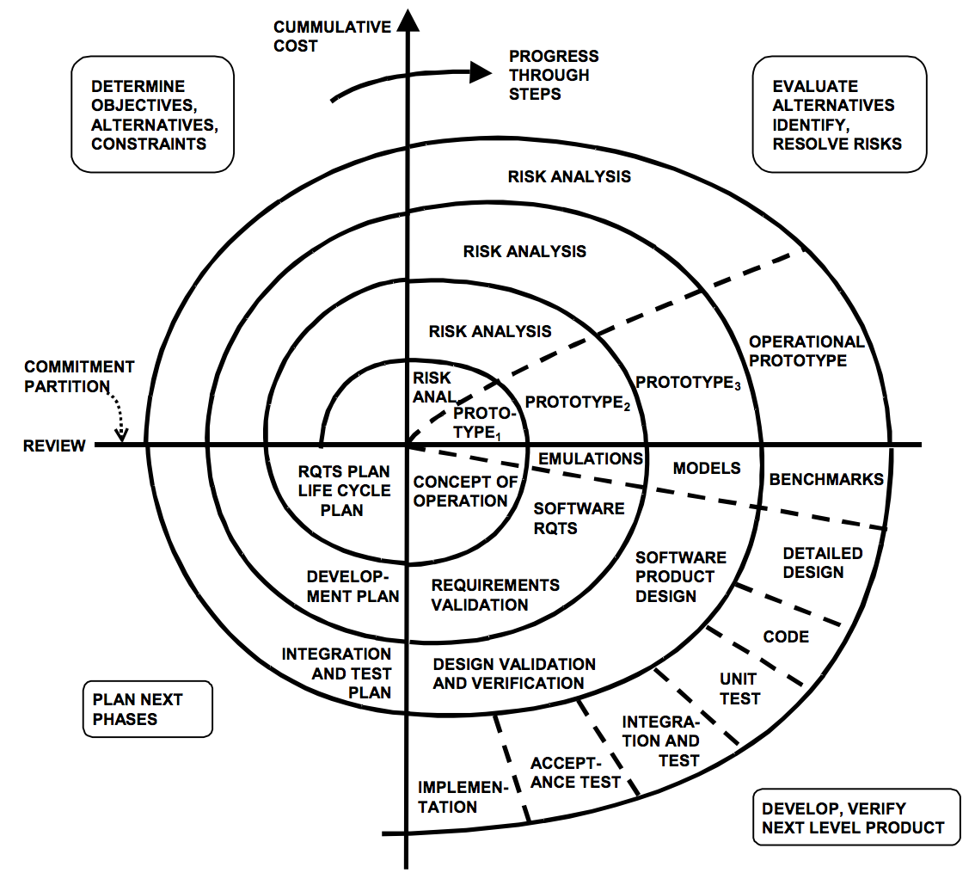

Slide 20
V-SHAPED MODEL
  The V-Shaped (V-Model) is an extension of the Waterfall model that emphasizes Verification and Validation. On the left side are verification phases (checking against technical requirements), and on the right are validation phases (ensuring the product meets business needs). Each development stage has a corresponding testing stage—for example, requirement analysis ↔ acceptance testing, system design ↔ system testing, and architecture design ↔ integration testing.

Slide 21
ADVANTAGE
  Every stage of V-shaped model has strict results so it’s easy to control
  Testing and verification take place in the early stages
  Good for the small projects, where requirements are static and clear

Slide 22
DISADVANTAGE
  Lack of the flexibility
  Bad choice for the small projects
  Relatively big risks

Slide 23
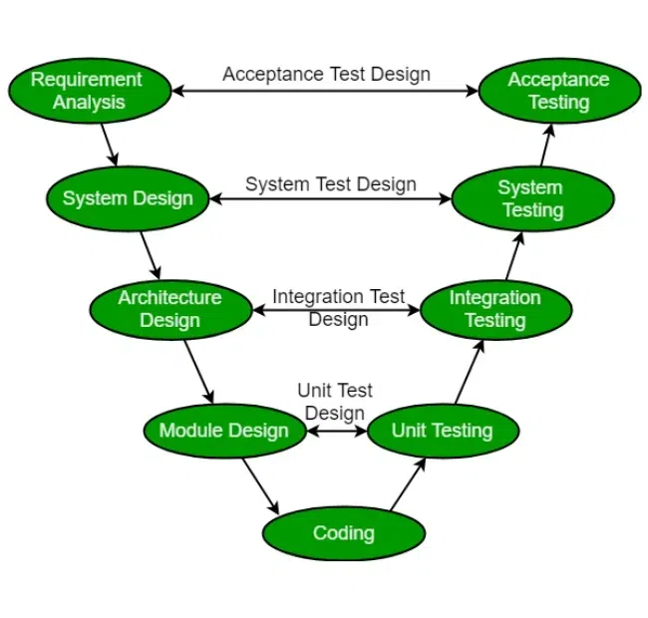

Slide 24
AGILE MODEL
  Agile Model is a philosophy and family of methods (e.g., Scrum, Kanban, XP) that focuses on flexibility, collaboration, and customer involvement. Work is divided into short cycles called sprints, where tasks can change even during development. Unlike rigid models, Agile emphasizes continuous communication with clients through regular updates, sprint reviews, and daily/weekly meetings.

Slide 25
ADVANTAGE
  Corrections of functional requirements are implemented into the development process to provide the competitiveness
  Project is divided by short and transparent iterations
  Risks are minimized thanks to the flexible change process
  Fast release of the first product version

Slide 26
DISADVANTAGE
  Difficulties with measuring the final cost because of permanent changes
  The team should be highly professional and client-oriented
  New requirements may conflict with the existing architecture
  With all the corrections and changes there is possibility that the project will exceed expected time

Slide 27
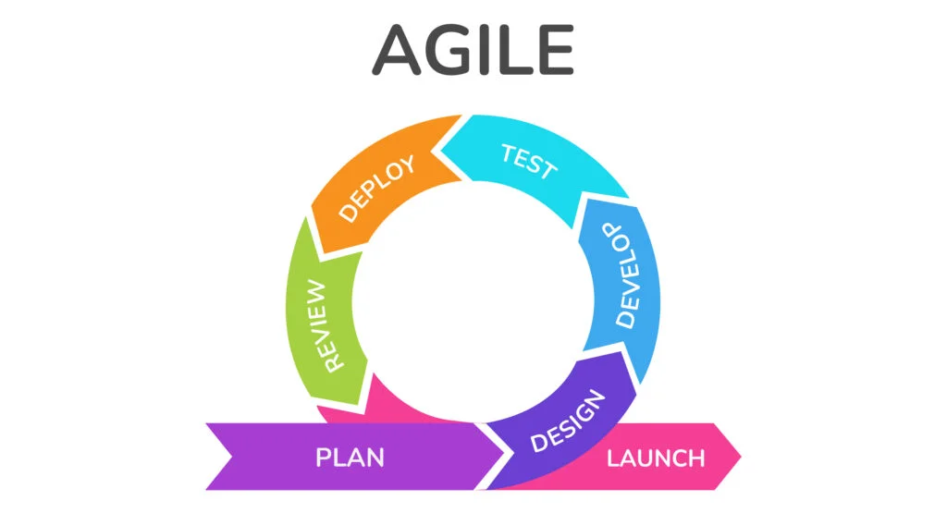

Slide 28
THANK YOU

