Slide 1



PROCEDURES
track elective 1
reallygreatsite.com

Slide 2

INTENDED LEARNING OUTCOMES
  Construct programs modularly by dividing them into procedures.
  Identify and utilize Sub Procedures and Function Procedures effectively.
  Demonstrate the ability to create new procedures within a program.
  Apply and explore common Math methods available in the Framework Class Library (FCL).
  Understand and apply the mechanisms of passing information (arguments/parameters) between procedures.
01

Slide 3
MODULES
  A module is like a container or toolbox that groups related procedures and functions.
  It usually holds the entry point of the program (e.g., Main).
  Purpose: organize code and keep it modular.
01

Slide 4
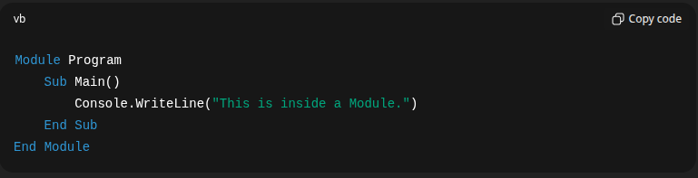
10

Slide 5
CLASSES
  A class is a blueprint for creating objects.
  It contains data (fields/properties) and actions (methods).
  Unlike a module, a class is designed to be reused by creating multiple objects.
01

Slide 6
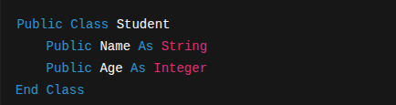
10

Slide 7
PROCEDURES
Procedures are blocks of reusable code. They come in different forms:
a) Sub Procedures
  Perform an action but do not return a value.
  Example uses: displaying output, updating data, printing messages.
b) Function Procedures
  Perform an action and return a value to the caller.
  Example uses: performing calculations, retrieving data, validating input.
01

Slide 8
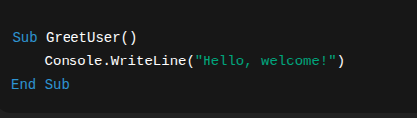
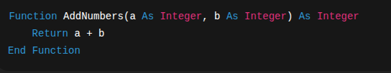
10

Slide 9
BUILT-IN MATH METHODS
  The Math class in the framework provides ready-made methods for common mathematical operations:
  Sqrt → square root (√)
  Pow → exponent (e.g., 2³)
  Round → rounds to the nearest whole number
  Floor → rounds down to the nearest whole number
  Ceiling → rounds up to the nearest whole number
01

Slide 10
PASSING INFORMATION BETWEEN PROCEDURES
Procedures often need data to work with. This is done using parameters.
By Value (ByVal)
  Passes a copy of the data.
  Changes inside the procedure do not affect the original value.
By Reference (ByRef)
  Passes the actual variable.
  Changes inside the procedure affect the original value.
01

Slide 11
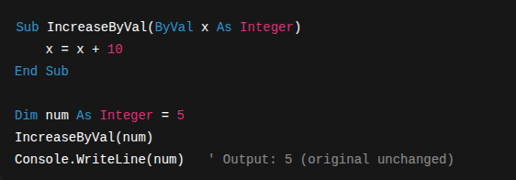
10

Slide 12
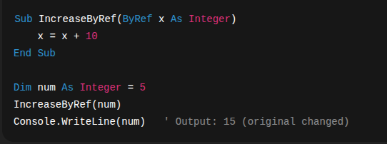
10

Slide 13
IN SUMMARY:
  Module → container, entry point
  Class → blueprint for objects
  Sub → action, no return
  Function → action, returns value
  Method → procedure inside a class
  Math Methods → built-in helpers
  Parameters (ByVal / ByRef) → control how values are passed
01

Slide 14
THANK YOU
10

