Slide 1


Telecom Customer Churn Prediction
explain
problems motivation
dataset
describe
preprocessing pipelines
how to evaluate
models
experimental
results&conclusions
Machine Learning Models Implemented From Scratch
AI3013 Machine Learning Course Project
Gao Ruiyang

Slide 2
C ONTENTS
01. Problem and Motivation
02. Dataset and EDA
03. Methodology and Models
04. Experimental Results
05. Sensitivity Analysis and Learning Curves
06. Interpretation and Conclusion
Gao Ruiyang
Notes:
introduce
describe
present
after that show

Slide 3
Customer churn means a customer stops using telecom services.
Retaining existing customers is cheaper than acquiring new ones.
Why Customer Churn Prediction Matters
Early prediction helps companies identify high-risk customers.
This task is formulated as a binary classification problem.
Gao Ruiyang
Notes:
From a business perspective, churn is a very important problem because losing customers directly reduces revenue. Also, it is widely known that XXX so churn prevention is a cost-effective strategy.
In our project, we aim to predict whether a customer will churn based on customer information such as contract type, service usage, payment method, and billing-related features. This is a binary classification problem: the target label is either churn or not churn.
The practical value is that if we can identify high-risk customers early, the company can take actions such as targeted discounts, service upgrades, or customer support interventions to reduce churn.

Slide 4

Source
Samples
Features
Target
IBM Telco Customer Churn Dataset from Kaggle
7043 raw samples, 7032 after cleaning
21 original features, 46 encoded features
Churn (Yes / No)
Dataset
Overview
Gao Ruiyang
Notes:
The raw dataset contains XXX including both numerical &categorical variables. The target column is Churn, labeled as Yes or No.
During cleaning, we handle the `TotalCharges` column by converting it to numeric values. Some entries are missing or non-numeric, so we treat them properly and remove a small number of invalid rows. After cleaning, we have 703
Because many features are categorical, we apply one-hot encoding, so the feature dimension increases to 46 encoded features. Later in preprocessing, we standardize numerical features such as tenure and charges.
So overall, this dataset has sufficient size and a rich mixture of feature types, which allows meaningful comparisons among different models. In the next section, we will show exploratory data analysis to understand class distribution and key churn-related patterns.

Slide 5
AI3013 Machine Learning Course Project
02
EDA and PREPROCESSING
Wang Runa
Notes:
I am Huang Yu. Let me introduce sections three, model theory and implementation

Slide 6

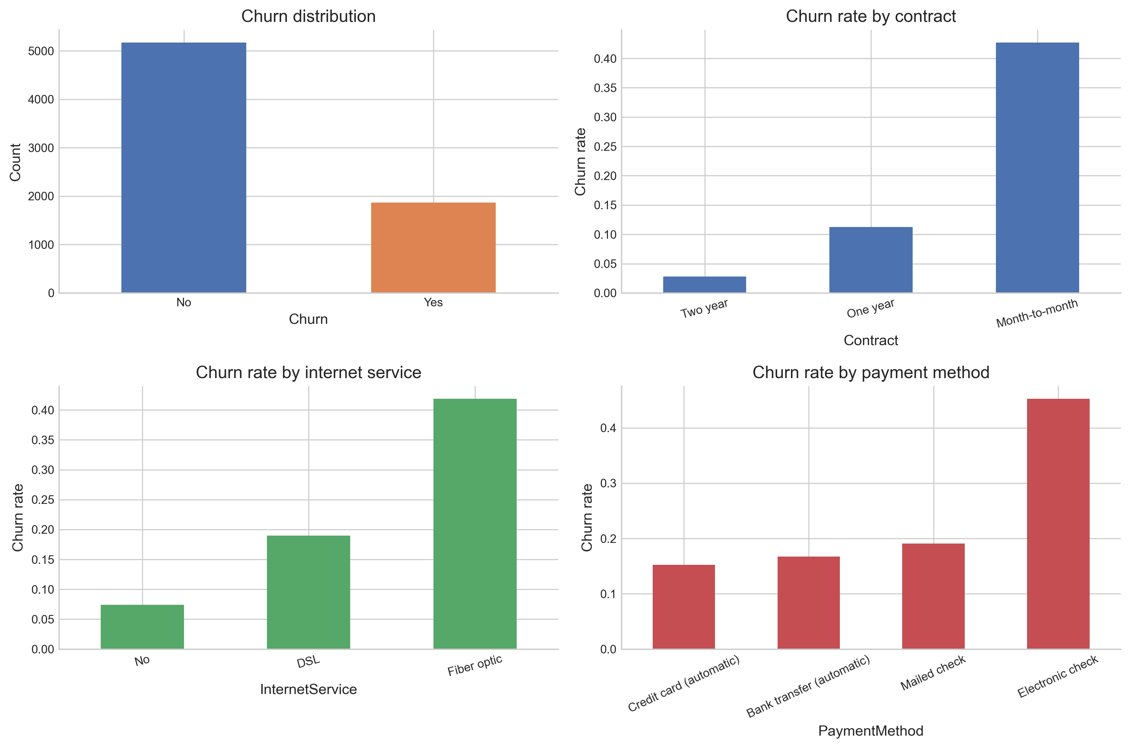
Key EDA Findings
• Churn is moderately imbalanced：Yes = 26.5%, No = 73.5%
• Month-to-month contracts have the highest churn rate of 42.7%, compared with One year = 11.3%, Two year = 2.8%.
• Fiber optic users show higher churn risk:41.9%, compared with DSL = 19.0%, No internet = 7.4%.
• Electronic check users churn more frequently.
•short-tenure customers are more likely to churn. 0–12 months = 47.4%, while 49–72 months = 9.5%
Notes:
1.Because of this imbalance, accuracy alone is not enough, so we also use metrics such as precision, recall, F1-score, ROC-AUC, and PR-AUC.
2.This suggests that longer contracts are associated with more stable customers.
3.Customers using electronic check also churn more frequently, with a churn rate around 45.3%, much higher than automatic payment methods.
4.Overall, EDA suggests that contract type, tenure, internet service, and payment method are informative features for churn prediction.

Slide 7
Preprocessing Pipeline
Drop customerID, because it is only an identifier
Convert TotalCharges to numeric
step1
step2
step3
step4
Load raw telecom churn data 7043 samples
Remove 11 rows with missing TotalCharges, leaving 7032 samples
No data leakage: scaling is performed using training folds only.

Slide 8
Preprocessing Pipeline
Use stratified 5-fold cross-validation and fit scaler/encoder only on training folds to avoid data leakage
One-hot encode categorical features
step5
step6
step7
step8
Encode target: Churn Yes = 1, No = 0
Standardize numeric features: tenure, MonthlyCharges, TotalCharges
No data leakage: scaling is performed using training folds only.
Notes:
6.For categorical variables such as Contract, InternetService, and PaymentMethod, we used one-hot encoding. This converts categories into numerical binary features, which can be used by our from-scratch models.
7.makes gradient descent more stable.
8.which keeps the churn ratio similar in each fold and helps produce a fairer model evaluation.

Slide 9

AI3013 Machine Learning Course Project
03
Model Theory and Implementation
Huang Yueqing
Notes:
I am Huang Yu. Let me introduce sections three, model theory and implementation

Slide 10
Logistic Regression
Gaussian Naive Bayes
Core Content
Decision Tree
Notes:
These are the three models we have implemented logistic regression, gaussian, NAV bay, and decision tree

Slide 11
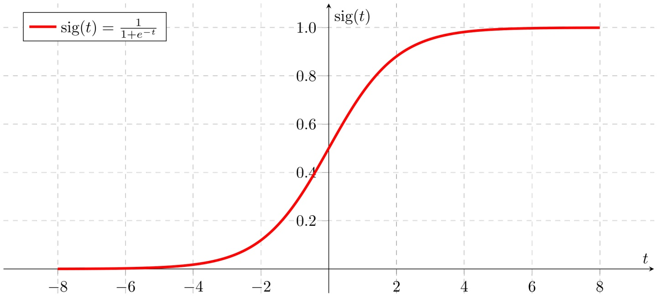
Logistic Regression: Theoretical Background
▍ Sigmoid Mapping Maps linear combination to (0,1): P(y=1|x) = 1 / (1 + e^(-(wᵀx + b)))
▍ Linear Decision Boundary Set wᵀx + b = 0 as the linear boundary. Initially use 0.5 as the classification threshold.
Loss Function: Binary Cross-Entropy
Measures the gap between predicted probabilities and true labels, the standard loss function for logistic regression:
L(w , b) = -1/N · ∑ [ yᵢ log(pᵢ) + (1-yᵢ) log(1-pᵢ) ]
Optimization: Gradient Descent
Iteratively updates parameters by gradient to find the minimum : w = w - α∇J
Regularization Strategy : Apply L2 (Ridge) to limit parameter scale and prevent overfitting.
Schematic of Gradient Descent Path
Notes:
For logistic regression, first we used sigmoid function to scale the results of multiplication between 0 and 1. Next, we set 0.5 as the liner decision boundary. Then, we defined a loss function using binary cross entropy to which measures the GAP between predicted probabilities and true labels. Finally, we used gradient descent to minimize the loss which it updates parameters by gradient. Additionally, to prevent over fitting and limit the parameter scale, we applied l2 regularization strategy

Slide 12
Pro: High Interpretability
The magnitude and sign of the weights w directly reflect the feature's impact on the result, facilitating business interpretation.
Con: Linear Assumption
Limited capacity; prone to underfitting if the decision boundary is non-linear in reality.
Logistic Regression
Pros and Cons Analysis
Pro: High Efficiency
The training process is simple and fast, often used as a baseline model for large-scale data.
Con: Sensitive to Outliers
As a linear model, it is vulnerable to extreme values; data cleaning is essential.
Notes:
Now let me introduce the pros and cons of logistic regression. First, it is highly interpretable. The sign of weight w directly reflect the feature's impact on the result, and it is simple and fast and often used as a baseline model for large scale data. However, it has a limited capacity as well as a prone to under fitting if the decision boundary is long liner in reality. what's more It is sensitive to outliers, so data cleaning is essential for logistic regression

Slide 13
Bayes' Theorem
Naive Assumption
Gaussian Distribution
Decision Rule
P(y | x) = P(x | y)P(y) / P(x)
Calculates the posterior probability of a class given features, the theoretical foundation.
P(x | y) = ∏ P(xj | y)
Assumes all features are conditionally independent, greatly simplifying computation.
Assumes continuous features follow a normal distribution (mean & variance) for density estimation.
ŷ = argmax [ P(y) ∏ P(xj | y) ]
Predicts the class with the maximum posterior probability.
Gaussian Naive Bayes
A simple and efficient classifier based on Bayes' theorem and the 'naive' assumption of feature conditional independence, built by learning the distribution of features under different classes.
Core Advantage: Extremely fast computation, insensitive to the number of classes or feature dimensions.
Applicable Scenarios: Text classification, spam filtering, sentiment analysis, and other scenarios with high feature dimensions and relatively independent distributions.
Notes:
Next, we have gaussian naïve bayes. It is a simple and efficient classifier based on Bayer, Syrian and the knife assumption of future conditional independence. .We choose this model because it is extremely fast and insensitive to the number of classes or feature dimensions, since the number of classes of our data set is large. The above are the Syrian basics of this model. Bayes theorem, which calculates the protester probability of a class, naive assumption, which assumes all features are conditionally independent, gaussian distribution, which assumes that condition features follow normal distribution, and the decision rule, which predicts the class with the maximum posterior probability

Slide 14


Gaussian Naive Bayes - Training and Prediction Process
Step 2: Training - Calculate Statistics
For each class and feature, calculate the mean μ and variance σ².
Step 4: Prediction - Decision
Select the class with the highest log likelihood
as the prediction result.
step1
step2
step3
step4
Step 3: Prediction - Calculate Posterior Probabilities
For a new sample, use gaussian pdf
to calculate its posterior probability of belonging to each class.
Step 1: Training - Calculate Prior Probabilities
Calculate the prior probability P(y=c) for each class.
Notes:
The steps of training gaussian naïve bears is simple. First, we calculate the prior probability for each class. Second, we calculate the mean meal and standard deviation for each class and feature. Third, we use this function to calculate the posterior probability of each new sample. At last, we select the class with the highest score as the prediction result

Slide 15
Pro: Extremely Fast Training
Only requires calculating statistics with no iterative optimization process, making training extremely efficient.
Con: Feature Conditional Independence Assumption
This is a strong assumption; features in real-world data are often correlated, which may affect performance.
Gaussian Naive Bayes
Pros and Cons Analysis
Pro: Insensitive to Missing Data
Based on probabilistic design principles, it is insensitive to cases with partially missing features.
Con: Sensitive to Distribution Assumptions
The model is based on the Gaussian distribution and may perform poorly on data that is non-Gaussian or non-unimodal.
Notes:
Now let's look at the pros and cons of this model..First, it is extremely fast in training because it only requires calculating statistics with no iterative optimization process. Second, it is insensitive to the missing data since it bases on probabilistic design principles..However, we assume that all the features are independent, but features in real world data are often correlated. Additionally, this model is based on the gaussian distribution and.Is sensitive to the distribution of the data set

Slide 16
Decision Tree - Training Process (Recursive Construction)
Step 2: Split Dataset
Splits the dataset into two subsets based on the optimal split and creates child nodes.
Step 4: Stopping Criteria
Stops recursion and creates a leaf node when the maximum depth is reached or the number of samples in a node is too small.
step1
step2
step3
step4
Step 1: Find Optimal Split
Iterates through all features and thresholds, calculating the Gini impurity after splitting to select the optimal one.
Step 3: Recursive Construction
Repeats the above process for each child node to build left and right subtrees.
Splitting Criterion: Gini Impurity
We use Gini Impurity to measure node impurity and guide the optimal split. It ranges from 0 (pure) to 0.5 (maximally impure). The goal is to find the split that minimizes the impurity.
Gini(D) = 1 - Σ(p_k²)
Notes:
Now let's move on to decision tree. The training process of decision tree is recursive. First, we find an optimal split, we iterate through all the features and thresholds, calculating the genie impurity after splitting to select the optimal one. Then we split the data set into two subsets based on the optimal split and create child nodes. third. We replace all the above process for each child node to build sub trees .And at last, when it reaches the maximum depth or the number of samples in a node is too small, we stops the recursion. Our criterion of splitting is genie impurity, which ranges from zero to 0.5 and our goal is to find the split that maximizes the reduction of impurity

Slide 17
Pro: High Interpretability
The decision process is clear and intuitive, similar to human decision-making logic, and can provide certain decision rules.
Con: Prone to Overfitting
Without constraints, it can perfectly fit the training data (including noise), leading to poor generalization ability.
Decision Tree - Pros and Cons Analysis
Pro: Handles Non-linear Relationships
No complex transformations of the data are needed; it naturally captures complex non-linear interactions between features.
Con: Instability
Slight adjustments or sampling of the training data can lead to completely different tree structures, affecting model stability.
Notes:
When it comes to the pros and cons of decision tree, it is high interpretable either because the decision process is clear and intuitive and similar to human decision making logic. Additionally, it handles non linear relationships and no complex transformations of the data are needed. However. They are prone to over fitting things on restricted growth makes them memorize noises which leads to poor generation ability. Decision trees are in stable as well because slight adjustments or sampling of the training data may lead to completely different tree structures

Slide 18

Evaluation Protocol
• Stratified 5-fold cross validation
• Out-of-fold evaluation for fair comparison
• Metrics:
- Accuracy
- Precision
- Recall
- F1-score
- ROC-AUC
- PR-AUC
Because churn data are imbalanced, accuracy alone is not sufficient.

Slide 19
AI3013 Machine Learning Course Project
04
Experimental results
Cao Yiqian

Slide 20
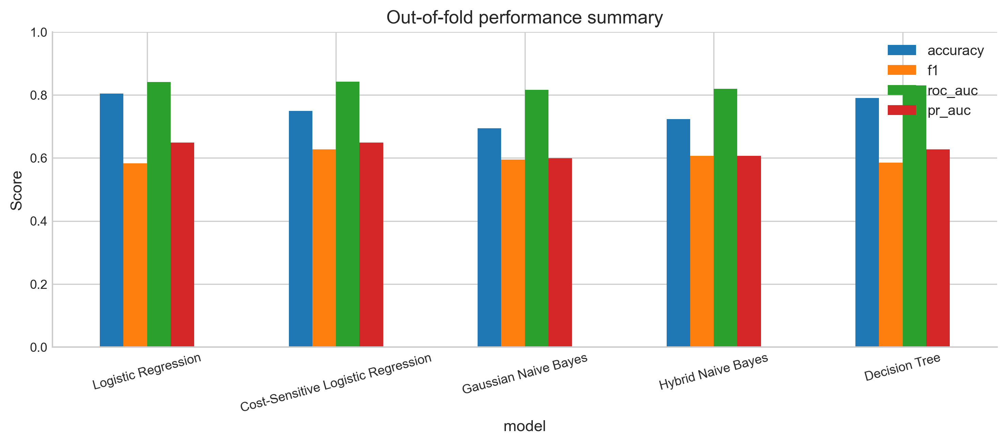
Overall Model Performance
Best Overall
• Gaussian Naive Bayes achieved the highest F1-score.
• Logistic Regression achieved the highest ROC-AUC.
• Decision Tree achieved competitive but slightly less stable performance.
Notes:
Now I’ll summarize our main experimental results based on stratified 5-fold cross validation.
Overall, Gaussian Naive Bayes achieves the best F1-score, meaning it gives the best balance between precision and recall at the chosen threshold. Logistic Regression has the highest ROC-AUC, so it ranks churn customers most reliably across thresholds. Decision Tree is competitive, but its performance is slightly less stable across folds.
In short: if we care about ranking quality, Logistic Regression is strongest; if we care about F1 at a specific operating point, Naive Bayes performs best; and the Decision Tree can capture nonlinearity but needs careful tuning.

Slide 21
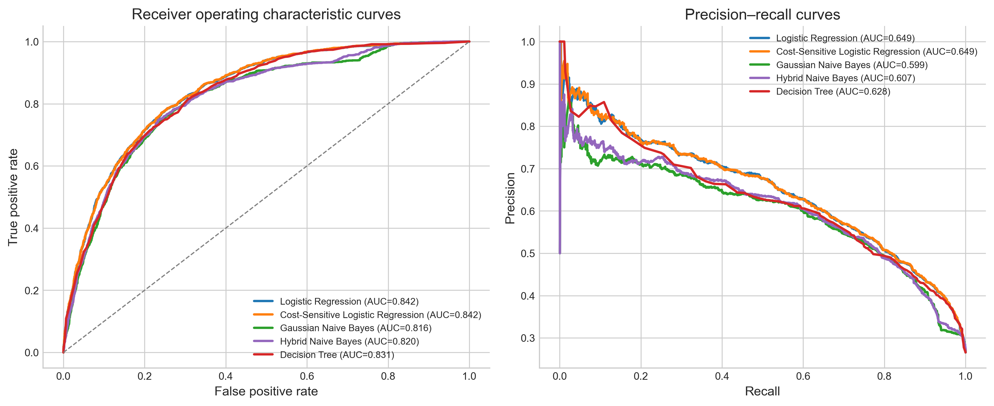
ROC and
Precision-Recall Analysis
Notes:
This slide compares ROC curves and precision–recall curves.
ROC-AUC measures how well a model separates churn vs non-churn across different false positive rates, and Logistic Regression leads here, consistent with its strong ranking ability.
But since churn is class-imbalanced, PR curves are often more actionable. PR focuses directly on the positive class—churn customers—so it highlights the trade-off we actually face: increasing recall catches more churners, but may reduce precision, meaning more unnecessary retention offers.
So we use ROC to evaluate ranking, but we rely more on PR to decide a practical operating point.

Slide 22
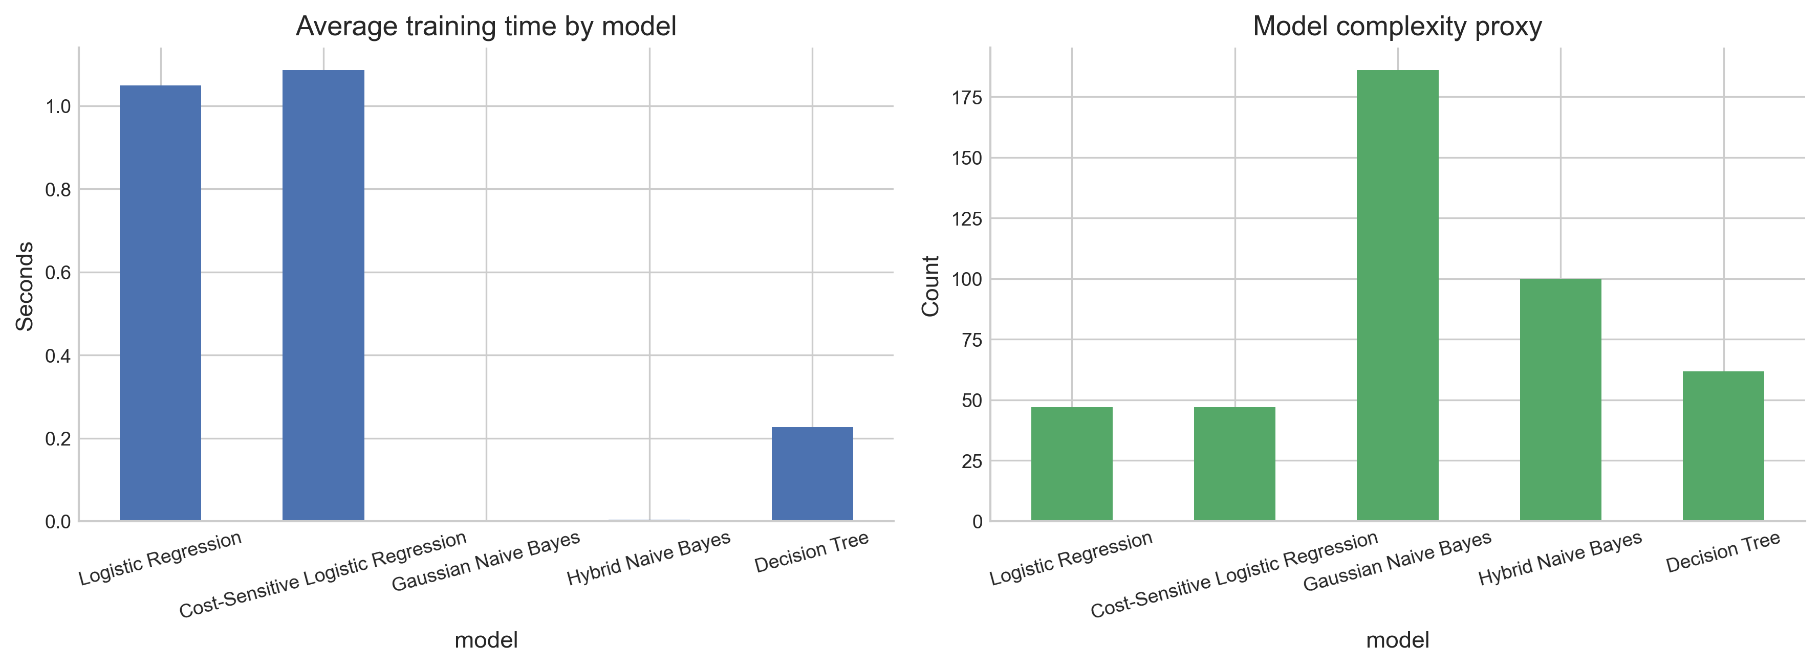
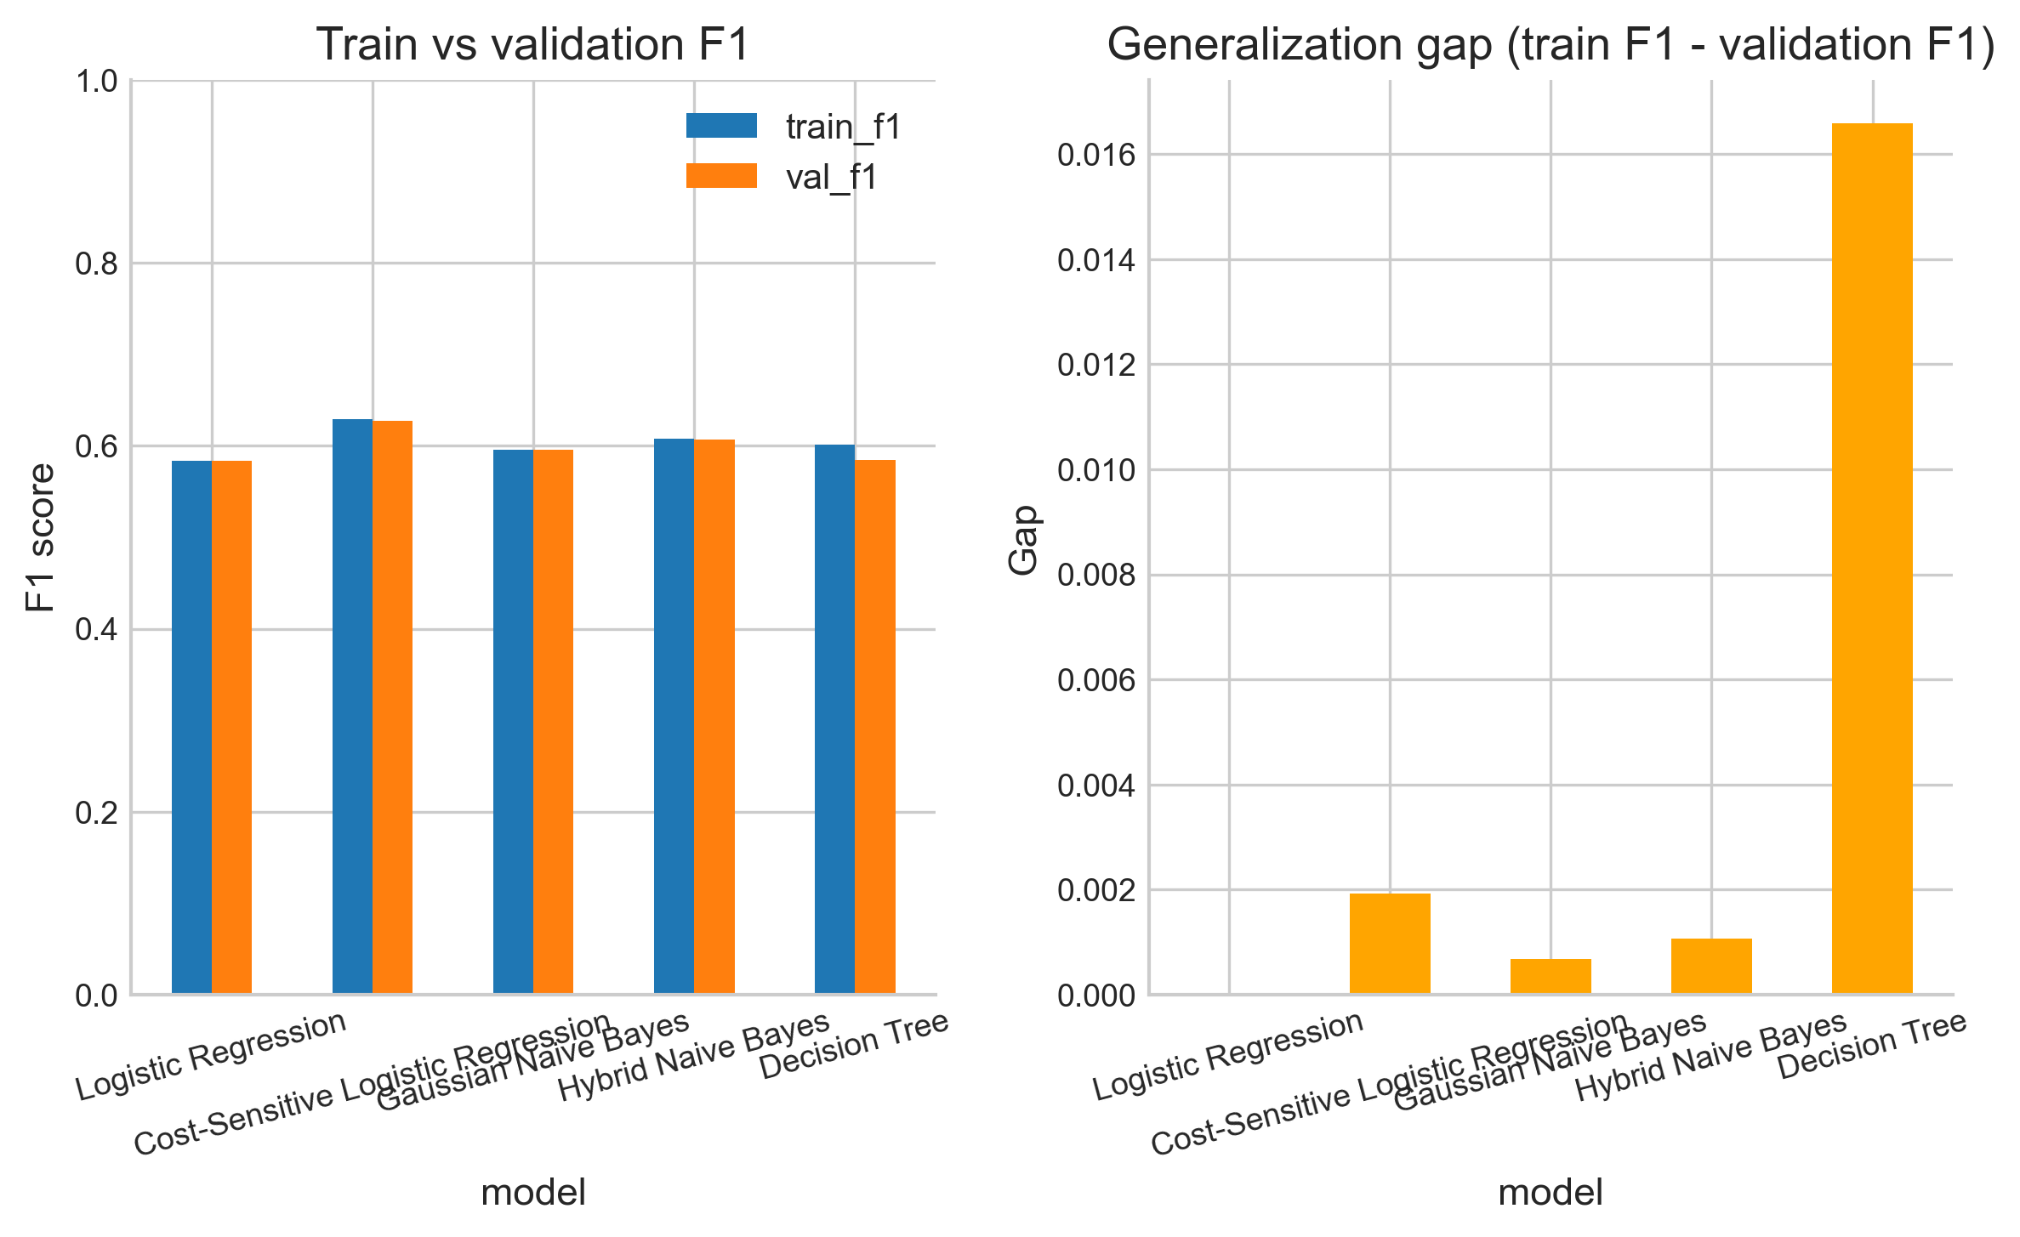
Efficiency and Generalization
• Gaussian Naive Bayes is the fastest model.
• Logistic Regression has the smallest generalization gap.
• Decision Tree captures nonlinearity but shows higher overfitting risk.
Notes:
Next is efficiency and generalization.
Naive Bayes is the fastest, because training is just estimating class-wise means and variances. Logistic Regression is slower due to iterative gradient-based optimization. Decision Trees can also be slower since they search over many possible splits.
For generalization, Logistic Regression shows the smallest train–validation gap, which indicates stable behavior. The Decision Tree shows higher overfitting risk, so controlling depth and other complexity-related parameters is important.

Slide 23
AI3013 Machine Learning Course Project
05
Sensitivity Analysis and Learning Curves
Cao Yiqian

Slide 24
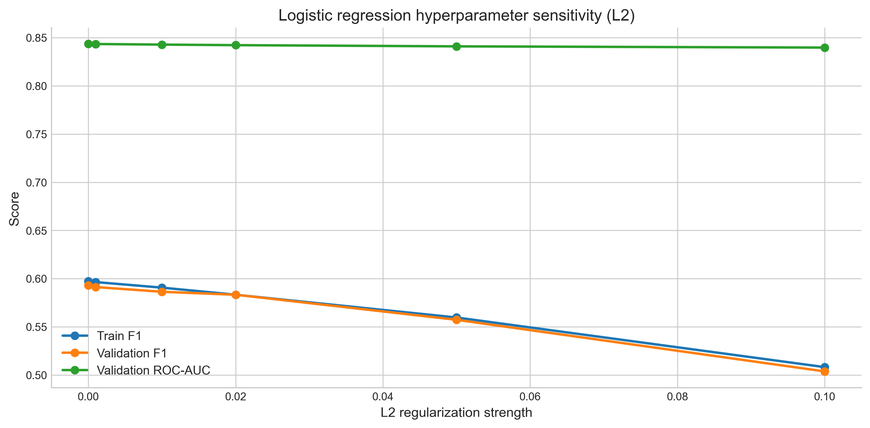
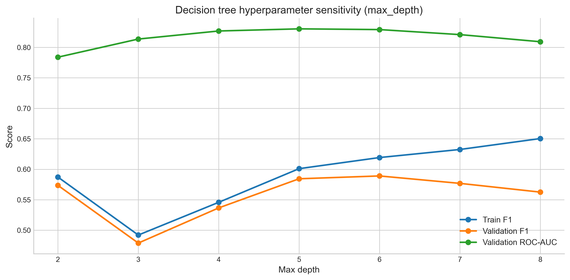
Hyperparameter Sensitivity Analysis
• Excessive L2 regularization reduces Logistic Regression flexibility.
• Increasing tree depth improves training F1 but may reduce validation F1.
• Hyperparameter tuning helps control the bias-variance trade-off.
Notes:
Here we show sensitivity to hyperparameters, which reflects the bias–variance trade-off.
For Logistic Regression, overly strong L2 regularization can hurt validation performance because it makes the model too rigid. So we need moderate regularization.
For the Decision Tree, increasing max depth usually improves training F1, but validation performance may plateau or drop—classic overfitting.
The takeaway is that tuning is not just for better numbers; it also explains why flexible models can degrade on unseen data without constraints.

Slide 25
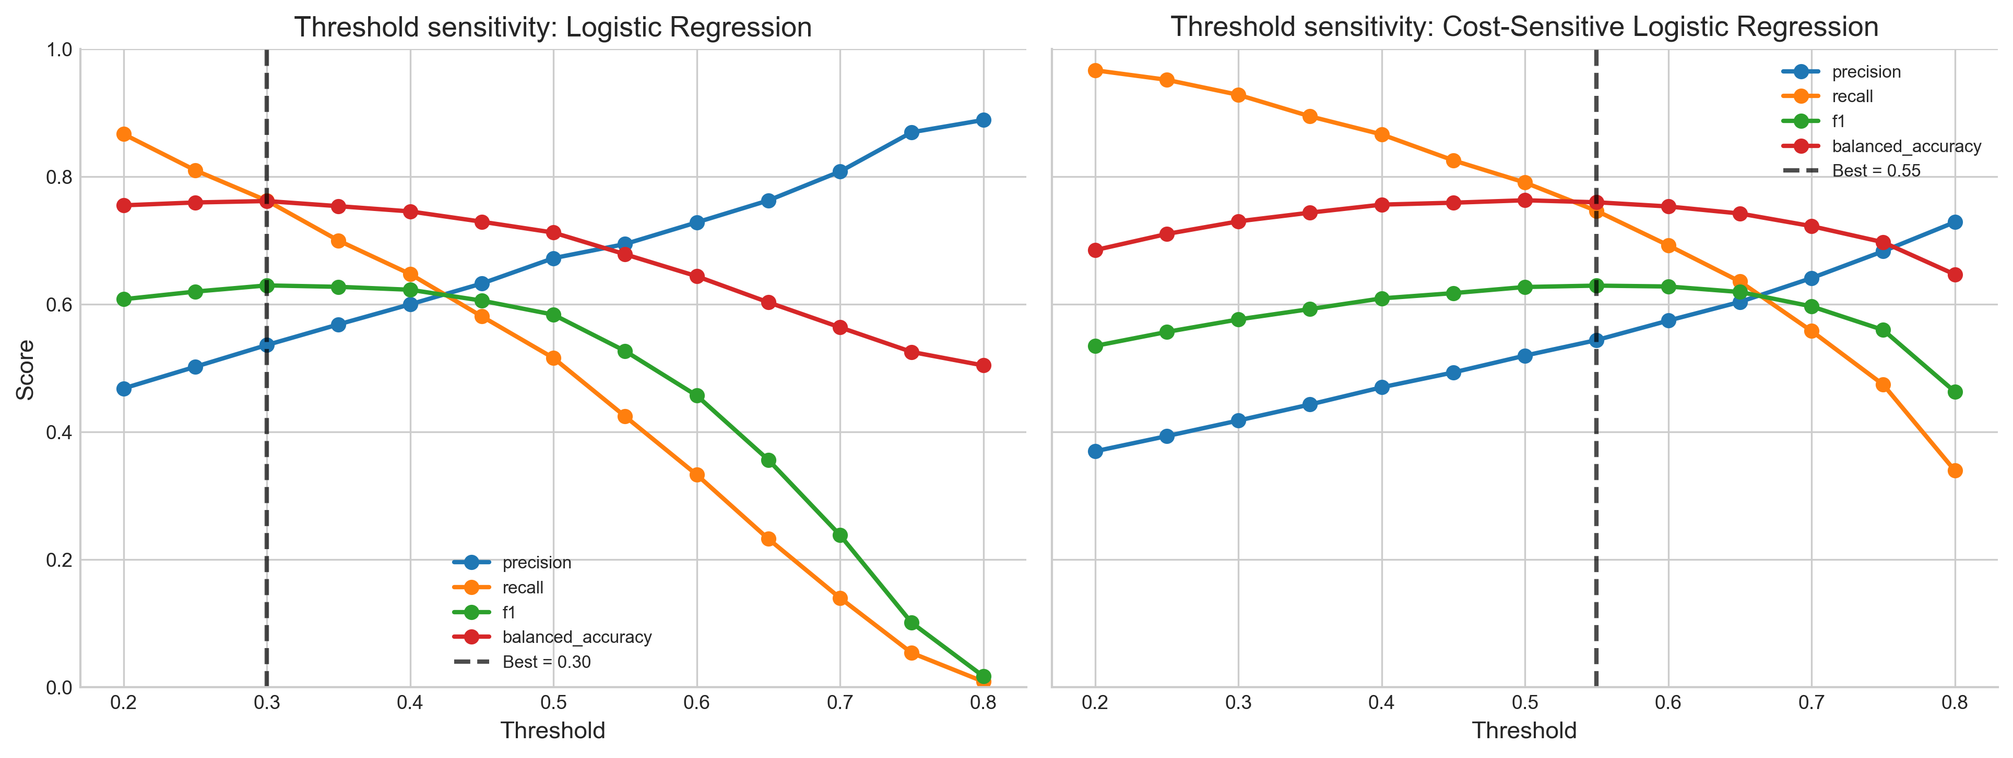
Notes:
This slide shows a **threshold sensitivity analysis**. We sweep the decision threshold from 0.2 to 0.8 and track how **precision, recall, F1-score, and balanced accuracy** change.
On the **left**, with standard **Logistic Regression**, increasing the threshold makes the model more conservative. As a result, **precision steadily increases**, but **recall drops sharply**, so **F1 first improves and then declines**. The dashed line marks the best threshold by F1, which is around **0.30**. This tells us that for an imbalanced churn dataset, using a threshold **lower than 0.5** can better balance catching churners while keeping false alarms manageable.
On the **right**, with **cost-sensitive Logistic Regression**, the trade-off shifts because mistakes have different costs. Here, the best F1 happens at a higher threshold, around **0.55**.
The key takeaway is that the threshold should be **tuned to the business objective**, not fixed at 0.5, because it directly controls the precision–recall trade-off.

Slide 26
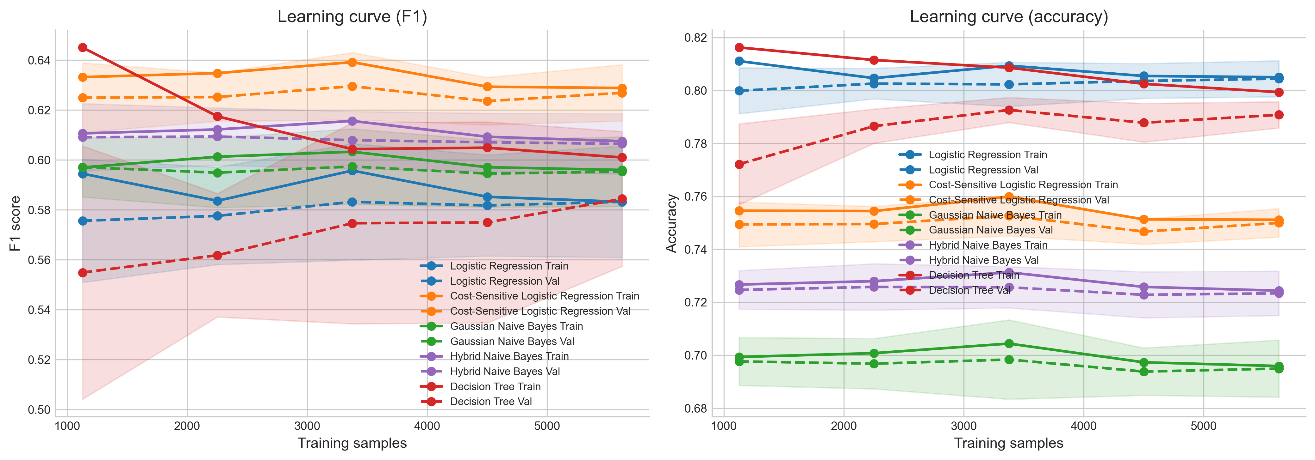

Learning Curves and Interpretation
• Validation performance becomes more stable with more training data.
• Contract type, tenure, and internet service are highly informative.
• Interpretability analysis reveals practical churn drivers.
Notes:
On this slide, we show learning curves for both F1-score on the left and accuracy on the right, as we increase the training set size.
A key takeaway is that validation curves become more stable with more data—the fluctuations and the gap between training and validation generally shrink. This suggests our models benefit from additional samples and that the current dataset size is reasonable, but not yet fully saturated.
We also see different generalization behaviors: Logistic Regression stays relatively stable, while more flexible models, especially the Decision Tree, show a larger train–validation gap, indicating higher overfitting risk.
记得讲一下创新点（就是两个新模型）的提升（左图）直接读图就好

Slide 27
AI3013 Machine Learning Course Project
06
Conclusion and
Future Work
Cao Yiqian

Slide 28

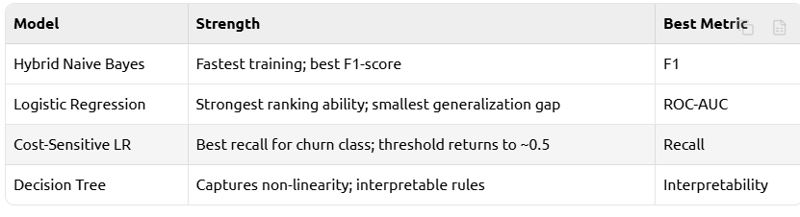
Conclusion
Main findings
• Gaussian Naive Bayes achieved the highest F1-score.
• Logistic Regression achieved the highest ROC-AUC.
• Gaussian Naive Bayes was the fastest model.
• Logistic Regression had the smallest generalization gap.
• The best threshold for Logistic Regression by F1 was 0.30.
Overall conclusion
• Classical machine learning models implemented from scratch can effectively solve telecom churn prediction.
• Different models are preferable under different business objectives.
Future work
• Test on more datasets
• Improve decision tree split strategy
• Explore cost-sensitive learning
Notes:
To summarize our contributions: we didn’t just implement three standard models—we adapted them for churn, covering modeling, training, and deployment.
First, we built a Hybrid Naive Bayes for mixed telecom features—Gaussian for continuous variables and Bernoulli for binary ones—which improved F1 over standard Gaussian NB.
Second, we designed a cost-sensitive Logistic Regression by weighting business costs in the loss, so the model penalizes missed churners more during training. As evidence, the best threshold shifted from 0.30 to 0.55, showing imbalance was handled in training, not only by post-hoc tuning.
Third, we provided a threshold selection framework for deployment: the right threshold should be chosen based on business costs, not a default 0.5.
Overall, these improvements form an end-to-end churn prediction pipeline.

