Slide 1



Lloyds Project
Bruce Chengdou Wei
Digdata

Slide 2

Defaulted loans are part of lending, but they are also where banks lose money. Some customers repay without problems, while others eventually fall behind and the loan has to be written off.
I wanted to understand what makes those two groups different.
So I looked at historical loan data from 18,324 previous customers, checking things like loan conditions, borrower profiles and credit history, just to answer one question:
Can we identify higher risk applicants earlier?
Bruce Chengdou Wei

Slide 3
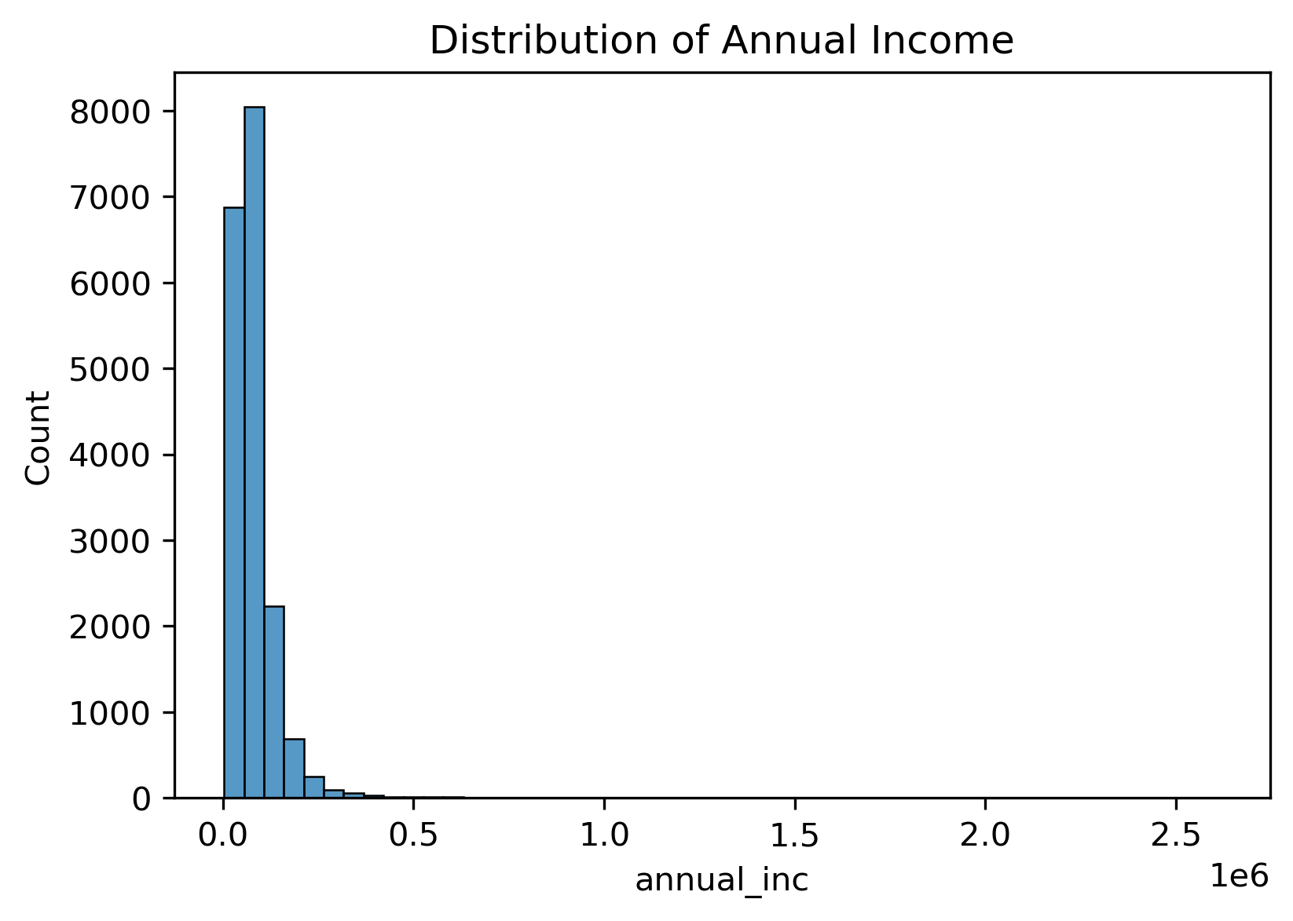
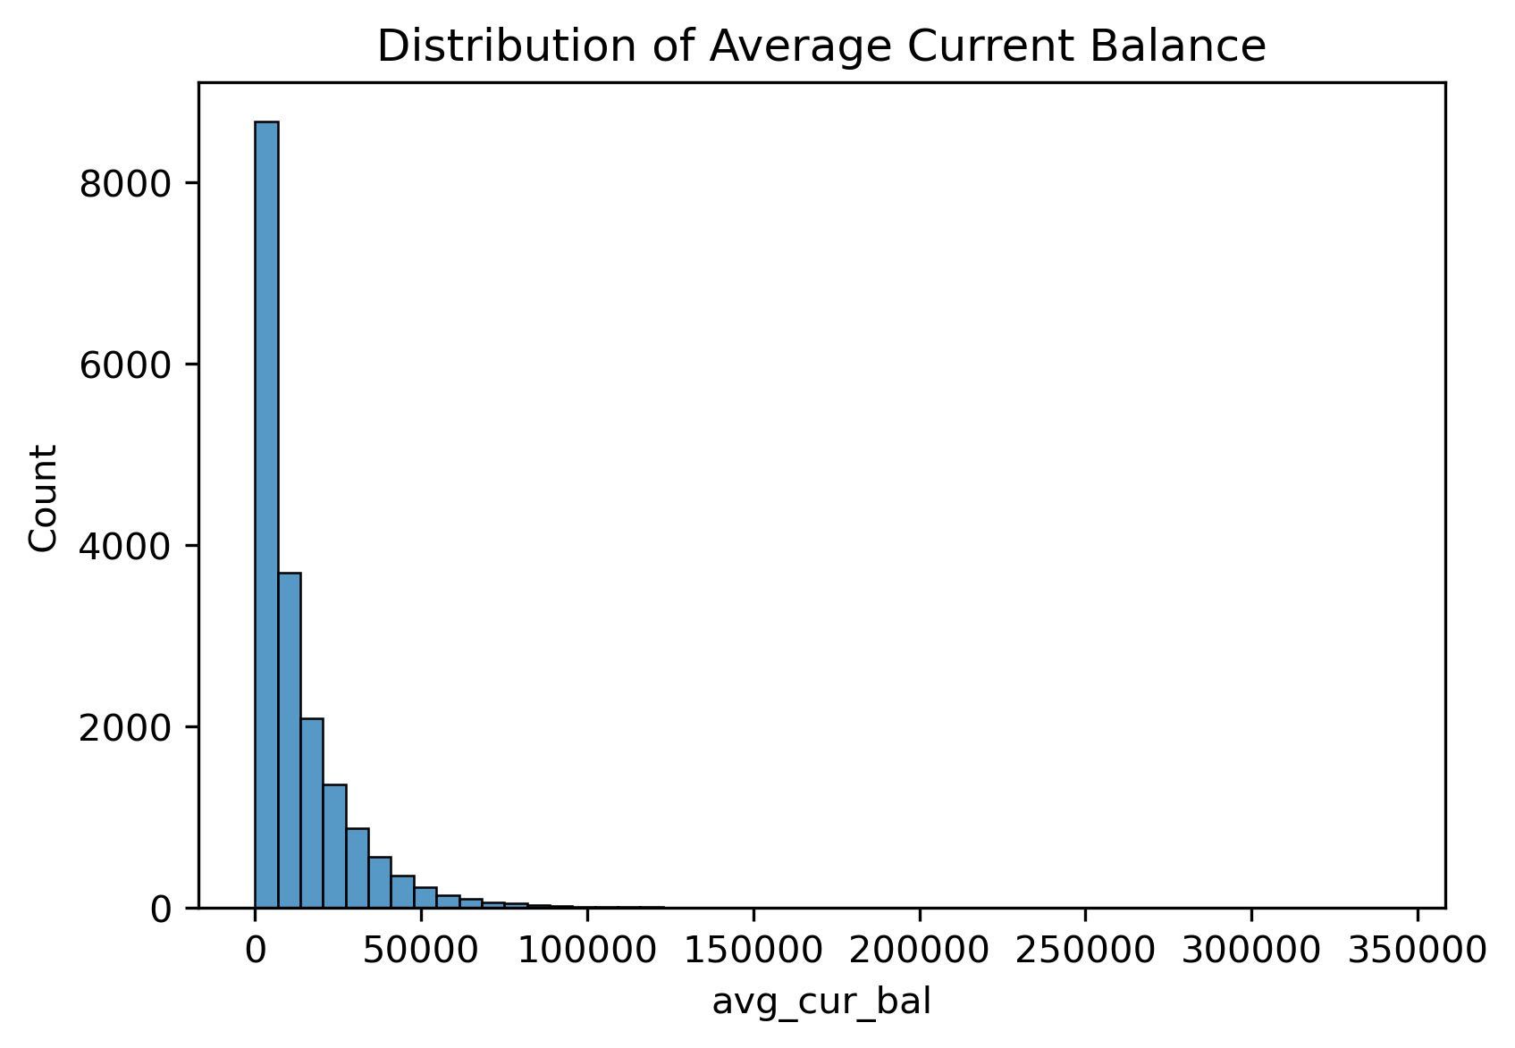

Who Are the Typical Borrowers?
Most borrowers fall within moderate income ranges, with only a small number of very high income outliers.
Average account balances suggesting that most customers maintain relatively modest balances.
Overall, most borrowers look like typical retail banking customers rather than high-income clients. This means their repayment capacity may be more sensitive to loan conditions.
Bruce Chengdou Wei

Slide 4
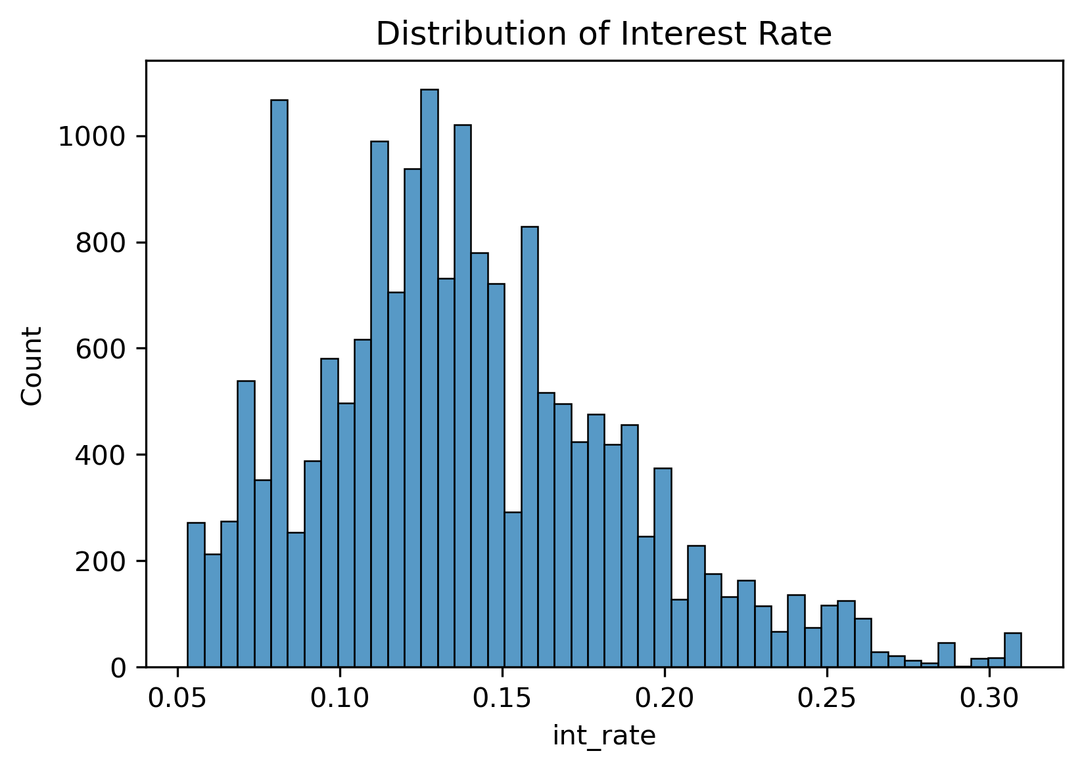
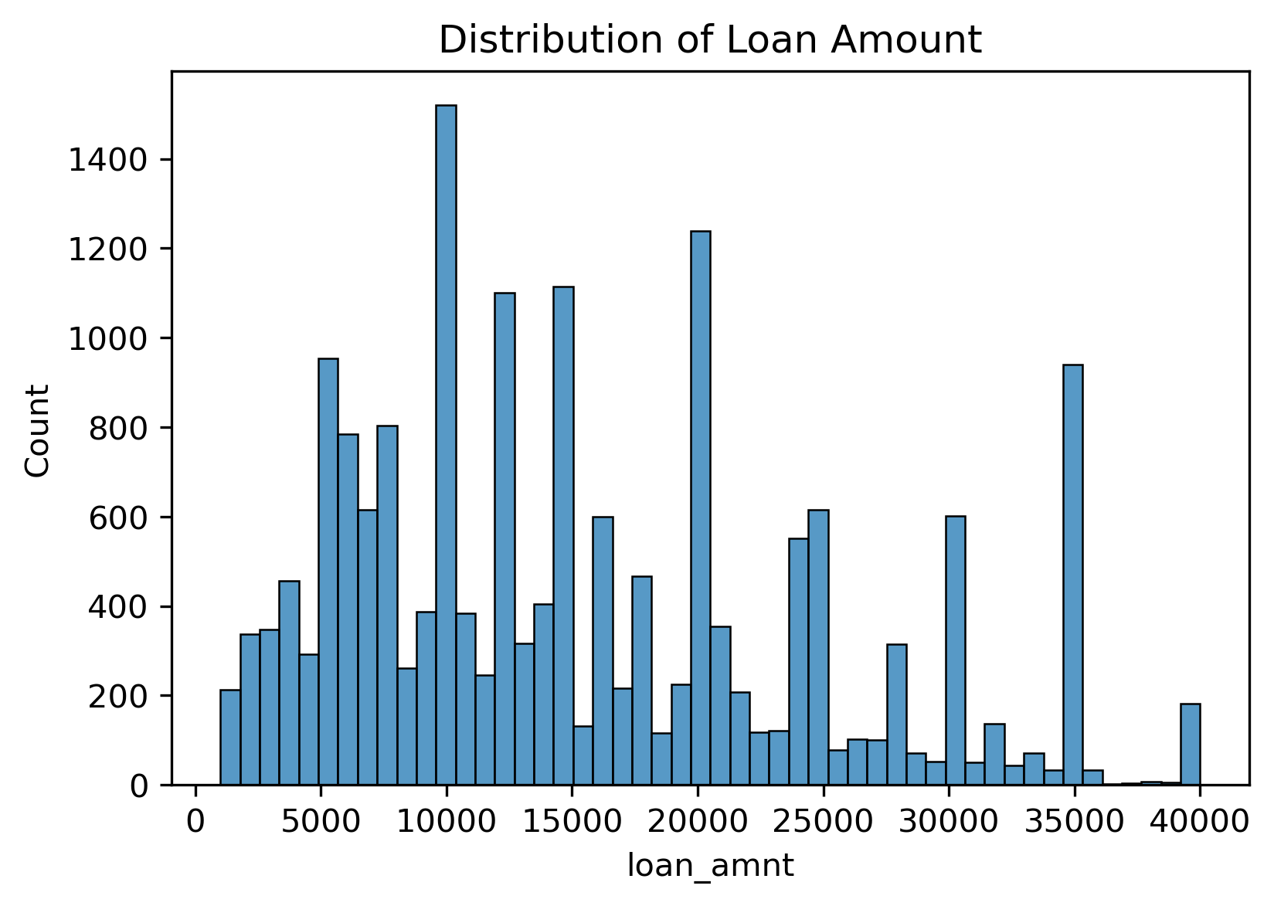
How Are These Loans Structured?
Interest rates are also concentrated within a relatively consistent range, which suggests a fairly standard pricing structure across the portfolio.
Loan amounts cluster around several common borrowing levels, suggesting that customers tend to take out loans in a few standard size bands.
This looks more like a standardised retail lending product, than a highly customised loan book.
Bruce Chengdou Wei

Slide 5
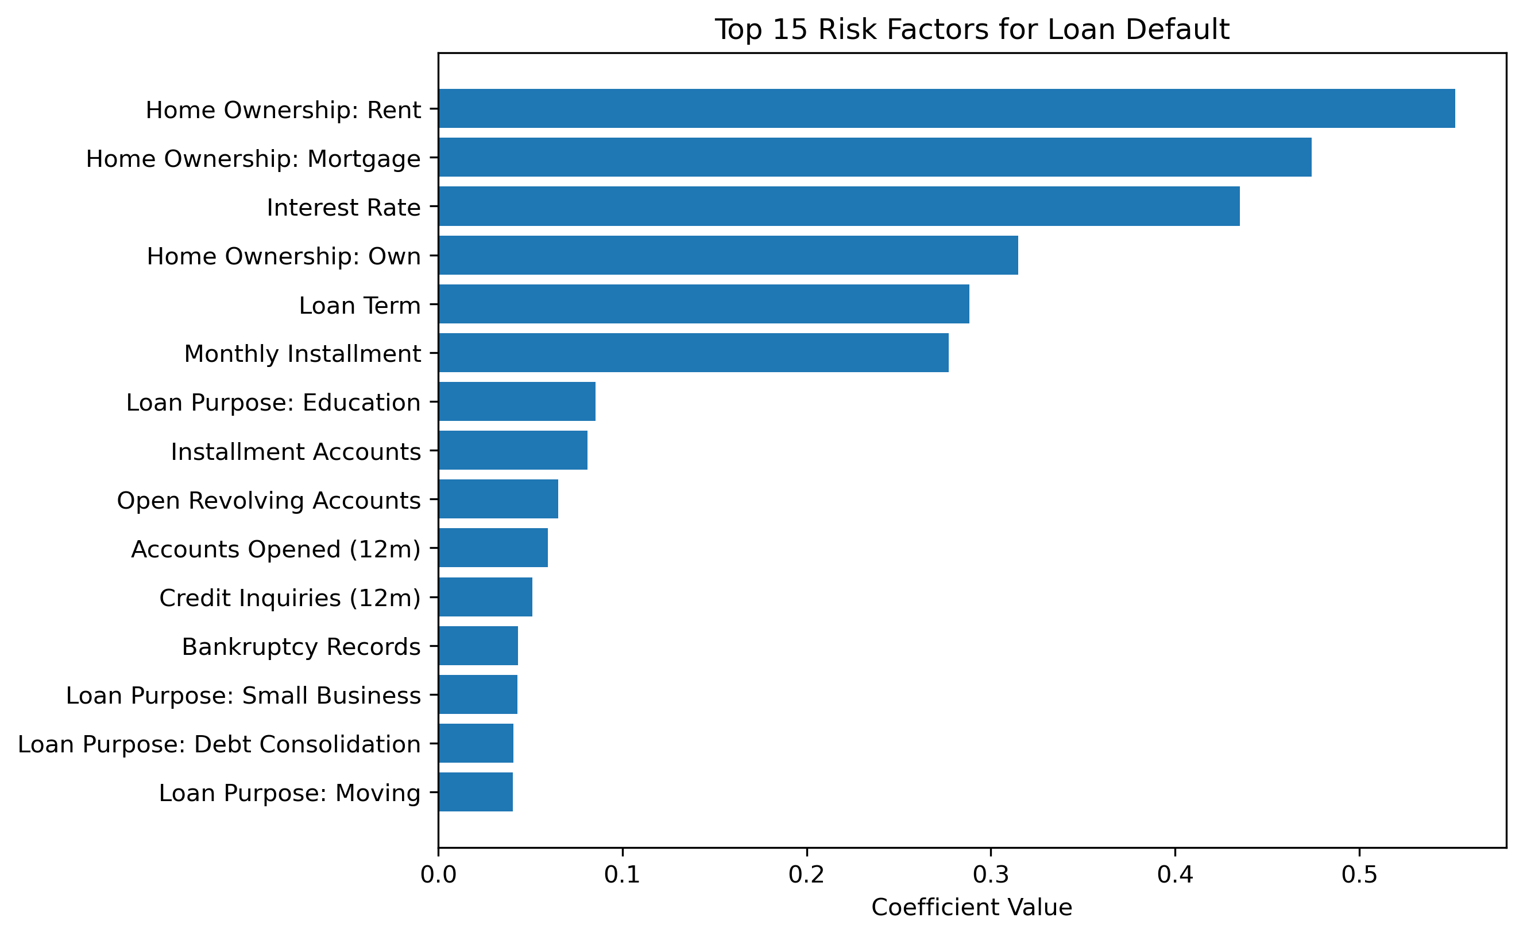
What Higher Risk Borrowers Tend to Look Like？
Defaults appear more frequently among borrowers who face higher borrowing costs, longer loan terms, and higher monthly instalments.
Housing status also stands out: borrowers who rent rather than own their homes appear more often among defaulted loans.
Several loan purposes, including education, small business financing and debt consolidation, also show higher default association.
The results suggest that loan structure and borrower stability are key drivers of default risk.
Bruce Chengdou Wei

Slide 6
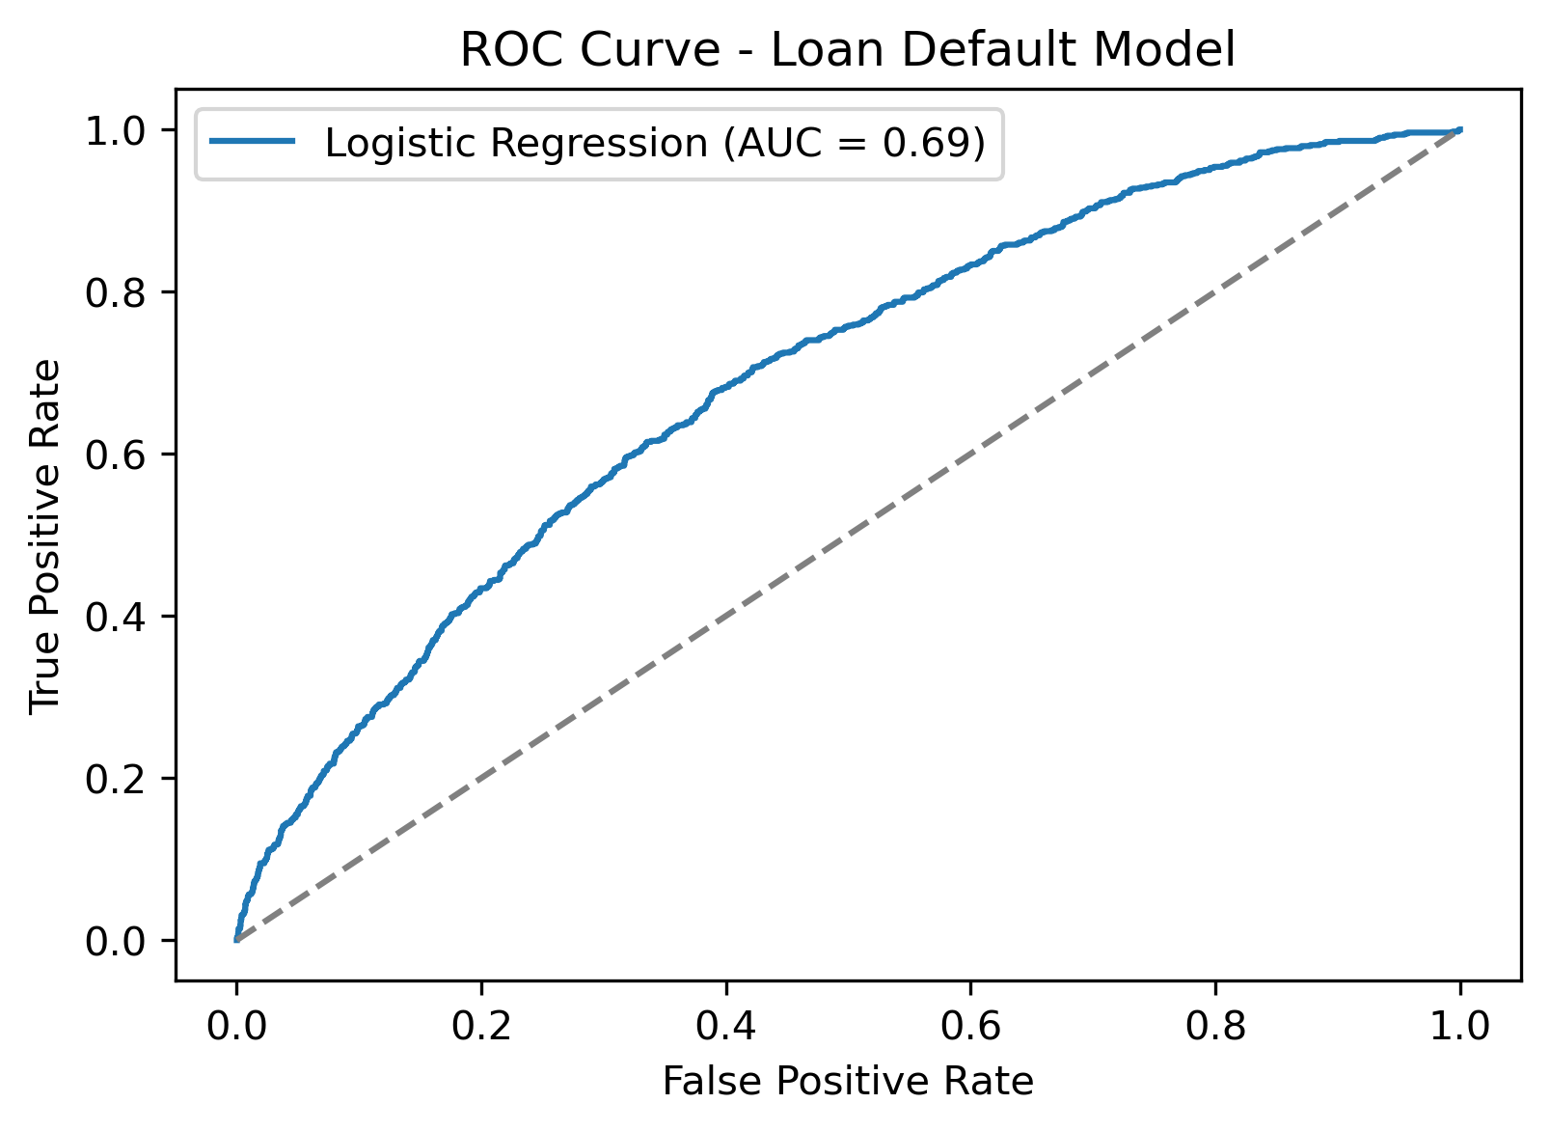
Can Default Risk Be Predicted?
Model approach
A logistic regression model was used to estimate the probability of loan default.
Borrower characteristics, loan terms and credit indicators were used as inputs.
Model performance
An ROC-AUC of around 0.69 suggests the model is not strong enough for fully automated decisions, but it is capable of highlighting higher risk cases.
Bruce Chengdou Wei
Notes:
Testing whether borrower characteristics can help identify future defaults

Slide 7
1. Pay closer attention to borrowing burden.
Charged-off loans tend to carry higher interest rates (16.1% vs 13.2%), with larger loan amounts, and higher monthly instalments. Applications combining these conditions may require stricter affordability checks before approval.
What Lloyds Can Actually Do？
2. Watch for Borrower stability signals. Defaulted borrowers tend to show:
lower annual income (£73k vs £82k),
weaker account balances,
higher credit utilisation and more recent credit inquiries
These factors highlight applicants whose repayment capacity may be more fragile.
3. Use predictive scoring to support early screening.
The logistic model achieved ROC-AUC 0.69. Lower thresholds can capture most defaults (recall 95%), but at the cost of many false positives, suggesting this model is best used for early screening rather than automated approval.
Default borrowers in this dataset tend to carry slightly larger, more expensive loans, while showing weaker financial stability indicators.
Bruce Chengdou Wei

