Slide 1

Classification and Clustering
CS303B – Assignment 2
Name：Zhang Ce Student ID: 11910803

Slide 2
Content
01
Dimension Reduction and Clustering
02
Binary Classification

Slide 3
Part I
Dimension Reduction and Clustering
1.PCA and clustering
2.LDA and clustering

Slide 4
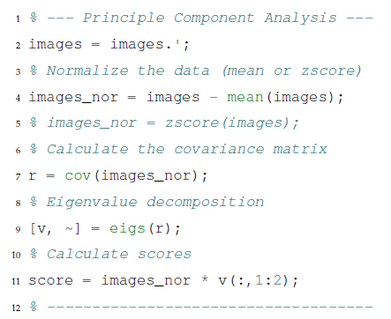
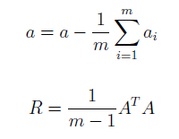

Principle Component Analysis
Goal:
find several directions such that the variance of the projected data in the subspace is maximized.
Steps:
1. Take transpose, make every column representing a picture.
2. Data normalization, minus average in each column.
3. Calculate the covariance matrix.
4. Diagonalization, keep the 2 eigenvectors with highest eigenvalues as the new direction, delete other parts.

Slide 5
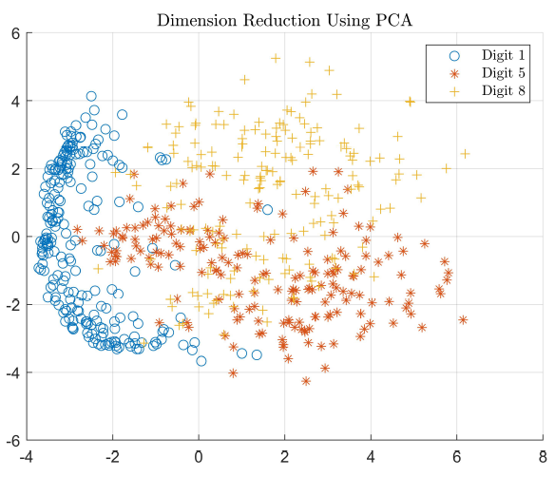
Principle Component Analysis
Finally, we can get a 2-dimension plot of the original 784-dimension pictures with lowest wastage.
We can find that the data points of digit 1 distribute on the left side, while digit 5 lies on the bottom-right, digit 8 on the top-right. We can see that the PCA process does separate those datapoints in the 2-dimension plot.

Slide 6
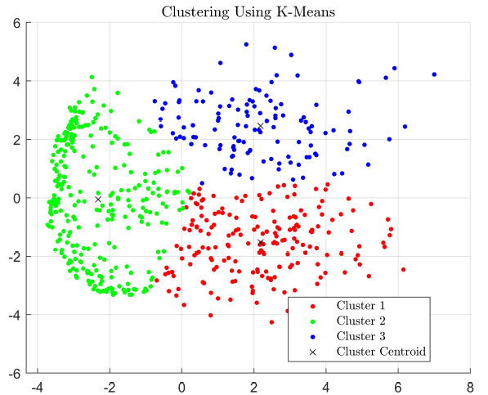
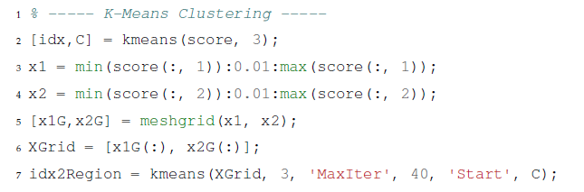
Centroid-Based: K-means Clustering
K-means clustering is an unsupervised learning algorithm that divide unlabeled dataset into k different clusters.

Slide 7
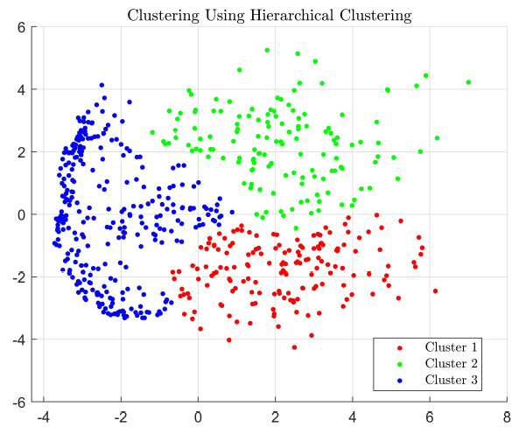

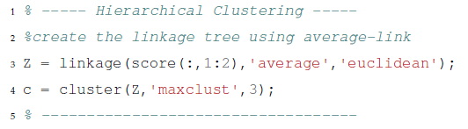
Connectively-Based: Hierarchical Clustering
Different from the centroid-based clustering method K-means, hierarchical clustering will try to calculate the distances between clusters and make a final decision.

Slide 8
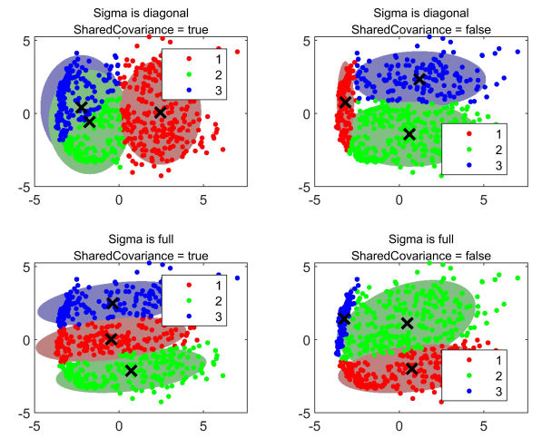

Distribution-Based: Gaussian Mixture Model
As our options of covariance matrix
type change, the clustering result also changes.

Slide 9
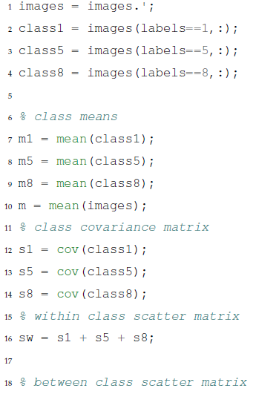

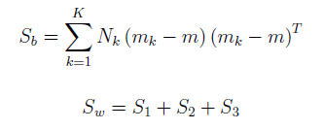
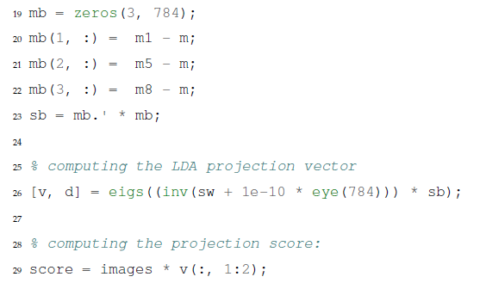
Linear Discriminant Analysis
Different with PCA, LDA finds most discriminant projection by maximizing between-class distance and minimizing within-class distance. It is a supervised algorithm.
The trace of those 2 matrices represent the between-class distance and the within-class distance.

Slide 10
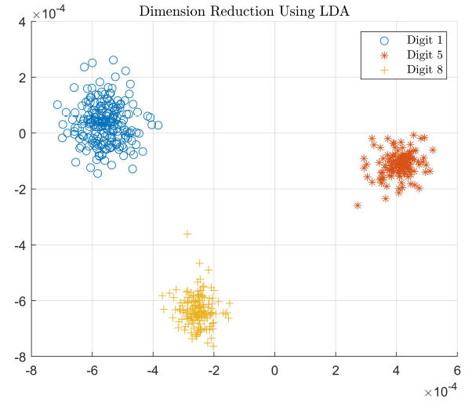
Linear Discriminant Analysis
From the result, we can clearly seen that the different digits are divided into different clusters in the 2-D plot, with no overlapping area.

Slide 11
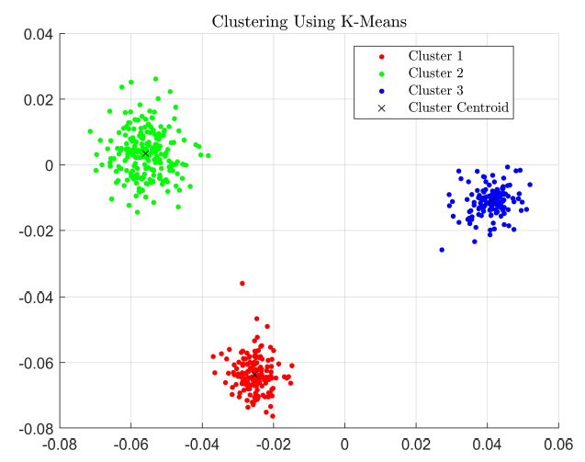
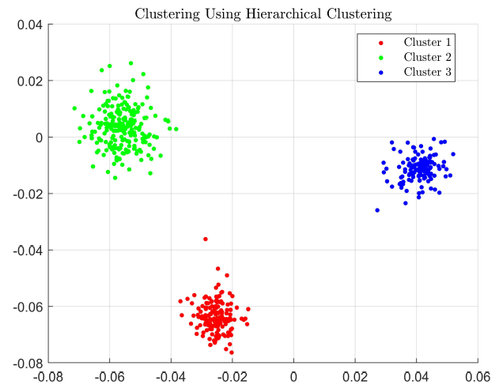
Clustering after LDA

Slide 12
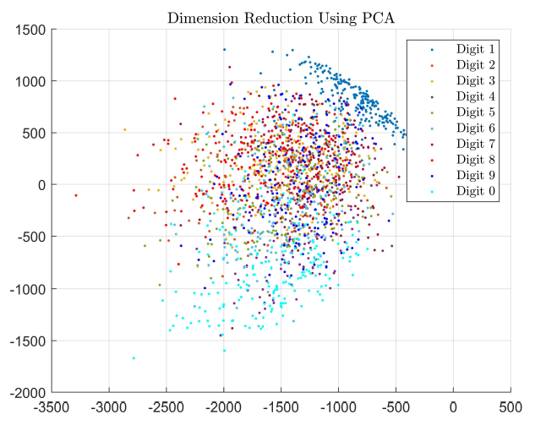
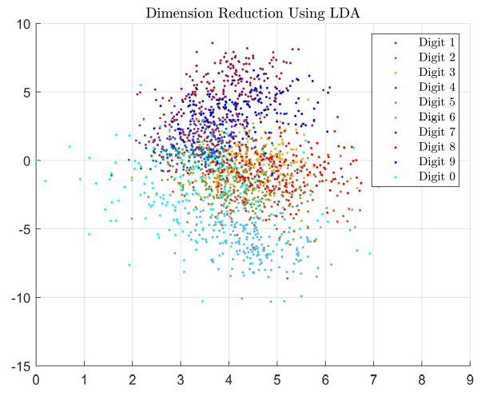
PCA and LDA on Larger MNIST Dataset

Slide 13
Part II
Binary Classification
1.SVM, NN
2.Cross-validation, ROC curves
3. Fine-tune a parameter

Slide 14


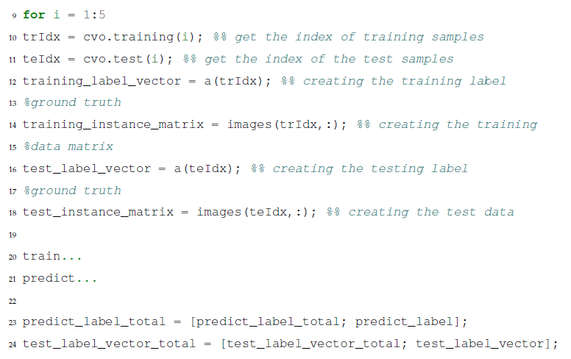
Preprocessing of Data, Cross-Validation Settings
Firstly, we divide the dataset by digit 5 against others. Here I set digit 5 with label 1 and others with label 0.
I also use 5-fold cross-validation in this part to get a authentic accuracy to evaluate the model.
Notice that cvpartition() will only be executed once during this whole
binary classification task to guarantee fairness for different algorithms.

Slide 15
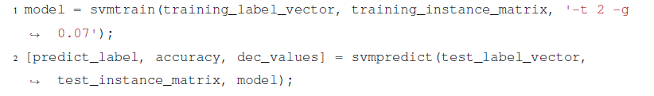
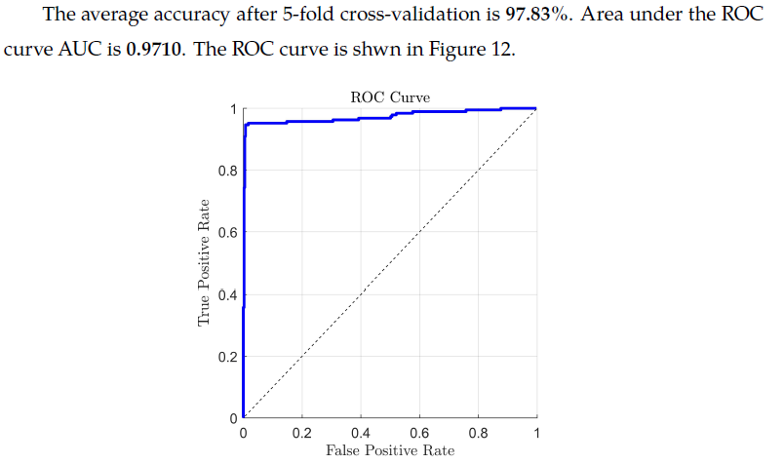
SVM with RBF Kernal

Slide 16

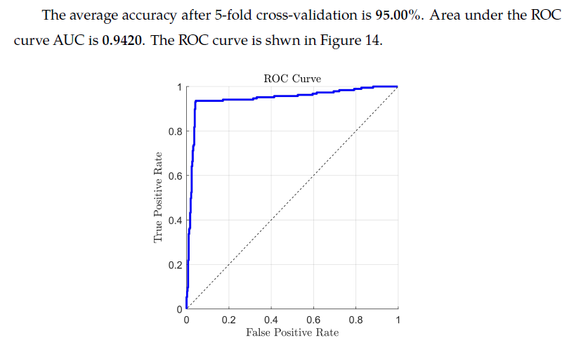
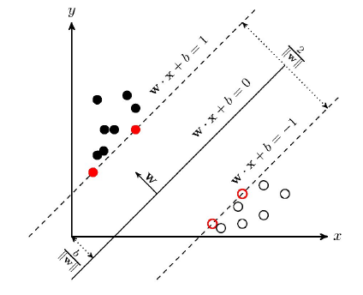
SVM with Linear Kernal

Slide 17
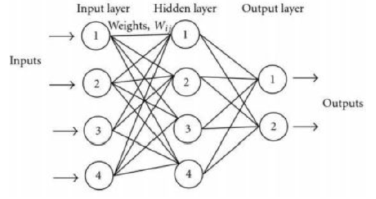
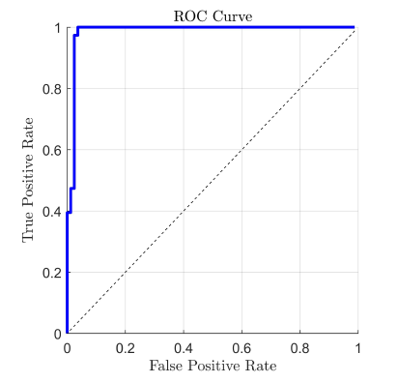
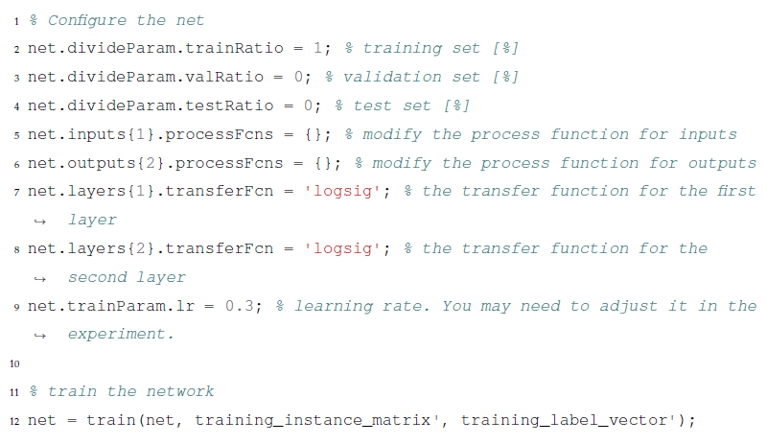
Neural Network

Slide 18
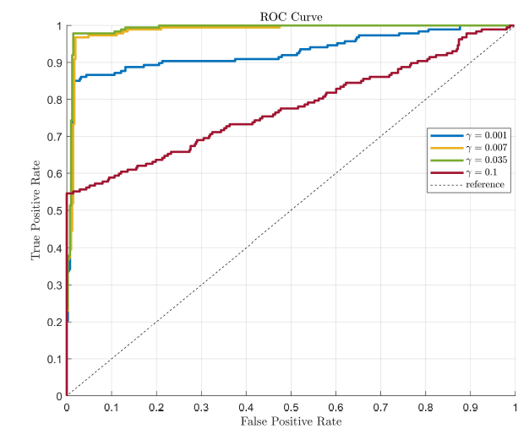
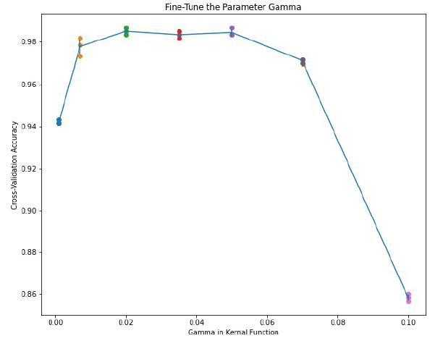
Fine-Tune the Parameters
Here we choose to fine-tune the hyperparameter gamma in SVM with RBF kernal.
Gamma should be chosen between 0.02 and 0.05.

Slide 19
Thanks for Listening!
CS303B – Assignment 2
Name：Zhang Ce Student ID: 11910803

