Slide 1
CSS

Slide 2
Box Sizing
The CSS box-sizing property allows us to include the padding and border in an element's total width and height.

Slide 3
Without the CSS box-sizing Property
By default, the width and height of an element is calculated like this:
width + padding + border = actual width of an element height + padding + border = actual height of an element
This means: When you set the width/height of an element, the element often appears bigger than you have set (because the element's border and padding are added to the element's specified width/height).

Slide 4
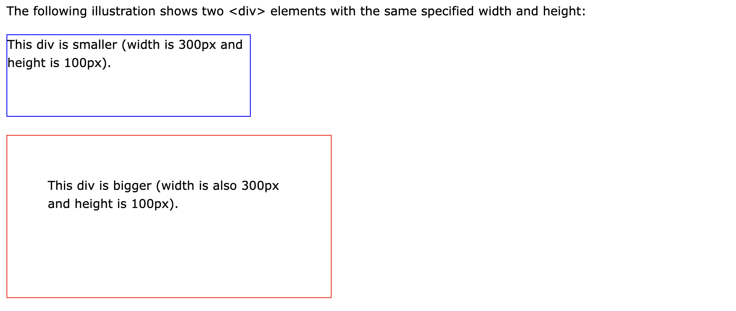

Slide 5
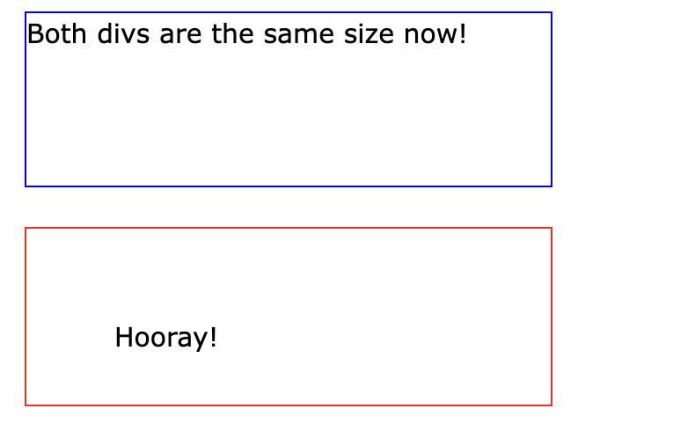
With the CSS box-sizing Property
The box-sizing property allows us to include the padding and border in an element's total width and height.
If you set box-sizing: border-box; on an element, padding and border are included in the width and height

Slide 6
CSS Layout - float and clear
The CSS float property specifies how an element should float.
The CSS clear property specifies what elements can float beside the cleared element and on which side.

Slide 7
float Property
The float property is used for positioning and formatting content e.g. let an image float left to the text in a container.
The float property can have one of the following values:
left - The element floats to the left of its container
right - The element floats to the right of its container
none - The element does not float (will be displayed just where it occurs in the text). This is default
inherit - The element inherits the float value of its parent
In its simplest use, the float property can be used to wrap text around images.

Slide 8
clear Property
When we use the float property, and we want the next element below (not on right or left), we will have to use the clear property.
The clear property specifies what should happen with the element that is next to a floating element.
The clear property can have one of the following values:
none - The element is not pushed below left or right floated elements. This is default
left - The element is pushed below left floated elements
right - The element is pushed below right floated elements
both - The element is pushed below both left and right floated elements
inherit - The element inherits the clear value from its parent

Slide 9
CSS Units
CSS Units
CSS has several different units for expressing a length.
Many CSS properties take "length" values, such as width, margin, padding, font-size, etc.
Length is a number followed by a length unit, such as 10px, 2em, etc.
Absolute
Relative

Slide 10
Absolute Lengths
The absolute length units are fixed and a length expressed in any of these will appear as exactly that size.
Absolute length units are not recommended for use on screen, because screen sizes vary so much. However, they can be used if the output medium is known, such as for print layout.
cm | centimeters
mm | millimeters
in | inches (1in = 96px = 2.54cm)
px * | pixels (1px = 1/96th of 1in)
pt | points (1pt = 1/72 of 1in)
pc | picas (1pc = 12 pt)

Slide 11
Relative Lengths
Relative length units specify a length relative to another length property. Relative length units scale better between different rendering medium.
Unit | Description
em | Relative to the font-size of the element (2em means 2 times the size of the current font)
rem | Relative to font-size of the root element
vw | Relative to 1% of the width of the viewport*
vh | Relative to 1% of the height of the viewport*
% | Relative to the parent element

Slide 12
CSS box-shadow Property
The box-shadow property attaches one or more shadows to an element.
Syntax: box-shadow: 10px 10px grey;

Slide 13
CSS text-shadow Property
The text-shadow property adds shadow to text.
This property accepts a comma-separated list of shadows to be applied to the text.
Syntax: text-shadow: 2px 2px #ff0000;

Slide 14
CSS Selectors
CSS element Selector
CSS id Selector
CSS class Selector
CSS Universal Selector
CSS Grouping Selector

Slide 15
CSS clip Property
The clip property lets you specify a rectangle to clip an absolutely positioned element. The rectangle is specified as four coordinates, all from the top-left corner of the element to be clipped.
The clip property does not work if "overflow:visible".
Syntax: clip: rect(0px,60px,200px,0px);

Slide 16
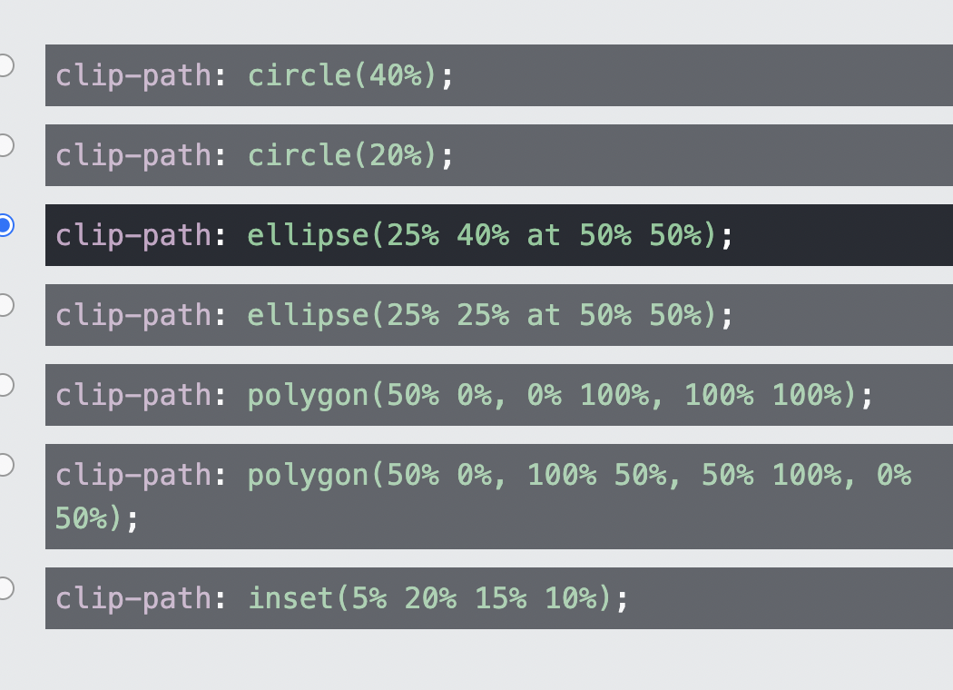
CSS clip-path Property
The clip-path property lets you clip an element to a basic shape or to an SVG source.

Slide 17
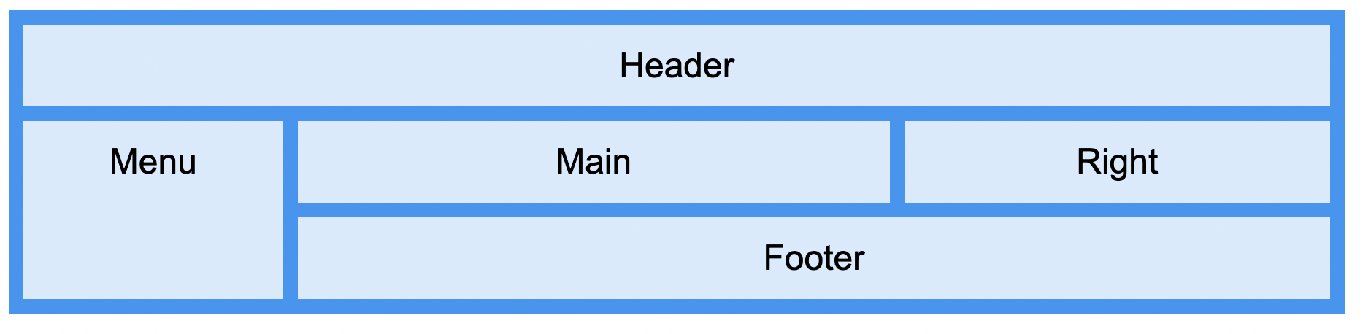
CSS Grid Layout Module
The CSS Grid Layout Module offers a grid-based layout system, with rows and columns, making it easier to design web pages without having to use floats and positioning.
Grid-area property

Slide 18
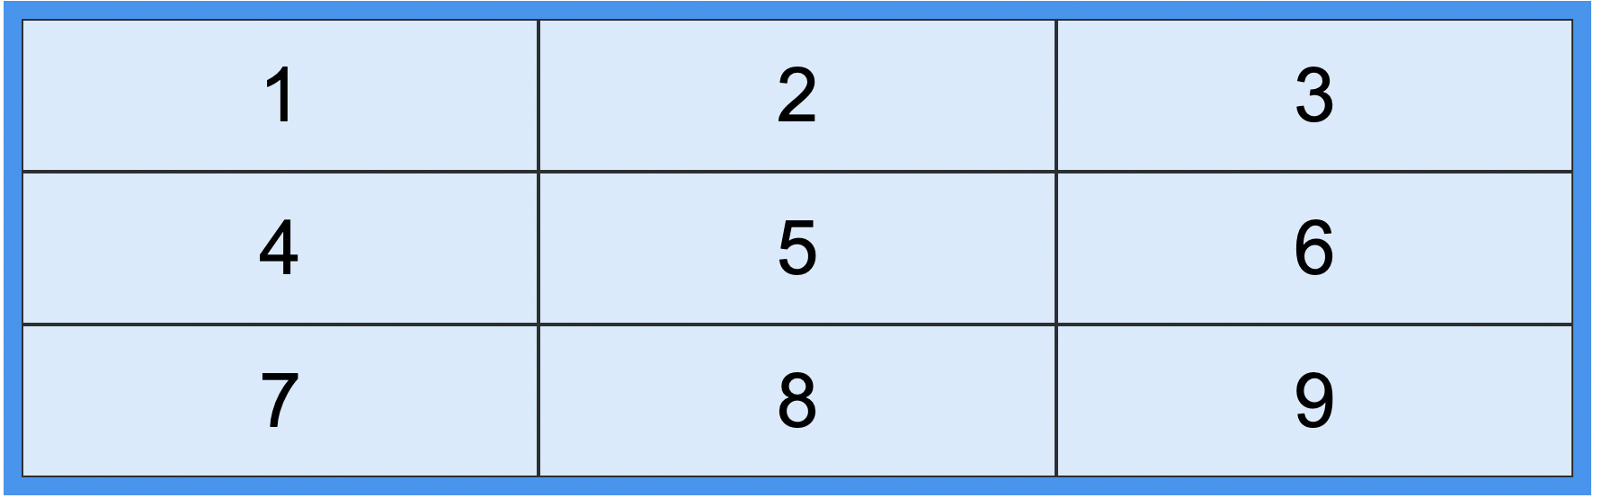
Grid Elements
A grid layout consists of a parent element, with one or more child elements

Slide 19
Display Property
An HTML element becomes a grid container when its display property is set to grid or inline-grid.
grid-template-areas
grid-template-columns Property
grid-template-row Property
justify-content
align-content

Slide 20
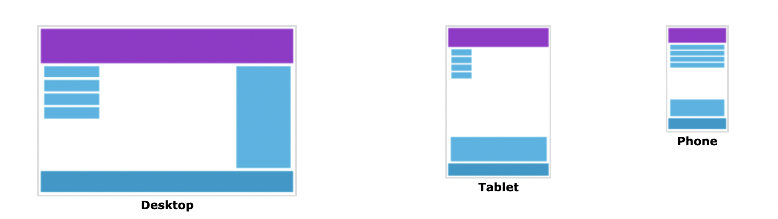
Responsive Web Design
Responsive web design makes your web page look good on all devices.
Responsive web design uses only HTML and CSS.
Responsive web design is not a program or a JavaScript

Slide 21
The Viewport
The viewport is the user's visible area of a web page.
The viewport varies with the device, and will be smaller on a mobile phone than on a computer screen.
Setting The Viewport
<meta name="viewport" content="width=device-width, initial-scale=1.0">
This gives the browser instructions on how to control the page's dimensions and scaling.
The width=device-width part sets the width of the page to follow the screen-width of the device (which will vary depending on the device).
The initial-scale=1.0 part sets the initial zoom level when the page is first loaded by the browser.

Slide 22
Media Queries
Media query is a CSS technique introduced in CSS3.
It uses the @media rule to include a block of CSS properties only if a certain condition is true.
If the browser window is 600px or smaller, the background color will be lightblue:
@media only screen and (max-width: 600px) { body { background-color: lightblue; } }
Always Design for Mobile First
Mobile First means designing for mobile before designing for desktop or any other device (This will make the page display faster on smaller devices).

Slide 23
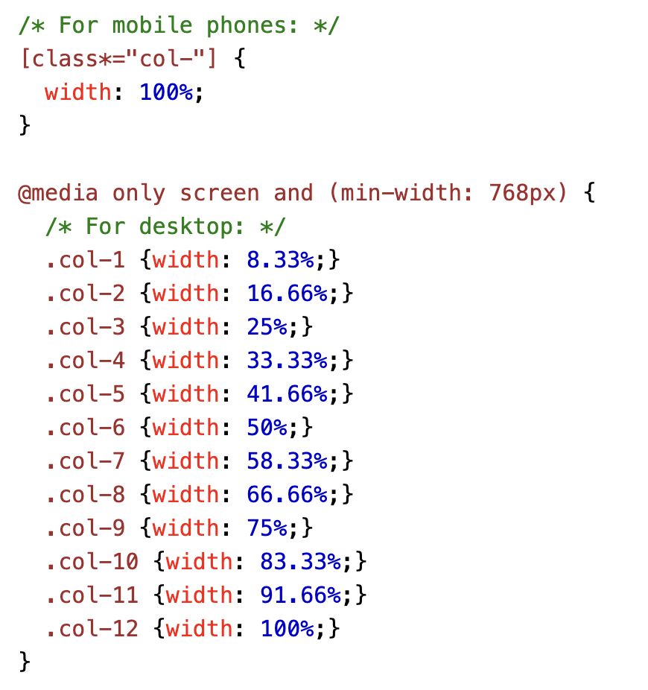
Example

Slide 24
Break Points
/* Extra small devices (phones, 600px and down) */ @media only screen and (max-width: 600px) {...} /* Small devices (portrait tablets and large phones, 600px and up) */ @media only screen and (min-width: 600px) {...} /* Medium devices (landscape tablets, 768px and up) */ @media only screen and (min-width: 768px) {...} /* Large devices (laptops/desktops, 992px and up) */ @media only screen and (min-width: 992px) {...} /* Extra large devices (large laptops and desktops, 1200px and up) */ @media only screen and (min-width: 1200px) {...}

Slide 25
Orientation: Portrait / Landscape
Media queries can also be used to change layout of a page depending on the orientation of the browser.
@media only screen and (orientation: landscape) { body { background-color: lightblue; } }

Slide 26
Hide Elements With Media Queries
Another common use of media queries, is to hide elements on different screen sizes:
/* If the screen size is 600px wide or less, hide the element */ @media only screen and (max-width: 600px) { div.example { display: none; } }

Slide 27
Button Styling
Basic Button Styling
Button Colors
Button Sizes
Rounded Buttons
Colored Button Borders
Hoverable Buttons
Shadow Buttons
Disabled Buttons
Animated Buttons

Slide 28
Styling Tables
Table Borders
Full-Width Table
Collapse Table Borders
Table Width and Height
Table Alignment
Table Padding
Horizontal Dividers
Hoverable Table
Striped Tables
Table Color

Slide 29
CSS transform Property
Rotate
Skew
Scale
translate()
rotate()
scaleX()
scaleY()
scale()
skewX()
skewY()
skew()

Slide 30
CSS tranisition property
CSS transitions allows you to change property values smoothly, over a given duration.
transition
transition-delay => Delay the Transition Effect
transition-duration
transition-property
transition-timing-function => Specify the Speed Curve of the Transition

