Slide 1
Fidessa group
Hackathon

Slide 2

“The leading supplier of multi-asset trading and investment management solutions for the world’s financial community”

Slide 3
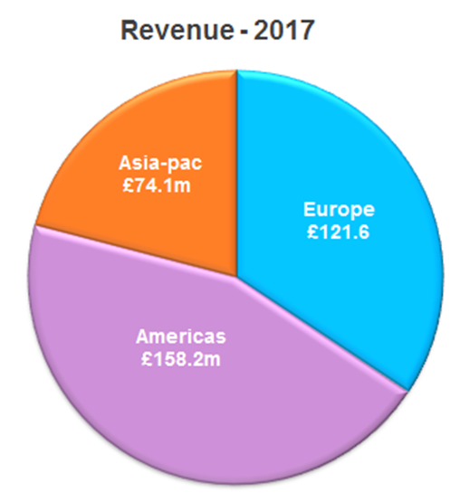
Credentials
Pedigree - Market leader with benchmark services for both the buy-side & sell-side
Experienced - Delivering leading-edge systems for 36 years, used by 85% of tier-one institutions
Scale - Global presence & broad client base: major banks & asset managers to niche players, 1,700 staff, 900 clients, 22,000 users
Established - Listed on LSE (FDSA), FTSE 250 member & £354m annual turnover

Slide 4
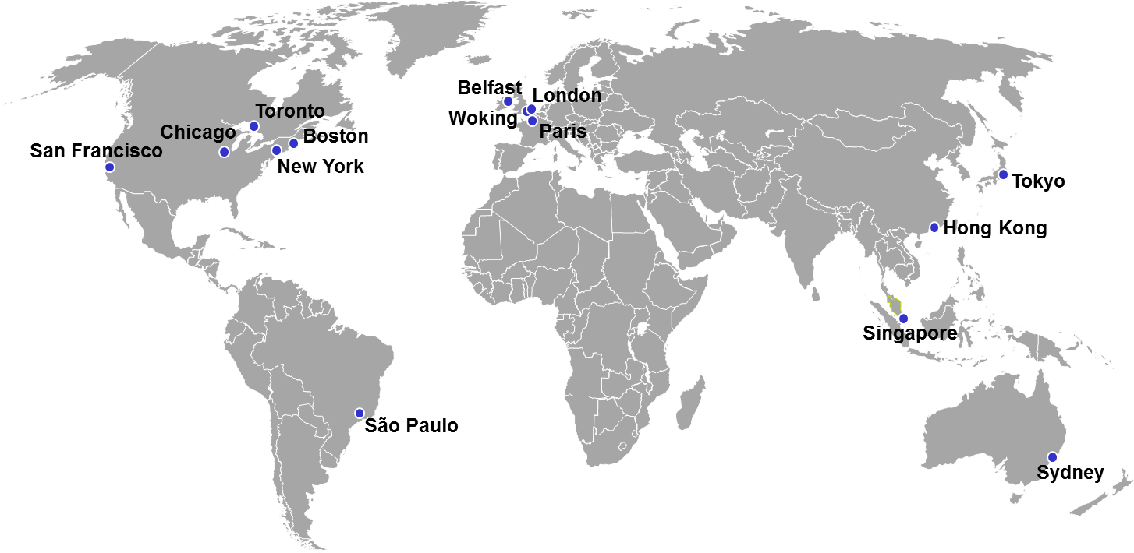
Global staff/offices
Total global headcount = 1,737
Notes:
Pie chart on the right adds up to 1,728

Slide 5
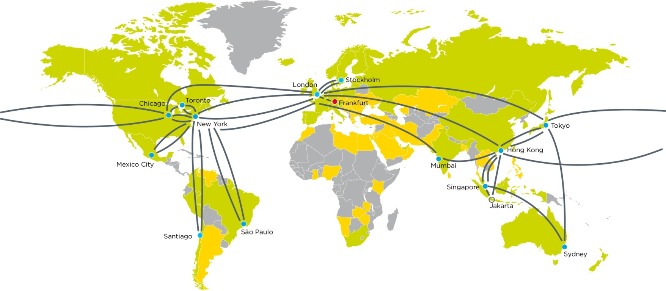

Global infrastructure and services
Community
715 Brokers/FCMs
5,600 Buy-sides
222 Exchanges/venues
750m Messages/month
$2.2tr Flow value/month
27,000 FIX connections
Hubs
Live datacentres
Planned datacentres
Direct client links
Network
Live links
Planned links
Market coverage
Member trading
Non-member trading

Slide 6


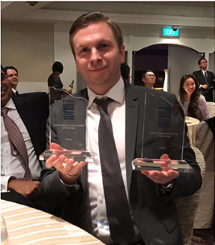
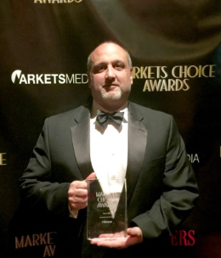
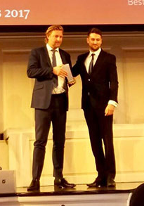
Fidessa Prospector voted Best New Product in the annual Fund Technology & WSL (Wall Street Letter) Awards.
Fidessa named Best Trading and Execution Technology Provider
Fidessa named Best Front-Office Execution Platform in Waters Sell-side Technology Awards
Fidessa voted Best Sell-side OMS in Markets Choice Awards
Fidessa - Best Sell-side OMS & Best Cross Asset Trading System - 2017 Intelligent Trading Technology (ITT) Awards.
Fidessa's derivatives platform - Best Trading and Execution Technology at the CTA Intelligence European Services Awards,
Fidessa presented with the 2017 Global Grain Award for Innovation.

Slide 7
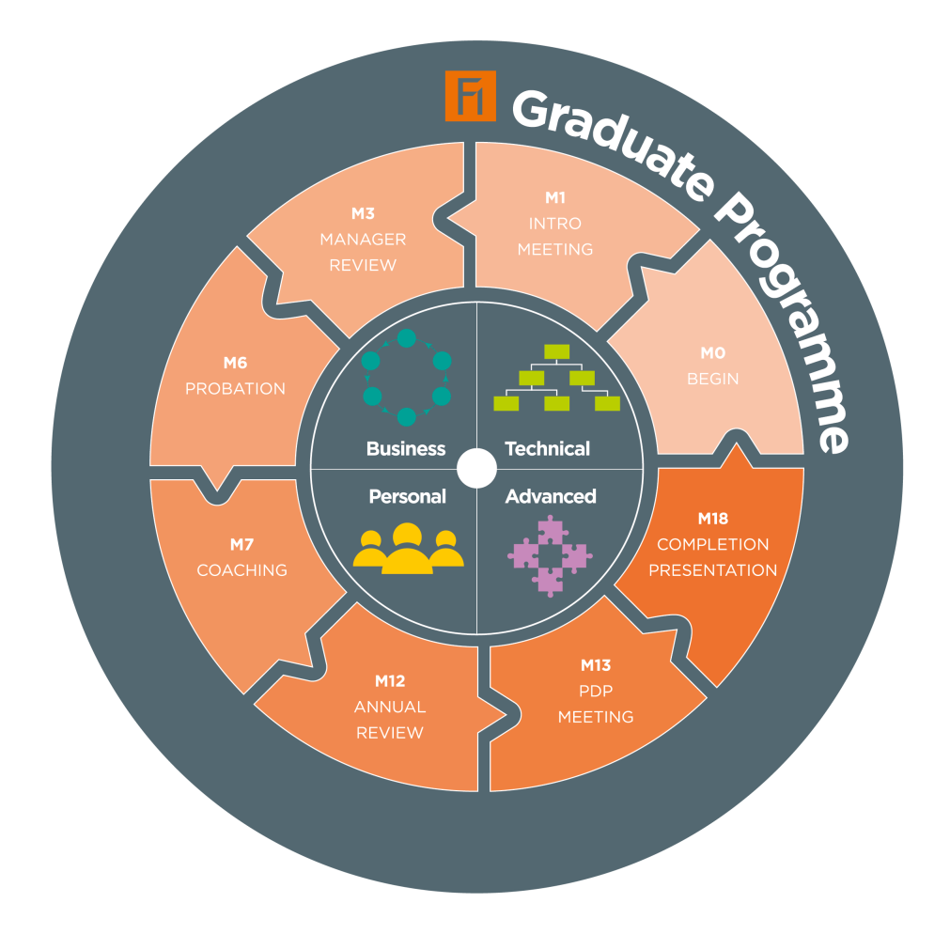
Internship
2014 - 30 grads, 2015 – 40 grads, 2016 – 38 grads, 2017 – 42 grads
Identifying future talent for Fidessa
8 week programme including training days, networking and team functions

Slide 8
Bruce Bland
Worked for Digital Equipment Corporation on Marketing its DECtrade real-time market data platform until the DECtrade software was sold to MTI. Worked for MTI marketing its object orientated display technology and researching its uses within trading rooms across the world.
Bruce Bland is currently Head of Algorithmic Research for Fidessa plc, and has been instrumental in the development of Fidessa's Pairs and BlueBox algorithmic offerings. The role has included the design of Fidessa's European and F&O algorithmic trading models and prior to this Mr Bland was a senior consultant working on the implementation of Fidessa's trading platforms and bespoke software design for many of Fidessa's global enterprise clients.
In recent years Mr Bland has been responsible for the design of Fidessa’s fuzzy logic based market abuse detection models and runs a small quant team developing prototype software for Fidessa globally.

Slide 9
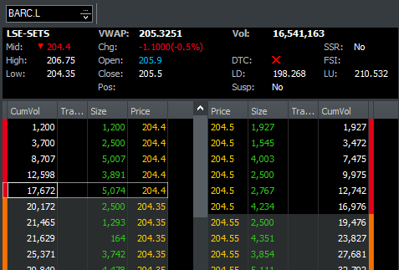
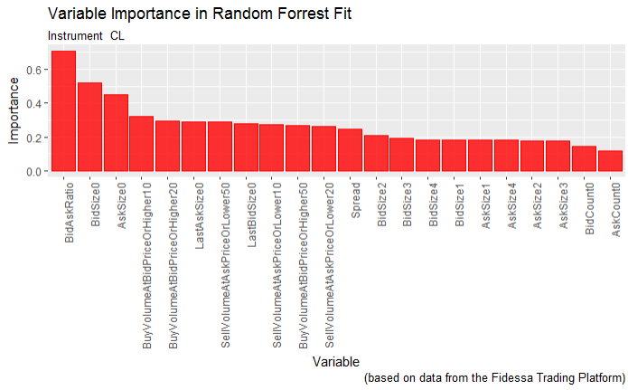
Challenge – Predict Future Price Change Direction

Slide 10

Model Design - Market Micro Structure - Basics
Definitions:
Spread – Price gap between buying and selling instrument
Bids – Orders to buy instrument
Asks – Orders to sell instrument
Mid Price – Half way between Bid and Ask
New Orders
Spread
Volume
Buy Orders
Sell Orders
Price
Bid.Size.3
Bid.Size.0
Ask.Size.0
Ask.Size.3
Mid Price $=\frac{Bid Price+Ask Price}{2}$

