Slide 1

Working with Angular
Getting started

Slide 2
Setup
Node
VSCode
Chrome

Slide 3
Angular CLI
The Angular CLI makes it easy to create an application that already works, right out of the box. It already follows our best practices!
- cli.angular.io
Boilerplate
Bundler
Dev Server
Commands
Test
Standards

Slide 4
My First Angular App
npm install –g @angular/cli
ng new my-project
ng serve

Slide 5
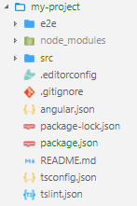
Main Folder Structure
End to End testing
App Dependenies
App Source Files
Git Ignore Configuration
Angular CLI Configuration
App Configuration
TypeScript Configuration
TSLint Configuration

Slide 6
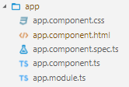
Application Source Folder Structure
Component’s Stylesheet
Component’s View Template
Component’s Unit Test Case
Component’s class
Module class

Slide 7
Build Workflow
*.*.ts
Browser
Run (NOT Supported)
Build Phase
main.bundle.js
Compiles
Run

Slide 8
Artifacts
App Source
App Distribution
index.html
styles.bundle.js
*.component.ts
*.module.ts
index.html
main.bundle.js
*.service.ts
index.css
vendor.bundle.js
*.directive.ts
*.pipe.ts
polyfills.bundle.js
node_modules
inline.bundle.js

