Slide 1

Working with Angular
Built-in directives

Slide 2
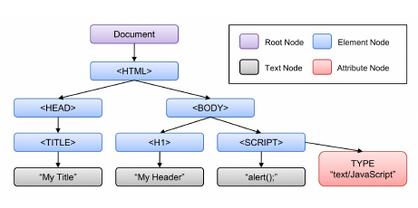
What are Directives?
Types
Structural Directives - change the DOM layout by adding and removing DOM elements
Attribute Directives - change the appearance or behavior of an element, component, or another directive.

Slide 3
ngStyle
ngStyle sets DOM elements style properties
<div [ngStyle]="{'background-color':'green'}"></div>
ngStyle can be javascript expressions which are evaluated
<div [ngStyle]="{'background-color': country === 'UK'?'green':'red'"></div>
export class AppComponent {
country = 'Canada';
}

Slide 4
ngClass
ngClass set the CSS class dynamically for a DOM element
<p [ngClass]="{'success':true}">Some Text</p>
ngClass can take javascript expressions to resolve to a boolean
<p [ngClass]="{'success': country == 'UK'}">Some Text</p>
export class AppComponent {
country = 'Canada';
}

Slide 5
*ngFor
export class AppComponent {
countries = ['Canada', 'UK', 'Japan'];
}
<ul>
<li *ngFor="let country of countries">{{country}}</li>
</ul>
Reading index
<li *ngFor="let country of countries; let i = index">
{{i}} - {{country}}
</li>

Slide 6
*ngIf
<ul>
<li *ngFor="let country of countries">
{{country}} <span *ngIf="country === homeCountry">(Home)</span>
</li>
</ul>
Alternatively using ng-template
<ng-template [ngIf]="country === homeCountry">
<span>(Home)</span>
</ng-template>​

Slide 7
*ngIf and else
<span *ngIf="country === homeCountry; else foreign">(Home)</span>
<ng-template #foreign>
<span>(Foreign)</span>
</ng-template>

Slide 8
Directives
Attribute Directives
Structural Directives
[ngStyle], [ngClass]
*ngIf, *ngFor
Looks like a normal HTML attribute (possibly with databinding or event binding)
Looks like a normal HTML attribute but have a leading *
Only affect/change the element they are added to
Affect a whole area in the DOM (elements get added/removed)

Slide 9
ngIf(remove) Vs ngStyle(hide)
 | ngStyle | *ngIf
DOM Changes | Stays attached to its DOM element | Added or Removed physically from DOM
DOM Events | Keeps listening | Detached
Change Detection | Still runs, affecting data bindings | Detached
Pros | Quickly re-rendered, previous state preserved | Component & DOM Nodes are garbage-collected and free up memory
Cons | More memory consumed, less responsive, low performance | More time to re-initialize

Slide 10
Using ngSwitch
value = 120;
<div [ngSwitch]="value">
<p *ngSwitchCase="5">Five</p>
<p *ngSwitchCase="10">Ten</p>
<p *ngSwitchCase="100">Hundred</p>
<p *ngSwitchDefault>Default</p>
</div>

