Slide 1
软件体系结构
ATAM
孙志岗
sun@hit.edu.cn

Slide 2
Architecture Tradeoff Analysis Method^{sm}
(ATAM^{sm})
SMATAM and Architecture Tradeoff Analysis Method are registered service marks of Carnegie Mellon University

Slide 3
Role of a Software Architecture
If the only criterion for software was to get the right answer, we would not need architectures.
如果评判软件的唯一标准是正确，那么就不需要体系结构
Unstructured, monolithic systems would suffice.
无结构的、单模块的系统已经足够。
But other things also matter, such as:
但事实上还有很多其他问题，比如：
  modifiability
  time of development
  performance
  coordination of work teams
These issues are often addressed in the Software Architecture
这些问题通常体现在软件体系结构当中

Slide 4
Why Analyze Software Architectures?
All design involves tradeoff in system qualities（设计即折中）
  System qualities are largely dependent on architectural decisions
  体系结构极大地影响系统质量
  Promoting one quality often comes at the expense of another quality
  提高一个质量，经常会降低另一个质量
A software architecture is the earliest life-cycle artifact that embodies significant design decisions: choices and tradeoffs.
“选择与折中”是设计中首要考虑的问题，软件体系结构是软件生命周期中最早一个遇到此问题的
  Choices are easy to make, but hard to change once the system is implemented
  选择很容易做，但是一旦系统已经实现，就很难更改

Slide 5
The ATAM
The purpose of the ATAM: is to assess the consequences of architectural decisions in light of quality attribute requirements.
ATAM的目标是：按照质量需求，评价体系结构设计

Slide 6
Context for the ATAM
P
A
Business
Goals
Architecture
Decisions
$ Value $
S
$ Cost $
M

Slide 7
Purpose of ATAM
We need a method in which the right questions are asked early to
我们需要一个新方法，让我们能尽早提出正确问题，来：
  Discover risks - alternatives that might create future problems in some quality attribute
  发现风险：可能在将来产生质量问题的方案
  Discover non-risks - decisions that promote qualities that help realize business/mission goals
  发现非风险：可以提高质量的决策
  Discover sensitivity points - alternatives for which a slight change makes a significant difference in some quality attribute
  发现关键点：方案中一个小小的变化，就可能让质量完全大变样
  Discover tradeoffs - decisions affecting more than one quality attribute
  发现折中：影响一个以上质量的决策
Notes:
风险：数据库带来的性能问题。不是十拿九稳的决定，比如让系统可以移植操作系统
关键点：网络的速度和可靠
折中：

Slide 8
Purpose of ATAM
The purpose of an ATAM is NOT to provide precise analyses, but to discover risks created by architectural decisions.
ATAM的目标不是做精确的分析，而是发现体系结构可能带来的风险
We want to find trends: correlation between architectural decisions and predictions of system properties.
我们要发现一些趋势：从体系结构方案预言系统的特性
Discovered risks can then be made the focus of mitigation activities: e.g. further design, further analysis, prototyping.
发现风险，然后做进一步的分析、设计
Surfaced tradeoffs can be explicitly identified and documented.
明显的折中可以被清晰地指出并写入文档
Notes:
风险：数据库带来的性能问题。不是十拿九稳的决定，比如让系统可以移植操作系统
关键点：网络的速度和可靠
折中：

Slide 9
ATAM Benefits
There are a number of benefits from performing ATAM analyses:
做ATAM分析可以得到下列益处：
  Clarified quality attribute requirements
  明确质量需求
  Improved architecture documentation
  提高体系结构文档质量
  Documented basis for architectural decisions
  文档化了的体系结构方案原理
  Identified risks early in the life-cycle
  及早发现风险
  Increased communication among stakeholders
  促进了角色之间的交流
The results are improved architectures.
结果是，体系结构得到改进

Slide 10
Purpose of ATAM
The purpose of ATAM is to assess the consequences of architectural decisions in light of quality attribute requirements.
ATAM的目标就是按照质量需求，评价体系结构设计
The ATAM process is a short, facilitated interaction between multiple stakeholders, leading to the identification of risks, sensitivities, and tradeoffs.
ATAM过程是角色之间交流的一个方便、快捷的手段，便于发现风险、关键点和折中
The purpose of an ATAM is NOT to provide precise analyses, the purpose IS to discover risks created by architectural decisions.
ATAM的目标不是提供精确的分析，而是发现体系结构方案可能带来的风险

Slide 11
Preconditions for an ATAM
Clients must have a Software Architecture
  Scope/scale must be manageable
  其作用范围和程度必须可管理
  ATAM will not work if the software architecture has not been created yet
  如果体系结构还没有被建立，那么ATAM毫无用武之地
  ATAM team members will review architectural artifacts, and may help refine documentation
  ATAM组将评估体系结构，并帮助改善文档
  Architect must prepare an architecture presentation
  架构师必须准备一个体系结构讲解
Clients must prepare a business/mission goals presentation
必须有一个商业/任务目标讲解
ATAM will review architecture artifacts, presentations, and read ahead material to become familiar with domain
ATAM要事先阅读一些材料来熟悉这个领域

Slide 12
Evaluation Team
Each ATAM team consists of a leader and at least three other team members
每个ATAM组有一个组长和至少三个组员
  domain expertise is not necessary
  领域专家不是必须
  ATAM team members must be experienced architects
  ATAM组员必须是经验丰富的架构师
  ATAM leaders must have EXCELLENT communication and facilitation skills
  ATAM组长必须有优秀的交流和激励技巧
The ATAM team members fill multiple roles during the course of the evaluation.
ATAM组员在评审过程中扮演多种角色
Notes:
多个经验丰富的架构师弥补了领域专家缺席的遗憾

Slide 13
Evaluation Team Roles
Moderator — facilitates discussions, brainstorming, analysis
主持人：推动讲解、自由讨论和分析
Scenario scribe(s) — writes utility tree, raw scenarios, risks, sensitivities, tradeoffs on flipcharts or whiteboards
场景记录员：在白板上记下原始场景、有效树、风险、关键点和折中
Proceedings scribe — captures scribe’s writing on a laptop computer, preparing the Results, Presentation template
会议记录员：把场景记录员写下的内容录入电脑，准备结论讲解模板

Slide 14
Evaluation Team Roles
Process enforcer/observer — monitors the process steps, takes notes about the process, and how it could be improved
过程实施者/观察者：监视各个步骤，做笔记，寻找改进方法
Timekeeper — informs the evaluation leader when the time allocated for a step has expired
计时员：当某一个步骤的时间已经超出时，提醒组长
Questioner(s) — raise issues that the stakeholders have not thought of; asks questions based on how quality attributes of interest relate to architectural styles
提问者：发现各个角色还没有想到的问题；询问质量因素怎样和体系结构风格关联的问题

Slide 15
Basic Rules for ATAM Team
Members
Keep the process moving!
让过程持续进行
Ask questions
提问
Propose scenarios
提出建议性的场景
Write down exactly what stakeholders say; do not “edit” their words!
记下各个角色所说的话，但是不要改写！

Slide 16
ATAM Steps
Present the ATAM
介绍ATAM
Present business drivers
讲解商业动力
Present architecture
讲解体系结构
Identify architectural approaches
明确体系结构方法
Generate quality attribute utility tree
生成有效树
Analyze architectural approaches
分析体系结构方法
Brainstorm and prioritize scenarios
自由讨论和为场景排序
Analyze architectural approaches
分析体系结构方法
Present results
讲解结论
Phase1
Phase2

Slide 17
1. Present the ATAM
Evaluation Team presents an overview of the ATAM including:
  ATAM steps in brief
  Techniques
    utility tree generation（有效树生成）
    architecture elicitation and analysis（体系结构引出和分析）
    scenario brainstorming/mapping（场景讨论/映射）
  Outputs
    architectural approaches
    utility tree
    scenarios
    risks and “non-risks”
    sensitivity points and tradeoffs

Slide 18
2. Present Business Drivers
ATAM customer representative describes the system’s business drivers including:
客户代表描述系统的商业动力
  Business context for the system
  High-level functional requirements
  High-level quality attribute requirements
    architectural drivers: quality attributes that “shape” the architecture
    体系结构动力：质量因素塑造体系结构
    critical requirements: quality attributes most central to the system’s success
    苛刻需求：对系统的成功有决定作用的质量
Notes:
森林防火要求实时动态画面

Slide 19
3. Present Architecture
Architect presents an overview of the architecture including:
架构师对体系结构的简介：
  Technical constraints such as an OS, hardware, or middle-ware prescribed for use
  技术限制，比如必须要采用的OS、硬件和中间件
  Other systems with which the system must interact
  其他必须与之交互的系统
  Architectural approaches/styles used to address quality attribute requirements
  用来满足质量需求的体系结构风格

Slide 20
3. Present Architecture
The architect, project manager, and marketing representative need to describe how the system will create value for the organization.
架构师、项目经理和市场代表一起来描述此系统如何为公司带来价值
  The marketing representative must detail how system responses (functional and quality attribute requirements) map to value.
  市场代表必须详细阐述系统的功能和质量需求对市场价值的影响
  The project manager must detail how architectural approaches map to cost.
  项目经理必须详细阐述体系结构需要的成本

Slide 21
ATAM产生的环境
Marketer
P
Architect
A
Business
Goals
Architecture
Decisions
$ Value $
S
$ Cost $
M
Project Manager
Goal：Max Value - Cost

Slide 22
4. Identify Architectural Approaches
Start to identify places in the architecture that are key for realizing quality attribute goals.
开始确认体系结构中对实现质量需求产生决定作用的部分
Identify any predominant architectural approaches.
明确主要的体系结构方法
Examples:
  client-server
  3-tier
  watchdog
  publish-subscribe
  redundant hardware

Slide 23
5. Generate Quality Attribute
Utility Tree
Identify, prioritize, and refine the most important quality attribute goals by building a utility tree.
通过建立一个有效树，来明确、排序和精炼大部分的质量目标
  A utility tree is a top-down vehicle for characterizing the “driving” attribute-specific requirements
  有效树是一个自顶向下的工具，用来刻画重要的需求
  Select the most important quality goals to be the high-level nodes (typically performance, modifiability, security, and availability)
  把最重要的质量目标放在高层节点（典型的有：性能、适应性、安全和可用性）
  Scenarios are the leaves of the utility tree
Output: a characterization and a prioritization of specific quality attribute requirements.
输出：质量需求的描述和优先级

Slide 24
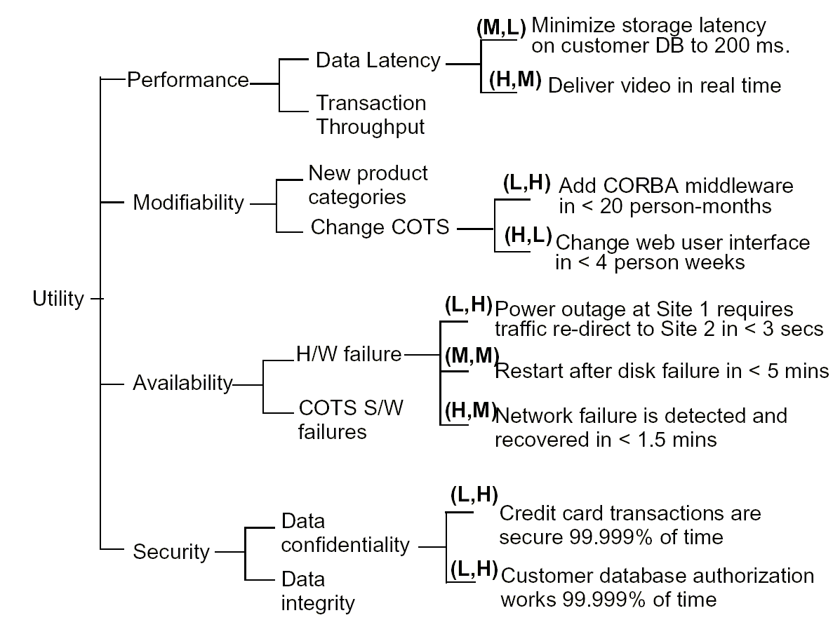
Utility Tree
Construction & Prioritization
Notes:
(对系统成功的影响程序, 带来的风险程度/难度)
我们应该专注于HH,HM。LL呢？

Slide 25
6. Elicit/Analyze
Architecture Approaches
Motivated by the high priority leaves of the utility tree, the Evaluation Team probes the architecture approaches.
有效树中高优先级的叶子促进评审组探查体系结构
  Identify the approaches which pertain to the highest priority quality attribute requirements
  确认可以满足高优先级的质量需求的方法
  Generate quality-attribute specific questions for highest priority quality attribute requirement
  为高优先级的质量需求制定关于质量的问题
  Ask quality-attribute specific questions
  询问这些问题
  Identify and record risks and non-risks
  确认和记录风险和非风险，关键点和折中

Slide 26
Quality Attribute Questions
Quality attribute questions probe styles to elicit architectural decisions which bear on quality attribute requirements.
质询体系结构在质量需求上如何作为
Performance
  How are priorities assigned to processes?
  怎样决定进程的优先级？
  What are the message arrival rates?
  消息到来的频率是多少？
Modifiability
  Are there any places where layers/facades are circumvented ?
  有按层封装的地方吗？
  What components rely on detailed knowledge of message formats?
  哪个组件依赖消息格式的细节？

Slide 27
Risks and Non-Risks
While risks are potentially problematic architectural decisions, …
风险是有潜在问题的体系结构
Non-risks are good decisions relying on implicit assumptions.
非风险是在一个可信的假设之下的，好的方案
Risk and non-risk constituents
风险和非风险要素
  architectural decision
  quality attribute requirement
  rationale
Sensitivity points are candidate risks and candidate tradeoff points.
关键点是候选的风险和折中

Slide 28
Risks and Non-Risks
Example risks
  Rules for writing business logic tier of your 3-tier style are not clearly articulated.
  三层架构下，商业逻辑层的规则还没有确定
  There is no way of detecting the “live” failure of a critical component.
  没有检测一个关键组件是否正常工作的机制
  Every component in the radar subsystem implicitly assumes a rotation rate.
  雷达系统的每一个组件都假定有一个固定的转动速率
Example non-risk
  Assuming message arrival rates of once per second, a processing time of less than 30 ms, and the existence of one higher priority process, a 1 second soft deadline seems reasonable.
  假定消息的到达速率是每秒一次，一次处理的时间小于30ms。如果对一个更高优先级的处理的响应时间要求是1秒钟，此系统可行
Notes:
非风险有前提，前提变了，就可能成为风险

Slide 29
Sensitivities and Tradeoffs
Example Sensitivity
  Changing the timing scheme from a harmonic framework to a non-harmonic framework would be easy, but due to implied timing dependencies, there would impact far reaching impacts to other modules.
  把定时方法从一个精确的框架移植到一个不精确的框架可能很容易，但是因为各个模块对定时的依赖，可能会极大地影响它们的正常工作
Example Tradeoffs
  In order to achieve the required level of performance in the discrete event generation component, assembly language had to be used thereby reducing the portability of this component.
  为了达到性能要求，不得不在离散的事件产生组件中使用汇编语言。此组件不再有移植性

Slide 30
Example Approach Elicitation
Scenario: Detect and recover from HW failure of main switch
场景：检测主交换机的硬件故障，并恢复
Stimulus: CPU failure
Response: 0.999999 availability of switch
Architectural Approaches: | R | S | T

Slide 31
Example Approach Elicitation
Scenario: Detect and recover from HW failure of main switch
场景：检测主交换机的硬件故障，并恢复
Stimulus: CPU failure
Response: 0.999999 availability of switch
Architectural Approaches: | R | S | T
Backup CPU(s)
Backup Data Channel
Watchdog
Heartbeat
Failover Rerouting

Slide 32
Example Approach Elicitation
Scenario: Detect and recover from HW failure of main switch
场景：检测主交换机的硬件故障，并恢复
Stimulus: CPU failure
Response: 0.999999 availability of switch
Architectural Approaches: | R | S | T
Backup CPU(s) | X | X
Backup Data Channel | X | X | X
Watchdog |  | X
Heartbeat |  | X
Failover Rerouting | X | X

Slide 33
Example Approach Elicitation
Analysis:
  ensures no common mode failure by using different HW and OS
  通过使用不同的硬件和操作系统确保不会有一样的错误发生
  worst-case rollover is accomplished in 3 seconds
  在最坏的情况下，只要3秒钟内回卷成功就可以
  guaranteed to detect failure with 1 second
  保证错误在1秒钟内被检测到
  watchdog is simple and proven reliable
  看门狗很简单，而且被证明可信赖
Notes:
小灵通的基站切换

Slide 34
7a. Brainstorm Scenarios
Scenarios are example stimuli used to
  Represent stakeholders’ interests
  说明角色关心的内容
  Understand quality attribute requirements
Scenarios are specific
场景是对系统的
  anticipated uses of (use case scenarios),
  预期使用(用例场景)，
  anticipated changes to (growth scenarios), or
  预期改变(演化场景)，或者
  unanticipated stresses to (exploratory scenarios)
  非预期的重压(试探场景)
the system.
A good scenario makes clear what the stimulus is that causes it and what responses are of interest.
一个好的场景可以清晰地描述出是什么引起这个场景，以及需要什么样的应答
Notes:
对有效树里的高优先级场景进行讨论
找来形形色色的人，提出形形色色的场景

Slide 35
Example Scenarios
Use case scenario
  Remote user requests a database report via the Web during peak period and receives it within 5 seconds.
  远程用户通过web周期地请求数据库报告，并且要求5秒钟内收到
Growth scenario
  Add a new data server to reduce latency in scenario 1 to 2.5 seconds within 1 person-week.
  用一人周的时间增加一个数据服务器，使上一个场景的潜伏期降低到2.5秒
Exploratory scenario
  Half of the servers go down during normal operation without affecting overall system availability.
  在做日常操作时，一半的服务器当机，却不影响整个系统的可用性
Scenarios should be as specific as possible.
场景应该尽可能的详细

Slide 36
起因(Stimuli)，环境(Environment)，结果(Responses)
用例场景
  远程用户通过web周期地请求数据库报告，并且要求5秒钟内收到
演化场景
  用一人周的时间增加一个数据服务器使上一个场景的潜伏期降低到2.5秒
试探场景
  在做日常操作时，一半的服务器当机，却不影响整个系统的可用性

Slide 37
7b. Prioritize Scenarios
Stakeholders have brainstormed a large set of scenarios.
各个角色已经讨论出很多很多场景
Each stakeholder is allocated a number of votes roughly equal to 0.3 x #scenarios
每个角色分给一个数用来投票，其值大约为(0.3 x 场景数)
Prioritized scenarios are compared with the utility tree and differences are reconciled.
排好次序的场景和有效树进行比较。如果有不同的，则要再次考量，达成一致
Notes:
角色可以一景多投

Slide 38
8. Analyze Architectural Approaches
Identify the architectural approaches impacted by the scenarios generated in the previous step.
确定被上一步产生的场景影响的体系结构设计
This step continues the analysis started in step 6 using the new scenarios.
用第6步同样的方法来分析新的场景
Continue identifying risks and non-risks.
继续确认风险和非风险
Continue annotating architectural information.
继续标注体系结构信息
Notes:
此时的分析，已经完备

Slide 39
9. Present Results
Recapitulate steps of the ATAM
总结所有ATAM的步骤
Present ATAM outputs
  architectural approaches
  utility tree
  scenarios
  risks and “non-risks”
  sensitivity points and tradeoffs
Offer recommendations
推荐

Slide 40
ATAM Nominal Phases
ATAM evaluations are often conducted in two stages or phases:
ATAM通常被分为两个阶段
  During phase 1 the architect describes the quality attribute goals and how the architecture meets these goals
  在阶段1，架构师描述质量目标，和体系结构如何达到目标
  During phase 2 we determine if a larger group of stakeholders agrees with the goals and the results
  在阶段2，确认是否各个角色都同意这些目标和结果

Slide 41
When to use ATAM
Academically, the time to use ATAM is right after the architecture has been specified when there is little or no code.
学术上说，应该在体系结构确定之后使用ATAM，此时没有或者仅有少量的代码
However, in practice, ATAM has been very effective in the following situations:
  Evaluating alternative candidate architectures
  评审候选的体系结构
  Evaluating existing systems prior to committing to major upgrades
  在升级之前，评审已有的系统
  Deciding between upgrade or replace
  无法决定是升级还是替换时

Slide 42
2. Present Business Drivers
A distributed battlefield control system (BCS)
一个分布式的战场控制系统
  One mobile central commander node
  一个移动的中心指挥官节点
  A set of mobile fighter nodes under commander
  麾下的一组移动战士节点
  Information from many sources/sensors
  来自很多信号源/传感器的信息
  Messages of different types (maps, orders)
  不同类型的消息（地图，命令）
Stakeholders wanted to understand how the system would perform and adapt to changes.
角色想了解这个系统怎样适应变化

Slide 43
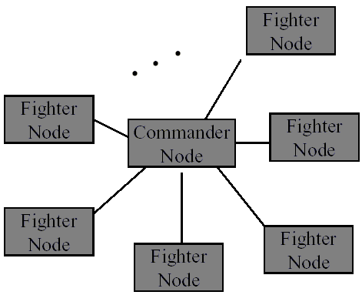
3. Present Architecture
Physical view: “client-server”, where the commander node is the server and the fighter nodes are clients.
Detailed information also collected for concurrency and code views.

Slide 44
4. Identify Architecture Approaches
We elicited information on the architectural approaches with respect to modifiability, availability, and performance.
我们关心适应性、可用性和性能
  For availability, a backup commander scheme was described.
  对可用性，有一个备份指挥官
  For modifiability, standard subsystem organizational patterns were described.
  对适应性，有基本的子系统组织模式
  For performance, an client-server style was described.
  对性能，采用客户/服务器风格的独立组件

Slide 45
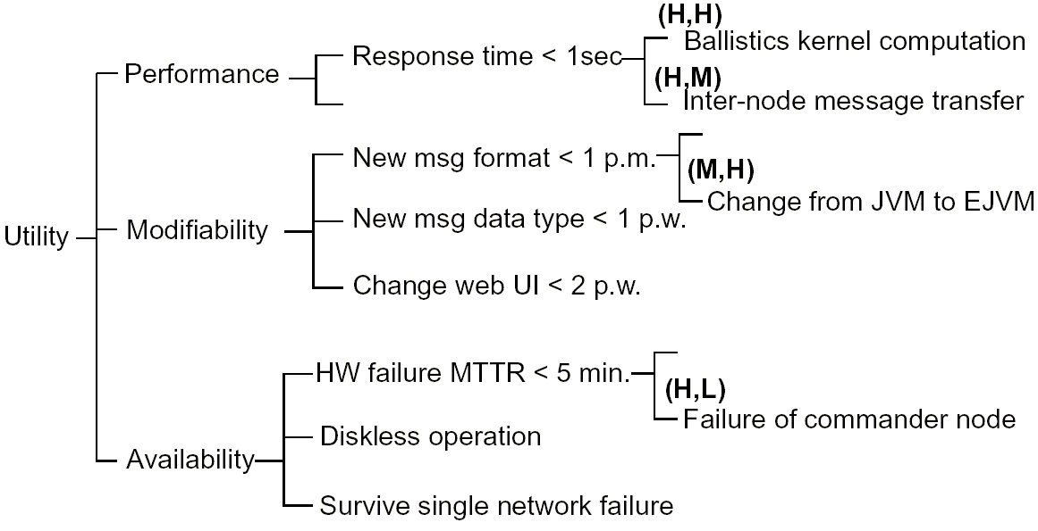
5. Generate Quality Attribute
Utility Tree

Slide 46
6. Elicit and Analyze
Architecture Styles
The repair time for the system is the time to turn the backup into the commander node.
修复时间是把备份节点转为指挥官节点的时间
Communication between the commander node and the backup keeps the backup “in sync”.
指挥官和备份节点之间的通讯维持着同步

Slide 47
Availability Analysis
Q_{A} = the fraction of time the system is working
Q_{A} = 系统工作的时间长度
The system is considered to be working if there is a working commander node and one or more fighter nodes.
有一个有效的指挥官，一个或更多工作的战士，则可以认为系统正在正常运行
When the commander node fails the system has failed.
指挥官故障，则系统故障
Provisions have been made in the BCS architecture to turn a designated fighter (backup) node into a commander node.
BCS体系结构允许一个指定的战士转为指挥官

Slide 48
Availability Analysis
Availability can be seen as:
  Q_{A}=h(λ_{c}, λ_{b} , μ_{c}, μ_{b})
    λ_{c}=failure rate of the commander
    λ_{b}=failure rate of the backup
    μ_{c}=repair rate of the commander
    μ_{b}=repair rate of the backup
Problem! The backup has no backup, i.e. in the BCS architecture,μ_{b}=0
We discovered this problem via elicitation of the hardware failure and repair approaches.
在评审硬件错误的恢复策略时，发现这个问题

Slide 49
Availability Analysis
Hence, two well-aimed hits (or hardware failures) disable the entire system!
因此，两个精确的打击（或者硬件故障）将使整个系统瘫痪
The solution was to turn more fighter nodes into potential backups.
解决方法是让更多的战士做备份
Alternatives could be:
  Acknowledging backups (n)
  确认备份(n)
  Passive backups (m)
  被动备份(m)
  Passive backups (m) + update
  被动备份(m)且请求更新
Notes:
两个节点间的频繁通信也容易让敌人看出关键点

Slide 50
Availability: Sensitivity/Risk Identification
The availability of the system can now be seen as:
系统的可用性可以被看作
  Q_{A}=j(n, m)
n and m are architectural availability sensitivity points.
n和m是体系结构可用的关键点
Since availability is a key attribute for the battle management mission, some choices of n and m present availability risks.
对战场管理任务来说，可用性是一个关键属性，对n和m的选择说明了风险

Slide 51
Performance Analysis
We discovered a performance problem via a qualitative attribute questions that asks about the relative speeds of communication and processing.
通过询问通讯和处理的速度，我们发现了性能问题
The problem uncovered was: the nodes in the BCS architecture communicated via slow modems.
这个问题是：BCS系统的节点通过慢速的调制解调器通信
Notes:
弹道计算不是问题，问题是通信。2400bps

Slide 52
Performance Analysis
End-to-end latency calculations showed that the overall latency was highly sensitive to the number and size of transmitted messages.
端到端的潜伏期计算表明，整个系统的潜伏期和传送消息的数量与大小有非常密切的关系
Communication load came from:
通信负荷来自:
  The normal operations communication overhead
  普通的命令通信开销
  The number of backups (both acknowledging and passive)
  备份节点的数量
Notes:
弹道计算不是问题，问题是通信。2400bps

Slide 53
Performance: Sensitivity/Risk Identification
Thus, system performance can be characterized as:
系统性能可以写作：
  Q_{p}=k(n, m, CO)
Communications overhead was a constant.
通信协议开销是个常数
n and m are architectural performance sensitivity points.
n和m是性能的关键点

Slide 54
Tradeoff Identification
Increasing the number of backups increases availability, but also increases average latency (because these backups must be kept up-to-date by the commander).
增大备份的数量提高可用性，但是也增大了平均潜伏期（因为所有的备份都要和指挥官保持同步）
Hence, the number of active and passive backups (n and m) is a tradeoff point in the BCS architecture.
因此主动和被动备份的数量(n和m)是一个折中点
The designers had not been aware of the tradeoff inherent in their design.
评审之前，设计者还不知道存在这个折中点

Slide 55
7a. Brainstorm Scenarios
Initial set of seed scenarios were too general
初始的场景太概括
  “System fails”
  “系统错误”
These scenarios were later refined
  “Commander node is destroyed and the Backup node takes over within 5 minutes”
  “指挥官被消灭，备份节点在5分钟内接管”
46 scenarios were eventually collected, covering modifiability, scalability, availability, performance, portability.
最后收集了46个场景，覆盖适应性、可测性、可用性、性能和移植性

Slide 56
7a. Brainstorm Scenarios
Examples:
  Modifiability: changed map data formats are accommodated within 1 person month
  适应性：改变地图数据格式需要一个人月
  Performance: the number of simultaneous missions doubles without affecting latency
  性能：在不影响潜伏期的情况下让并发的任务数加倍
  Availability: commander node is destroyed and the backup node takes over within 5 minutes
  可用性：指挥官被消灭，备份节点在5分钟内接管

Slide 57
7b. Prioritize Scenarios
The stakeholders used preference-voting to prioritize scenarios.
用投票的方式排序
The result was 15 high priority scenarios.
最后得到15个高优先级的场景

Slide 58
8. Re-exploration of Architecture
Approaches
The architects mapped each of the unexplored high-priority scenarios onto the BCS architecture.
架构师把每一个高优先级的场景映射到体系结构
During this stage we:
  Gathered attribute-specific information qualitative attribute questions
  收集特殊属性的信息和问题
  Clarified our understanding of the architecture and the scenarios
  加强了对体系结构和场景的理解
  Documented the answers
  答案记入文档

Slide 59
9. Present Out-Brief/Write Report
Presentation and written report detailed the potential modifiability, performance, and availability problems, and …
详细阐述了潜在的关于适应性、性能和可用性的问题
… delineated new architecture options and their costs:
描绘了新体系结构的建议和它们的成本
  Acknowledging backups
  Passive backups
  Passive backups + updates

Slide 60
Results of the BCS ATAM
Greatly improved architectural documentation
极大地改善了体系结构文档
Stakeholder buy-in
Discovery of missing performance and availability requirements
发现了被漏掉的性能和可用性需求
Highlighting of a previously unknown tradeoff point in the architecture
突出了以前没被意识到的体系结构折中点
Delineation of recommendations to mitigate the risks of this tradeoff
提出减轻折中的风险的建议
Notes:
在ATAM之前，此体系结构被放置到公众网上18个月，没有发现任何大问题
设计者一直把精力集中在弹道计算和消息格式上

Slide 61
Summary
The ATAM is a method for evaluating an architecture with respect to multiple quality attributes.
ATAM是一个根据质量需求评审体系结构的方法
It is an effective strategy for discovering the consequences of architectural decisions. The ATAM:
  can be done early; can be done on legacy systems
  可以在开发早期作；可以对旧系统作
  is inexpensive
  builds stakeholder confidence and buy-in
  建立角色的信心和大宗的订单
The key to the method is looking for trends, not in making precise analyses.
方法的关键是寻找趋势，而不是做预言式的分析

Slide 62
Summary
The ATAM relies critically on
  Appropriate preparation by the customer
  客户的有效准备
  Clearly-articulated quality attribute requirements
  清晰的质量需求
  Active stakeholder participation
  角色的积极参与
  Active participation by the architect
  架构师的积极参与
  Familiarity with architectural approaches/styles and analytic models
  对体系结构风格和分析模型的熟悉

