Slide 1
软件体系结构
3. 数据流体系结构
Data Flow Architectures
孙志岗
sun@hit.edu.cn

Slide 2
Styles -Moving from Qualities to
Architectures
Architectural styles help software engineers to reason about architectural qualities.
体系结构风格帮助软件工程师
推断软件体系结构的质量

Slide 3
Styles -Moving from Qualities to
Architectures
A style
  describes a class of architectures
  描述一类体系结构
  is found repeatedly in practice
  在实践中被多次设计、应用
  is a package of design decisions
  是若干设计思想的综合
  has known properties that permit reuse
  具有已经被熟知的特性，并且可以复用

Slide 4
Architectural Styles
A style is determined (described) by
  a set of component types (e.g., data repository, process, object)
  一组组件类型（例如：数据容器，过程，对象）
  a set of connector types/interaction mechanisms (e.g., subroutine call, event, pipe)
  一组连接件类型/交互机制（例如：过程调用，事件，管道）
  a topological layout of these components
  这些组件的拓扑分布

Slide 5
Architectural Styles
A style is determined (described) by
  a set of constraints on topology and behavior (e.g., a data repository is not allowed to change stored values, pipelines are acyclic)
  一组对拓扑和行为的约束（例如：数据容器不能自己改变数据，管道不能是循环的
  an informal description of the costs and benefits of the style, e.g.: “Use the pipe and filter style when reuse is desired and performance is not a top priority
  一些对风格的成本和益处的非正式的描述，例如：如果你需要重用性并且性能不是很重要，那么可以使用管道风格

Slide 6
Architectural Styles
Garlan and Shaw compiled a catalog of architectural styles in 1995. Others, such as Buschmann, have augmented this.
There is no complete list.
没有完备的列表
There is no unique, non-overlapping list.
没有无重叠的列表
Styles overlap. 风格是彼此重叠的
Systems exhibit multiple styles at once.
一个系统通常表现出多种风格

Slide 7
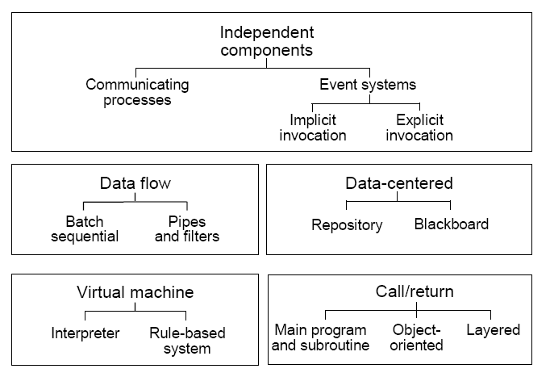
Types of Architectural Styles

Slide 8
Notes about Architectural Styles
When we introduce a new style, we will typically first examine its “pure” form.
  pure architectural style are rarely found in practice
  纯粹的体系风格在实际中很难遇到
  systems in practice
    regularly deviate from the academic definitions of these systems. 循规蹈矩地背离了对这些系统的学术定义
    typically feature many architectural styles simultaneously
    典型地，融合很多体系风格的特色
  as an architect you must understand the “pure” styles to understand the strength and weaknesses of the style as well as the consequences of deviating from the style
  作为一个架构师，你必须理解“纯”的风格。理解它的优点与缺陷，也要理解背离此种风格之后会带来什么结果

Slide 9
Data Flow Style（数据流风格）
A data flow system is one in which
  the availability of data controls the computation
  由数据控制计算
  the structure of the design is dominated by orderly motion of data from process to process
  系统结构由数据在处理之间的有序移动决定
  the pattern of data flow is explicit
  数据流系统的结构是显而易见的
In a pure data flow system, there is no other interaction between processes
在纯数据流系统中，处理之间除了数据交换，没有任何其他的交互
Notes:
数据没有，就没有计算

Slide 10
The Data Flow Style
There are variety of variations on this genera theme:
  how control is exerted (e.g., push versus pull)
  如何施加控制（比如：推还是拉）
  degree of concurrency between processes
  并行的程度
  topology

Slide 11
Data Flow Styles
Components: Data Flow Components
  Interfaces are input ports and output ports
  组件接口是输入端口和输出端口
  Input ports read data; output ports write data
  从输入端口读数据，向输出端口写数据
  Computational model: read data from input ports, compute, write data to output ports
  计算模型：从入口读数，计算，然后写到出口

Slide 12
Data Flow Styles
Connectors: Data Streams
  Uni-directional（单向）
    usually asynchronous, buffered （通常是异步的，有缓冲）
  Interfaces are reader and writer roles
  接口是reader和writer
  计算模型: 把数据从writer转向reader
Systems
  Arbitrary graphs（任意拓扑结构）
  Computational model: functional composition（计算模型: 功能组合）

Slide 13
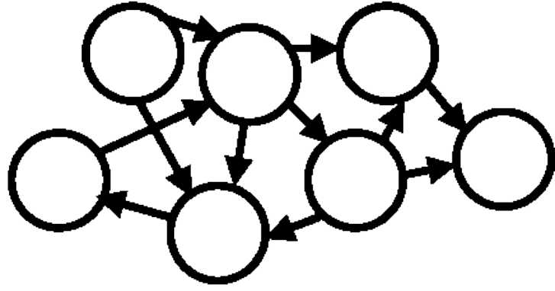
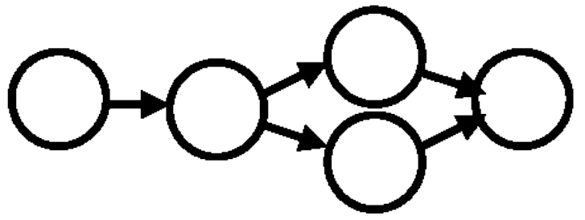

Patterns of Data Flow in Systems
In general, data can flow in arbitrary patterns（一般情况，数据的流向无序）
Often we are primarily interested in nearly linear data flow systems（我们主要研究近似线性数据流）
or in very simple, highly constrained cyclic structures（或者是在限度内的循环数据流）
Notes:
第一个体系结构可用吗？
如果数据流如此混乱，说明我们选择的体系结构不对

Slide 14
Control Flow vs. Data Flow
Control Flow (typical case in procedural systems)
  Dominant question is how locus of control moves through the program
  主要问题是控制点怎样在程序或系统之间移动
  Data may accompany the control but is not the driving force
  数据可能跟着控制走，但是并不起推动系统运转的作用
  Primary reasoning is about order of computation
  关注的核心是计算顺序
Notes:
瓶颈

Slide 15
Control Flow vs. Data Flow
Data Flow
  Dominant question is how data moves through a collection of (atomic) computations
  主要问题是数据怎样在运算单元之间流动
  As data moves, control is “activated”
  数据到了，控制（计算）单元便开始工作
  We reason about data availability, transformations, latency,…
  我们关心数据是否可用，转换，潜伏……
Notes:
瓶颈

Slide 16
Three Examples of Data Flow
Batch Sequential（批处理）
Pipe-and-Filter（管道）
Process Control（控制）
Notes:
管道是批处理的进化

Slide 17
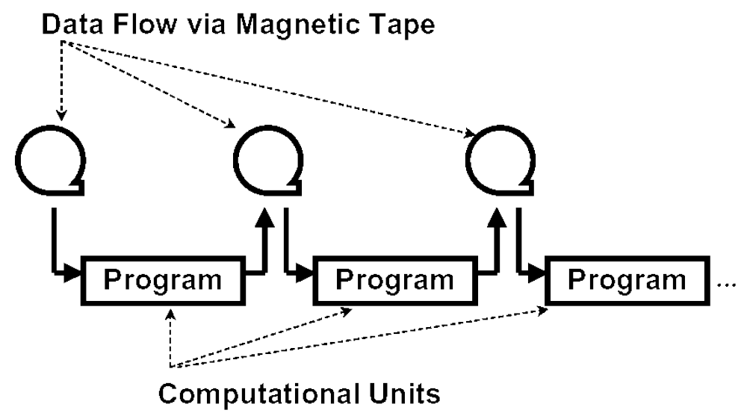
Batch Sequential Pattern
Notes:
历史上曾经是最重要的计算方式

Slide 18
Characteristics of Batch Sequential Systems
Processing steps are independent programs
每个处理步骤是一个独立的程序
Each step runs to completion before next step starts
每一步必须在前一步结束后才能开始
Data transmitted as a whole between steps
数据必须是完整的，以整体的方式传递
Typical applications:
  classical data processing
  program compilation/computer aided software engineering

Slide 19
Characteristics of Batch Sequential Systems
Architectural Heuristics
  components (processing steps) are independent programs
  connectors are some type of media - traditionally magnetic tape
  each step runs to completion before the next step begins

Slide 20
Example: Batch Sequential Systems
Compilers
  early compilers began as essentially batch sequential systems
    lexical analysis, parsing, semantic analysis, code generation
  initially a mechanism to turn higher level source code into object code
Computer Aided Software Engineering
  CASE tools initially provided an environment to write and compile source code into object code
    compiler, library, linker, make, into an integrated tool
  early tools were independent programs
  later tools shared only files
    common formats, simple sharing mechanisms, scripts
    eventually tools grew to include design, documentation, configuration control, and even automatic code generation

Slide 21
Three Examples of Data Flow
Batch Sequential（批处理）
Pipe-and-Filter（管道）
Process Control（控制）
Notes:
管道是批处理的进化

Slide 22
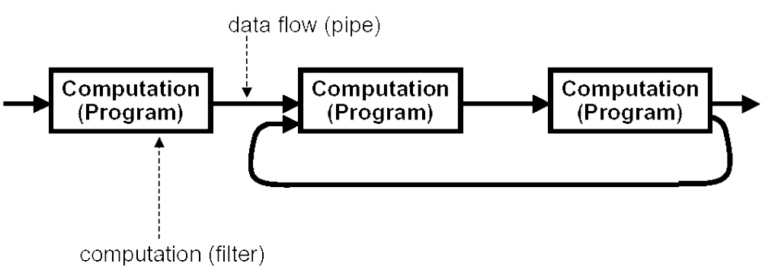
Pipe-and-Filter

Slide 23
Pipes and Filters
Role of (“pure”) filters
  reads streams of data as input, produces streams of data as output
    traditionally byte-oriented
performs stream-to-stream transformations
  enrich data by computation and adding information
  通过计算和增加信息丰富数据
  refine by distilling data or removing irrelevant data
  通过浓缩和删除精炼数据
  transform data by changing its representation
  通过改变记录方式转化数据

Slide 24
Pipes and Filters
  incrementally transform data from the source to the sink（递增地转化数据）
    data is processed as it arrives, not gathered then processed
    数据到来时便被处理，不是收集然后处理（偶有例外）
  filters are independent entities
    no context in processing streams
    no state preservation between instantiations
    no knowledge of upstream/downstream filters
    the correctness of the output should not depend upon the order in which the pipes are connected in a pipe-and-filter network
    过滤器的先后顺序不影响输出的结果

Slide 25
Pipe-and-Filter
Role of (“pure”) pipes (SG96)
  move data from a filter output to a filter input (or to a device or file)
  data moves in one direction, upstream flow control is allowed
  pipes form data transmission graphs
Overall Operation
  system action is mediated by data delivery
  数据传送引起系统动作
  pipe-and-filter systems run until no more data is available and no more computations possible

Slide 26
“Pipes” and “Filters” in unix
unix processes that transform stdin to stdout are generally called filters
  but when they consume all the input before starting the output, they violate the filter assumption
  sort, for example
unix pipes can treat files as well as filters as data sources and sinks
  but files are passive, so you can’t make arbitrary combinations
unix assumes that the pipes carry ASCII character streams
  the good news: anything can connect to anything else
  the bad news: everything must be encoded in ASCII, then shipped, then decoded

Slide 27
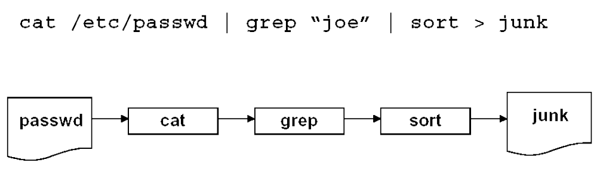
“Pipes” and “Filters” in unix
Notes:
有假定不好，没有也不好

Slide 28
Issue: Data Pulling and Data Pushing
Question: what is the force that makes the data flow?
Three choices, all with force emanating from filters:
  push: data source pushes data in downstream direction
  pull: data sink pulls data from upstream direction
  push/pull: a filter is actively pulling from upstream, computing, and pushing downstream
  passive: don’t do either, act as a sink for data
Combinations may be complex. If more than one filter is pushing/pulling, synchronization is needed
So: Why can’t you pipe a file to a file in unix?

Slide 29
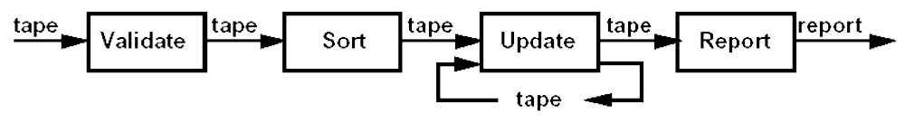
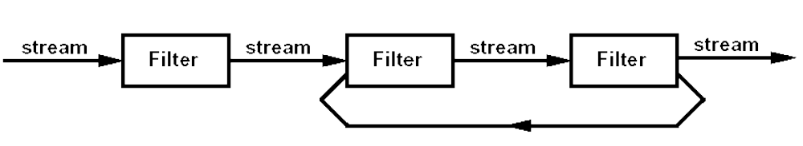
Batch Sequential vs Pipe & Filter

Slide 30
Batch Sequential vs Pipe & Filter (UNIX)
Both
Decompose task into fixed sequence of computations Interact only through data passed from one to another
把任务分解成为一系列固定顺序的计算单元(组件)，组件间只通过数据传递交互

Slide 31
Batch Sequential vs Pipe & Filter (UNIX)
Batch Sequential | Pipe/Filter
total | incremental
High latency (real-time is hard) | Results start immediately
Random access to input ok | Processing localized in input
No concurrency | Feedback loops possible
Non-interactive | Often interactive, awkwardly

Slide 32
A Variant on Data Flow
Issue: in some systems,
  Data flows slowly through the system
  Data does not remain strictly in order

Slide 33
Summary: Guidance for Selecting a Data Flow Style
task is dominated by the availability of data
任务由数据主导
data can be moved predictably from process to process
事先知道数据的确切流向
pipe-and-filter architectures are good choices for many data flow applications because
  they permit reuse and reconfiguration of filters
  generally easy to reason about
  reduce system testing
  may allow incremental AND parallel processing
there may be a performance penalty in data flow styles, however this depends on many factors
数据的流动带来性能损耗
Notes:
Robustness？

Slide 34
Three Examples of Data Flow
Batch Sequential（批处理）
Pipe-and-Filter（管道）
Process Control（控制）
Notes:
管道是批处理的进化

Slide 35
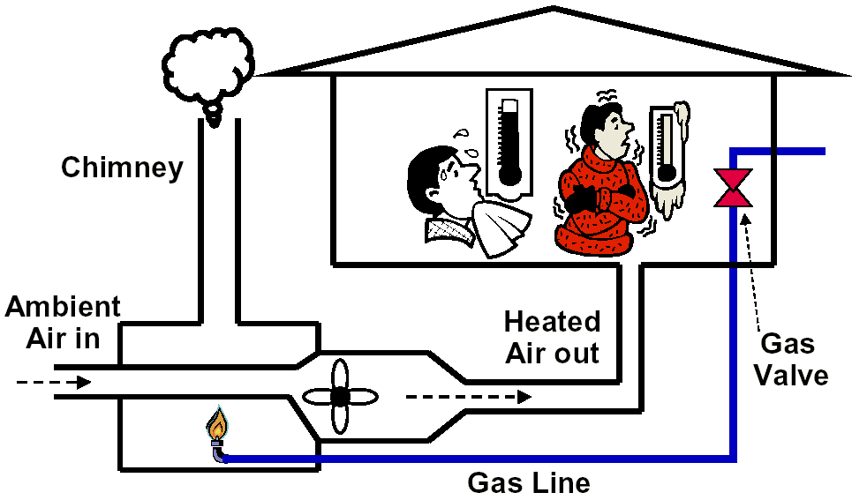
Open Loop Control(开环控制)

Slide 36
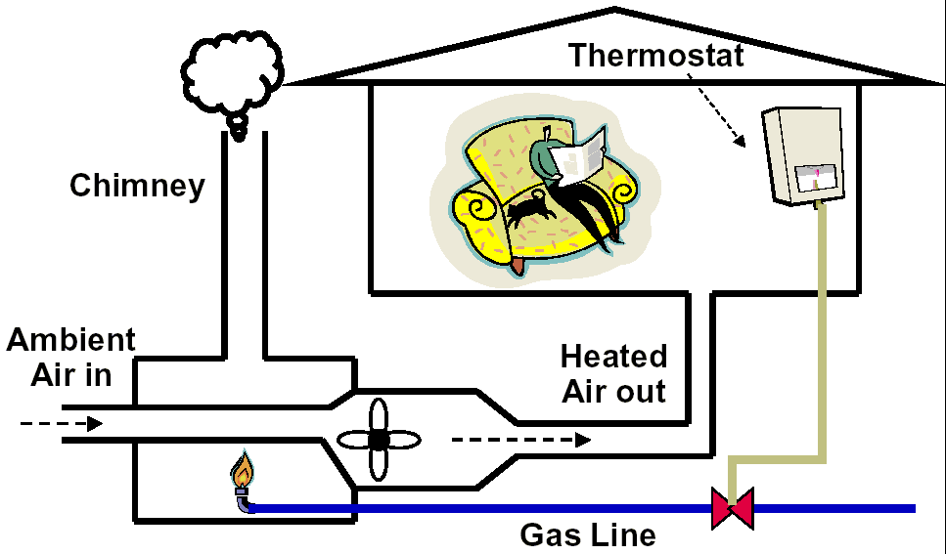
Closed Loop Control(闭环控制)

Slide 37
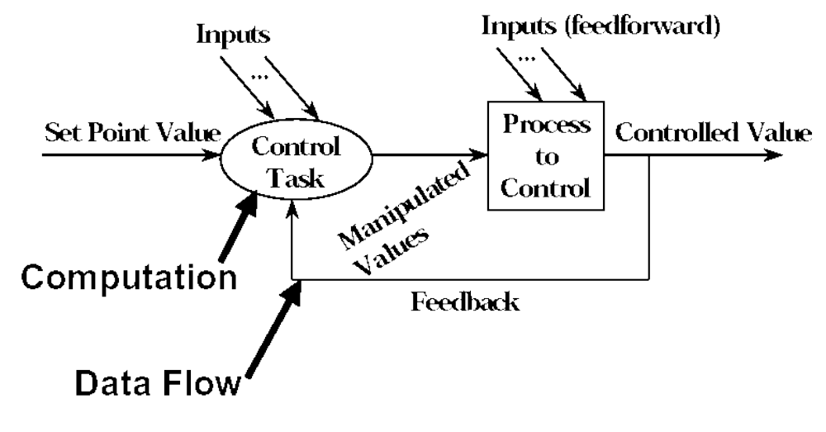
Closed Loop Process Control Architecture

Slide 38
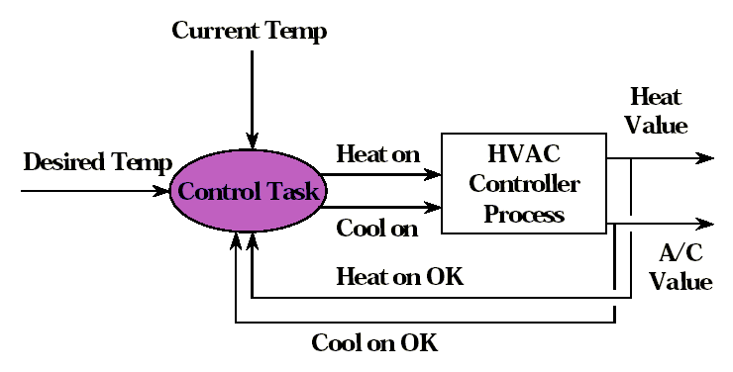
Example - Thermostatic Control Architecture

Slide 39
Summary: Guidance for Selecting a Control Style
Consider a Closed Loop Control Architecture when:
  the task involves continuous action, behavior, changing state
  任务包含连续的动作、行为、状态的改变
  when open loop control systems are inadequate
  开环结构不适合
    safety、function、ease of use、reduction of manpower
  software can be reasonably be embedded in a physical system
    writing software for these systems often requires domain expertise beyond software
    写此类软件通常都需要相当的领域知识

