Slide 1
软件体系结构
事件驱动体系结构
Event System
孙志岗
sun@hit.edu.cn

Slide 2
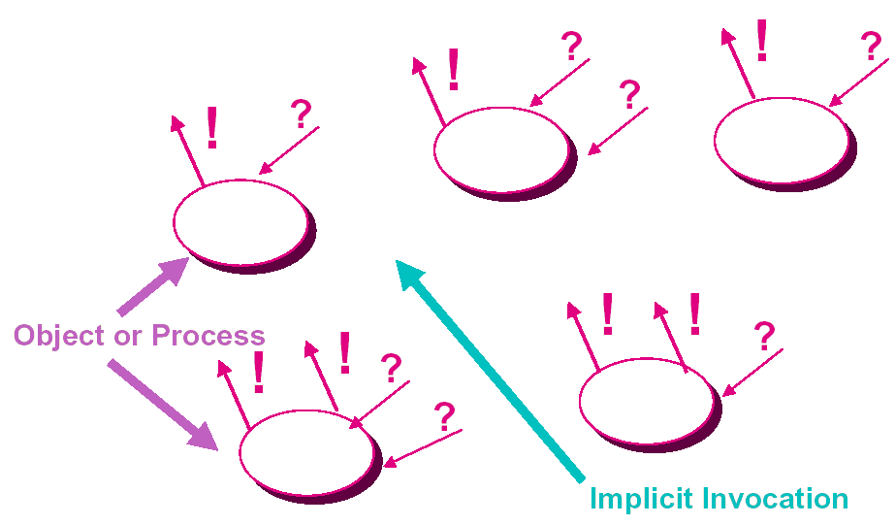
Event Systems
Notes:
中断系统，apache，proftpd

Slide 3
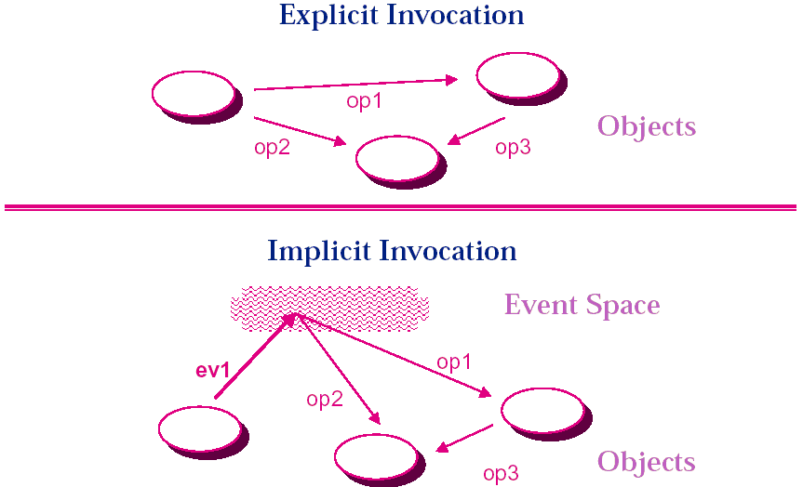
Implicit versus Explicit Invocation

Slide 4
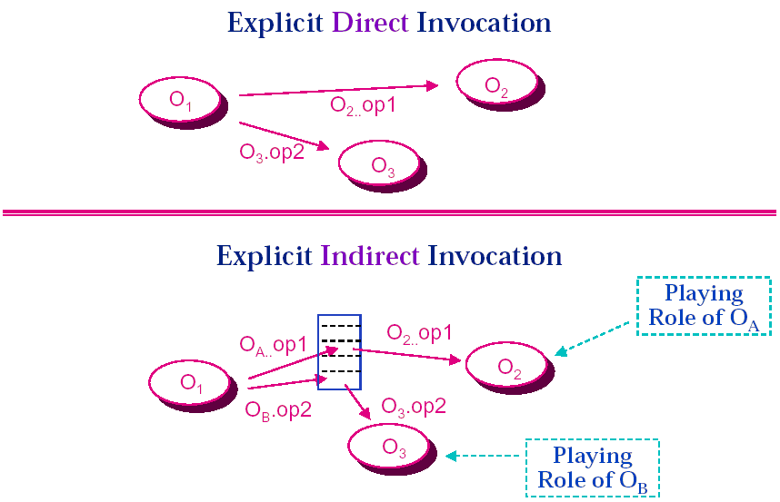
Indirect versus Implicit Invocation

Slide 5
Event Systems: Model
Components: objects or processes
  Interface defines a set of incoming procedure calls
  Interface also defines a set of outgoing events
Connections: event-procedure bindings
  Procedures are registered with events
  Components communicate by announcing events at “appropriate” times
  when an event is announced the associated procedures are (implicitly) invoked
  Order of invocation is non-deterministic
  In some treatments, connectors are event-event bindings

Slide 6
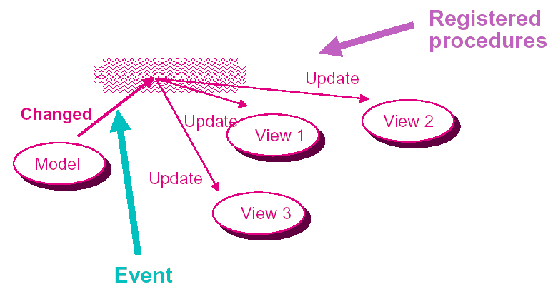
Example 1：Smalltalk-80
Model-View-Controller (MVC)

Slide 7
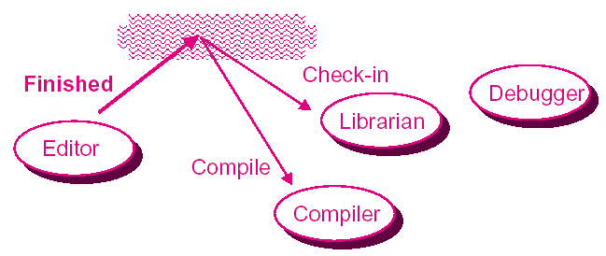
Example 2：
Field Programming Environment

Slide 8
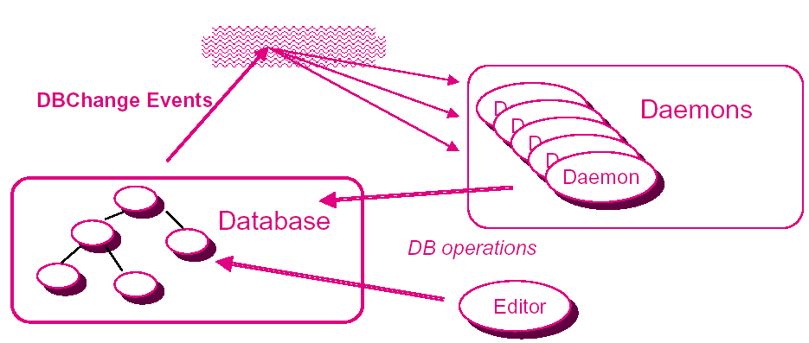
Example 3：
Gandalf Environments

Slide 9
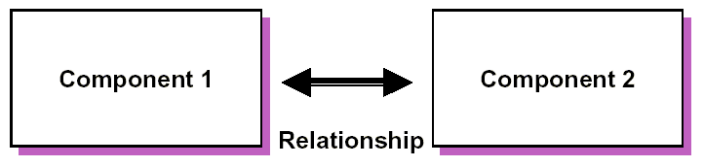
Application 1: Mediators
Example:
  Component 1 = nodes of a graph
  Component 2 = edges of a graph
  Relationship = maintain correspondence

Slide 10
Possible Solutions
Each of the components knows about the other
  when update operation is applied, call routine in other
  result: brittle （脆弱）
Write a third component that encompasses the two
  new component has combined interface
  result: overly specialized （特殊化）

Slide 11
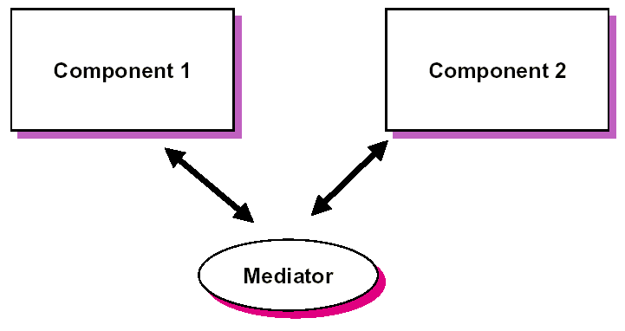
Implicit Invocation Solution

Slide 12
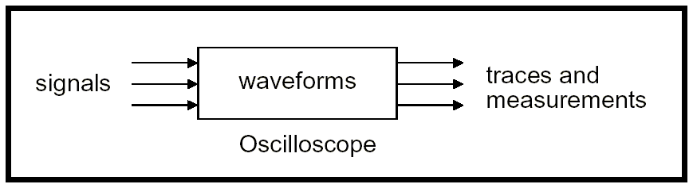
Application 2: Case Study in Industrial Architecture Design
Oscilloscopes （示波器）
Goals
  Multiple hardware platforms for same user interface
  Multiple user interfaces for same platform
How to separate user interface from application?

Slide 13
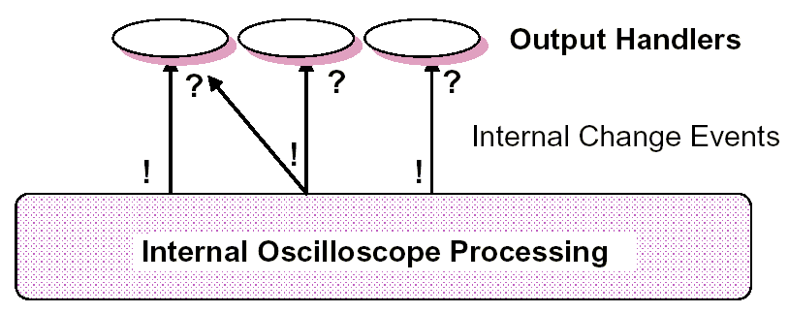
continue..
Output: application announces events

Slide 14
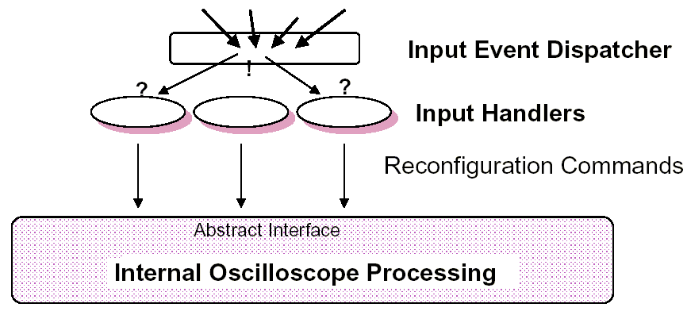
continue..
Input: user generates events
Notes:
不阻塞的过程调用可以用来实现事件

Slide 15
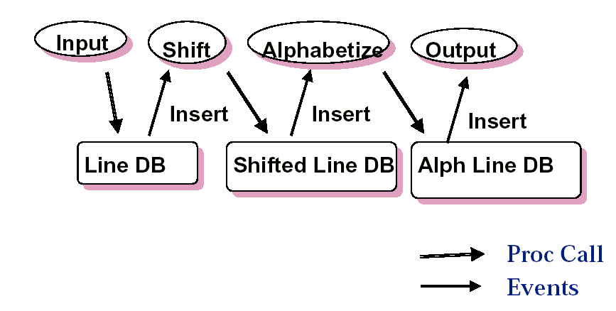
KWIC：Solution 4
Notes:
怎么加入新的功能？

Slide 16
Advantages
Problem Decomposition
  Objects more independent than with explicit invocation
  Interaction policy can be separated from interacting objects
System Maintenance and Reuse
  Static name dependencies not wired in, so dynamic reconfiguration is easy
  Reuse objects simply by registering them
Performance
  Possibility of parallel handling of events.
Robustness
  The crash of one component can’t affect the others

Slide 17
Disadvantages
Problem Decomposition
  No control over sequencing of invocations
  Function call semantics problematic
  Cycles may be problematic
System Maintenance and Reuse
  Needs central management to keep track of events, registrations, and dispatch policies
  Event handling may interact badly with other run time mechanisms (e.g., event control loops of X, rpc, etc.)
Performance
  Indirection may incur overhead
Notes:
再看KWIC
数据传输问题

Slide 18
Reasoning about Events Systems
Issues
  Is a component living up to system-level expectations for event announcements?
    possibility of events not announced at appropriate times
    possibility of events announced at wrong time
  Are the event-method bindings sufficient to achieve intended system behavior?
    possibility of not having registered enough or the right components to events
  Will components interfere with each other
    possibility of two components working concurrently concurrently on shared data
Requires new forms of interface specification and compositional reasoning!

Slide 19
Implementation Concerns:
Two Key Issues
What are the kinds of components?
  objects
  modules
  processes
  tools
How are events raised?
  in the programming language
  as external communication events
  via some other mechanism (e.g., active data)

Slide 20
Categories of Event System
Programming language extensions and libraries
  Smalltalk, Mediators, Ada Events, C++ with events, Corba
Integration frameworks
  Programming envts: Field, Forest, HP Softbench, Dec Fuse, Sun ToolTalk
  User interface frameworks: X Windows, Visual Basic, Java Beans
Special-purpose applications
  Gandalf daemons, Active databases, APPL/A

Slide 21
Design Issues
Event Declarations
  Who should declare events and where?
Event Structure
  How should events be parameterized?
Event Bindings
  How/when should events be bound to procedures?
Event Announcement
  How should events be announced and dispatched?
Concurrency
  Can components operate concurrently?

Slide 22
Event Declarations
How should events be declared?
  Predefined Set of Events
  Static Event Declaration
  Dynamic Event Declaration
Where should events be declared?
  Central Declaration of Events
  Distributed Declaration of Events

Slide 23
Event Structure
How should events be parameterized?
  Simple Names
  Fixed Parameter Lists
  Parameters Determined by Event Type
  Parameters Determined Dynamically

Slide 24
Event Bindings
When should events be bound to procedures?
  Static Event-Procedure Binding
  Dynamic Event Registration
How should data be communicated between an event and its implicitly-invoked procedures?
  Single Fixed Parameters (Event_Manager.Arg)
  Multiple Parameters, but all passed
  Selectable Parameters
  Expressions over parameters

Slide 25
Event Announcement
How should events be announced?
  Single Announcement Procedure
  Multiple Announcement Procedures
  Extend language (e.g., announce keyword)

Slide 26
Concurrency
What is an implicitly-invocable component?
  Independent procedure
  Module/object with procedure calls
  Independent process
  Process defined by Event_Manager
How are events "delivered"?
  Full Delivery
  Selective Delivery
  Pattern-based Selection
  State-based Policy (ala Forest)

Slide 27
Example 1：Smalltalk-80
Model-View-Controller (MVC)

Slide 28
Example 1：Smalltalk
Key Points
  Commercial programming language/environment
  Small vocabulary of events and methods
  Implemented by inheritance + dependency list
  Synchronous dispatch
  Dynamic registration of dependents
  Primary application is user interfaces (MVC)

Slide 29
Example 2：
Field Programming Environment

Slide 30
Example 2：
Field Programming Environment
Key Points:
  ROTS
  Processes communicating via sockets to central dispatcher (MSG)
  Synchronous and asynchronous
  Pattern matching as selection mechanism
  Events can be arbitrary strings
  Primary application is tool integration

Slide 31
Example 3：
Gandalf Environments

Slide 32
Example 3：
Gandalf Environments
Key points:
  Events triggered on operations to data
  Fixed set of events for predefined data operations
  Fixed event structure
  Extensible set of events for other operations
  Organized around transactions
  Synchronous invocation
  "Tools" are written in a special purpose language, which understands notion of events and event structure

Slide 33
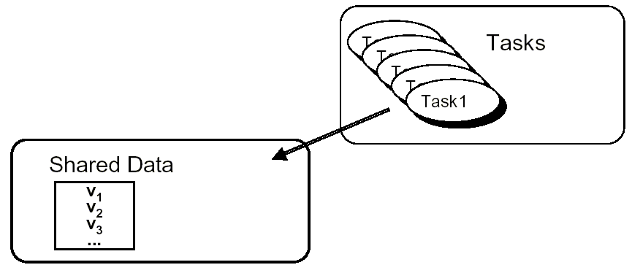
Cyclic Tasks + Shared data
Events via Shared Data
  Gandalf: use events to signal changes in data
  Alternative: use changes in data to represent events
Each task repeatedly checks the state of some set of variables. Changes to variables act like event announcements.

Slide 34
Cyclic Tasks + Shared data
Key points:
  Events are represented by changes to shared data
  Each shared variable can be thought of as an event
  Tasks must be cyclic: could be cyclic processes in a real-time operating system, or written as a program with an outer cyclic loop.

