Slide 1
软件体系结构
过程调用体系结构
Call/Return Systems
孙志岗
sun@hit.edu.cn

Slide 2
History
Main program and subroutines
  Decomposition into processing steps with single-threaded control
  单线程控制，划分为若干处理步骤
Functional modules
  Aggregation of processing steps into modules
  把处理步骤集成到模块内
Abstract Data Types
  Bundle operations and data, hide representations and other secrets
  操作和数据捆绑在一起，隐藏实现和其他秘密

Slide 3
History
Objects
  Methods (bound dynamically), polymorphism (subtypes), reuse (through inheritance)
  方法（动态绑定），多态（子类），重用（继承）
OO Architectures
  Objects as separate processes/threads
  对象活动与不同的进程/线程
  Client-server, tiered styles
Components
  Multiple interfaces, binary compatibility, advanced middleware （多个接口，二进制兼容，高级中间件）

Slide 4
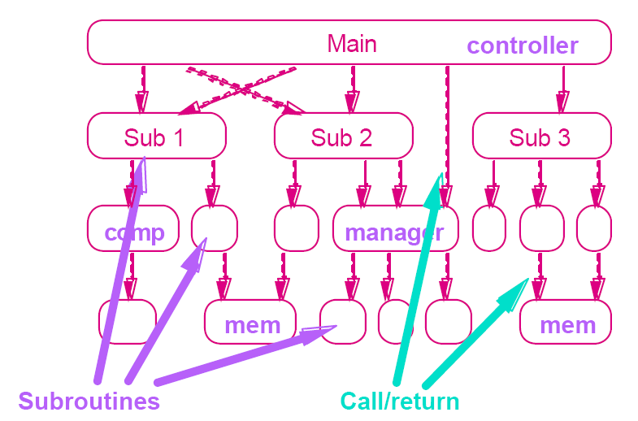
Main Program and Subroutine

Slide 5
Main Program and Subroutine
Hierarchical decomposition:
逐步分解
  Based on definition-use relationship
  基于定义—使用关系
  Uses procedure call as interaction mechanism
  用过程调用作为交互机制
Single thread of control:
单线程控制
  Supported directly by programming languages
  程序设计语言直接支持

Slide 6
Main Program and Subroutine
Hierarchical reasoning:
推论
  Correctness of a subroutine depends on the correctness of the subroutines it calls
  子程序的正确性取决于它调用的子程序的正确性
Subsystem structure implicit:
子系统的结构不清晰
  Subroutines typically aggregated into modules
  子程序通常合成为模块

Slide 7
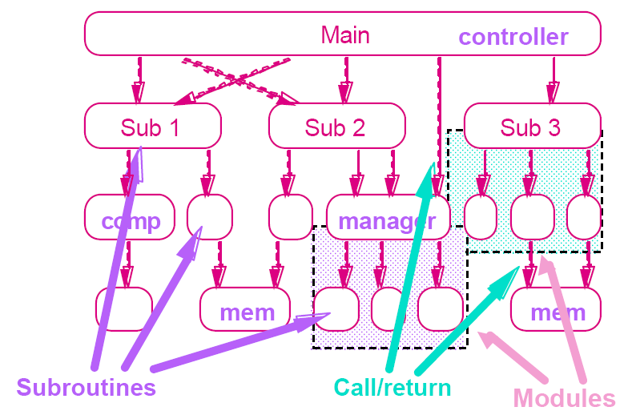
Main Program and Subroutine

Slide 8
Criteria for Modularization
What is a module?
  Common view: a piece of code. Too limited.
  Compilation unit, including related declarations and interface （编译单元，包含相关的声明和接口）
  Parnas: a unit of work.
Why modularize a system, anyway?
  Management: Partition the overall development effort
    divide and conquer (分而治之)
  Evolution: Decouple parts of a system so that changes to one part are isolated from changes to other parts
  进化：降低模块间的耦合度，使改变一个模块不会影响其他
  Understanding: Permit system to be understood as composition of mind-sized chunks
  理解：系统可以被理解成若干个易于理解的模块的组合
Key issue: what criteria to use for modularization

Slide 9
Modularization Problems
Access to internal representation:
  Vulnerability: Visible representations can be manipulated in unexpected, undesired, and dangerous ways
  Nonlocality: If the way something is used depends on its implementation, you must find all uses to change it (e.g. Y2K)
Forced distribution of knowledge:
  Non-uniform referents: Syntax may reveal structure (If you export a data structure, how does its user iterate through it?)

Slide 10
Modularization Problems
Coupling:
  Instance dependence: When multiple instances of a given structure are active, they must remain independent
Families of definitions:
(众说纷纭)
  Dynamic binding: If shared definitions involve type variants, function variants must be chosen at run-time

Slide 11
Module Decomposition
Parnas
  Hide secrets. OK, what’s a “secret”?
    Representation of data
    Properties of a device, other than required properties
    Mechanisms that support policies
  Try to localize future change
    Hide system details likely to change independently
    把可能改变的系统细节分别隐藏
    Expose in interfaces assumptions unlikely to change
    把改变的可能不大的放到接口当中
  Use functions to allow for change
    They’re easier to change than visible representation

Slide 12
Key Word In Context (KWIC)
Problem Description:
  "The KWIC index system accepts an ordered set of lines, each line is an ordered set of words, and each word is an ordered set of characters.
  KWIC索引系统接受一些行，每行有若干字，每个字由若干字符组成
  Any line may be ‘circularly shifted’ by repeatedly removing the first word and appending it at the end of the line.
  每行都可以循环移位。重复地把第一个字删除，然后接到行末
  The KWIC index system outputs a listing of all circular shifts of all lines in alphabetical order.“
  KWIC把所有行的各种移位情况按照字母表顺序输出

Slide 13
Key Word In Context (KWIC)
Inputs: Sequence of lines
  Pipes and Filters
  Architectures for Software Systems
Outputs: Sequence of lines, circularly shifted and alphabetized
  and Filters Pipes
  Architectures for Software Systems
  Filters Pipes and
  for Software Systems Architectures
  Pipes and Filters
  Software Systems Architectures for
  Systems Architectures for Software

Slide 14
Design Considerations
Change in Algorithm
  Eg., batch vs incremental
Change in Data Representation
  Eg., line storage, explicit vs implicit shifts
Change in Function
  Eg., eliminate lines starting with trivial words
Performance
  Eg., space and time
Reuse
  Eg., sorting
Notes:
你想到的体系结构如何？

Slide 15
Solution 1
Decompose the overall processing into a sequence of processing steps.
  Read lines; Make shifts; Alphabetize; Print results
Copy data in modules
数据在每个模块内拷贝
Determine the representation of data between neighbors.
相邻模块间约定好数据格式
  Usually use the same representation of data for all modules
  通常完全采用相同的数据格式，也最好这样做

Slide 16
Solution 1：Modularization
Module 1：Input
  Read data lines and pass to the next module
  按行读取数据，传递给下一模块
Module 2：Circular Shift
  The first line’s coming make it work
  第一行数据到来后开始运作
  Transmit the old and new lines to the next
  把原始数据行，和新的移位后的行输出给下一模块
Module 3：Alphabetize
  Collect data lines, buffer. All done, begin to work
  接收行数据，缓存。当数据都到达后，开始排序
  Finish, output results
  排序完毕，输出结果

Slide 17
Solution 1：Modularization
Module 4：Output
  Called after Alphabetization
  排序后被调用
  Read sorted data lines, print formatted output
  读取排序生成的数据，逐行格式化输出

Slide 18
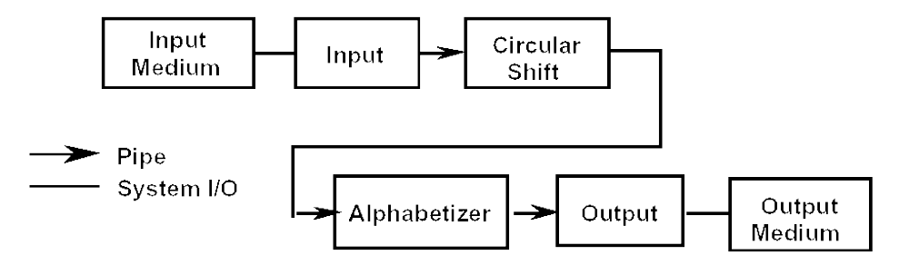
Architecture of Solution 1

Slide 19
Properties of Solution 1
Concurrent partly
部分并行处理
Use lots of memory
空间消耗很大
Every modules should know the representation of data
每个模块都必须知道输入和输出的数据格式

Slide 20
Solution 2
Decompose the overall processing into a sequence of processing steps.
  Read lines; Make shifts; Alphabetize; Print results
Each step transforms the data completely.
每一步完全转换数据
Intermediate data stored in shared memory.
  Arrays of characters with indexes
  带索引的字符数组
  Relies on sequential processing
  串行处理

Slide 21
Solution 2：Modularization
Module 1: Input
  Reads data lines and stores them in “core”.
  Storage format: 4 chars/machine word; array of pointers to start of each line.
Module 2: Circular Shift
  Called after Input is done.
  Reads line storage to produce new array of pairs: (index of 1st char of each circular shift, index of original line)
Module 3: Alphabetize
  Called after Circular Shift.
  Reads the two arrays and produces new index.

Slide 22
Solution 2：Modularization
Module 4: Output
  Called after alphabetization and prints nicely formatted output of shifts
  Reads arrays produced by Modules 1 & 3
Module 5: Master Control
  Handles sequencing of other modules
  Handles errors

Slide 23
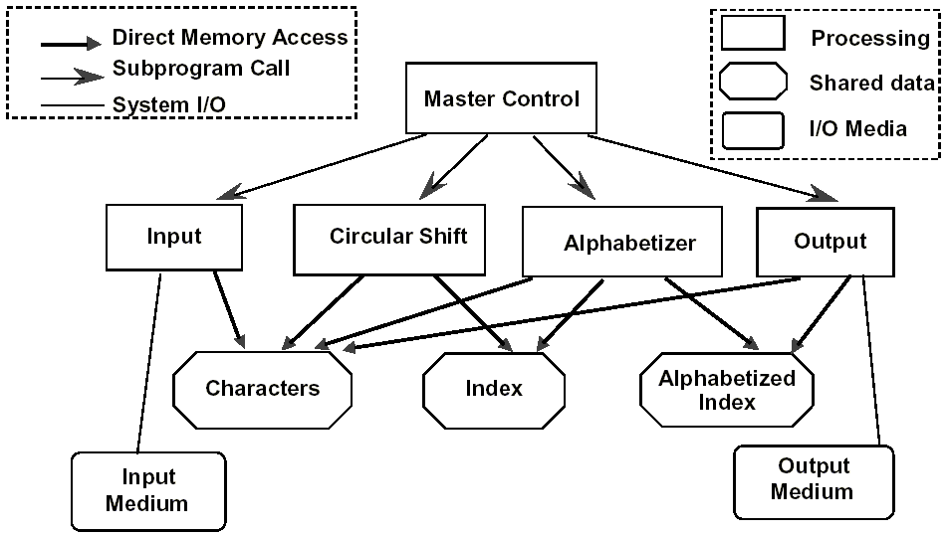
Architecture of Solution 2

Slide 24
Properties of Solution 2
Batch sequential processing.
Uses shared data to get good performance.
用共享数据获得性能
Processing phases handled by control module.
  So has some characteristics of main program – subroutine organization.
  Depends critically on single thread of control.
Shared data structures exposed as inter-module knowledge.
共享数据的结构是所有模块必须知道的
  Design of these structures must be worked out before work can begin on those modules.
  数据结构的设计必须在其他模块设计开始之前进行

Slide 25
Solution 3
Maintain same flow of control, but
Organize solution around set of abstract data type managers (objects):
  for initial lines
  shifted lines
  alphabetized lines
Each manager:
  handles (and hides) the representation of the data
  provides a procedural interface for accessing the data

Slide 26
Solution 3: Modularization
Module 1: Line storage
  Manages lines and characters; procedural interface
  Storage format: not specified at this point
Module 2: Input
  Reads lines of data and stores using “Characters” ADT
Module 3: Circular Shift
  Provides access functions to characters in circular shifts
  Requires “setup” as initialization after Input is done

Slide 27
Solution 3: Modularization
Module 4: Alphabetize
  Provides index of circular shift
  “Alph” called to initialize after Circular Shift
Module 5: Output
  Prints formatted output of shifted lines
Module 6: Master Control
  Handles sequencing of other modules

Slide 28
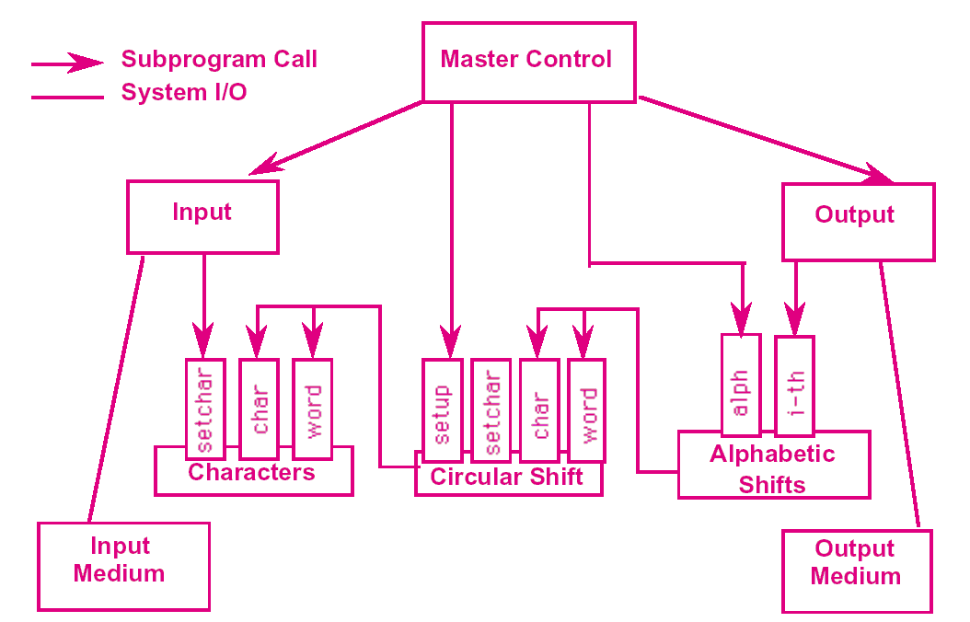
Architecture of Solution 3

Slide 29
Properties of Solution 3
Module interfaces are abstract
  hide data representations
    could be array + indices, as before
    or lines could be stored explicitly
  hide internal algorithm used to process that data
    could be lazy or eager evaluation
  require users to follow a protocol for correct use
    initialization, error handling
Allows work to begin on modules before data representations are designed.
Could result in same executable code as solution 2.
  according to Parnas, at least

Slide 30
Comparisons - 1
Change in Algorithm
  Solution 1: permits alternatives
  Solution 2: batch algorithm hard-wired
  Solution 3: permits alternatives
Change in Data Representation
  Solution 1: data formats are common among many modules or two modules
  Solution 2: data formats are common among many modules
  Solution 3: data formats are hidden

Slide 31
Comparisons - 2
Change in Function
  Solution 1: easy if adding a new filter
  Solution 2: easy if adding a new phase of processing
  Solution 3: modularization doesn’t give particular help. But we can use inheritance.
Performance
  Solution 1: Bad in space and good in speed
  Solution 2: Good
  Solution 3: Probably not as good, but might be

Slide 32
Comparisons - 3
Reuse
  Solution 1: Poor since tied to particular data formats
  Solution 2: Poor since tied to particular data formats
  Solution 3: Better

Slide 33
KWIC：Summary
What does this example teach us?
For some quality attributes (space/time performance, change of functional flow) shared memory can be a good architecture
For other quality attributes (reuse, general modifiability, portability) ADT solution is better
The ADT solution also permits a divide-and-conquer approach to software development
  in terms of allocation of work
  in terms of cognitive effort
This thinking leads to (led to) object architectures.

Slide 34
Encapsulation/Information Hiding
Parnas：Hide secrets (not just representations)
Booch: Object’s behavior is characterized by actions that it suffers and that it requires
对象的行为体现在其接受和请求的动作

Slide 35
Encapsulation/Information Hiding
Practically speaking:
  Object has state and operations, but also has responsibility for the integrity of its state
  对象拥有状态和操作，也有责任维护状态
  Object is known by its interface
  通过接口了解对象
  Object is probably instantiated from a template
  对象一般是一个模板（类）的实例
  Object has operations to access and alter state and perhaps generator
  通过操作来存取、改变和产生对象的状态
  There are different kinds of objects (e.g., actor, agent, server)

Slide 36
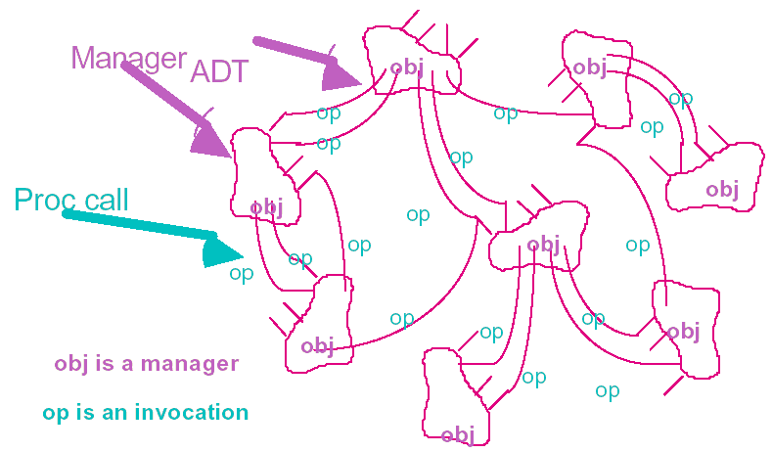
Data Abstraction or Object-Oriented

Slide 37
Elements of Object Architectures
Encapsulation: Restrict access to certain information
封装：限制对某些信息的访问
Interaction: Via procedure calls or similar protocol
交互：通过过程调用或类似的协议
Polymorphism: Choose the method at run-time
多态：在运行时选择具体的操作
Inheritance: Keep 1 definition of shared functionality
继承：对共享的功能保持唯一的接口
Notes:
与语言结合得太紧密

Slide 38
Elements of Object Architectures
Advantage: Reuse and maintenance: Exploit encapsulation and locality to increase productivity
复用和维护：利用封装和聚合提高生产力
Problem: Management of many objects: Need structure on large set of definitions
管理大量的对象：怎样确立大量对象的结构
Note: the object architecture often closely resembles the object programming style. Is this a problem?
注意：面向对象体系结构，通常和面向对象编程风格
很类似，这是个问题吗？
Notes:
与语言结合得太紧密

Slide 39
Finding Objects: Model the Real World
It’s intuitive: if we understand the domain then we are led to a natural system structure based on the domain.
直觉很重要：如果对现实领域理解得很好，那么我们设计的体系结构就自然而然地基于现实的结构
The real world doesn’t change much, so systems that model it are unlikely to change much either.
现实世界结构变化很小，按照其结构建立的体系结构变化也会很小

Slide 40
Finding Objects: Model the Real World
Capture families of related designs through use of templates, and inheritance
通过类和继承表达同一家族的事物
But what happens when you aren’t modeling the real world (e.g. system for manipulating FSMs, fuzzy logic robot controller, natural language translation system)?
但是当你不是为现实世界建模时，怎么办？（比如，你在写FSM管理软件，模糊逻辑机器人控制，翻译软件）

Slide 41
Problems with Object Approaches
Managing many objects
  vast sea of objects requires additional structuring
  对象的海洋需要额外的结构来容纳
  hierarchical design suggested by Booch and Parnas
Managing many interactions
  single interface can be limiting & unwieldy (hence, “friends”)
  单一的接口能力有限并且笨拙（于是，”友元”）
  some languages/systems permit multiple interfaces (inner class, interface, multiple inheritance)

Slide 42
Problems with Object Approaches
Distributed responsibility for behavior
  makes system hard to understand
  interaction diagrams now used in design
Capturing families of related designs
  types/classes are often not enough
  design patterns as an emerging off-shoot

Slide 43
Managing Large Object Sets
Pure O-O design leads to large flat systems with many objects
  Same old problems can reappear
  Hundreds of modules => hard to find things
  Need a way to impose structure
Need additional structure and discipline
Structuring options
  Layers (which are not necessarily objects)
  Supplemental index
  Hierarchical decomposition: big objects and little objects

Slide 44
Pipes versus Procedures
 | Pipes | Procedures
Control | Asynchronous, data-driven | Synchronous, blocking
Semantics | Functional | Hierarchical
Data | Streamed | Parameter / return value
Variations | Buffering, end-of-file behavior | Binding time, exception handling, polymorphism

Slide 45
Stylistic Variations
Client-server
  Objects are processes
  进程就是对象
  Asymmetric: client knows about servers, but not vice versa
  不对称：客户端知道服务器，反之则不然
Tiered
  Elaboration on client-server
  C/S模式的扩展
  Aggregation into run-time strata
  运行时层的结合
  Usually small number of tiers
  通常只有少量的层

Slide 46
Stylistic Variations
Components (later)
  Multiple interfaces
  Special protocols for dynamic reconfiguration
  支持动态配置的专门协议
Compound documents (later)
  Document is a set of embedded objects
  一组嵌入的对象构成文档

Slide 47
The Middleware View
Applications
Common Application Services
Common Transport Services
invokes
Main features
  tiered system
  factor out 50%-90% of application independent code into shared services
  build on existing transport/communication infrastructure

Slide 48
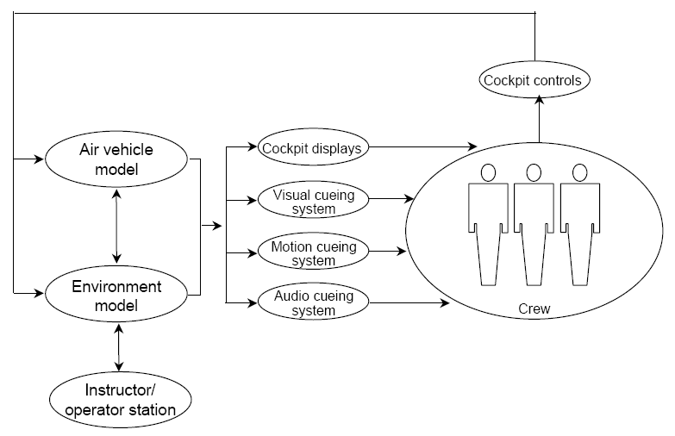
Reference Model for Flight Simulator

Slide 49
Required Qualities
Real-time performance
Modifiability
  Aircraft being simulated is frequently modified.
  飞机型号经常被更换
  Extend these systems so that they can simulate more and more of the real world and further improve the fidelity of the simulation
  扩展系统使其能模拟更多的真实情况和让模拟的精度更高
Integrability of components
  large numbers
  often developed by different organizations

Slide 50
History - 1
Electronic flight simulators date from the 1940s.
Digital flight simulators date from the 1960s.
Flight simulators were written in Fortran.
These architectures were (and are) multi-process and multi-processor:
  communication through global common
  optimized for efficiency
  emphasized “run” mode over other modes
  fragmented functionality (for load balancing)
  software partitioned based on update rates

Slide 51
History - 2
Consequences
  difficult to modify/update (too many intertwined relationships)
  difficult to distribute (and to change the distribution)
  low fidelity in non-run mode
  在非run模式，精度很低
  difficult to insert simulated aircraft malfunctions
  难以增加飞机的新故障
  integration time was growing exponentially with the size of the system

Slide 52
History - 3
The primary focus has been on performance and crew control loops.
System and software organization have been based on simulator state:
  landing
  level flight
  turns

Slide 53
Requirements Growth
The simulator domain has grown continually larger and more complex.
  A complex simulator has 1-2 million lines of code.
  Simulations involve multiple interacting aircraft (such as refueling missions).
  模拟多飞机的协作
  Aircraft have multiple-person crew.
  Multi-processor systems are used.

Slide 54
Interaction Among Instructor, Environment, and Air Vehicle
Instructor operator station responds to events corresponding to instructor commands.
The air vehicle model works as a set of periodic processes.
  events assumed to happen at end of period
  one “periodic” activity is to service just-occurred aperiodic events
The environment model updates itself periodically or responds to events.

Slide 55
Structural Model - 1
A structural model has two parts.
  reference model
  architectural style
Architectural style features
  object-based approach (not pure O-O because of real-time considerations)
  limited number of component types
  few patterns of components
  strictly constrained methods of communication (hierarchical)
Notes:
在20世纪80年代SEI用下面的体系结构为美国空军构建了飞行模拟系统。后来很多商业公司采用此结构，不只开发飞行模拟系统，还有直升机模拟和核反应堆模拟。它已经成为一个复杂的实时模拟系统的通用结构

Slide 56
Structural Model - 2
Also concerned with
  management of time
  coordination among components
  periodic and aperiodic computations
The goal of the structural modeling O-O style is to isolate interfaces and encapsulate knowledge, as with ADTs.
目标是分离接口、封装细节

Slide 57
Reference Model
Some functions are based on physical air vehicle model components.
  airframe subsystems（机身子系统）
  propulsion subsystems（推进子系统）
Some functions are based on environment and physics models.
  equations of motion
  weather
  terrain
  forces and moments
Each of these is broken into subsystem and component objects hierarchically.

Slide 58
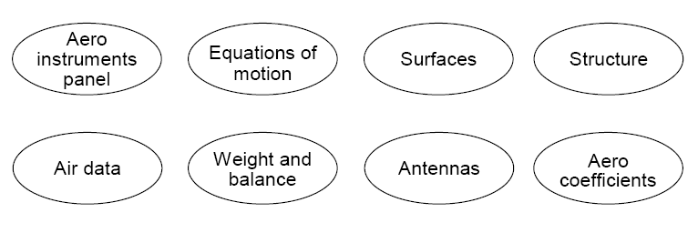
Functional Partitioning - Airframe

Slide 59
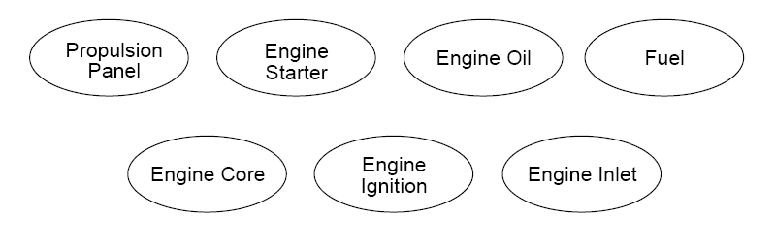
Functional Partitioning - Propulsion

Slide 60
How the Reference Model Leads to Software Structure
Fewer interfaces (because of functional cohesion)
Decomposition based on physical components when possible; this facilitated communication between the software engineers and the customers/users
尽可能地按照物理组件的形式进行分解。这使开发者和用户之间更容易交流
Modeling of malfunctions encapsulated within components affected
把故障封装在引起该故障的组件内

Slide 61
Structural Modeling Style:
Major Object Types
Two parts: application and executive
Application: modeling objects
  subsystems
  components
Executive: real-time scheduling, instructor/operator interface, data sharing/integrity objects
  periodic sequencer
  event handler
  timeline synchronizer
  surrogates

Slide 62
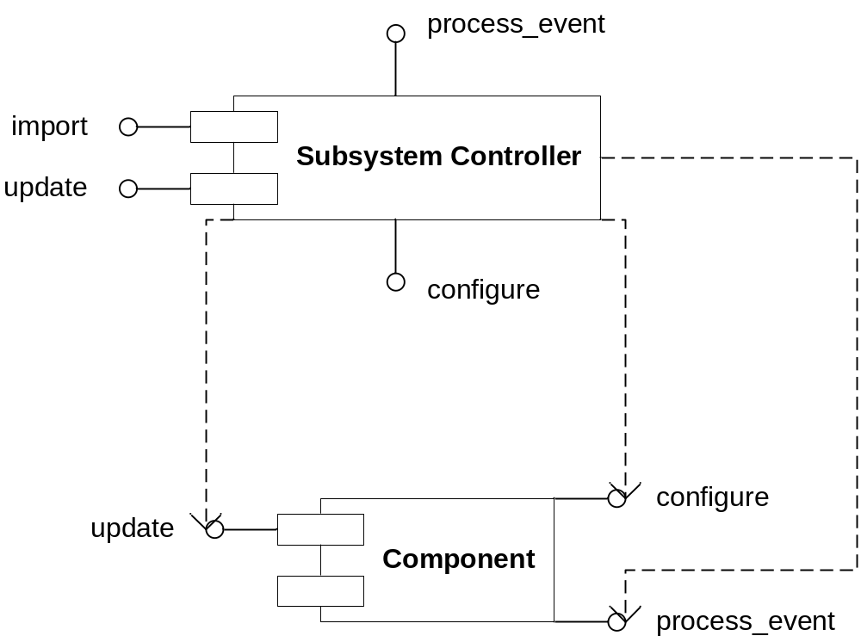
Application Component/Patterns

Slide 63
Salient Features of Application
Supports strict two-level hierarchical pattern of decomposition and interaction.
  Each subsystem controller has multiple components as children.
  Communication between subsystems is handled by subsystem controllers, not independent components.
  Each component can communicate only with its parent.
  There are limited methods.
    normal cyclic operation
    aperiodic operation
    modify configuration

Slide 64
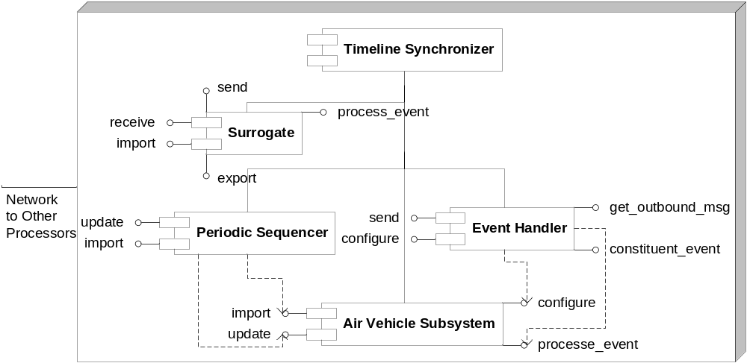
Executive Components

Slide 65
Salient Features of Executive
Executive: controls real-time scheduling, manages events, invokes data sharing.
  the timeline synchronizer manages the real-time scheduling on a single hardware platform and synchronization with other computers
  periodic tasks are controlled by the periodic sequencer (principally import and update)
  aperiodic events are handled by the event handler
  surrogates represent “non-native” subsystems on a computer and hides platform specifics from the rest of the executive and the application

Slide 66
Responsibilities of Components
Timeline synchronizer
  maintains global time for single processor
  coordinates time with other processors
The periodic sequencer controls schedule (invoking subsystems at the right rates/orders).
The event handler manages aperiodic events (configure, send, etc.).
Surrogates manage communication between air vehicle, environment, and operator.

Slide 67
How Structural Model Achieves Qualities
Real-time performance is managed via a strict separation of concerns.
  Scheduling is managed by the executive.
  Application does the modeling.
  Subsystems are given a time “budget” and must complete their computations within that time.
  Frame overruns are recorded for performance monitoring and tuning.
  Subsystems run independently of each other.

Slide 68
How Structural Model Achieves Qualities
Modifiability is managed by
  a division of functionality that matches the air vehicle wherever possible
  making components and subsystems “standalone”; components/subsystems do not communicate directly with each other
  strict patterns of object interactions
This avoids “spaghetti” objects.

Slide 69
How Structural Model Achieves Qualities
Integrability is achieved by the limited paths of communication between components and subsystems.
  Components are called by their subsystem, which manages their data needs.
  Subsystems are similarly called by the executive.
There is little direct coupling between objects (unlike in unconstrained object architectures).

Slide 70
Side Issue: Template-Based Development
Templates (forms) were developed for specifying functions.
A generator was applied to the templates to insert coordination and communication interfaces; functionality is kept separate from infrastructure.

Slide 71
Flight Simulation: Summary
Architecture was the basis for achieving qualities.
A structural model uses a minimal number of patterns to construct flight simulators; this eases system comprehension.
The strict limitations on data and control flow simplify integrability, modifiability, and performance tuning.
Modifiability is also eased by the direct mapping of air vehicle subsystems to software subsystems.

