Slide 1
软件体系结构
信息共享体系结构
Shared Information
孙志岗
sun@hit.edu.cn

Slide 2

Where are we?

Slide 3
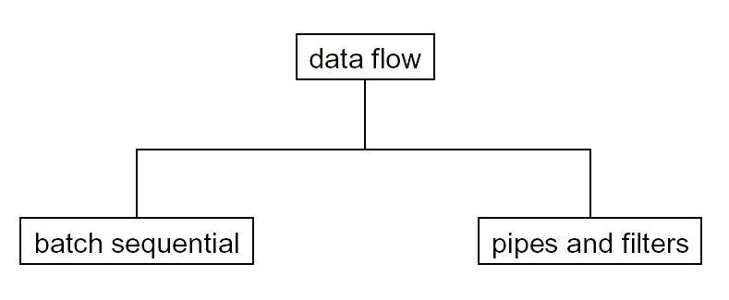
Families of Architectural Styles

Slide 4
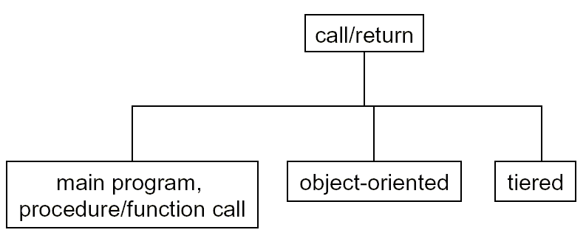
Families of Architectural Styles

Slide 5
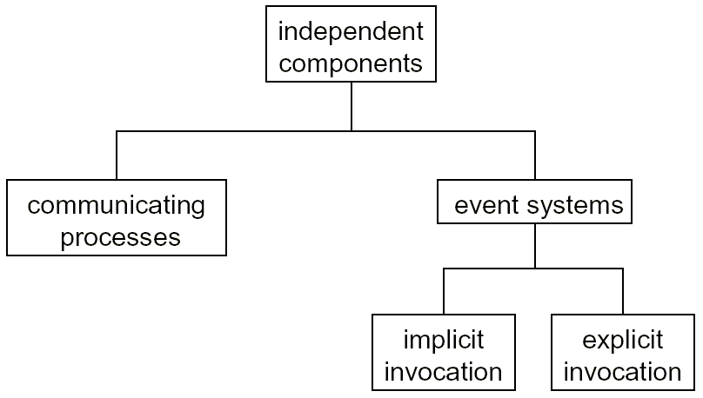
Families of Architectural Styles

Slide 6
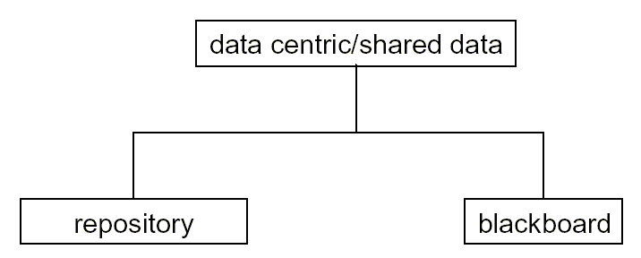
Families of Architectural Styles

Slide 7
Shared Information Systems
Style represents a large variety of systems
这种风格描绘很多种系统
  many variants depending on nature of shared data
  共同特点是共享数据
Style addresses mechanisms for:
风格说明其运行机制是
  collecting, manipulating and preserving large bodies of data
  收集、操作、保存大量的数据
Databases are a natural example, but not the only one
数据库是一个典型的例子，但不是仅有的例子
  we’ll see others in this lecture

Slide 8
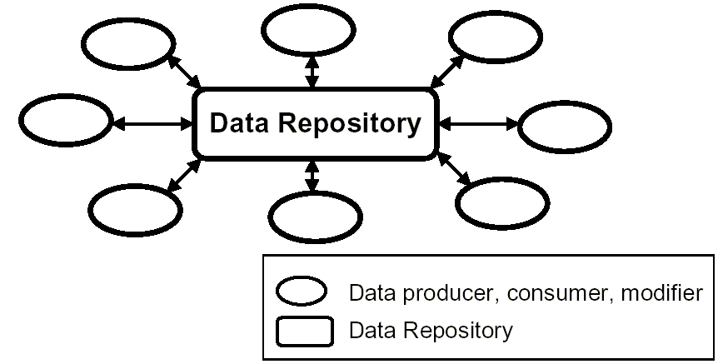
Shared Information Systems
High level view
  what are the apparent features of this style?
  风格的明显特点是什么？
  what are some issues regarding this style?
  这种这个风格有什么可研究的问题？

Slide 9
Shared Information Systems
Advantages
  easy to add consumers and producers of data
  很容易增加数据的生产者和消费者
    How about modifier?
Issues
  synchronization（同步）
  configuration and schema management（配置和管理）
  atomicity（原子性）
  consistency（一致性）
  persistence（持久性）
  performance（性能）

Slide 10
Shared Information Systems Lineage
Earliest repositories appear in batch sequential systems
早期的仓库出现在批处理系统
  mainframes, drums, magnetic tapes, disc drives
  resources manually managed
  人工调配资源
Pressure for on-line access to data
迫切需要数据即时存取
  requirement to make access to data easy and instant
  简捷地数据存取
  help to drive the shift from batch-sequential to interactive processing
  促进了从批处理到交互式处理的转变

Slide 11
Shared Information Systems Lineage
Today
  shared information systems appear everywhere from the smallest business, to the most advanced scientific applications
  从最小的商业应用到最顶尖的科学应用，信息共享无处不在
  many applications provide access mechanisms to shared data
  很多应用提供对共享数据的存取机制
  the Web has become a giant distributed repository
  Web成为庞大的分布式仓库

Slide 12
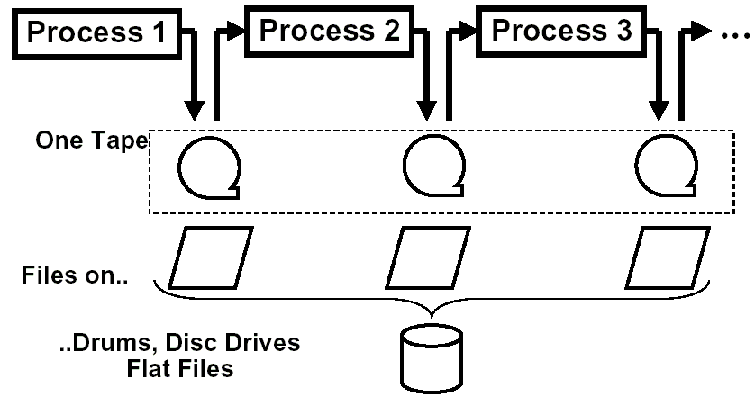
Evolution of Shared Information Systems
Batch Sequential Systems
  flat file access (I/O)
Notes:
书P72图，P74图

Slide 13
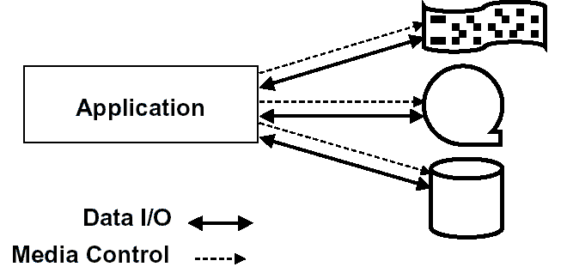
Early File Access
In the earliest systems, code had to be written to position the media, read the data, and do any associated “house cleaning” operations.
早期的系统，很难编写代码来完成定位存储介质、读数据等操作

Slide 14
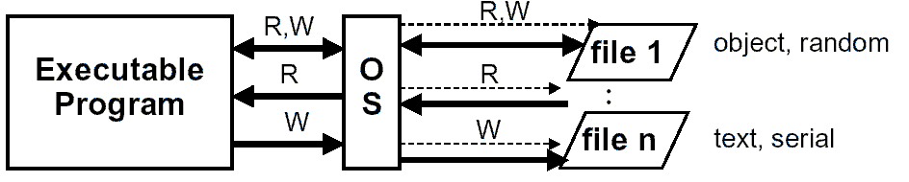
Early File Access
Advances in OS development focused on the abstraction of devices
  the demand to use external data helped to drive the development of more capable file systems
    flat file systems - one level of directories that contain only files
    hierarchical file systems - directories that can contain files and more directories
    language and OS support for many file types and file access methods
Notes:
问题：
开发者必须知道文件的确切结构，自己决定如何访问、检索文件
多任务下还要考虑互斥
纯文件的bbs->web+db论坛，dablio服务器

Slide 15
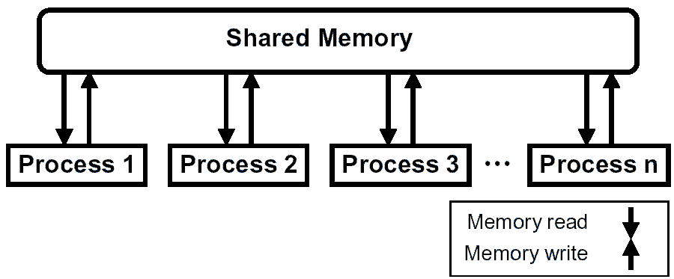
Evolution of Shared Information Systems
Datapool (Shared Memory) Example:
  Enabled by availability of RAM and languages to permit the sharing of common data (E.g., FORTRAN COMMON BLOCK)
  Processes are not necessarily sequential
  Gets messy without implementation rules - what are the issues?

Slide 16
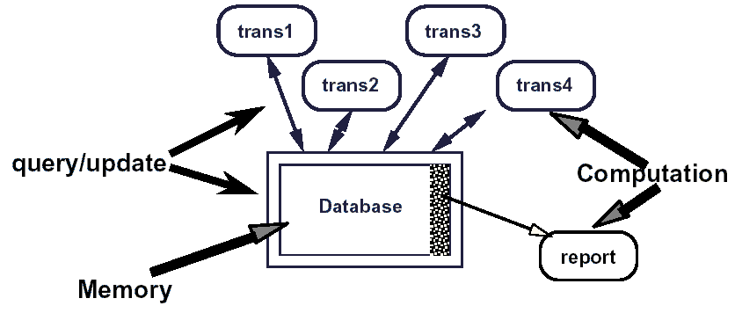
Repository Architecture
Notes:
Database开始爆炸，版本众多

Slide 17
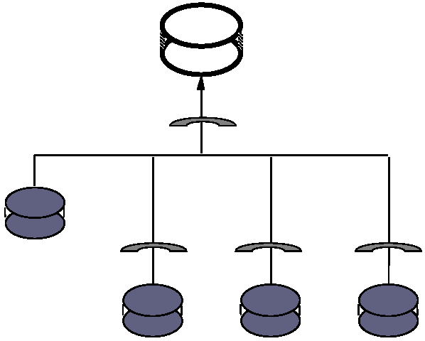
Unified Schemas for Integrating
Databases
Abstraction:
multiplex the databases; put
filters on the query/update to
match diverse views
抽象：
复合多个数据库；
在查询/更新操作中
增加过滤器来匹配
不同的视图
Notes:
schemas固定，用户必须事先想好

Slide 18
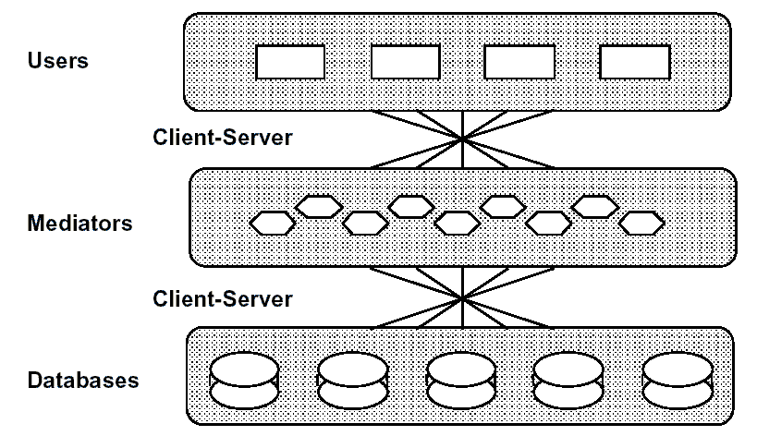
Multi-databases

Slide 19
Evolving Database Architectures
Batch processing:
  Standalone programs （独立的程序）
  results were passed from one to another on magtape （结果通过磁带从一个程序传到另一个程序）
  batch sequential model （批处理风格）
Interactive processing:
  concurrent operation and faster updates preclude batching, so updates are out of synch with reports.
  并行操作、更快的更新速度，但是使更新和报告难以保持同步。
  Repository model with external control （仓库风格）
Problem: information became distributed
among many different DBs.
新问题：信息分布到很多不同的数据库

Slide 20
Evolving Database Architectures
Unified schemas:
  create one virtual database by defining (passive) consistent conversion mappings to multiple DBs
  建立一个虚拟数据库，定义到多个数据库的静态映射
Multi-database:
  DBs have many users; passive mappings don‘t suffice; use active agents.
  数据库有很多用户；静态映射不满足要求；使用活动的代理。
  “Layered” hierarchy
  层次风格

Slide 21
Computer Aided Software
Engineering
Initially just translation from source to object code: compiler, library, linker, make
起初，就是做从源代码到目标代码的转换
Grew to include design record, documentation, analysis, configuration control, incrementality
开始包含分析、设计、调试、测试、文档、配置管理、增量编译等功能
Integration demanded for 20 years, but not here yet.
集成已经作了20年，但还没有结束

Slide 22
CASE vs. DBMS
As compared to databases, CASE has:
  more types of data
  更多的数据类型
  fewer instances of each type
  更少的数据类型实例
  slower query rates
  更慢的查询频率
  larger, more complex, less discrete information
  更大，更复杂，更集中的信息
  but not shorter lifetime
  生命周期没有更短

Slide 23
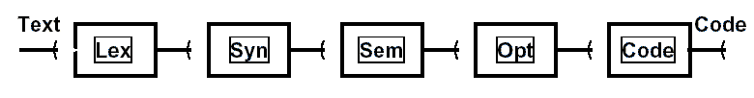
Traditional Compiler

Slide 24
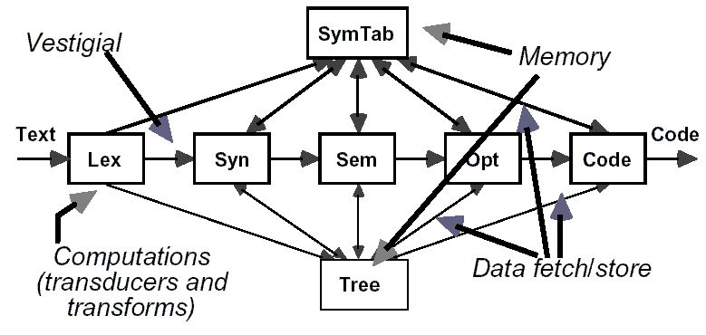
Example: Modern Canonical
Compiler

Slide 25
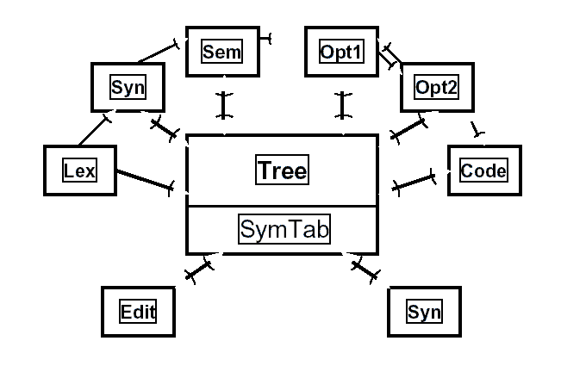
Canonical Compiler

Slide 26
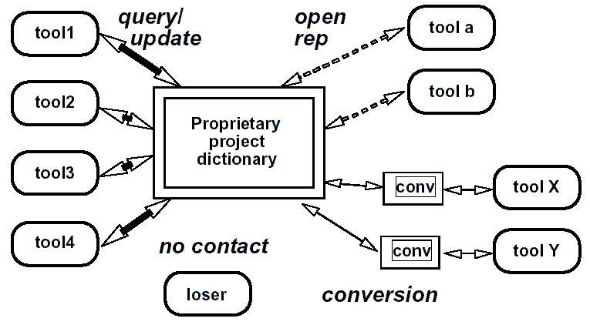
Software Tools with Shared
Representation

Slide 27
Evolution of CASE Environments
Evolution is much like databases:
Interaction: batch --> interactive
交互：批处理→交互式
Granularity: complete processing -->incremental
粒度：完全处理→增量
Coverage: compilation --> full life cycle
覆盖：编译→全生命周期
Like databases, started with batch sequential style
从批处理风格开始
Integration needs led to repositories with rigid control, then to open systems in layers
对集成性的要求，促成了仓库风格被应用，让系统开始分层

Slide 28
Varieties of Repositories
Discriminate on control strategy（在控制策略上的区别）
Predetermined by designer （设计者预先定义好）
  Compilers
Driven by types of information in input stream
输入流的信息类型决定
  Database transaction system
Driven by availability of new information from other parts of the system （系统其他部分的新信息决定）
  Scratchboard （刮板）
Opportunistic: driven by state of computation
机会主义：计算的状态决定
  Blackboard

Slide 29
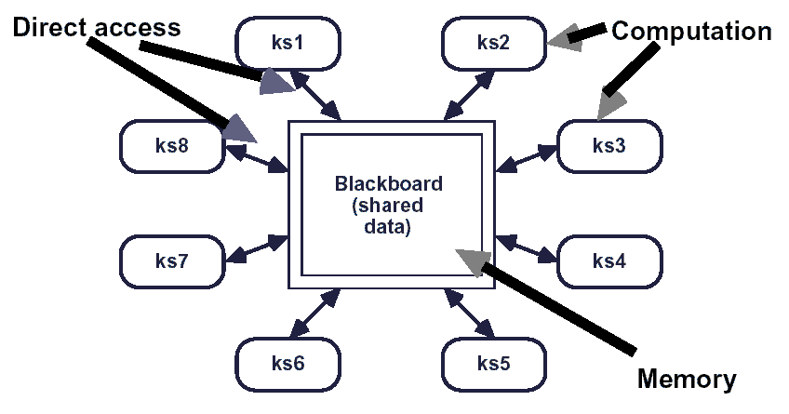
Repository (Blackboard)
Notes:
要有一个模块来控制哪个ks工作

Slide 30
The Blackboard Model
Knowledge Sources
  Problem-appropriate knowledge partitioned into separate, independent computations
  把问题分成几个部分，每个部分独立计算
  React to changes in blackboard
  响应黑板上的变化
Blackboard Data Structure
  Global database containing entire state of problem solution
  全局数据库包含解域的全部状态
  Only means by which knowledge sources interact
  知识源互相作用的唯一媒介
Control
  Knowledge sources respond
  “opportunistically”
  让知识源响应偶然事件

Slide 31
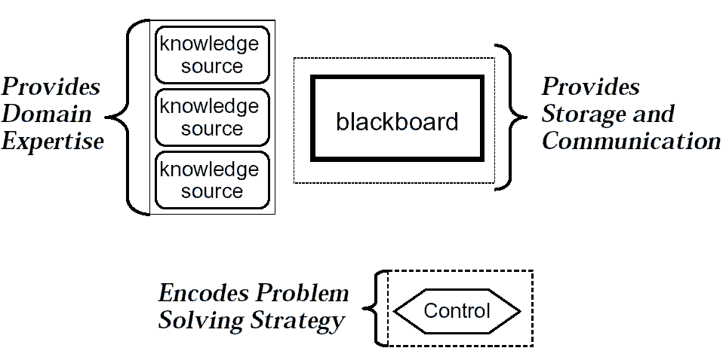
The Blackboard Model

Slide 32
Blackboard Architecture
Key ideas
  knowledge shared and distributed among some number of cooperating processes
  知识在一些协作的processes之间共享和分布
  opportunistic processing of data
  机会主义地处理数据
The Blackboard Architecture have 3 major components
  knowledge sources （知识源）
  blackboard （黑板）
  control （控制）
Historical examples:
  Hearsay I, Hearsay II, HASP/SAIP, CRYSALIS, ATOME
  Originally most were from signal processing/interpretation domains （信号处理、专家系统、模式识别领域经常采用）

Slide 33
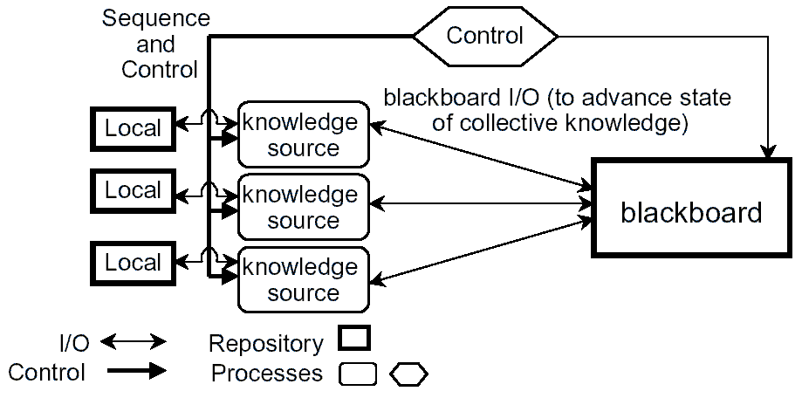
Blackboard Architecture

Slide 34
Blackboard Problem Characteristics
no direct algorithmic solution
没有直接的算法可解
  multiple approaches to solving the problem
  多种方法都可能解决问题
  various domain expertise required to solve the problem
  需要多个领域的专门知识协作解决
uncertainty
  error and variability in data and solution
  数据和解决方法可能错误或变化
  moderate to low “signal-to-noise-ratio” in data
  数据中信噪比的变化
  Uncertainty interferes with algorithmic solutions
  算法接口的变化

Slide 35
Blackboard Problem Characteristics
“Best-effort” or approximation is good enough
  no single discrete answer to problem, or “right” answer may vary
  问题没有唯一的解答，或者“正确”答案会变化
examples
  signal processing （信号处理）
  problem solving (planning, logistics, diagnostics)
  compiler optimization

Slide 36
Knowledge Sources
Objective:
  contribute knowledge that leads to solution
  提供解决问题的知识
Representation:
  procedures, sets of rules, logic assertions
  过程、规则、逻辑断言
Action:
  modify only the blackboard (or control data -- magic)
  只修改黑板
Responsibility:
  know when it’s possible to help
  知道何时能发挥作用
Selection:
  loosely-coupled subtasks, or areas of specialization
  低耦合的子任务，或者有特别的能力

Slide 37
Blackboard Data Structure
Objective:
  hold data for use by knowledge sources
  保存知识源要使用的数据
Representation:
  stores objects from solution space, including
  保存来自解空间的数据，包括
    input data, partial solutions, alternatives, final solutions, control data
    objects and properties define the terms of the discourse
    relationships are denoted by named links (“next-to”, “part-of”)
Organization:
  hierarchical, possibly multiple hierarchies; links between objects on same or different levels
  分层；链接同层或不同层的对象

Slide 38
Control
Objective:
  make knowledge sources respond opportunistically
  让知识源响应偶然事件
Representation:
  keeps various sorts of information about which knowledge sources could operate and picks a sequence that allows the solution process to proceed a step at a time
  了解各个知识源的能力，决策解决问题的步骤
Remark:
  the control mechanisms are thoroughly ad hoc
  控制机制是彻底的与时俱进

Slide 39
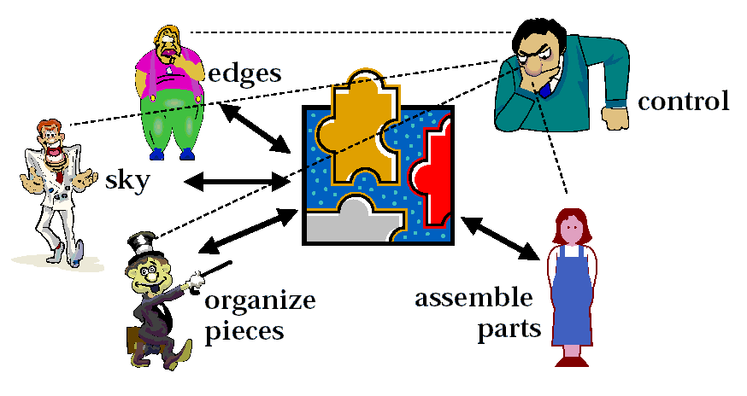
Example：The Puzzle Metaphor

Slide 40


Example：The Puzzle Metaphor
Data within the blackboard is often structured hierarchically
Level 4 | assemble chunks
Level 3 | build chunks of edges build chunks of sky
Level 2 | collect edge pieces collect sky pieces
Level 1 | Turn all pieces picture side up

Slide 41
Hearsay II
Complex blackboard system to deal with arbitrary speech recongition (a difficult problem):
  Ambiguity in segmentation（音节分割问题）:
  “Mary’s truck” versus “Mary struck”
  Ambiguity in stress（重音问题）:
  “disease” versus “dizzies”
  Ambiguity in grammar（语法问题）:
  “The horse raced past the barn fell”
  Ambiguity in semantics（语义问题）:
  “I saw the man on the hill with the binoculars”

Slide 42
Problem Solving Strategy
Had to be incremental, opportunistic, flexible
必须是增量的、机会的、灵活的
Hearsay-II employed several strategies:
  Bottom-up (synthetic)
  Top-down (analytic)
  General hypothesize-and-test （猜测和测试）
Blackboard structure entertained many simultaneous hypotheses
黑板结构可以同时处理多种假设
Control was complex: had a monitor portion and a priority based scheduler
控制很复杂：有一个监视器，采用基于优先级的调度

Slide 43
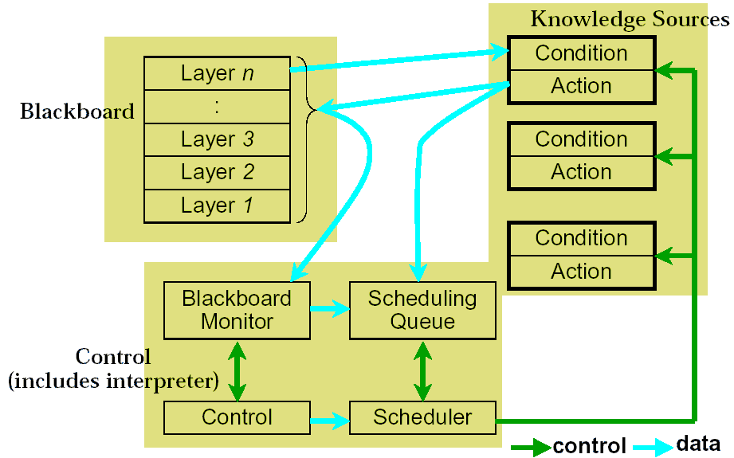
Hearsay II Structure

Slide 44
Lecture Summary
Repositories are ubiquitous in computer-based applications.
仓库在计算机应用中几乎无处不在
Shared information systems in many areas show similar trends, stimulated by similar technological and business pressures.
信息共享系统在很多领域有相似的发展趋势，因为有相似的技术和商业压力的激励
Blackboards are specialized types of repositories for dealing with “messy” information processing domains where the control strategy must be opportunistic.
黑板是一种特别的仓库，主要用于需要对凌乱的信息进行处理的领域，其控制策略必须是机会主义的

