Slide 1
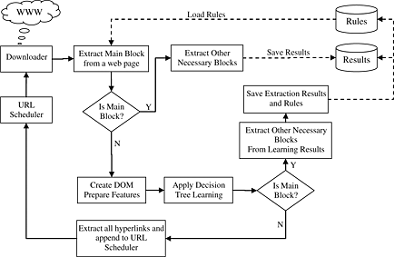
An effective and efficient Web content extractor for optimizing the crawling process
Software: Practice and Experience Volume 44, Issue 10, pages 1181-1199, 27 MAR 2013 DOI: 10.1002/spe.2195 http://onlinelibrary.wiley.com/doi/10.1002/spe.2195/full#spe2195-fig-0001
Notes:
The architecture of iCrawler.
IF THIS IMAGE HAS BEEN PROVIDED BY OR IS OWNED BY A THIRD PARTY, AS INDICATED IN THE CAPTION LINE, THEN FURTHER PERMISSION MAY BE NEEDED BEFORE ANY FURTHER USE. PLEASE CONTACT WILEY'S PERMISSIONS DEPARTMENT ON PERMISSIONS@WILEY.COM OR USE THE RIGHTSLINK SERVICE BY CLICKING ON THE 'REQUEST PERMISSIONS' LINK ACCOMPANYING THIS ARTICLE. WILEY OR AUTHOR OWNED IMAGES MAY BE USED FOR NON-COMMERCIAL PURPOSES, SUBJECT TO PROPER CITATION OF THE ARTICLE, AUTHOR, AND PUBLISHER.

