Slide 1
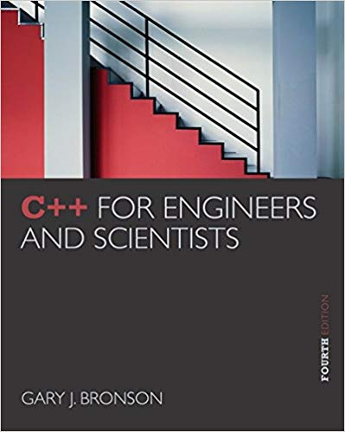
ELEG 1043
Computer Applications in Engineering
C++ for Engineers and Scientists, Fourth Edition
Notes:
1. Not vey new, but good enough for you
2. Not for Computer Science, For engineering

Slide 2
Chapter 1:
Preliminaries
Notes:
Before starting to learn, need to learn some preliminary knowledge
Some parts may be known before.
Necessary for others.

Slide 3
Acknowledgement
Some of the slides or images are from various sources. The copyright of those materials belongs to their original owners.
C++ for Engineers and Scientists, Fourth Edition
Notes:
Don’t distribute the soft copies t others or sell hard copy
Copyright issues

Slide 4
Objectives
In this chapter, you will learn about:
Unit analysis
Exponential and scientific notations
Software development
Algorithms
Software, hardware, and computer storage
Common programming errors
C++ for Engineers and Scientists, Fourth Edition
Notes:
In all fields of study, using consistent and correct units when making computations is crucial.
Using consistent sets of units
Knowing how to convert between units

Slide 5
Preliminary Three: Software Development
Computer program: Self-contained set of instructions used to operate a computer to produce a specific result
  Also called software
  Solution developed to solve a particular problem, written in a form that can be executed on a computer
C++ for Engineers and Scientists, Fourth Edition
Notes:
Students often believe that once the program is written, it is done.
A discussion of the software life cycle is helpful.

Slide 6
Preliminary Three: Software Development (continued)
Software development procedure: Helps developers understand the problem to be solved and create an effective, appropriate software solution
Software engineering:
  Concerned with creating readable, efficient, reliable, and maintainable programs and systems
  Uses software development procedure to achieve this goal
C++ for Engineers and Scientists, Fourth Edition
Notes:
Each field of study has its own name for the systematic method of designing solutions to solve problems.
Professional software developers use the software development procedure for understanding the problem to be solved and for creating an effective, appropriate software solution.

Slide 7
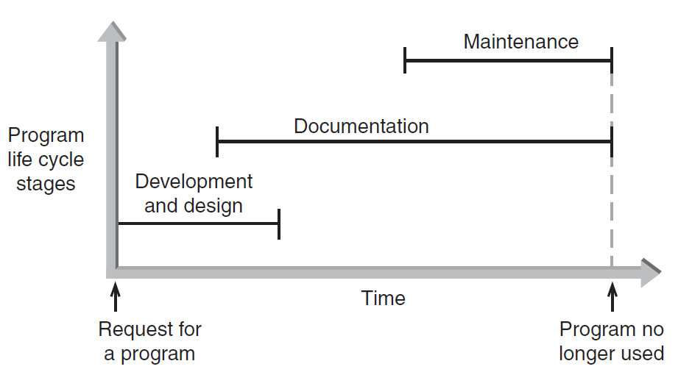
Preliminary Three: Software Development (continued)
Figure 1.2 The three phases of program development
C++ for Engineers and Scientists, Fourth Edition
Notes:
consists of three overlapping phases
Although the documentation phase is described as occurring after the software has been written, a great deal of documentation is actually developed during the analysis phase.
Functional specifications provide details of what the software must do.
System specifications describe the architecture of the software.

Slide 8
Phase I: Development and Design
Program requirement: Request for a program or a statement of a problem
After a program requirement is received, Phase I begins:
Phase I consists of four steps:
  Analysis
  Design
  Coding
  Testing
C++ for Engineers and Scientists, Fourth Edition
Notes:
Phase I begins with a statement of a problem or a specific request for a program, which is referred to as a program requirement.
Breaking the complex problem into many simple problems

Slide 9
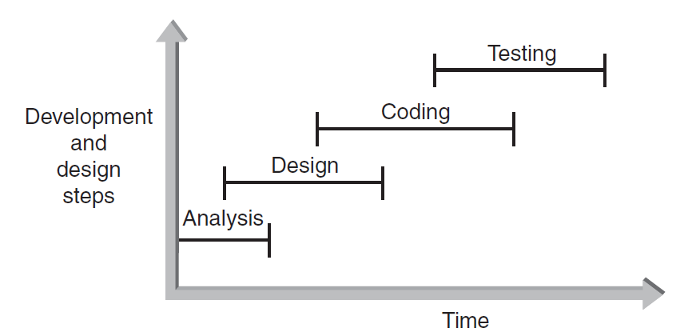
Phase I: Development and Design (continued)
Figure 1.3 The development and design steps
C++ for Engineers and Scientists, Fourth Edition
Notes:
Teamwork
Communicate with other very frequently

Slide 10
Phase II: Documentation
Five main documents for every problem solution:
  Program description
  Algorithm development and changes
  Well-commented program listing
  Sample test runs
  Users' manual
C++ for Engineers and Scientists, Fourth Edition
Notes:
Because of inadequate documentation, so much work becomes useless or lost and many tasks must be repeated, so documenting your work is one of the most important steps in problem solving.
Many critical documents are created during the analysis, design, coding, and testing steps.
Although not everybody classifies them in the same way, there are five main documents for every problem solution
The documentation phase formally begins in the development and design phase and continues into the maintenance phase.

Slide 11
Phase III: Maintenance
Maintenance includes:
  Ongoing correction of newly discovered bugs
  Revisions to meet changing user needs
  Addition of new features
Usually the longest phase
May be the primary source of revenue
Good documentation vital for effective maintenance
C++ for Engineers and Scientists, Fourth Edition
Notes:
This phase is concerned with the ongoing correction of problems, revisions to meet changing needs, and addition of new features.
Maintenance is often the major effort, the primary source of revenue, and the longest lasting of the engineering phases.
Development might take days or months, but maintenance could continue for years or decades.
The better the documentation is, the more efficiently maintenance can be performed, and the happier customers and end users will be.

Slide 12
Chapter 2:
Problem Solving Using C++

Slide 13
Acknowledgement
Some of the slides or images are from various sources. The copyright of those materials belongs to their original owners.
C++ for Engineers and Scientists, Fourth Edition
Notes:
Don’t distribute the soft copies t others or sell hard copy
Copyright issues

Slide 14
Objectives
In this chapter, you will learn about:
Modular programs
Programming style
Data types
Arithmetic operations
Variables and declaration statements
Common programming errors
C++ for Engineers and Scientists, Fourth Edition

Slide 15
Introduction to C++
Modular program: A program consisting of interrelated segments (or modules) arranged in a logical and understandable form
  Easy to develop, correct, and modify
Modules in C++ can be classes or functions
C++ for Engineers and Scientists, Fourth Edition

Slide 16
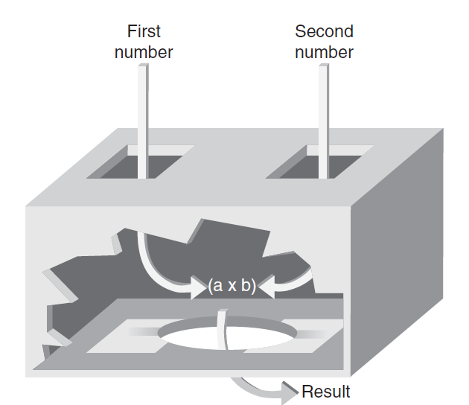

Introduction to C++ (continued)‏
Function: Accepts an input, processes the input, and produces an output
  A function’s processing is encapsulated and hidden within the function
C++ for Engineers and Scientists, Fourth Edition

Slide 17
Introduction to C++ (continued)‏
Class: Contains both data and functions used to manipulate the data
Identifier: A name given to an element of the language, such as a class or function
  Rules for forming identifier names:
    First character must be a letter or underscore
    Only letters, digits, or underscores may follow the initial letter (no blanks allowed)‏
    Keywords cannot be used as identifiers
    Maximum length of an identifier = 1024 characters
C++ for Engineers and Scientists, Fourth Edition

Slide 18
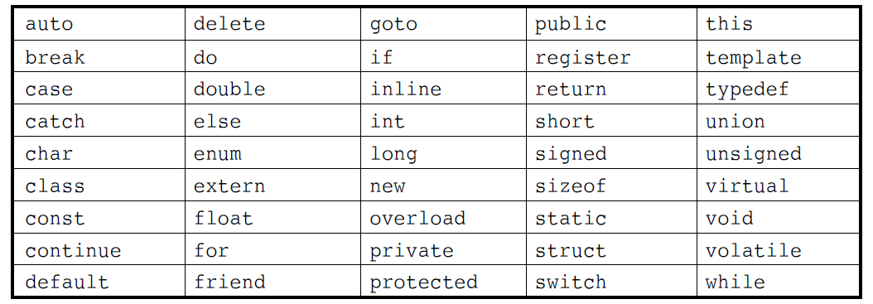
Introduction to C++ (continued)‏
Keyword: A reserved name that represents a built-in object or function of the language
Table 2.1: Keywords in C++
C++ for Engineers and Scientists, Fourth Edition

Slide 19
Introduction to C++ (continued)‏
Examples of valid C++ identifiers:
  degToRad intersect addNums
  slope bessell multTwo
  findMax density
Examples of invalid C++ identifiers:
  1AB3 (begins with a number)‏
  E*6 (contains a special character)‏
  while (this is a keyword)‏
C++ for Engineers and Scientists, Fourth Edition

Slide 20
Introduction to C++ (continued)‏
Function names
  Require a set of parentheses at the end
  Can use mixed upper and lower case
  Should be meaningful, or be a mnemonic
Examples of function names:
addNums() multTwoNums()‏
Note that C++ is a case-sensitive language!
  addNums() is different from AddNums()
C++ for Engineers and Scientists, Fourth Edition

Slide 21
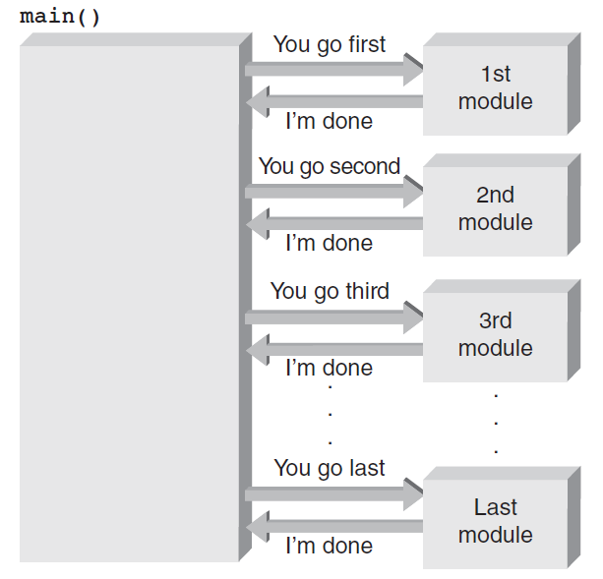
The main() Function
Overall structure of a C++ program contains one function named main(), called the driver function
All other functions are invoked from main()‏
Figure 2.3 The main() function directs all other functions.
C++ for Engineers and Scientists, Fourth Edition

Slide 22
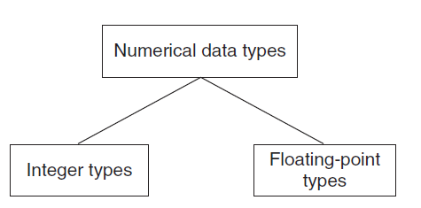
Data Types
Data type: A set of values and the operations that can be applied to these values
Two fundamental C++ data groupings:
  Class data type (a class): Created by the programmer
  Built-in data type (primitive type): Part of the C++ compiler
Figure 2.5 Built-in data types
C++ for Engineers and Scientists, Fourth Edition

Slide 23
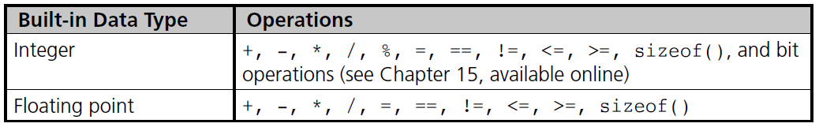
Data Types (continued)
C++ for Engineers and Scientists, Fourth Edition

Slide 24
Data Types (continued)‏
Literal (constant): An actual value
  Examples:
3.6 //numeric literal
“Hello” //string literal
Integer: A whole number
C++ has nine built-in integer data types
C++ for Engineers and Scientists, Fourth Edition

Slide 25
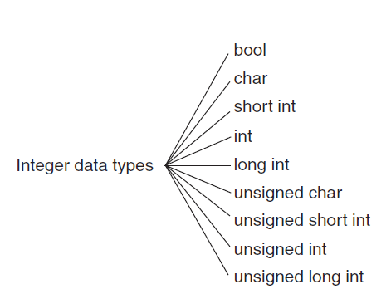
Integer Data Types
Figure 2.6 C++ integer data types
C++ for Engineers and Scientists, Fourth Edition

Slide 26
Integer Data Types (continued)‏
int data type: Whole numbers (integers), optionally with plus (+) or minus (–) sign
  Example: 2, -5
char data type: Individual character; any letter, digit, or special character enclosed in single quotes
  Example: ‘A’
C++ for Engineers and Scientists, Fourth Edition

Slide 27
Integer Data Types (continued)‏
bool data type: Represents Boolean (logical) data
  Restricted to two values: true or false
  Useful when a program must examine a condition and take a prescribed course of action, based on whether the condition is true or false
C++ for Engineers and Scientists, Fourth Edition

Slide 28
Floating-Point Types
Floating-point number (real number): Zero or any positive or negative number containing a decimal point
  Examples: +10.625, 5., -6.2
  Three floating-point data types in C++:
    float (single precision)‏
    double (double precision)‏
    long double
C++ for Engineers and Scientists, Fourth Edition

Slide 29
Floating-Point Types (continued)‏
float literal: Append an f or F to the number
long double literal: Append an l or L to the number
  Examples:
9.234 // a double literal
9.234F // a float literal
9.234L // a long double literal
C++ for Engineers and Scientists, Fourth Edition

Slide 30
Arithmetic Operations
C++ supports addition, subtraction, multiplication, division, and modulus division
Different data types can be used in the same arithmetic expression
Arithmetic operators are binary operators
  Binary operators: Require two operands
  Unary operator: Requires only one operand
  Negation operator (-): Reverses the sign of the number
C++ for Engineers and Scientists, Fourth Edition

Slide 31
Arithmetic Operations (continued)‏
Operation
Operator
Addition
+
Subtraction
-
Multiplication
*
Division
/
Modulus division
%
C++ for Engineers and Scientists, Fourth Edition

Slide 32
Integer Division
Integer division: Yields an integer result
  Any fractional remainders are dropped (truncated)‏
  Example: 15/2 yields 7
Modulus (remainder) operator: Returns only the remainder
  Example: 9 % 4 yields 1
C++ for Engineers and Scientists, Fourth Edition

Slide 33
Variables and Declaration Statements (continued)‏
Assignment statement: Used to store a value into a variable
Value of the expression on the right is assigned to the memory location of the variable on the left side
  Examples:
num1 = 45;
num2 = 12;
total = num1 + num2;
C++ for Engineers and Scientists, Fourth Edition

Slide 34
Common Programming Errors (continued)‏
Missing \n to indicate new line
Substituting letter O for zero and vice versa
Failing to declare all variables
C++ for Engineers and Scientists, Fourth Edition

Slide 35
Summary
A C++ program consists of one or more modules, called functions, one of which must be called main()‏
All C++ statements must be terminated by a semicolon “;”
Data types include int, float, bool
C++ for Engineers and Scientists, Fourth Edition

Slide 36
Summary (continued)‏
Variables
  Variables must be declared with their data type
  A variable can be used only after it has been declared
  Variables may be initialized when declared
C++ for Engineers and Scientists, Fourth Edition

Slide 37
Chapter 3:
Assignment, Formatting, and Interactive Input

Slide 38
Acknowledgement
Some of the slides or images are from various sources. The copyright of those materials belongs to their original owners.
C++ for Engineers and Scientists, Fourth Edition
Notes:
Don’t distribute the soft copies t others or sell hard copy
Copyright issues

Slide 39
Objectives
In this chapter, you will learn about:
Assignment operations
Formatting numbers for program output
Using mathematical library functions
Program input using the cin object
Symbolic constants
A case study involving acid rain
Common programming errors
C++ for Engineers and Scientists, Fourth Edition

Slide 40
Assignment Operations
Assignment Statement: Assigns the value of the expression on the right side of the = to the variable on the left side of the =
  int a = 2;
  left right
Another assignment statement using the same variable will overwrite the previous value with the new value
Examples:
slope = 3.7;
slope = 6.28; (Overwrite)
C++ for Engineers and Scientists, Fourth Edition

Slide 41
Assignment Operations (continued)
Additional assignment operators provide short cuts: +=, -=, *=, /=, %=
  Example:
  sum = sum + 10;
  is equivalent to: sum += 10;
  price *= rate +1;
  is equivalent to:
  price = price * (rate + 1);
C++ for Engineers and Scientists, Fourth Edition

Slide 42
Assignment Operations (continued)
Increment operator ++: Unary operator for the special case when a variable is increased by 1
Prefix increment operator appears before the variable
  Example: ++i
Postfix increment operator appears after the variable
  Example: i++
C++ for Engineers and Scientists, Fourth Edition

Slide 43
Assignment Operations (continued)
Example: k = ++n; //prefix increment
is equivalent to:
n = n + 1; //increment n first
k = n; //assign n’s value to k
Example: k = n++; //postfix increment
is equivalent to
k = n; //assign n’s value to k
n = n + 1; //and then increment n
C++ for Engineers and Scientists, Fourth Edition

Slide 44
Assignment Operations (continued)
Decrement operator --: Unary operator for the special case when a variable is decreased by 1
Prefix decrement operator appears before the variable
  Example: --i;
Postfix decrement operator appears after the variable
  Example: i--;
C++ for Engineers and Scientists, Fourth Edition

Slide 45
Program Input Using cin
cin Object: Allows data entry to a running program
Use of the cin object causes the program to wait for input from the keyboard
When keyboard entry is complete, the program resumes execution, using the entered data
An output statement preceding the cin object statement provides a prompt to the user
C++ for Engineers and Scientists, Fourth Edition

Slide 46
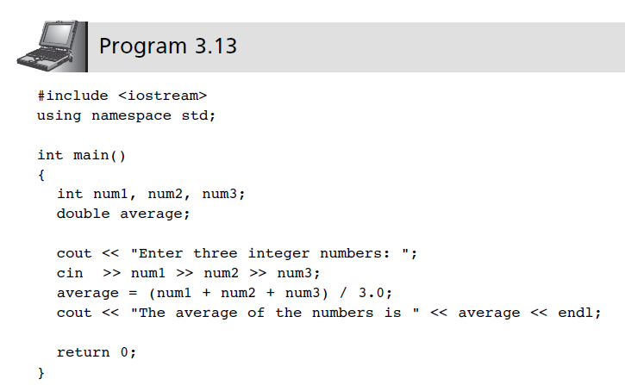
Program Input Using cin (continued)
C++ for Engineers and Scientists, Fourth Edition

Slide 47
Chapter 4:
Selection Structures

Slide 48
Objectives
In this chapter, you will learn about:
  Selection criteria
  The if-else statement
  Nested if statements
  The switch statement
  Program testing
  Common programming errors
C++ for Engineers and Scientists, Fourth Edition

Slide 49
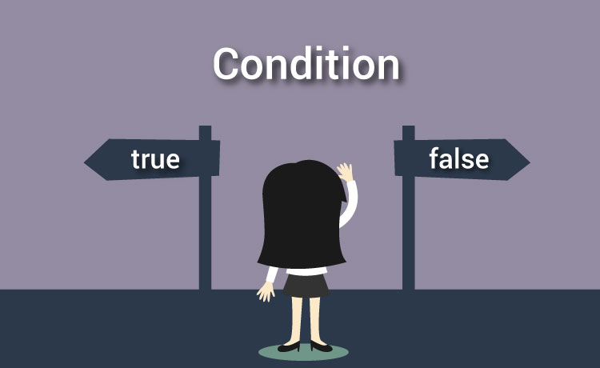
Selection Criteria
https://www.programiz.com/c-programming/c-if-else-statement
C++ for Engineers and Scientists, Fourth Edition

Slide 50
Selection Criteria
if-else statement: Implements a decision structure for two alternatives
Syntax:
if (condition)
statement executed if condition is true;
else
statement executed if condition is false;
C++ for Engineers and Scientists, Fourth Edition

Slide 51
Selection Criteria (continued)
The condition is evaluated to its numerical value:
  A non-zero value is considered to be true
  A zero value is considered to be false
The else portion is optional
  Executed only if the condition is false
C++ for Engineers and Scientists, Fourth Edition

Slide 52
Logical Operators
AND (&&): Condition is true only if both expressions are true
OR (||): Condition is true if either one or both of the expressions is true
NOT (!): Changes an expression to its opposite state; true becomes false, false becomes true
C++ for Engineers and Scientists, Fourth Edition

Slide 53
Logical Operators
A && B -> True when both A and B are True, Otherwise False
A || B -> False when both A and B are False, Otherwise True
C++ for Engineers and Scientists, Fourth Edition

Slide 54
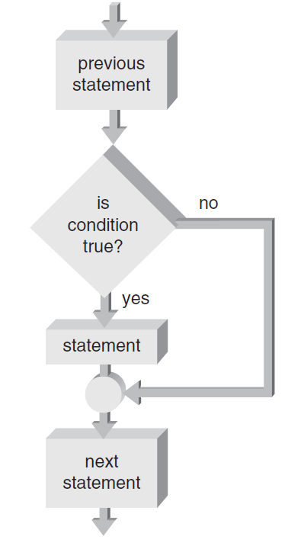
One-Way Selection
One-way selection: An if statement without the optional else portion
  int a = 1;
  if(a > 0)
  {
  cout<<a;
  }
Figure 4.3 A one-way selection if statement
C++ for Engineers and Scientists, Fourth Edition

Slide 55
Nested if Statements
if-else statement can contain any valid C++ statement, including another if-else
Nested if statement: an if-else statement completely contained within another if-else
Use braces to block code, especially when inner if statement does not have its own else
C++ for Engineers and Scientists, Fourth Edition

Slide 56
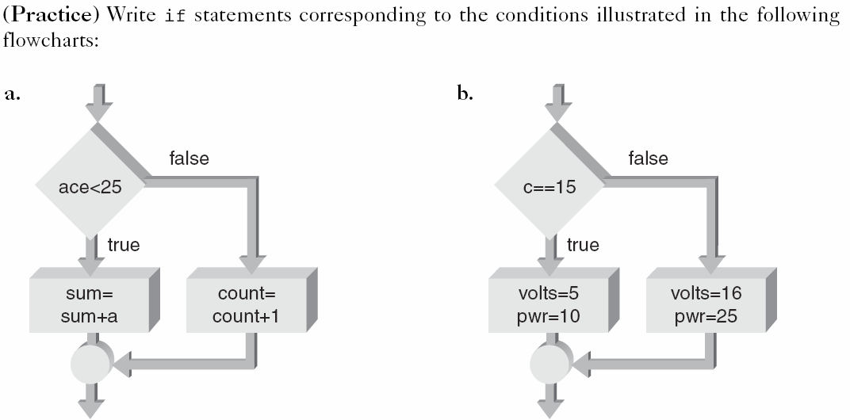
Exercise 4
C++ for Engineers and Scientists, Fourth Edition

Slide 57
Answer
a.
if(a < 25)
{
sum = sum + a;
}
else
{
count = count + 1;
}
b.
if(c == 15)
{
volt = 5; power = 10;
}
else
{
volt = 16; power = 25;
}
C++ for Engineers and Scientists, Fourth Edition

Slide 58
Chapter 5:
Repetition Statements

Slide 59
Objectives
In this chapter, you will learn about:
Basic loop structures
while loops
Interactive while loops
for loops
Loop programming techniques
C++ for Engineers and Scientists, Fourth Edition

Slide 60
Objectives (continued)
Nested loops
do while loops
Common programming errors
C++ for Engineers and Scientists, Fourth Edition

Slide 61
Basic Loop Structures
Repetition structure has four required elements:
  Repetition statement
  Condition to be changed
  Initial value for the condition
  Loop termination
Repetition statements include:
  while
  for
  do while
C++ for Engineers and Scientists, Fourth Edition

Slide 62
Example
(a) Repetition statement
(b) Condition to be changed
(c) Initial value for the condition
(d) Loop termination
(c) (d) (b)
for(int i = 0; i < 10; i++)
{ cout<<i<<endl; (a)
}
C++ for Engineers and Scientists, Fourth Edition

Slide 63

while Loops
C++ for Engineers and Scientists, Fourth Edition

Slide 64
while Loops
while statement is used to create a while loop
  Syntax:
while (expression)
statement;
Statements following the expressions are executed as long as the expression condition remains true (evaluates to a non-zero value)
C++ for Engineers and Scientists, Fourth Edition

Slide 65
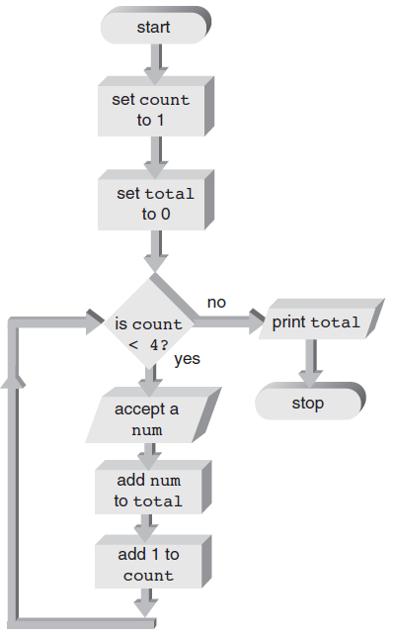
Interactive while Loops (cont’d)
Figure 5.7 Accumulation flow of control
C++ for Engineers and Scientists, Fourth Edition

Slide 66
Interactive while Loops (cont’d)
#include <iostream>
using namespace std;
int main()
{
int count = 0, total = 0;
while(count < 4)
{
int num;
cout<<“Enter a num \n”;
cin>>num;
total = total + num;
count = count + 1
}
cout<<“The total is “<<total;
return 0;
}
C++ for Engineers and Scientists, Fourth Edition

Slide 67
Exercise 4
Write a Program to print the numbers from 1 to 10 in increments of 3. The output of your program should be the following:
1 4 7 10
C++ for Engineers and Scientists, Fourth Edition

Slide 68
Answer
#include <stream>
using namespace std;
int main(){
int num = 1;
while(num < 11){
cout<<num<<“ ”;
num = num + 3;}
return 0;
}
C++ for Engineers and Scientists, Fourth Edition

Slide 69

for Loops
  https://cdn.programiz.com/sites/tutorial2program/files/C%2B%2Bfor-loop.jpg
C++ for Engineers and Scientists, Fourth Edition

Slide 70
for Loops
for statement: A loop with a fixed count condition that handles alteration of the condition
  Syntax:
for (initializing list; expression; altering list)
statement;
Initializing list: Sets the starting value of a counter
Expression: Contains the maximum or minimum value the counter can have; determines when the loop is finished
C++ for Engineers and Scientists, Fourth Edition

Slide 71
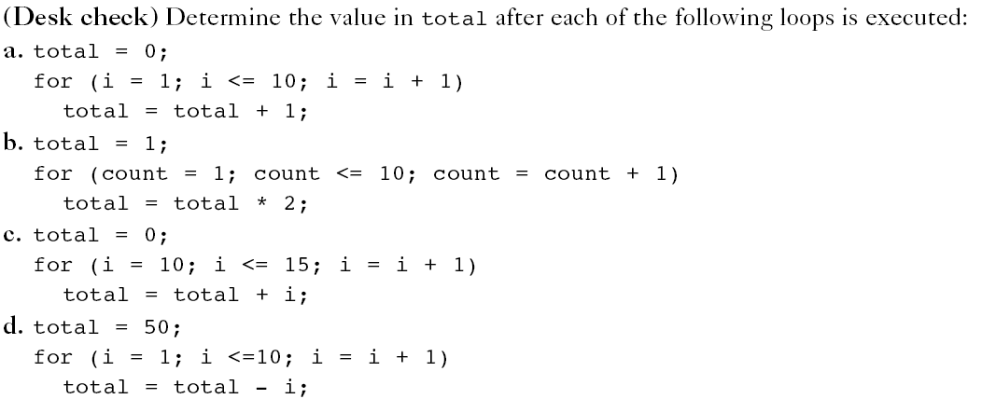
Exercise
C++ for Engineers and Scientists, Fourth Edition

Slide 72
Answer
a. total = 0 + 1*10 = 10
b. total = 1*2*2*2*2*2*2*2*2*2*2 = 1,024
c. total = 0 + 10 + 11 + 12 + 13 + 14 + 15 = 75
d. total = 50 - 1 - 2 - 3- 4 - 5 - 6 - 7- 8 - 9 -10= -5
C++ for Engineers and Scientists, Fourth Edition

Slide 73
Exercise
Write a Program to display the numbers from 1 to 10 in increments of 2 with the loop statement. The output of your program should be the following:
  1 3 5 7 9
C++ for Engineers and Scientists, Fourth Edition

Slide 74
Answer
#include <iostream>
using namespace std;
int main()
{
for(int i = 1; i <10; i = i + 2)
{
cout<<i<<” ”;
}
return 0;
}
C++ for Engineers and Scientists, Fourth Edition

Slide 75
Chapter 6:
Modularity Using Functions

Slide 76
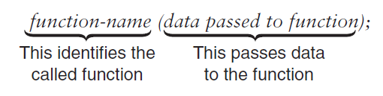
Function and Parameter Declarations
Interaction with a function includes:
  Passing data (Arguments) to a function correctly when its called
  Returning values from a function when it ceases operation
A function is called by (1) giving the function’s name and (2) passing arguments in the parentheses following the function name
Figure 6.1 Calling and passing data to a function
C++ for Engineers and Scientists, Fourth Edition

Slide 77
Function and Parameter Declarations (continued)
Before a function is called, it must be declared to function that will do calling
Declaration statement for a function is referred to as function prototype
Function prototype tells calling function:
  Type of value that will be formally returned, if any
  Data type and order of the values (arguments) the calling function should transmit to the called function
Function prototypes can be placed with the variable declaration statements above the calling function name or in a separate header file
C++ for Engineers and Scientists, Fourth Edition

Slide 78
Defining a Function
Every C++ function consists of two parts:
  Function header
  Function body
Function header’s purpose:
  Identify data type of value function returns, provide function with name, and specify number, order, and type of arguments function expects
Function body’s purpose:
  To operate on passed data and return, at most, one value directly back to the calling function
C++ for Engineers and Scientists, Fourth Edition

Slide 79
Calling a Function
Requirements when calling a function include:
  Using the name of the function
  Enclosing any data passed (Arguments) to the function in the parentheses following the function name, using the same order and type declared in the function prototype
C++ for Engineers and Scientists, Fourth Edition

Slide 80
Exercise
Write a program that is to build a function to receive 5 numbers from the keyboard and display “You lose!” if the number is less than 0, and call this function in main function.
C++ for Engineers and Scientists, Fourth Edition

Slide 81
Answer
#include <iostream>
using namespace std;
void game(){
for(int i = 0; i < 5; i++){
int num;
cin>>num;
if(num < 0){
cout<<”You lose!”<<endl;}
}
}
int main(){
game();
return 0;
}
C++ for Engineers and Scientists, Fourth Edition

Slide 82
Chapter 7:
Arrays

Slide 83
Acknowledgement
Some of the slides or images are from various sources. The copyright of those materials belongs to their original owners.
C++ for Engineers and Scientists, Fourth Edition
Notes:
Don’t distribute the soft copies t others or sell hard copy
Copyright issues

Slide 84
Objectives
In this chapter, you will learn about:
One-dimensional arrays
Array initialization
Declaring and processing two-dimensional arrays
Arrays as arguments
Statistical analysis
C++ for Engineers and Scientists, Fourth Edition

Slide 85
Objectives (continued)
The Standard Template Library (STL)
Searching and sorting
Common programming errors
C++ for Engineers and Scientists, Fourth Edition

Slide 86
One-Dimensional Arrays
One-dimensional array: A list of related values with the same data type, stored using a single group name (called the array name)
  Syntax:
dataType arrayName[number-of-items]
By convention, the number of items is first declared as a constant, and the constant is used in the array declaration
C++ for Engineers and Scientists, Fourth Edition

Slide 87
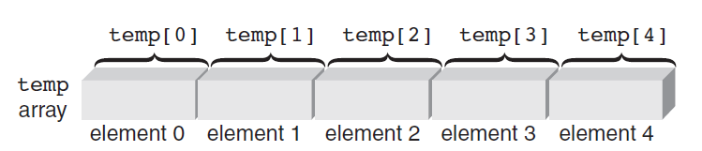
One-Dimensional Arrays (continued)
Element: An item in the array
  Array storage of elements is contiguous
Index (or subscript) of an element: The position of the element within the array
  Indexes are zero-relative
To reference an element, use the array name and the index of the element
Figure 7.2 Identifying array elements
C++ for Engineers and Scientists, Fourth Edition

Slide 88
One-Dimensional Arrays (continued)
All of the elements of an array can be processed by using a loop
The loop counter is used as the array index to specify the element
Example:
int sum = 0;
int temp[5] = {1,2,3,4,5};
for (int i=0; i<5; i++)
sum = sum + temp[i];
C++ for Engineers and Scientists, Fourth Edition

Slide 89
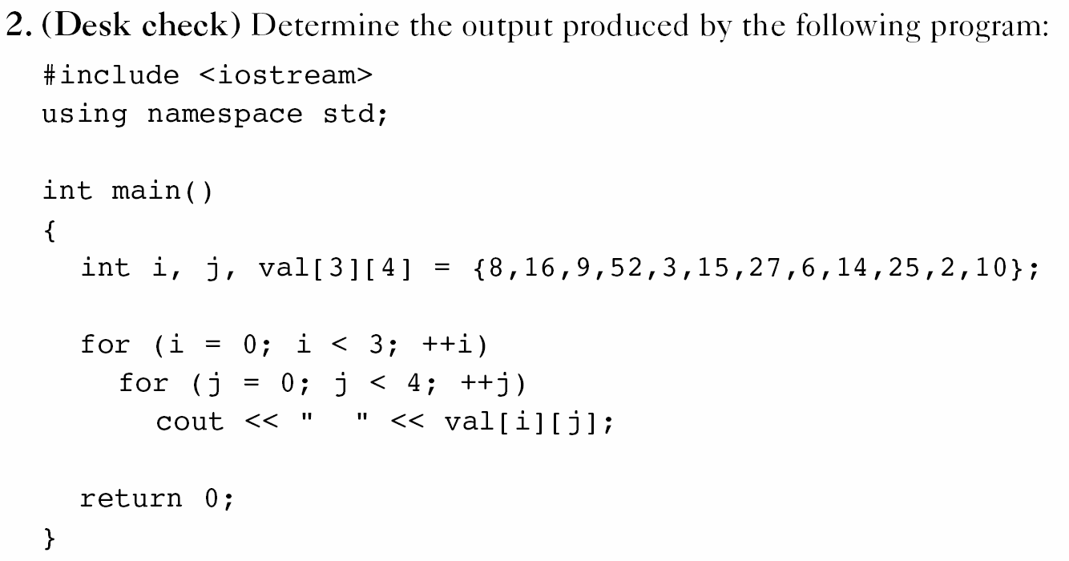
Homework Assignment 4
C++ for Engineers and Scientists, Fourth Edition

Slide 90
Homework Assignment 4
int a[20] = {1,2,3,4,5,6,7,8,9,10,11,12,13,14,15,16,17,18,19,20};
for (int k = 1; k < 5; k = k + 3)
cout << a[k] << " ";
C++ for Engineers and Scientists, Fourth Edition

Slide 91
Input and Output of Array Values
Array elements can be assigned values interactively using a cin stream object
Out of range array indexes are not checked at compile-time
  May produce run-time errors
  May overwrite a value in the referenced memory location and cause other errors
Array elements can be displayed using the cout stream object
C++ for Engineers and Scientists, Fourth Edition

Slide 92
Declaring and Processing
Two-Dimensional Arrays
Two-dimensional array: Has both rows and columns
  Also called a table
Both dimensions must be specified in the array declaration
  Row is specified first, then column
Both dimensions must be specified when referencing an array element
C++ for Engineers and Scientists, Fourth Edition

Slide 93
Declaring and Processing
Two-Dimensional Arrays (cont’d)
Two-dimensional arrays can be initialized in the declaration by listing values within braces, separated by commas
Braces can be used to distinguish rows, but are not required
Nested for loops are used to process two-dimensional arrays
  Outer loop controls the rows
  Inner loop controls the columns
C++ for Engineers and Scientists, Fourth Edition

Slide 94
Arrays as Arguments
An individual array element can be passed as an argument just like any individual variable
The called function receives a copy of the array element’s value
Passing an entire array to a function causes the function to receive a reference to the array, not a copy of its element values
The function must be declared with an array as the argument
Single element of array is obtained by adding an offset to the array’s starting location
C++ for Engineers and Scientists, Fourth Edition

Slide 95
Exercise 1
Write a program to input 10 positive integer numbers in an array named Mini and determine and display the minNum value entered, where the numbers are received from keyboard
C++ for Engineers and Scientists, Fourth Edition

Slide 96
Answer
#include <iostream>
using namespace std;
int main(){
int Mini [10] = {0};
  int num = -1;
  cin>>num;
  Mini [0] = num;
  int minNum = num;
  for(int i = 1; i < 10; i++){
  cin>>num;
  Mini [i] = num;
  if(minNum > num)
  {minNum = num;} }
  cout<<minNum<<endl;
  return 0;}
C++ for Engineers and Scientists, Fourth Edition

Slide 97
Exercise 2
Write a program to build a function named multiply to input the following integer numbers in an array named grades: 12.3, 16.4, and 30.6. As each number is input, multiply the numbers to a variable mul and return the mul value.
C++ for Engineers and Scientists, Fourth Edition

Slide 98
Answer
#include <iostream>
using namespace std;
double multiply(double arr[], int length);
int main(){
double arr[3] = {12.3, 16.4, 30.6};
  cout<< multiply(arr, 3);
  return 0;
  }
double multiply(double arr[], int length){
double mul = 1.0;
  for(int i = 0; i < length; i++){
  mul = mul*arr[i];
  }
  return mul;
}
C++ for Engineers and Scientists, Fourth Edition

Slide 99
Summary
An array is a data structure that stores a list of values having the same data type
  Array elements: stored in contiguous memory locations; referenced by array name/index position
  Two-dimensional arrays have rows and columns
  Arrays may be initialized when they are declared
  Arrays may be passed to a function by passing the name of the array as the argument
    Arrays passed as arguments are passed by reference
    Individual array elements as arguments are passed by value (copy)
C++ for Engineers and Scientists, Fourth Edition

Slide 100
Chapter 10:
Pointers

Slide 101
Objectives
In this chapter you will learn about:
  Addresses and pointers
  Array names as pointers
  Pointer arithmetic
  Passing addresses
  Common programming errors
C++ for Engineers and Scientists, Fourth Edition

Slide 102
Addresses and Pointers
The address operator, &, accesses a variable’s address in memory
The address operator placed in front of a variable’s name refers to the address of the variable
  &num means the address of num
C++ for Engineers and Scientists, Fourth Edition

Slide 103
Storing Addresses (continued)
Example statements store addresses of the variable m, list, and ch in the variables d, tabPoint, and chrPoint
  d = &m;
  tabPoint = &list;
  chrPoint = &ch;
d, tabPoint, and chrPoint are called pointer variables or pointers
C++ for Engineers and Scientists, Fourth Edition

Slide 104
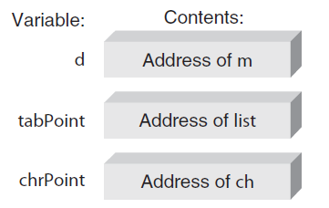
Storing Addresses (continued)
Figure 10.3 Storing more addresses
C++ for Engineers and Scientists, Fourth Edition

Slide 105
Declaring Pointers
Like all variables, pointers must be declared before they can be used to store an address
When declaring a pointer variable, C++ requires specifying the type of the variable that is pointed to
  Example: int *numAddr;
C++ for Engineers and Scientists, Fourth Edition

Slide 106
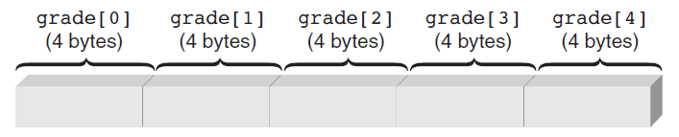
Array Names as Pointers
There is a direct and simple relationship between array names and pointers
Figure 10.9 The grade array in storage
Using subscripts, the fourth element in grade is referred to as grade[3], address calculated as:
  &grade[3] = &grade[0] + (3 * sizeof(int))
C++ for Engineers and Scientists, Fourth Edition

Slide 107
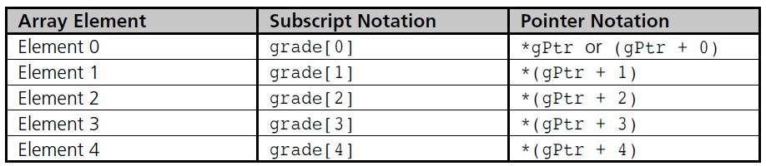
Array Names as Pointers (continued)
Table 10.1 Array Elements Can Be Referenced in Two Ways
C++ for Engineers and Scientists, Fourth Edition

Slide 108
Exercise 1
Replace each of the following references to a subscripted variable with a pointer reference
  year[10]
  seconds[30]
  students[0]
C++ for Engineers and Scientists, Fourth Edition

Slide 109
Exercise 2
Replace each of the following pointer references with a subscript (index) reference
  *(year + 2)
  *(seconds + 20)
  *(students)
C++ for Engineers and Scientists, Fourth Edition

Slide 110
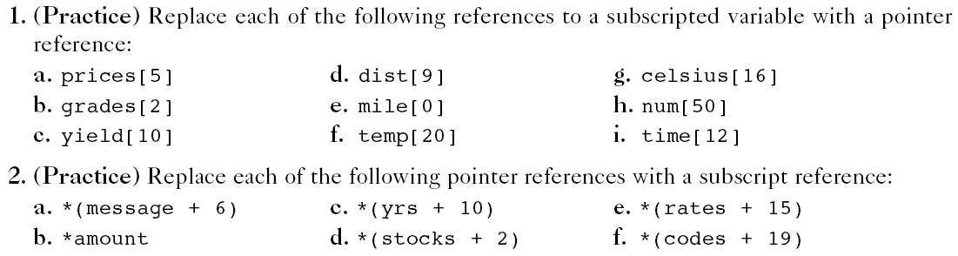
Homework Assignment 5
C++ for Engineers and Scientists, Fourth Edition

Slide 111
Passing Arrays
When an array is passed to a function, its address is the only item actually passed
  “Address” means the address of the first location used to store the array
  First location is always element zero of the array
C++ for Engineers and Scientists, Fourth Edition

Slide 112
Common Programming Errors
Attempting to store address in a variable not declared as pointer
Using pointer to access nonexistent array elements
Initialized pointer variables incorrectly
C++ for Engineers and Scientists, Fourth Edition

Slide 113
Summary
Every variable has a data type, an address, and a value
In C++, obtain the address of variable by using the address operator, &
A pointer is a variable used to store the address of another variable
  Must be declared
  Use indirection operator, *, to declare the pointer variable and access the variable whose address is stored in pointer
C++ for Engineers and Scientists, Fourth Edition

Slide 114
Summary (continued)
Array name is a pointer constant
Arrays are passed to functions as addresses
When a one-dimensional array is passed to a function, the function’s parameter declaration can be an array declaration or a pointer declaration
Pointers can be incremented, decremented, compared, and assigned
C++ for Engineers and Scientists, Fourth Edition

Slide 115
Chapter 11:
Introduction to Matlab

Slide 116
Objectives
In this chapter you will learn about:
  What is Matlab?
  Matlab Screen
  Variables, array, matrix, indexing
  Operators (Arithmetic, relational, logical )
  Display Facilities
  Flow Control
  Using of M-File
  Debugging
C++ for Engineers and Scientists, Fourth Edition

Slide 117
Variables
No need for types. i.e.,
All variables are created with double precision unless specified and they are matrices.
After these statements, the variables are 1x1 matrices with double precision
int a;
double b;
float c;
Example:
>>x=5;
>>x1=2;
C++ for Engineers and Scientists, Fourth Edition

Slide 118
Workspace
The workspace is Matlab’s memory
Can manipulate variables stored in the workspace
>> a=12;
  >> b=10;
  >> c=a+b
  c =
  22
  >>
C++ for Engineers and Scientists, Fourth Edition

Slide 119
Variables
View variable contents by simply typing the variable name at the command prompt
>> a
a =
12
>>
>> a*2
a =
24
>>
C++ for Engineers and Scientists, Fourth Edition

Slide 120
Array, Matrix
A vector x = [1 2 5 1]
x =
1 2 5 1
A matrix t = [1 2 3; 5 1 4; 3 2 -1]
t =
1 2 3
5 1 4
3 2 -1
Transpose y = x’ y =
1
2
5
1
C++ for Engineers and Scientists, Fourth Edition

Slide 121

The : operator
VERY important operator in Matlab
Means ‘to’
>> 1:10
ans =
1 2 3 4 5 6 7 8 9 10
>> 1:2:10
ans =
1 3 5 7 9
Try the following
>> x=0:pi/12:2*pi;
>> y=sin(x)
C++ for Engineers and Scientists, Fourth Edition

Slide 122
The : operator
>>A(3,2:3)
ans =
1 7
>>A(:,2)
ans =
2
1
1
A =
3 2 1
5 1 0
2 1 7
What’ll happen if you type A(:,:) ?
C++ for Engineers and Scientists, Fourth Edition

Slide 123
Long Array, Matrix
t = 1:10
t =
1 2 3 4 5 6 7 8 9 10
k = 2:-0.5:-1
k =
2 1.5 1 0.5 0 -0.5 -1
X = [1:4; 5:8]
x =
1 2 3 4
5 6 7 8
C++ for Engineers and Scientists, Fourth Edition

Slide 124
Generating Vectors from functions
zeros(M,N) MxN matrix of zeros
ones(M,N) MxN matrix of ones
rand(M,N) MxN matrix of uniformly distributed random
numbers on (0,1)
x = zeros(1,3)
x =
0 0 0
x = ones(1,3)
x =
1 1 1
x = rand(1,3)
x =
0.9501 0.2311 0.6068
C++ for Engineers and Scientists, Fourth Edition

Slide 125
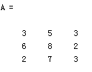


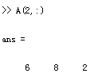

Matrix Index
The matrix indices begin from 1 (not 0 (as in C))
The matrix indices must be positive integer
Given:
C++ for Engineers and Scientists, Fourth Edition

Slide 126
Operators (arithmetic)
+ addition
- subtraction
* multiplication
/ division
^ power
‘ matrix transpose
C++ for Engineers and Scientists, Fourth Edition

Slide 127
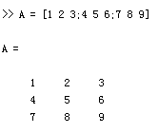
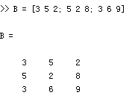
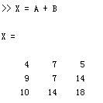
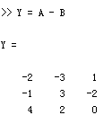
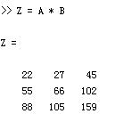
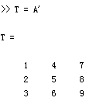
Matrices Operations
Given A and B:
Addition
Subtraction
Product
Transpose
C++ for Engineers and Scientists, Fourth Edition

Slide 128
Operators (Element by Element)
.* element-by-element multiplication
./ element-by-element division
.^ element-by-element power
C++ for Engineers and Scientists, Fourth Edition

Slide 129
The use of “.” – “Element” Operation
A = [1 2 3; 5 1 4; 3 2 1]
A =
1 2 3
5 1 4
3 2 -1
x = A(1,:)
x=
1 2 3
y = A(3 ,:)
y=
3 4 -1
b = x .* y
b=
3 8 -3
d = x .^2
d=
1 4 9
C++ for Engineers and Scientists, Fourth Edition

