Slide 1
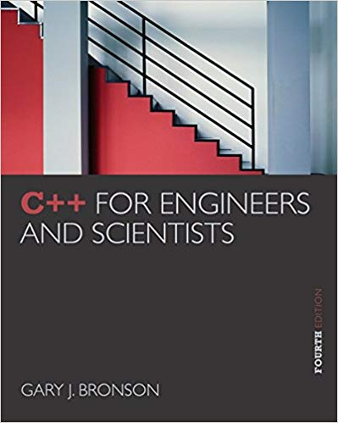
ELEG 1043
Computer Applications in Engineering
C++ for Engineers and Scientists, Fourth Edition
Notes:
1. Not vey new, but good enough for you
2. Not for Computer Science, For engineering

Slide 2
Chapter 3:
Assignment, Formatting, and Interactive Input

Slide 3
Acknowledgement
Some of the slides or images are from various sources. The copyright of those materials belongs to their original owners.
C++ for Engineers and Scientists, Fourth Edition
Notes:
Don’t distribute the soft copies t others or sell hard copy
Copyright issues

Slide 4
Objectives
In this chapter, you will learn about:
Assignment operations
Formatting numbers for program output
Using mathematical library functions
Program input using the cin object
Symbolic constants
A case study involving acid rain
Common programming errors
C++ for Engineers and Scientists, Fourth Edition

Slide 5
Assignment Operations
Assignment Statement: Assigns the value of the expression on the right side of the = to the variable on the left side of the =
  int a = 2;
  left right
Another assignment statement using the same variable will overwrite the previous value with the new value
Examples:
slope = 3.7;
slope = 6.28; (Overwrite)
C++ for Engineers and Scientists, Fourth Edition

Slide 6
Assignment Operations (continued)
Right side of an assignment statement may contain any expression that can be evaluated to a value
Examples:
newtotal = 18.3 + total;
taxes = .06*amount;
average = sum / items;
Only one variable can be on the left side of an assignment statement
C++ for Engineers and Scientists, Fourth Edition

Slide 7
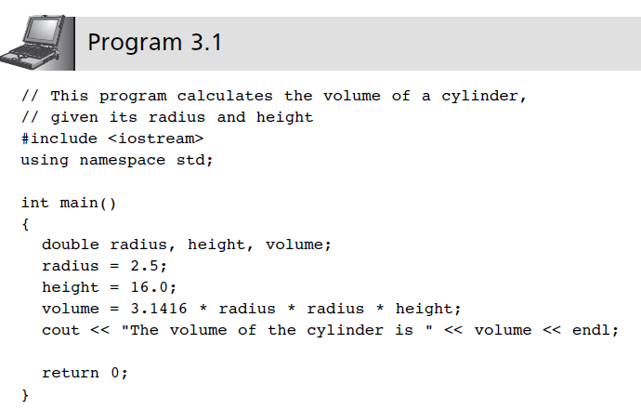
Assignment Operations (continued)
C++ for Engineers and Scientists, Fourth Edition

Slide 8
Assignment Operations (continued)
Assignment operator: The = sign
C++ statement: Any expression terminated by a semicolon
Multiple assignments in the same expression are possible
Example:
a = b = c = 25;
C++ for Engineers and Scientists, Fourth Edition

Slide 9
Assignment Operations (continued)
Coercion: Forcing a data value to another data type
  Value of the expression on the right side of an assignment statement will be coerced (converted) to the data type of the variable on the left side during evaluation
    double a = 4.3;
    int b = (int) a;
  Variable on the left side may also be used on the right side of another assignment statement
C++ for Engineers and Scientists, Fourth Edition

Slide 10
Assignment Operations (continued)
Accumulation statement: Has the effect of accumulating, or totaling
Syntax:
variable = variable + newValue;
int a = 0;
a = a + 2;
C++ for Engineers and Scientists, Fourth Edition

Slide 11
Assignment Operations (continued)
Additional assignment operators provide short cuts: +=, -=, *=, /=, %=
  Example:
  sum = sum + 10;
  is equivalent to: sum += 10;
  price *= rate +1;
  is equivalent to:
  price = price * (rate + 1);
C++ for Engineers and Scientists, Fourth Edition

Slide 12
Assignment Operations (continued)
Increment operator ++: Unary operator for the special case when a variable is increased by 1
Prefix increment operator appears before the variable
  Example: ++i
Postfix increment operator appears after the variable
  Example: i++
C++ for Engineers and Scientists, Fourth Edition

Slide 13
Assignment Operations (continued)
Example: k = ++n; //prefix increment
is equivalent to:
n = n + 1; //increment n first
k = n; //assign n’s value to k
Example: k = n++; //postfix increment
is equivalent to
k = n; //assign n’s value to k
n = n + 1; //and then increment n
C++ for Engineers and Scientists, Fourth Edition

Slide 14
Assignment Operations (continued)
Decrement operator --: Unary operator for the special case when a variable is decreased by 1
Prefix decrement operator appears before the variable
  Example: --i;
Postfix decrement operator appears after the variable
  Example: i--;
C++ for Engineers and Scientists, Fourth Edition

Slide 15
Formatting Numbers for Program Output
Proper output formatting contributes to ease of use and user satisfaction
cout with stream manipulators can control output formatting
C++ for Engineers and Scientists, Fourth Edition

Slide 16
Formatting Numbers for
Program Output (continued)
Formatting floating-point numbers requires three field-width manipulators to:
  Set the total width of the display
  Force a decimal place
  Set the number of significant digits after the decimal point
Example:
#include <iomanip>
cout << "|" << setw(10) << fixed
<< setprecision(3) << 25.67 << "|";
produces this output: | 25.670|
C++ for Engineers and Scientists, Fourth Edition

Slide 17
Formatting Numbers for
Program Output (continued)
Manipulators affect only output; the value stored internally does not change
Manipulators can also be set using the ostream class methods
Separate the cout object name from the method name with a period
Example:
cout.precision(2)
C++ for Engineers and Scientists, Fourth Edition

Slide 18
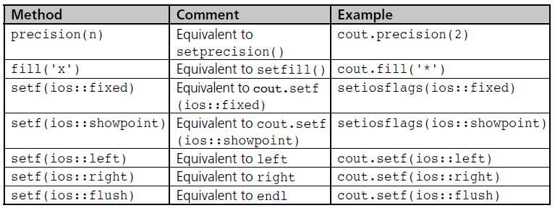
Formatting Numbers for
Program Output (continued)
Table 3.4 ostream Class Functions
C++ for Engineers and Scientists, Fourth Edition

