Slide 1

Python Data Structures
learn more about data types and primitive as well as non-primitive data structures, such as strings, lists, stacks, etc.

Slide 2
Data structures
Data structures are a way of organizing and storing data so that they can be accessed and worked with efficiently. They define the relationship between the data, and the operations that can be performed on the data. There are many various kinds of data structures defined that make it easier for the data scientists and the computer engineers, alike to concentrate on the main picture of solving larger problems rather than getting lost in the details of data description and access.

Slide 3
Data structures Types
Abstract Data Type and Data Structures
Primitive Data StructuresIntegers
Float
Strings
Boolean

Slide 4
Data structures Types
Non-Primitive Data StructuresArrays
Lists
Tuples
Dictionary
Sets
Files

Slide 5
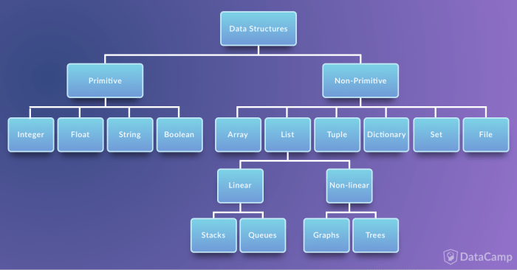
Data structures Types

Slide 6
Abstract Data Type and Data Structures
Data structures help you to focus on the bigger picture rather than getting lost in the details. This is known as data abstraction.
Data structures are actually an implementation of Abstract Data Types or ADT. This implementation requires a physical view of data using some collection of programming constructs and basic data types.
Data structures can be divided into two categories in computer science: 1) primitive and 2) non-primitive data structures. The former are the simplest forms of representing data, whereas the latter are more advanced: they contain the primitive data structures within more complex data structures for special purposes.

Slide 7

Primitive Data Structures
These are the most primitive or the basic data structures. They are the building blocks for data manipulation and contain pure, simple values of a data. Python has four primitive variable types:
Integers
Float
Strings
Boolean

Slide 8
Integers
Integers
You can use an integer represent numeric data, and more specifically, whole numbers from negative infinity to infinity, like 4, 5, or -1.

Slide 9
Float
Float
"Float" stands for 'floating point number'. You can use it for rational numbers, usually ending with a decimal figure, such as 1.11 or 3.14.

Slide 10
Try out
# Absolute value
print(abs(x))
# x to the power y
print(x ** y)
# Multiplication
print(x * y)
# Returns the quotient
print(x / y)
# Returns the remainder
print(x % y)
# Floats
x = 4.0
y = 2.0
# Addition
print(x + y)
# Subtraction
print(x - y)

Slide 11
Dynamically Typed Language
Note that in Python, you do not have to explicitly state the type of the variable or your data. That is because it is a dynamically typed language. Dynamically typed languages are the languages where the type of data an object can store is mutable.

Slide 12
String
Strings are collections of alphabets, words or other characters. In Python, you can create strings by enclosing a sequence of characters within a pair of single or double quotes. For example: 'cake', "cookie", etc.
You can also apply the + operations on two or more strings to concatenate them, just like in the example below:

Slide 13
Try Out
x = 'Cake’
y = 'Cookie’
x + ' & ' + y
Output: 'Cake & Cookie'

Slide 14
Other Basic Operations
Here are some other basic operations that you can perform with strings; For example, you can use * to repeat a string a certain number of times:
# Repeat
x * 2
Output: ‘CakeCake’

Slide 15
Slicing Strings
You can also slice strings, which means that you select parts of strings:
# Range Slicing
z1 = x[2:]
Print(z1)
# Slicing
z2 = y[0] + y[1] print(z2)
Output:
ke
Co

Slide 16
Alpha-Numeric
Note that strings can also be alpha-numeric characters, but that the + operation still is used to concatenate strings.
x = ‘4’
y = ‘2’
x + y
Output: ’42’

Slide 17
Built-in methods
Python has many built-in methods or helper functions to manipulate strings. Replacing a substring, capitalising certain words in a paragraph, finding the position of a string within another string are some common string manipulations. Check out some of these:
Capitalize strings
str.capitalize(‘cooking’)
Output: ‘Cookie’

Slide 18
Try Out
Retrieve the length of a string in characters. Note that the spaces also count towards the final result:
str1 = ”Here, Cake 4 U"
str2 = "404"
Len(str1)
What is the Output?

Slide 19
Try Out
Check whether a string consists of only digits
str1.isdigit()
Output: False
str2.isdigit()
Output: True

Slide 20
Try Out
Replace parts of strings with other strings
str1.replace('4 U', str2)
Output: 'Cake 404'

Slide 21
Try Out
Find substrings in other strings; Returns the lowest index or position within the string at which the substring is found:
str1 = 'cookie’
str2 = 'cook’
str1.find(str2)
Output: 0

Slide 22
Try Out
The substring 'cook' is found at the start of 'cookie'. As a result, you refer to the position within 'cookie' at which you find that substring. In this case, 0 is returned because you start counting positions from 0!
str1 = 'I got you a cookie’
str2 = 'cook’
str1.find(str2)
Output: 12

Slide 23
Substring
Similarly, the substring 'cook' is found at position 12 within 'I got you a cookie'. Remember that you start counting from 0 and that spaces count towards the positions!
You can find an exhaustive list of string methods below.
Source: https://docs.python.org/3/library/stdtypes.html#string-methods

Slide 24
Boolean
This built-in data type that can take up the values: True and False, which often makes them interchangeable with the integers 1 and 0. Booleans are useful in conditional and comparison expressions, just like in the following examples:
x = 4
y = 2
x == y
Output: False

Slide 25
Boolean
x > y
Output: True
x = 4
y = 2
z = (x==y) # Comparison expression (Evaluates to false)
if z: # Conditional on truth/false value of 'z’
print("Cookie")
else: print("No Cookie")
Output: No Cookie

Slide 26
Data Type Conversion
Sometimes, you will find yourself working on someone else's code and you'll need to convert an integer to a float or vice versa, for example. Or maybe you find out that you have been using an integer when what you really need is a float. In such cases, you can convert the data type of variables!
To check the type of an object in Python, use the built-in type() function, just like in the lines of code below:
i = 4.0
type(i)
Output: float

Slide 27
Type Conversion
When you change the type of an entity from one data type to another, this is called "typecasting". There can be two kinds of data conversions possible: implicit termed as coercion and explicit, often referred to as casting.

Slide 28
Implicit Data Type Conversion
This is an automatic data conversion and the compiler handles this for you. Take a look at the following examples:
# A float
x = 4.0
# An integer
y = 2
# Divide `x` by `y`
z = x/y
# Check the type of `z`
Type(z)
Output: float

Slide 29
Implicit Data Type Conversion
In the example above, you did not have to explicitly change the data type of y to perform float value division. The compiler did this for you implicitly.

Slide 30
Explicit Data Type Conversion
This type of data type conversion is user defined, which means you have to explicitly inform the compiler to change the data type of certain entities. Consider the code chunk below to fully understand this:
x = 2
y = "The Godfather: Part "
fav_movie = y + x

Slide 31
Explicit Data Type Conversion
The above example gave you an error because the compiler does not understand that you are trying to perform concatenation or addition, because of the mixed data types. You have an integer and a string that you're trying to add together.
There's an obvious mismatch.
To solve this, you'll first need to convert the int to a string to then be able to perform concatenation.
Note that it might not always be possible to convert a data type to another. Some built-in data conversion functions that you can use here are: int(), float(), and str().

Slide 32
Explicit Data Type Conversion: Try Out
x = 2
y = "The Godfather: Part "
fav_movie = (y) + str(x)
print(fav_movie)
Output: The Godfather: Part 2

Slide 33
Primitive Data Structures
END

Slide 34
Non-Primitive Data Structures
START

Slide 35
Python Data Structures
Non-Primitive Data Structures
The Non-primitive types are the sophisticated members of the data structure family. They don't just store a value, but rather a collection of values in various formats.
In the traditional computer science world, the non-primitive data structures are divided into:
Arrays
Lists
Files

Slide 36
Arrays
Arrays
First off, arrays in Python are a compact way of collecting basic data types, all the entries in an array must be of the same data type. However, arrays are not all that popular in Python, unlike the other programming languages such as C++ or Java.
In general, when people talk of arrays in Python, they are referring to lists. However, there is a fundamental difference between them, and you will see this in a bit. For Python, arrays can be seen as a more efficient way of storing a certain kind of list. This type of list has elements of the same data type, though.

Slide 37
Arrays
In Python, arrays are supported by the array module and need to be imported before you start initializing and using them. The elements stored in an array are constrained in their data type. The data type is specified during the array creation and specified using a type code, which is a single character like the I you see in the example below:
import array as arr
a = arr.array("I",[3,6,9])
type(a)
Output: array.array

Slide 38
Lists
Lists in Python are used to store collection of heterogeneous items. These are mutable, which means that you can change their content without changing their identity. You can recognize lists by their square brackets [ and ] which hold elements, separated by a comma ,.
Lists are built into Python:
you do not need to invoke them separately.
x = [] # Empty list
type(x)
Output: list

Slide 39
TryOut
x1 = [1,2,3]
type(x1)
Output: list
X2 = list([1, ‘apple’, 3])
Type(x2)
Output: list
print(x2[1])
Output: apple

Slide 40
TryOut
x2[1] = ‘orange’
print(x2)
Output: [1, ‘orange’, 3]
Note: You have seen in the above example with x1, lists can also hold homogeneous items and hence satisfying the storage functionality of an array. This is fine unless you want to apply some specific operations to this collection.

Slide 41
Lists
Python provides many methods to manipulate and work with lists. Adding new items to a list, removing some items from a list, sorting or reversing a list are common list manipulations. Let's see some of them in action:
Add 11 to the list_num list with append(). By default, this number will be added to the end of the list.

Slide 42
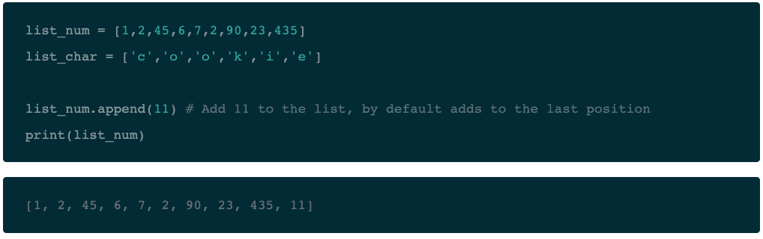
Lists TryitOut

Slide 43
list
Use insert() to insert 11 at index or position 0 in the list_num list
list_num.insert(0, 11)
print(list_num)
Output: [11, 1, 2, 45, 6, 7, 2, 90, 23, 435, 11]
Use insert() to insert 11 at index or position 0 in the list_num list

Slide 44
Lists
list_num.insert(0, 11)
print(list_num)
Output: [11, 1, 2, 45, 6, 7, 2, 90, 23, 435, 11]

Slide 45
Lists TryitOut
Remove the first occurrence of 'o' from list_char with the help of remove()
List_char.remove(‘o’)
print(list_char)
Output: [‘c’, ‘o’, ’k’, ‘i’, ‘e’]

Slide 46
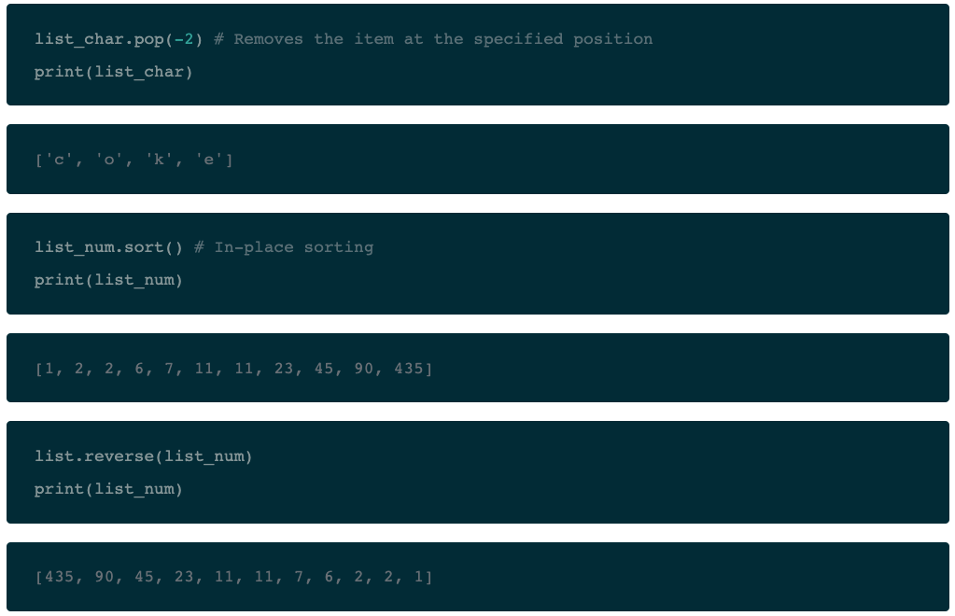
Lists TryitOut
Remove the item at index -2 from list_char

Slide 47
Arrays versus Lists
Now that you have seen lists in Python, you maybe wondering why you need arrays at all. The reason is that they are fundamentally different in terms of the operations one can perform on them. With arrays, you can perform an operations on all its item individually easily, which may not be the case with lists. Here is an illustration:
array_char = array.array("u",["c","a","t","s"])
array_char.tostring()
print(array_char)
Output: array(‘u’, ‘cats’)

Slide 48
Arrays versus Lists
You were able to apply tostring() function of the array_char because Python is aware that all the items in an array are of the same data type and hence the operation behaves the same way on each element. Thus, arrays can be very useful when dealing with a large collection of homogeneous data types. Since Python does not have to remember the data type details of each element individually; for some uses arrays may be faster and uses less memory when compared to lists.

Slide 49
Arrays versus Lists
It is also worthwhile to mention the NumPy array while we are on the topic of arrays. NumPy arrays are very heavily used in the data science world to work with multidimensional arrays. They are more efficient than the array module and Python lists in general. Reading and writing elements in a NumPy array is faster, and they support "vectorized" operations such as elementwise addition. Also, NumPy arrays work efficiently with large sparse datasets.

Slide 50
Linear and Non-Linear Data Structures
Traditionally, the list data structure can be further categorized into linear and non-linear data structures.
Stacks and Queues are called "linear data structures", whereas Graphs and Trees are "non-linear data structures".
These structures and their concepts can be relatively complex but are used extensively due to their resemblance to real world models.

Slide 51
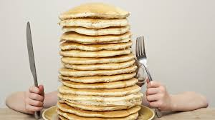

Linear Data Structure
Note: in a linear data structure, the data items are organized sequentially or, in other words, linearly.
The data items are traversed serially one after another and all the data items in a linear data structure can be traversed during a single run.

Slide 52
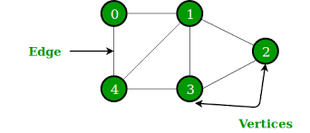
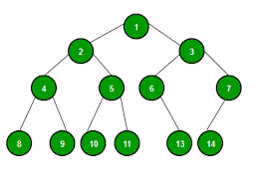
Non-Linear Data Structure
In non-linear data structures, the data items are not organized sequentially. That means, the elements could be connected to more than one element to reflect a special relationship among these items.
All the data items in a non-linear data structure may not be traversed during a single run.

Slide 53
Stacks
A stack is a container of objects that are inserted and removed according to the Last-In-First-Out (LIFO) concept.
Think of a scenario where at a dinner party where there is a stack of plates, plates are always added or removed from the top of the pile.
In computer science, this concept is used for evaluating expressions and syntax parsing, scheduling Algorithms/routines, etc.

Slide 54
Stacks
Stacks can be implemented using lists in Python. When you add elements to a stack, it is known as a push operation, whereas when you remove or delete an element it is called a pop operation.
Note that you have actually have a pop() method at your disposal when you're working with stacks in Python:

Slide 55
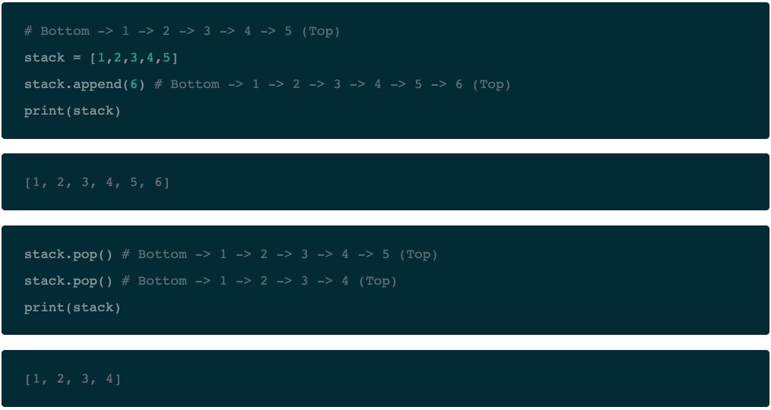
Stacks TryitOut

Slide 56
Queues
A queue is a container of objects that are inserted and removed according to the First-In-First-Out (FIFO) principle.
An excellent example of a queue in the real world is the line at a ticket counter where people are catered according to their arrival sequence and hence the person who arrives first is also the first to leave.
Queues can be of many different kinds.

Slide 57
Queues
Lists are not efficient to implement a queue, because append() and pop() from the end of a list is not fast and incur a memory movement cost.
Also, insertion at the end and deletion from the beginning of a list is not so fast since it requires a shift in the element positions.

Slide 58
Graphs
A graph in mathematics and computer science are networks consisting of nodes, also called vertices which may or may not be connected to each other.
The lines or the path that connects two nodes is called an edge. If the edge has a particular direction of flow, then it is a directed graph, with the direction edge being called an arc. Else if no directions are specified, the graph is called an undirected graph.

Slide 59
Graphs
Graphs are an important concept specially in Data Science and are often used to model real life problems. Social networks, molecular studies in chemistry and biology, maps, recommender system all rely on graph and graph theory principles.

Slide 60
Graphs: TryitOut
graph = { "a" : ["c", "d"],
"b" : ["d", "e"],
"c" : ["a", "e"],
"d" : ["a", "b"],
"e" : ["b", "c"] }
def define_edges(graph):
edges = []
for vertices in graph:
for neighbour in graph[vertices]:
edges.append((vertices, neighbour))
return edges
print(define_edges(graph))
Output: [('a', 'c'), ('a', 'd’), ('b', 'd'), ('b', 'e'), ('c', 'a'), ('c', 'e'), ('e', 'b'), ('e', 'c'), ('d', 'a'), ('d', 'b')]

Slide 61
Graphs Implementation
You can do some cool stuff with graphs such as trying to find of there exists a path between two nodes, or finding the shortest path between two nodes, determining cycles in the graph.
The famous "travelling salesman problem" is, in fact, about finding the shortest possible route that visits every node exactly once and returns to the starting point. Sometimes the nodes or arcs of a graph have been assigned weights or costs, you can think of this as assigning difficulty level to walk and you are interested in finding the cheapest or the easiest path.

Slide 62
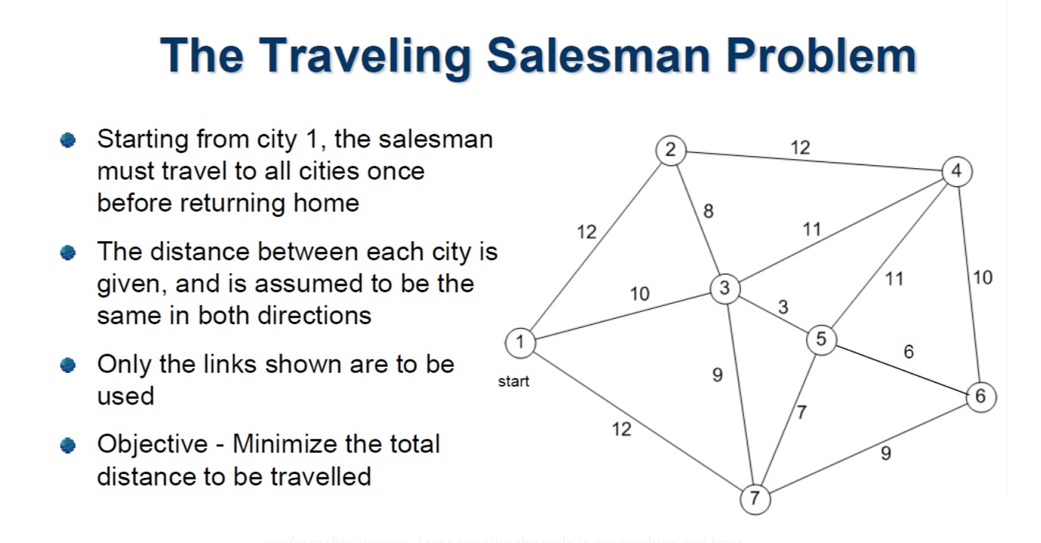
The Travelling Salesman Problem

Slide 63
Non-Primitive Data Structures
END

Slide 65
START

Slide 66

Trees

Slide 67
Trees
A tree in the real world is a living being with its roots in the ground and the branches that hold the leaves, fruit out in the open.
The branches of the Tree spread out in a somewhat organized way.
In computer science, Trees are used to describe how data is sometimes organized, except that the root is on the top and the branches, leaves follow, spreading towards the bottom and the tree is drawn inverted compared to the real tree.

Slide 68
Trees
To introduce a little more notation, the root is always at the top of the tree. Keeping the tree metaphor, the other nodes that follow are called the branches with the final node in each branch being called leaves. You can imagine each branch as being a smaller tree in itself.
The root is often called the parent and the nodes that it refers to below it called its children. The nodes with the same parent are called siblings. Do you see why this is also called a family tree?

Slide 69
Trees
Trees help in defining real world scenarios and are used everywhere from the gaming world to designing XML parsers and also the PDF design principle is based on trees. In data science, 'Decision Tree based Learning' actually forms a large area of research.
Numerous famous methods exist like bagging, boosting use the tree model to generate a predictive model. Games like chess build a huge tree with all possible moves to analyze and apply heuristics to decide on an optimal move.

Slide 70
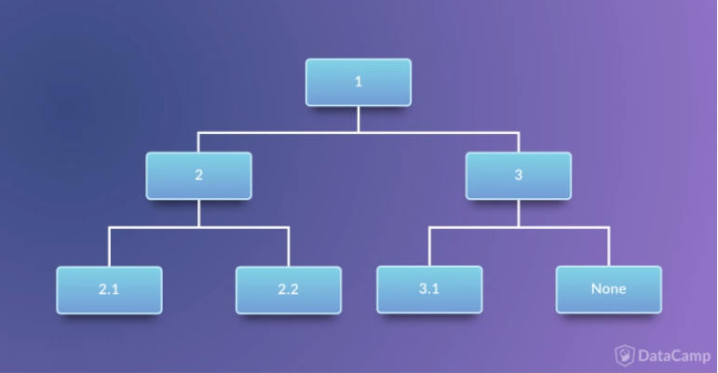
Trees:
We can implement a tree structure using and combining the various data structures you have seen so far in this tutorial.

Slide 71
Trees
class Tree:
def __init__(self, info, left=None, right=None):
self.info = info
self.left = left
self.right = right
def __str__(self):
return (str(self.info) + ', Left child: ' + str(self.left) + ', Right child: ' + str(self.right))
tree = Tree(1, Tree(2, 2.1, 2.2), Tree(3, 3.1))
print(tree)
Output: 1, Left child: 2, Left child: 2.1, Right child: 2.2, Right child: 3, Left child: 3.1, Right child: None

Slide 72
Tuples, Dictionary, Sets
We’ve learnt about arrays and also seen the list data structure. However, Python provides many different flavors of data collection mechanisms, and although they might not be included in traditional data structure topics in computer science, they are worth knowing specially with regards to Python programming language:
Tuples
Dictionary
Sets

Slide 73
Tuples
Tuples are another standard sequence data type. The difference between tuples and list is that tuples are immutable, which means once defined you cannot delete, add or edit any values inside it. This might be useful in situations where you might to pass the control to someone else but you do not want them to manipulate data in your collection, but rather maybe just see them or perform operations separately in a copy of the data.

Slide 74
Tuples: TryOut
x_tuple = 1,2,3,4,5
y_tuple = ('c','a','k','e’)
x_tuple[0]
Output: 1

Slide 75
Tuples
y_tuple[3]
x_tuple[0] = 0 # Cannot change values inside a tuple
ErrorOutput:
---------------------------------------------------------------------------
TypeError Traceback (most recent call last)
<ipython-input-74-b5d6da8c1297> in <module>()
1 y_tuple[3]
----> 2 x_tuple[0] = 0 # Cannot change values inside a tuple
TypeError: 'tuple' object does not support item assignment

Slide 76
Dictionary
Dictionaries are exactly what you need if you want to implement something similar to a telephone book. None of the data structures that you have seen before are suitable for a telephone book.
x_dict = {'Edward':1, 'Jorge':2, 'Prem':3, 'Joe':4}
del x_dict['Joe’]
x_dict
Output: {'Edward': 1, 'Jorge': 2, 'Prem': 3}
x_dict['Edward'] # Prints the value stored with the key 'Edward’.
Output: 1

Slide 77
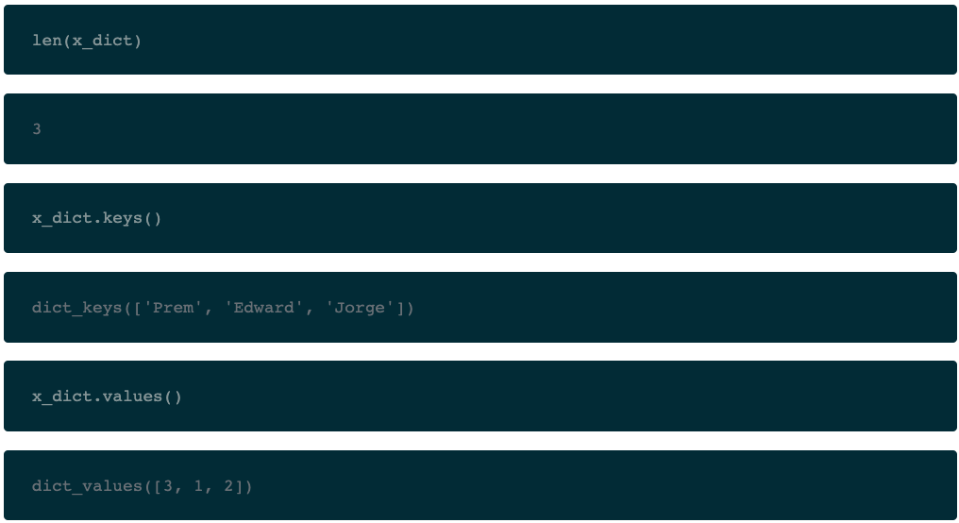
Dictionary
You can apply many other inbuilt functionalizes on dictionaries:

Slide 78
Sets
Sets are a collection of distinct (unique) objects. These are useful to create lists that only hold unique values in the dataset. It is an unordered collection but a mutable one, this is very helpful when going through a huge dataset.
x_set = set('CAKE&COKE’)
y_set = set('COOKIE’)
print(x_set)
Output: {'A', '&', 'O', 'E', 'C', 'K’}
print(y_set) # Single unique ‘o’
Output: {'I', 'O', 'E', 'C', 'K’}

Slide 79
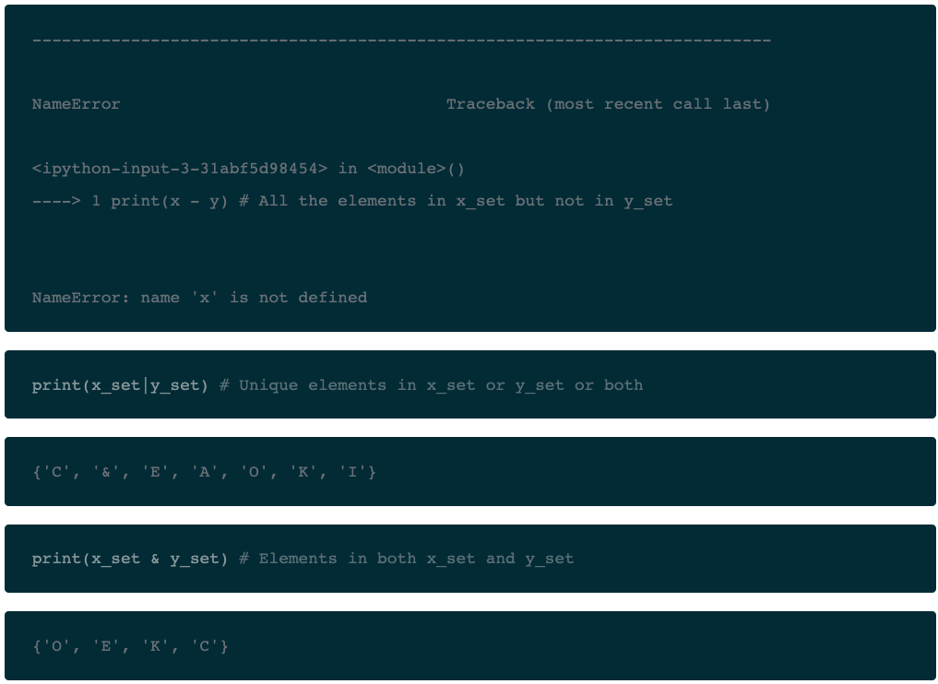
Sets
print(x - y) # All the elements in x_set but not in y_set

Slide 80
Files
Files are traditionally a part of data structures. And although big data is commonplace in the data science industry, a programming language without the capability to store and retrieve previously stored information would hardly be useful. You still have to make use of the all the data sitting in files across databases and you will learn how to do this.
The syntax to read and write files in Python is similar to other programming languages but a lot easier to handle. Here are some of the basic functions that will help you to work with files using Python:

Slide 81
Files
open() to open files in your system, the filename is the name of the file to be opened;
read() to read entire files;
readline() to read one line at a time;
write() to write a string to a file, and return the number of characters written; And
close() to close the file.

Slide 82
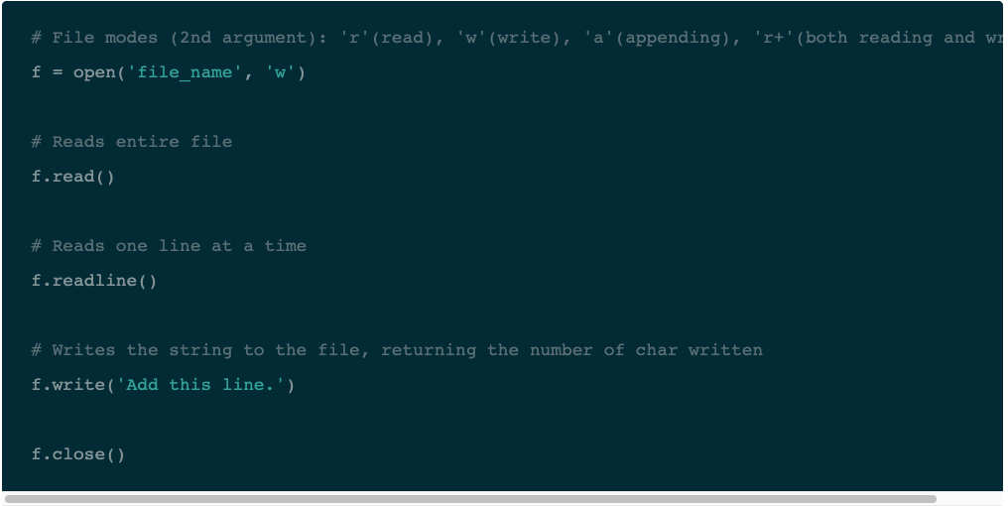
Files

Slide 83
Files
The second argument in the open() function is the file mode. It allows you to specify whether you want to read (r), write (w), append (a) or both read and write (r+).

Slide 84
Nodes
There are situations when the allocation of memory to store data cannot be in a continuous block of memory. So we seek the help of pointers where along with the data, the address of the next location of data element is also stored.
So, we know the address of the next data element from the values of current data element.
In general, such structures are known as pointers. But in Python we refer them as Nodes.

Slide 85
Nodes
Nodes are the foundations on which various other data structures linked lists and tress can be handled in python.

Slide 86
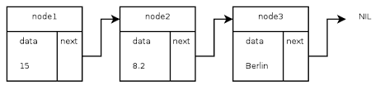
Nodes

Slide 87
Nodes
class Node:
def __init__(self, dataval=None):
self.dataval = dataval
self.nextval = None
class SLinkedList:
def __init__(self):
self.headval = None
list1 = SLinkedList()
list1.headval = Node("Mon")
e2 = Node("Tue")
e3 = Node("Wed")
# Link first Node to second node
list1.headval.nextval = e2
# Link second Node to third node
e2.nextval = e3

Slide 88
Traversing a Linked List
Singly linked lists can be traversed in only forward direction starting form the first data element. We simply print the value of the next data element by assigning the pointer of the next node to the current data element.

Slide 89
Linked List
class Node:
def __init__(self, dataval=None):
self.dataval = dataval
self.nextval = None
class SLinkedList:
def __init__(self):
self.headval = None
def listprint(self):
printval = self.headval
while printval is not None:
print (printval.dataval)
printval = printval.nextval

Slide 90
Linked List
list = SLinkedList()
list.headval = Node("Mon")
e2 = Node("Tue")
e3 = Node("Wed")
# Link first Node to second node
list.headval.nextval = e2
# Link second Node to third node
e2.nextval = e3
list.listprint()

Slide 91
Python - Linked Lists
A linked list is a sequence of data elements, which are connected via links. Each data element contains a connection to another data element in form of a pointer. Python does not have linked lists in its standard library. We have already seen how we create a node class and how to traverse the elements of a node. In this chapter we are going to study the types of linked lists known as singly linked lists. In this type of data structure there is only one link between any two data elements. We create such a list and create additional methods to insert, update and remove elements from the list.
A linked list is a linear data structure, in which the elements are not stored at contiguous memory locations. The elements in a linked list are linked using pointers as shown in the below image:

Slide 92
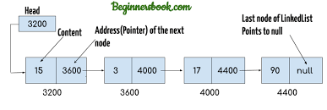
Creation of Linked list

Slide 93
A linked list is created by using the node class. We create a Node object and create another class to use this ode object. We pass the appropriate values through the node object to point the to the next data elements. The below program creates the linked list with three data elements. In the next section we will see how to traverse the linked list.

Slide 94
Files
END

