Slide 1
Garbage

Slide 2
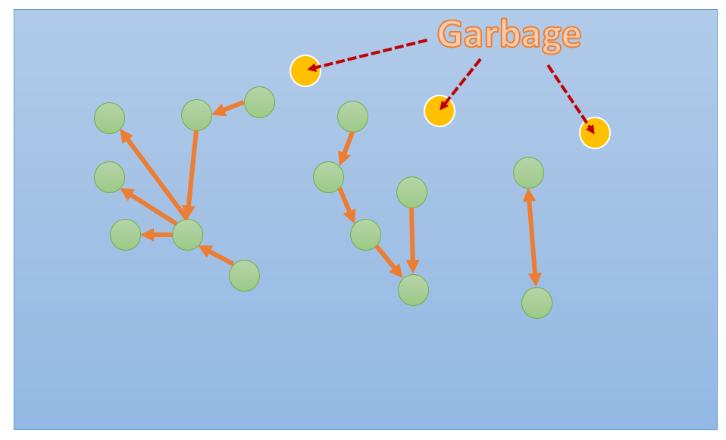

Slide 3
Garbage
GC Roots

Slide 4
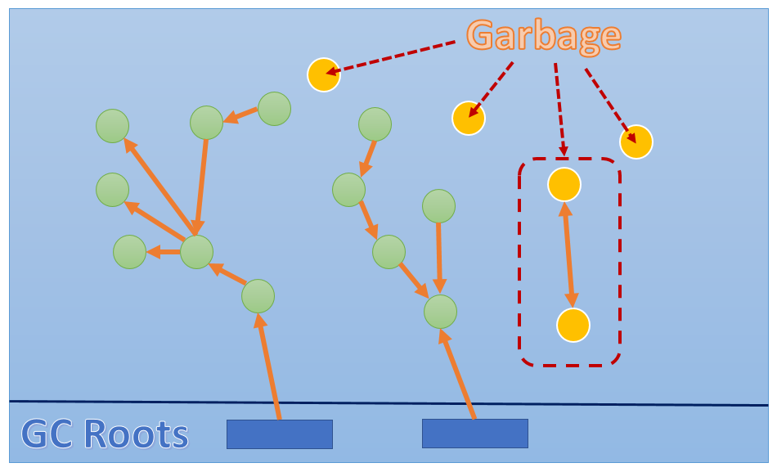

Slide 5
Mark
Delete
Compact

Slide 6
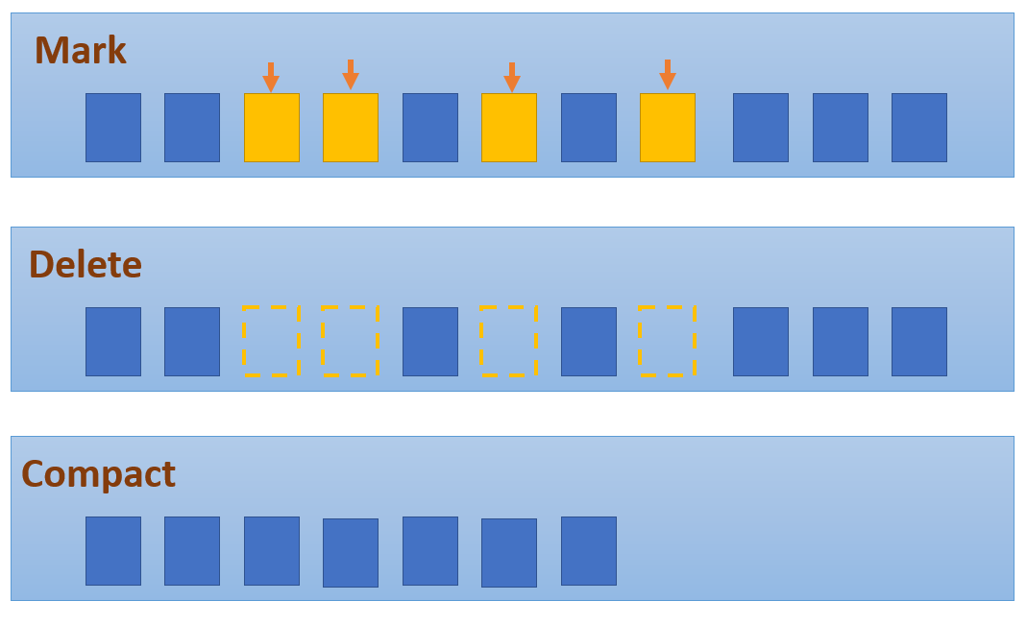

Slide 7
Mark
Empty Memory
Copy
Empty Memory

Slide 8
