Slide 1
Bruce's Part
Payment
Evaluation
Qrder Query

Slide 2
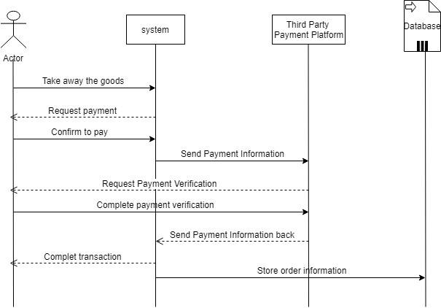
Payment
After users successfully take the goods, the cabinet door is locked, the timer stop timing, the user interface will automatically jump to the payment interface. After the user chooses to pay, the system will help to open the third-party payment platform application for payment. This method of payment can better ensure the safety of users'property.

Slide 3
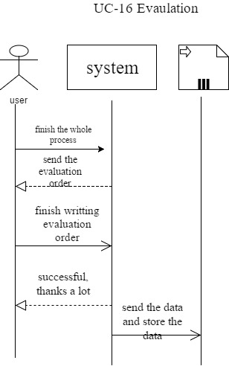
Evaluation
If the user wants to evaluate us or give us suggestions, they can click “service” in the main interface to enter our Customer service center. Then they could write down what they want to say to us. After they upload, their words will be stored in the database, waiting for the administrator to call them.

Slide 4
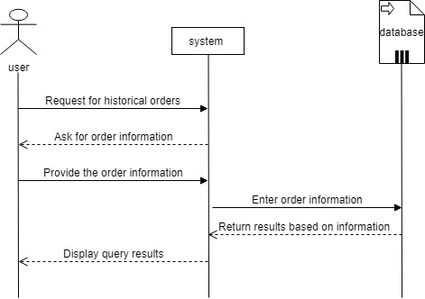
Qrder Query
If customers have doubts about their orders, we have provided a query service for historical orders. Customers need to log in to the system and then initiate queries in the main interface. After entering the order number and date, the user can see the details of the order.

