Slide 1
Shodan Revisited
A comprehensive study on Industrial Control Systems
By Jenna Baccus, Philippe Bled and Bruce Huang

Slide 2
Industrial Control Systems
ICS - a term that describes several types of cyber-physical and computerized control systems that are associated with industrial production.
Includes technologies such as:
PLCs
SCADA Systems
Distributed Control Systems
Industrial Control systems are used in critical national infrastructure such as nuclear power plants, water generation plants and electrical power grids.
Background
Notes:
PLC - programmable logic controllers
SCADA - Supervisory Control and Data Acquisition Systems

Slide 3
Quantitatively Assessing and Visualising Industrial System Attack Surfaces
by Éireann Leverett
Éireann Leverett’s dissertation for the University of Cambridge explores the connections between Industrial Control Systems.
Two areas of Investigation
Prove that ICS systems are connected to the internet despite the popular belief that those systems are securely segregated.
Log ICS internet connections over time and visualize connections with related vulnerability information
Leverett’s Data Sources Include
Successful exploits of vulnerable Industrial Control Systems connected to the internet
Shodan.io to discover and map the time and geolocation of internet-connecting ICS.
Discovery of types of Operating Systems ICS’s run on.
ExploitDB.com to discover and relate vulnerabilities for ICS operating systems.

Slide 4
Shodan Revisited
Data Required
-> Shodan queries
Queries vs. Connection
Country vs. Connection
Operating System vs. Counts
Server vs. Counts
HTTP vs. Counts
-> Exploit Database
Operating System vs. Exploit Counts
Methodology
Notes:
(pipeline, sensor is easy to access, figure out the protocol, packet sniffer. is not secure, has no security. Sensor goes away, loss data, company want to keep it. But sensor is very. Remote, at&t as them ip is not check by... Use api. ) josh - ture digital security company in tulsa.
Shodan -> it can be find by anyone.
So question: why it is in internet, it should not be in.
Question. Is it secured? ->this will based on what type of device, is it authenticate needed,

Slide 5
Methodology - Shodan -> Old/New Comparison
 | Connections | Country | OS/Server | HTTP Response
2011 | Direct Search Results | Banner - ISO country code | Banner | Banner
2017 | API - search() | API - count() | Banner & OS | Banner
Notes:
API -> search
Results[j]['total'] (j is query name)
API -> count method.
cdict[i] = api.count(i,[('country', 300)])
What is banner:
A banner is the metadata associated with a TCP connection to a specific port.
Recently banner often reflect default setup of a system.
The banner is not always provide os information, this might also mean the connection is more secured.

Slide 6
Methodology - Shodan -> OS, Server and HTTP
Problems:
Poorly formatted Banner
Banner format varies across queries
OS not always available
Helpful Facts:
Position of OS is right after server
Banner format is similar within each query
Banner starts with length-fixed HTTP response
Solutions:
Split banner word by word
Manually measure length of server in each queries
Combine Banner and OS volume
Banner Examples:
Powerlink:
************
HTTP/1.1 200 OK
Date: Tue, 18 Apr 2017 06:36:22 GMT
Server: Apache/1.3.31 (Unix) PHP/4.3.9 mod_ssl/2.8.20 OpenSSL/0.9.7e
CIMPLICITY:
************
HTTP/1.0 302 Redirection
Server: CIMPLICITY-HttpSvr/1.0
Date: Wed, 12 Apr 2017 23:21:16 GMT
A850+Telemetry+Gateway:
************
A850 Telemetry Gateway
Notes:
Algorithm : find server position, use server name length, add one for OS. join and save the string. (add counter for counting)
Problem b -> same as author said: automation approach is not scalable in the long run. Since many queries have data dependant decomposition techniques
Problem c -> second example does not have os

Slide 7
Methodology - Exploit Database
Search keywords: remote + ‘os type’
Problem:
Online search engine does not return .csv friendly results
No city location data (w/o premium account, search() returns limited results)
Helpful Fact:
SearchSploit -> command-line search tool for Exploit-DB returns JSON format
Solution:
Use searchSploit : JSON -> python dictionary -> .csv
Thermo map: Country vs. Connection
Linear-regression: OS vs. Exploit counts
Notes:
Search results overlap (dont need mention, OS is from banner, which is the exploit target)
Set algebra: A∪B - A⋂B / OS is from banner.
Remote results only
>>> sample['matches'][0]['location']
{'area_code': None,
'city': None,
'country_code': 'BG',
'country_code3': 'BGR',
'country_name': 'Bulgaria',
'dma_code': None,
'latitude': 42.69999999999999,
'longitude': 23.33330000000001,
'postal_code': None,
'region_code': None}

Slide 8
Shodan Revisited
Compare Leverett’s results (2011) to ours (2017):
Connected Devices and Systems
Number of Connections per Country
Proportional Change in Connections per Country
Operative Systems and the relation to number of exploits
Exploring Dataset
Notes:
If i am a bad guy, i’ll think about this, this sensor is connected to the internet. 2 things i will figure out:
1 is this security?
2 why this is connected to the internet.
So let’s be bad guy, and see what we can see.

Slide 9
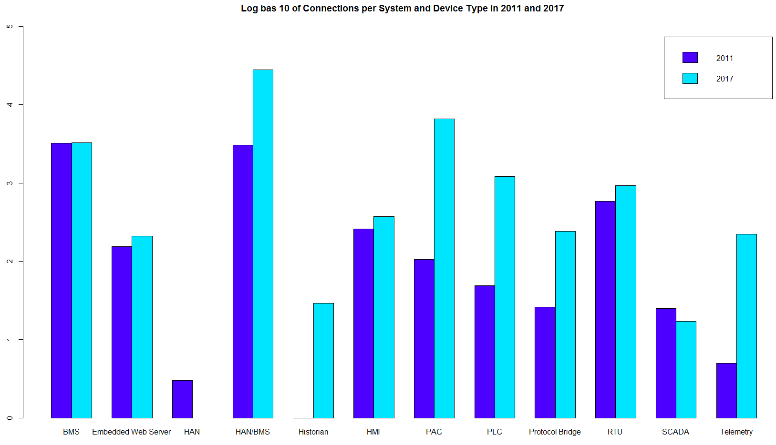
Explore Connected Device and System
Name | Ratio
PAC | 250.08
Telemetry | 100.33
PLC | 77.46
Protocol Bridge | 34.95
Historian | 28.00
HMI | 25.49
HAN/BMS | 10.76
Embedded Web Server | 1.74
RTU | 1.07
BMS | 0.46
SCADA | -0.43
HAN | -1.00
PCS | -1.00
Notes:
Ratio = (New-Old) / Old
PAC changes the most
Except SCADA and HAN, all the rest of category connection increases
The max lays on HAN/BMS for both two years
One Category
One major difference between a PLC and a PAC is the programming interface.
Most PLCs are programmed in a graphical representation of coils and contacts called Ladder Logic.
Most PACs are programmed in a modern programming language such as C or C++.
HMI - Human Machine Interface
SCADA - Supervisory Control and Data Acquisition Server.
DMS - Distribution Management System.
BMS - Building Management System (CCTV systems, elevators, door controls, can be part of HVAC) -Compromising one of these can lead to physical site compromise or CCTV footage of personnel and their daily tasks.
HAN - Home Area/Automation Network
PLC - Programmable Logic Controller.
PAC - Programmable Automation Controller.

Slide 10
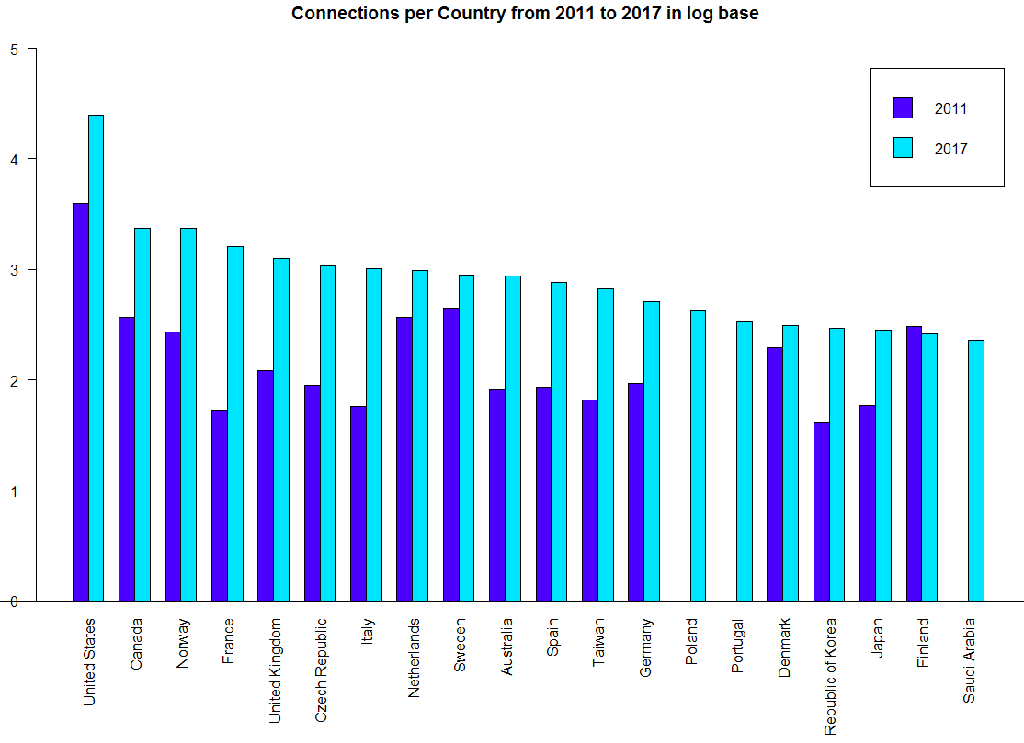
Explore Countries - Country vs. lg(Connections)
Name | Old | New | Ratio
United States | 3920 | 24955 | 5.37
Canada | 365 | 2372 | 5.50
Norway | 271 | 2346 | 7.66
France | 53 | 1618 | 29.53
United Kingdom | 122 | 1245 | 9.20
Czech Republic | 90 | 1076 | 10.96
Italy | 57 | 1008 | 16.68
Netherlands | 370 | 981 | 1.65
Sweden | 442 | 886 | 1.00
Australia | 81 | 872 | 9.77
Spain | 86 | 764 | 7.88
Taiwan | 66 | 661 | 9.02
Germany | 92 | 513 | 4.58
Poland | 0 | 420 | Inf.
Portugal | 0 | 336 | Inf.
Denmark | 194 | 310 | 0.60
Korea | 41 | 290 | 6.07
Japan | 59 | 284 | 3.81
Finland | 301 | 262 | -0.13
Saudi Arabia | 0 | 226 | Inf.
Notes:
Green- top 20 of 2011 counts (only 17 are included)
Orange - top 20 of 2017
Blue - top 20 changed ( not include new country)
Ratio:
(New-Old)/(Old+0.0001)

Slide 11
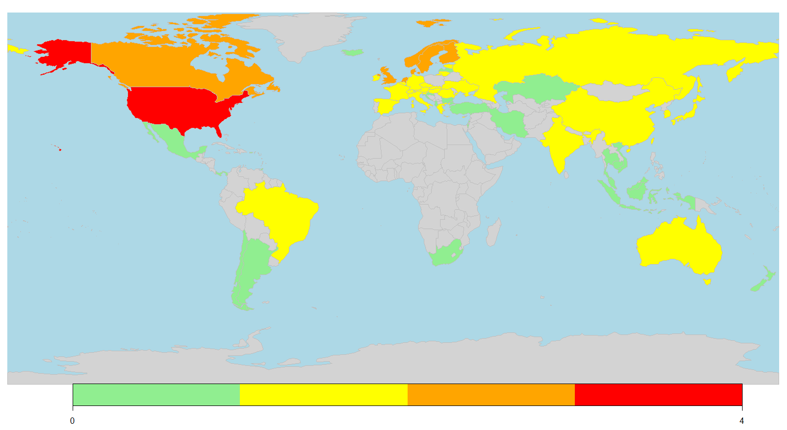
Map of Connections per Country in 2011 (log scale)

Slide 12
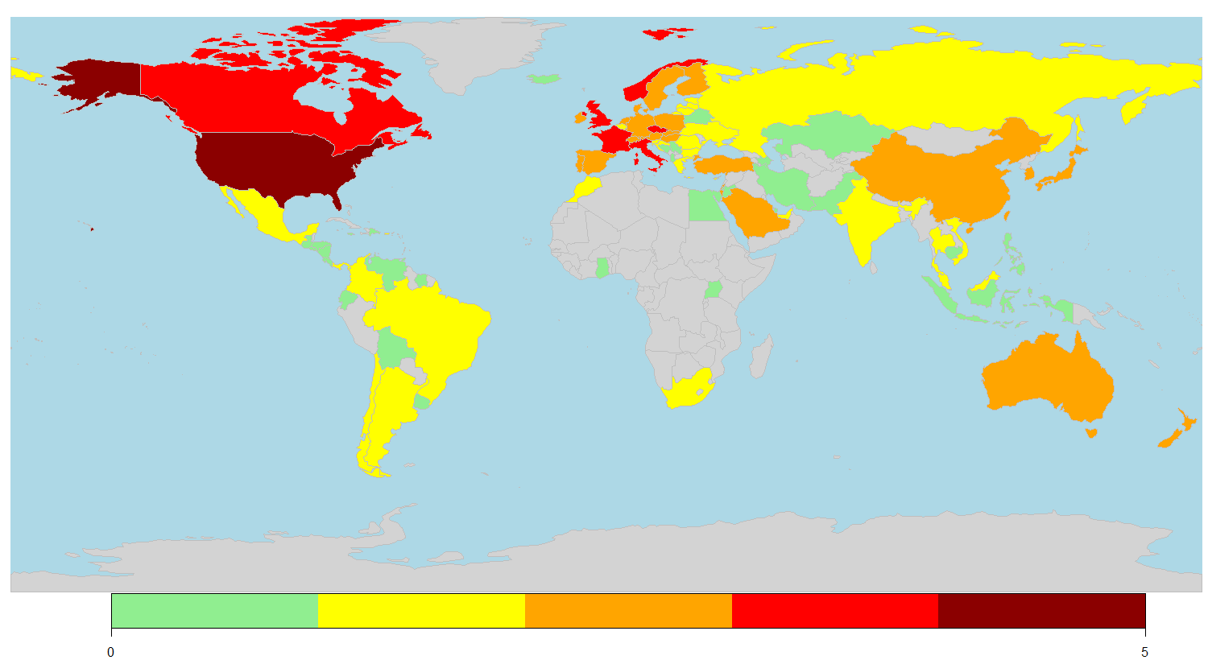
Map of Connections per Country in 2017 (log scale)

Slide 13
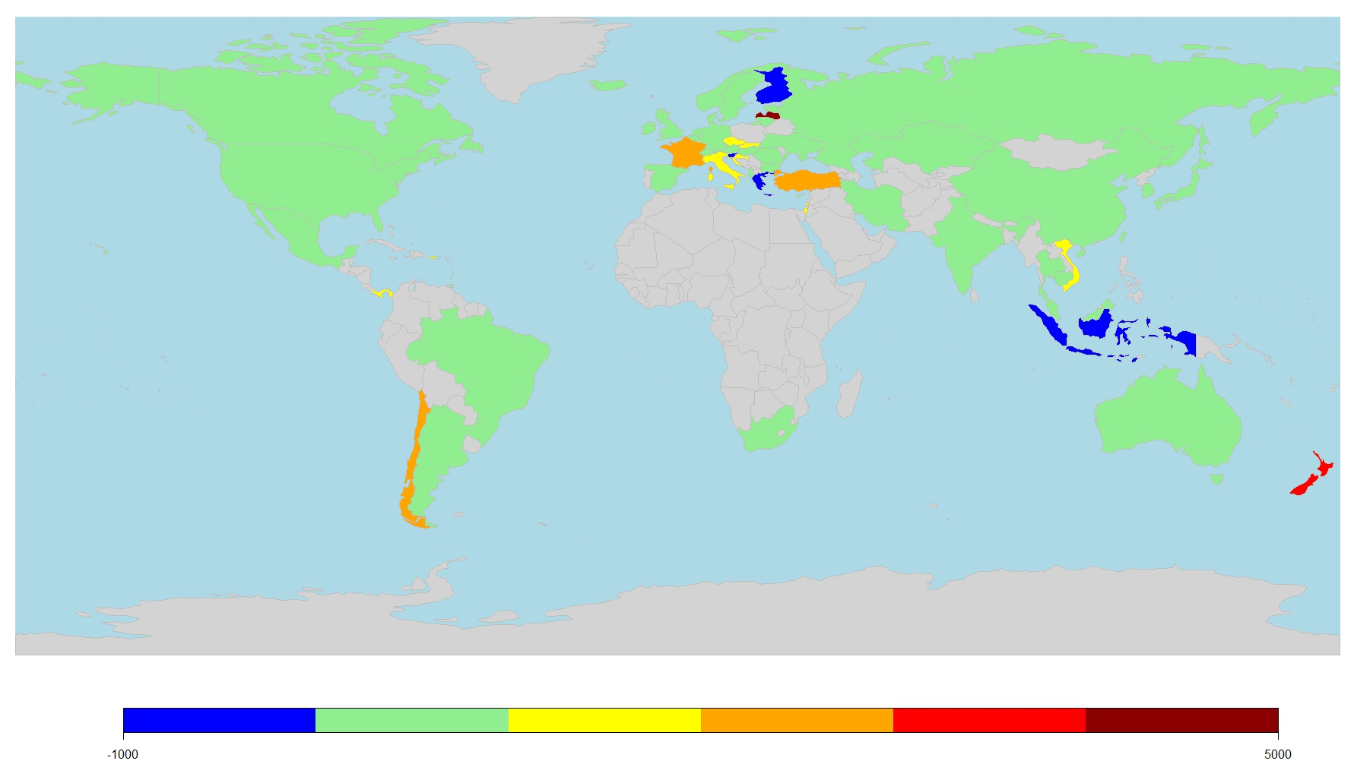
Percentile Change 0f Connections
-> Decrease (Only 3):
Finland
Greece
Slovenia
-> Most increase (Ratio):
Martinique
Colombia
Latvia
New Zealand
France
Chile
-> Most increase (Number):
United States
Norway
Canada
France
United Kingdom
Notes:
: >

Slide 14
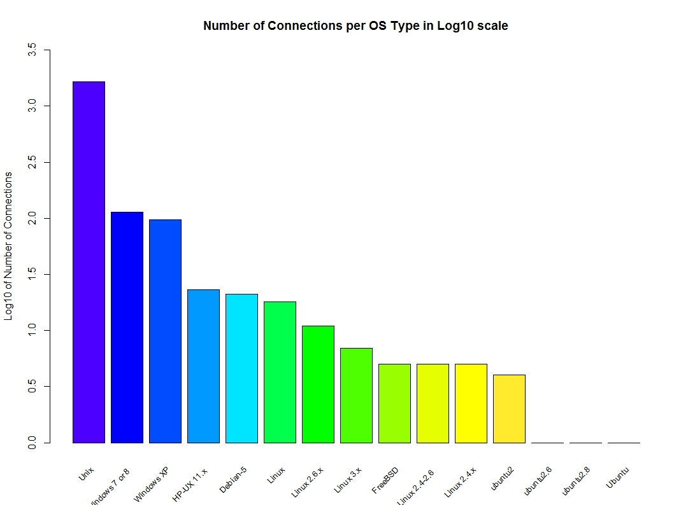
Which is the most popular OS?
Operating System | Connections
Unix | 1655
Windows 7 or 8 | 113
Windows XP | 97
HP-UX 11.x | 23
Debian-5 | 21
Linux | 18
Linux 2.6.x | 11
Linux 3.x | 7
FreeBSD | 5
Linux 2.4-2.6 | 5
Linux 2.4.x | 5
Ubuntu 2 | 4
Ubuntu 2.6 | 1
Ubuntu 2.8 | 1

Slide 15
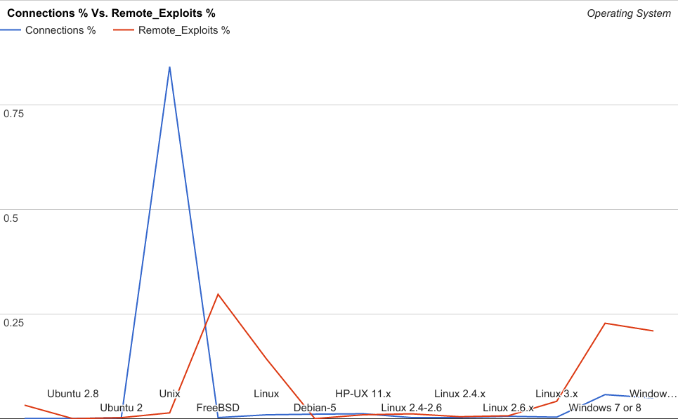
Popular OS has more Remote exploits?
Linear-Regression
-> Assumption (H0):
The popularity of operating system influences the number of remote exploit.
-> Result:
Coefficients: Estimate Std. Error t value Pr(>|t|) (Intercept) 2.4030 1.0992 2.186 0.0493 * lgICS 0.2476 0.2368 1.045 0.3165 F-statistic: 1.093 on 1 and 12 DF, p-value: 0.3165
-> Conclusion:
Abort H0 assumption.
There are not enough evidence to say popular OS has more remote exploits.
Notes:
Value is iterm/total. The percentage of each category.

Slide 16
Potential Incidents faced by Industrial Control Systems
Threats to industrial controls systems can come from many various sources including terrorists groups, disgruntled employees, malicious intruders, accidents and system complications. The chance of an incident grows as ICS’s are connected to the internet.
Incidents may include:
Unauthorized changes to commands, code, instructions, or alarm thresholds.
Blocked or delayed flow of information
Inaccurate information due to unauthorized changes
Modifications of ICS software or configuration settings
Notes:
NIST whitepaper
Unauthorized changes may cause damages to, disruptions of or shuts downs of critical equipment
Blocked/delay of information will disrupt ICS operations

Slide 17
Conclusions
Leverett’s findings:
Industrial Control Systems are connected to the internet
Remain connected over time
Our research:
ICS continue to remain online with ports vulnerable to scans
108 countries increased in number of internet-connected Industrial Control Systems
Only 3 countries did not increase
We found almost 600% increase in the number of CS connections globally
Programmable Automation Controller increased by 25,000%
A Summary
Notes:
The US went from under 4,000 to close to 25,000
Total: Over 7489 we found Over repeating the same queries discovered 44,266
Programmable Automation Controller - has had the most significant increase in the number of port connections to the internet. Type of microprocessor that are modular and you adjust it to your application and relays information remotely.

Slide 18
Questions?
It’s fine if you have none :>

