Slide 1


PYG(PYTORCH GEOMETRIC)
TUTORIAL 6: GRAPH AUTOENCODERS (GAE) AND VARIATIONAL GRAPH AUTOENCODERS (VGAE)
2025.01.20
Christopher
2022134004@cbnu.ac.kr
BigData Lab.
1

Slide 2






TABLE OF CONTENTS
AUTOENCODERS
GRAPH AUTOENCODERS
VARIATIONAL AUTOENCODERS
VARIATIONAL GRAPH AUTOENCODERS
2

Slide 3





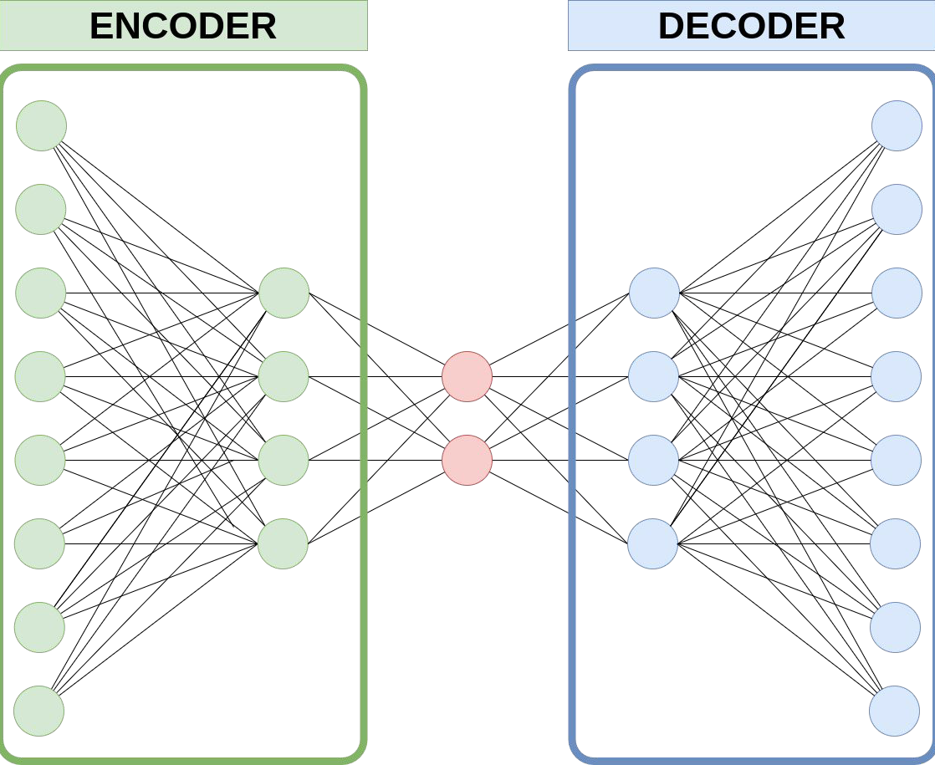



AUTOENCODERS
Structure and Objective
Autoencoders are a type of neural networks that work in an unsupervised manner
An Autoencoder consists of two main components:
Encoder that maps the input data to a compressed latent space
Decoder that reconstructs the input data from the latent representation.
Input
Output
Backpropagation
The objective is to minimize the reconstruction error, which measures the difference between the original input and its reconstruction
(
)
3
$$Loss = Similarity$$
,

Slide 4
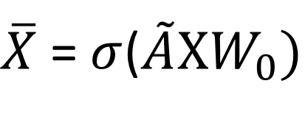
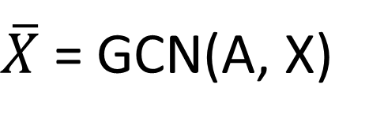
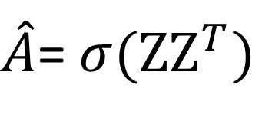
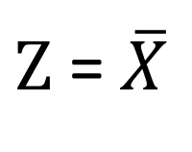
GRAPH AUTOENCODERS (1/5)
Introduction
A Graph Autoencoder (GAE) is an extension of the traditional Autoencoder designed to work with graph-structured data.
It encodes the graph structure and/or node features into a low-dimensional latent space (node embedding)
The Encoder is often implemented using Graph Neural Networks (GNNs), such as Graph Convolutional Networks (GCNs).
It produces latent representations $Z$
It reconstructs the graph structure or other graph properties from the latent representation.
Encoder
Embedding
Decoder
$\overline{X}$ = GCN(A, X)
$Z$ = $\overline{X}$
$\hat{A}$= $σ(ZZ^{T})$
$\overline{X}$ = $σ$($\tilde{A}XW_{0})$
4
* With $\tilde{A}$ = $D^{−1/2}AD^{−1/2}$ (The normalized adjacency matrix)
Notes:
1- It learns low-dimensional representations (embeddings) of nodes or entire graphs while preserving the graph's structural and feature information.

Slide 5
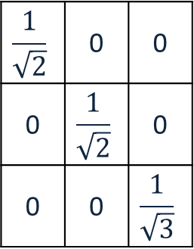



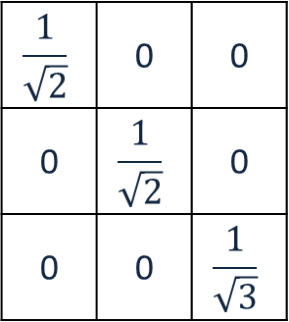


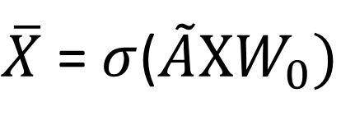

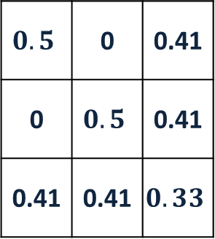

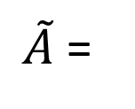

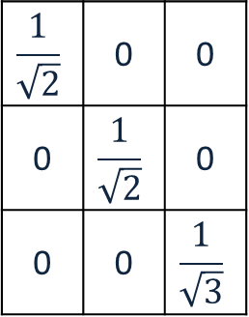

GRAPH AUTOENCODERS (2/5)
Example (1/2)
$$A$$
$$X$$
$$W_{0}$$
$$X∗W_{0}$$
Embedding
A
0 | 0 | 1
0 | 0 | 1
1 | 1 | 0
1 | 0 | 0
0 | 1 | 0
0 | 0 | 1
0.1 | 0.2
0.3 | 0.4
0.5 | 0.6
0.1 | 0.2
0.3 | 0.4
0.5 | 0.6
$$\left[\begin{matrix}\text{0.255} & \text{0.346} \\ \text{0.355} & \text{0.446} \\ 0.329 & 0.444\end{matrix}\right]$$
C
*
=
B
$$A$$
$$A+I$$
$$D$$
$$D^{−1/2}$$
Encoder
0 | 0 | 1
0 | 0 | 1
1 | 1 | 0
1 | 0 | 1
0 | 1 | 1
1 | 1 | 1
2 | 0 | 0
0 | 2 | 0
0 | 0 | 3
$$\frac{1}{\sqrt{2}}$$ | 0 | 0
0 | $$\frac{1}{\sqrt{2}}$$ | 0
0 | 0 | $$\frac{1}{\sqrt{3}}$$
0.6
$\overline{X}$ = $σ$($\tilde{A}XW_{0})$
0.5
B
C
0.4
A
0.3
0.2
0.1
$$\frac{1}{\sqrt{2}}$$ | 0 | 0
0 | $$\frac{1}{\sqrt{2}}$$ | 0
0 | 0 | $$\frac{1}{\sqrt{3}}$$
0 | 0 | 1
0 | 0 | 1
1 | 1 | 0
$$\frac{1}{\sqrt{2}}$$ | 0 | 0
0 | $$\frac{1}{\sqrt{2}}$$ | 0
0 | 0 | $$\frac{1}{\sqrt{3}}$$
$$0.5$$ | 0 | 0.41
0 | $$0.5$$ | 0.41
0.41 | 0.41 | $$0.33$$
0.1
0.2
0.3
0.4
0.5
0.6
$\tilde{A}$=
*
*
=
* With $σ\left(x\right)=ReLU\left(x\right)= \left\{\begin{aligned}x if x>0, \\ 0 if x ≤0\end{aligned}\right.$
4
Notes:
Graphs are represented as G=(V,E)
In the equation $\overline{X}$= $σ$($\tilde{A}XW_{0}),$ $X$ is the feature matrix containing node attributes, $\tilde{A}$is the normalized adjacency matrix and $W_{0}$ is the learnable weight matrix

Slide 6


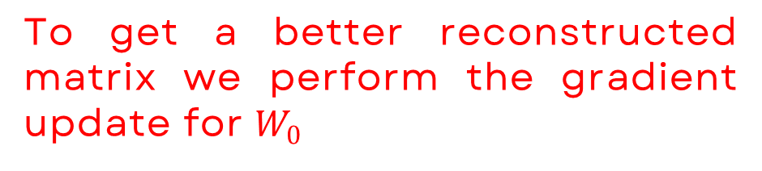

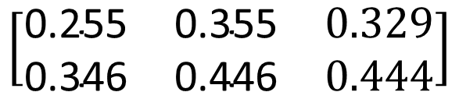
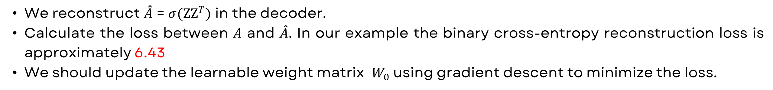
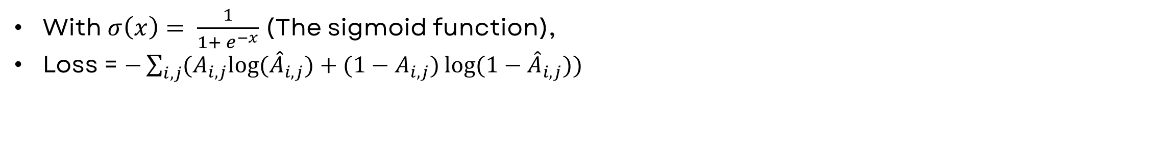
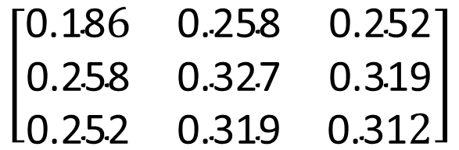
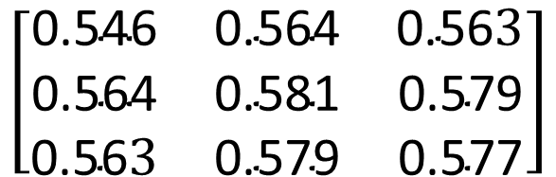



GRAPH AUTOENCODERS (3/5)
Example (2/2)
We reconstruct $\hat{A}$ = $σ(ZZ^{T})$ in the decoder.
Calculate the loss between $A$ and $\hat{A}$​. In our example the binary cross-entropy reconstruction loss is approximately 6.43
We should update the learnable weight matrix ​ $W_{0}$ using gradient descent to minimize the loss.
A
$$Z$$
$$Z^{T}$$
$$ZZ^{T}$$
C
$$\left[\begin{matrix}\text{0.255} & \text{0.346} \\ \text{0.355} & \text{0.446} \\ 0.329 & 0.444\end{matrix}\right]$$
$$\left[\begin{matrix}\text{0.255} & \text{0.355} & 0.329 \\ \text{0.346} & \text{0.446} & 0.444\end{matrix}\right]$$
$$\left[\begin{matrix}\text{0.18}6 & \text{0.258} & \text{0.252} \\ \text{0.258} & \text{0.327} & \text{0.319} \\ \text{0.252} & \text{0.319} & \text{0.31}2\end{matrix}\right]$$
*
=
B
Decoder
$$\hat{A}$$
To get a better reconstructed matrix we perform the gradient update for $W_{0}$
$\hat{A}$= $σ(ZZ^{T})$
=
$$\left[\begin{matrix}\text{0.546} & \text{0.564} & \text{0.56}3 \\ \text{0.564} & \text{0.581} & \text{0.579} \\ \text{0.56}3 & \text{0.579} & \text{0.577}\end{matrix}\right]$$
With $σ\left(x\right)= \frac{1}{1+ e^{−x}}$ (The sigmoid function),
Loss = $−\sum_{i,j}{(A_{i,j}log⁡({\hat{A}}_{i,j})+(1−A_{i,j})\log{(1−{\hat{A}}_{i,j}))}}$
4
Notes:
Graphs are represented as G=(V,E)
In the equation $\overline{X}$= $σ$($\tilde{A}XW_{0}),$ $X$ is the feature matrix containing node attributes, $\tilde{A}$is the normalized adjacency matrix and $W_{0}$ is the learnable weight matrix

Slide 7
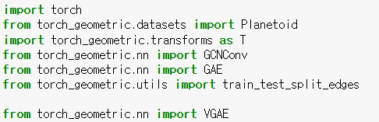
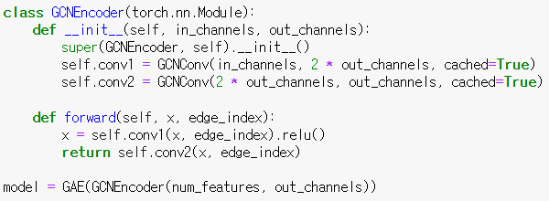
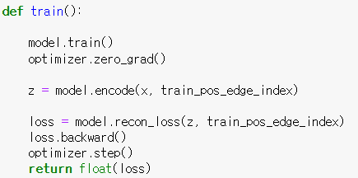
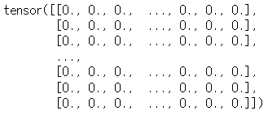

GRAPH AUTOENCODERS (4/5)
Pytorch Geometric Implementation
Name | #nodes | #edges | #features | #classes
Cora | 2,708 | 10,556 | 1,433 | 7
CiteSeer | 3,327 | 9,104 | 3,703 | 6
PubMed | 19,717 | 88,648 | 500 | 3
x=[3327, 3703] represents the node feature matrix.
train_pos_edge_index=[2, 7740] represents the positive edges (existing edges) used in the training set.
4
Notes:
1- It learns low-dimensional representations (embeddings) of nodes or entire graphs while preserving the graph's structural and feature information.

Slide 8
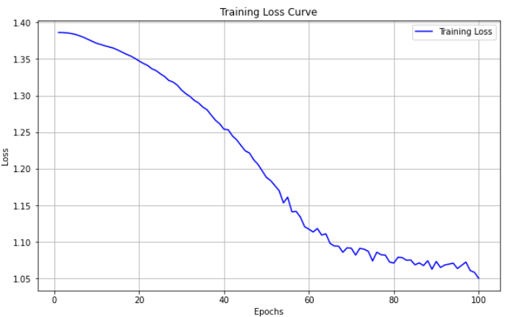
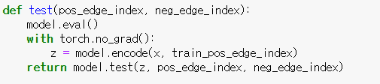
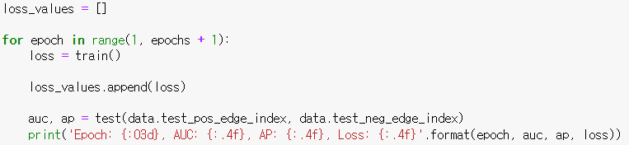
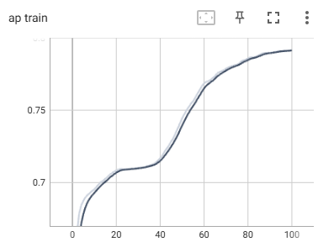
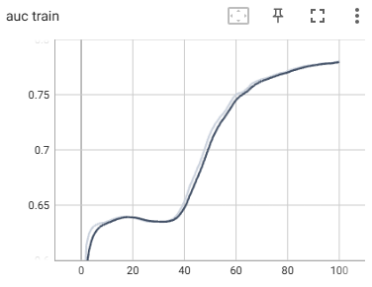
GRAPH AUTOENCODERS (5/5)
Pytorch Geometric Implementation
Epoch: 001, AUC: 0.6539, AP: 0.6747, Loss: 1.3863
Epoch: 002, AUC: 0.6533, AP: 0.6823, Loss: 1.3862
Epoch: 003, AUC: 0.6552, AP: 0.6868, Loss: 1.3858
.
.
.
Epoch: 098, AUC: 0.7673, AP: 0.7615, Loss: 1.0609
Epoch: 099, AUC: 0.7677, AP: 0.7615, Loss: 1.0583
Epoch: 100, AUC: 0.7680, AP: 0.7620, Loss: 1.0503
4
Notes:
1- It learns low-dimensional representations (embeddings) of nodes or entire graphs while preserving the graph's structural and feature information.

Slide 9
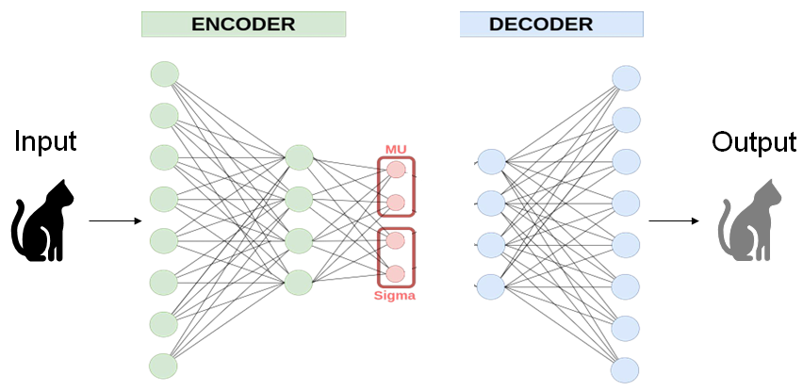
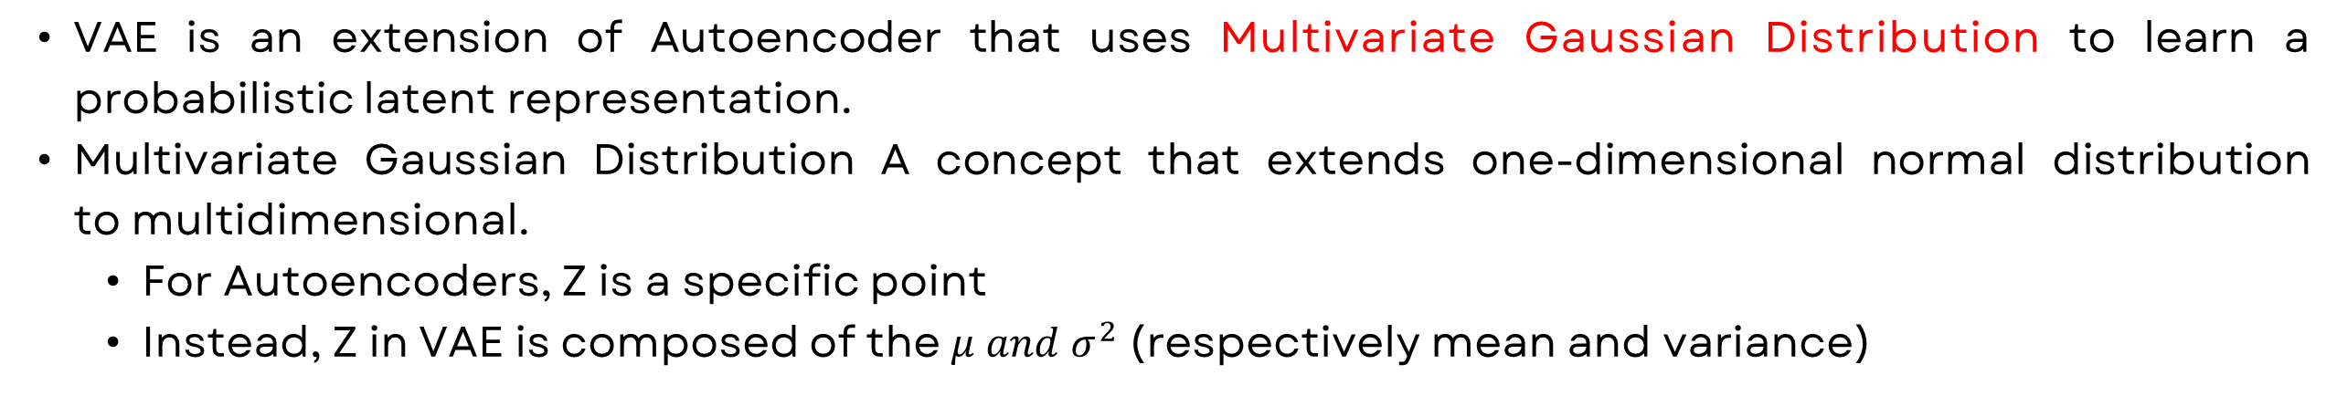
VARIATIONAL AUTOENCODERS (1/3)
Introduction
VAE is an extension of Autoencoder that uses Multivariate Gaussian Distribution to learn a probabilistic latent representation.
Multivariate Gaussian Distribution A concept that extends one-dimensional normal distribution to multidimensional.
For Autoencoders, Z is a specific point
Instead, Z in VAE is composed of the $μ and σ^{2}$ (respectively mean and variance)
8
Notes:
Parameters of Multivariate Gaussian Distribution

Slide 10




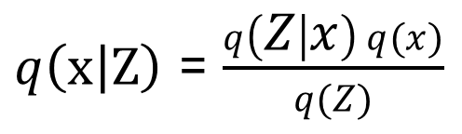

VARIATIONAL AUTOENCODERS (2/3)
Structure and Objective (1/2)
$$x$$
Encoder
Embedding
Decoder
Latent Space
Distribution of
the input
$$Z$$
AS much similar as possible
$$p\left(Z | x\right)$$
$q\left(x | Z\right)$ = $\frac{q\left(Z | x\right) q(x)}{q(Z)}$
Multivariate Gaussian
The objective is to minimize the distance between distributions measured by KL-Divergence.
$$KL(q\left(Z | x\right)\left\|\left.p\left(Z | x\right)\right.\right.)$$
We cannot compute
8
$$min KL(q\left(Z | x\right)\left\|\left.p\left(Z | x\right)\right.\right.)$$
Notes:
Parameters of Multivariate Gaussian Distribution

Slide 11
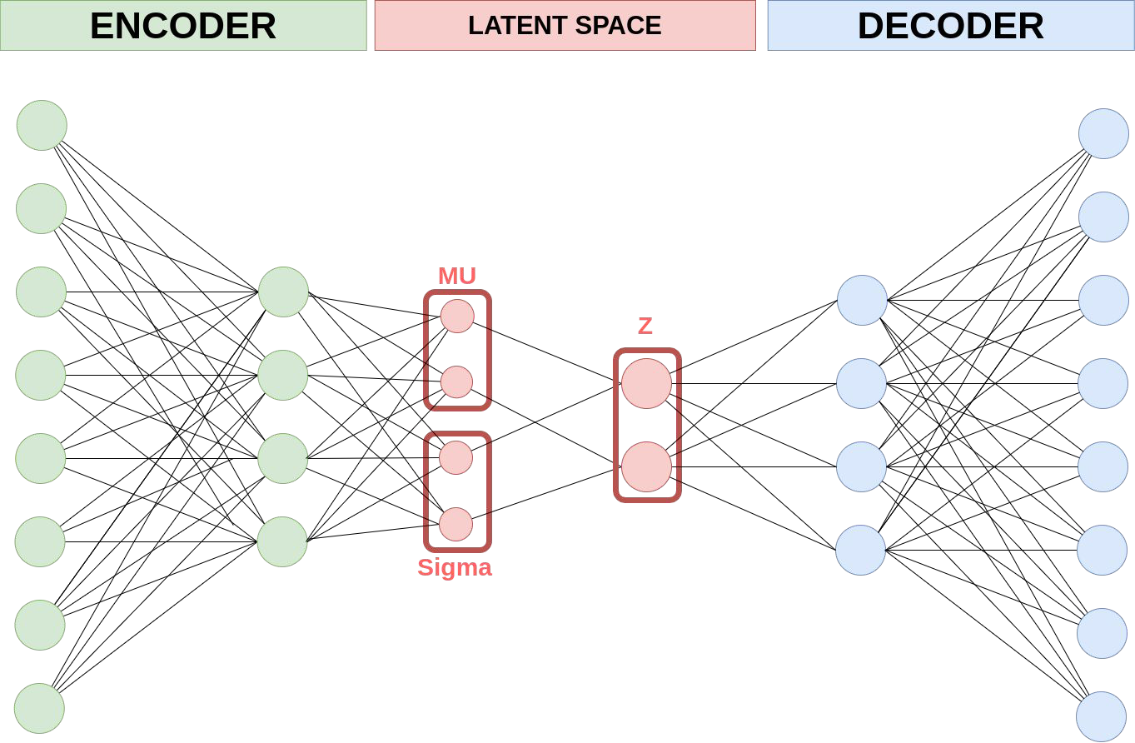
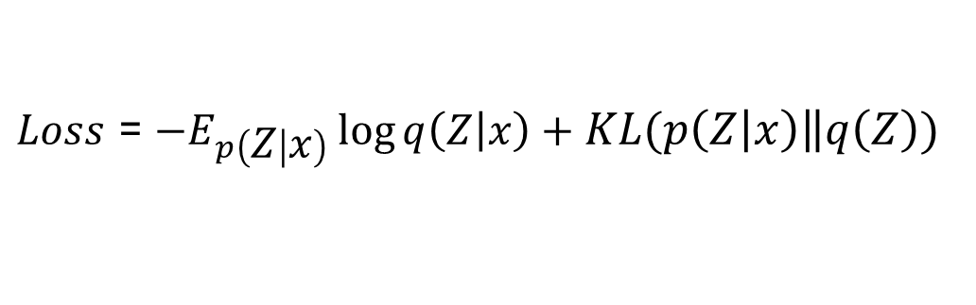
VARIATIONAL AUTOENCODERS (3/3)
Structure and Objective (2/2)
VAE uses reparameterization trick to find Z in a latent space: $Z$ = $μ+ σ^{2} \text{⊙} ϵ, where ϵ ≈Norm(0,1)$
Input
Output
To train the model and measure the difference between the original input and its reconstruction we calculate the loss
$Loss$ = $−E_{p\left(Z | x\right)}\log{q\left(Z | x\right)}+KL(p\left(Z | x\right)\left\|q\left(Z\right)\right.)$
Variational Lower Bound [Reconstruction error]
Regularizer
[KL-Divergence]
8
Notes:
Variational Lower Bound: Measures how well the reconstructed adjacency matrix​ matches the original adjacency matrix A. This is often computed using the Binary Cross-Entropy Loss (BCE).
KL Divergence (Regularization Term): Encourages the latent variables to follow a standard normal distribution N(0,1), which ensures that the latent space is smooth and well-structured.

Slide 12
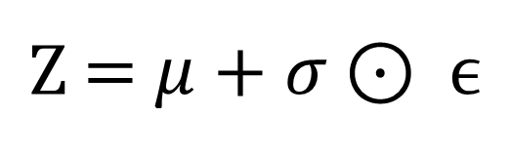
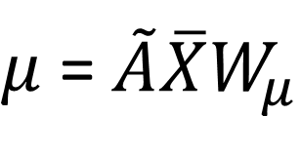
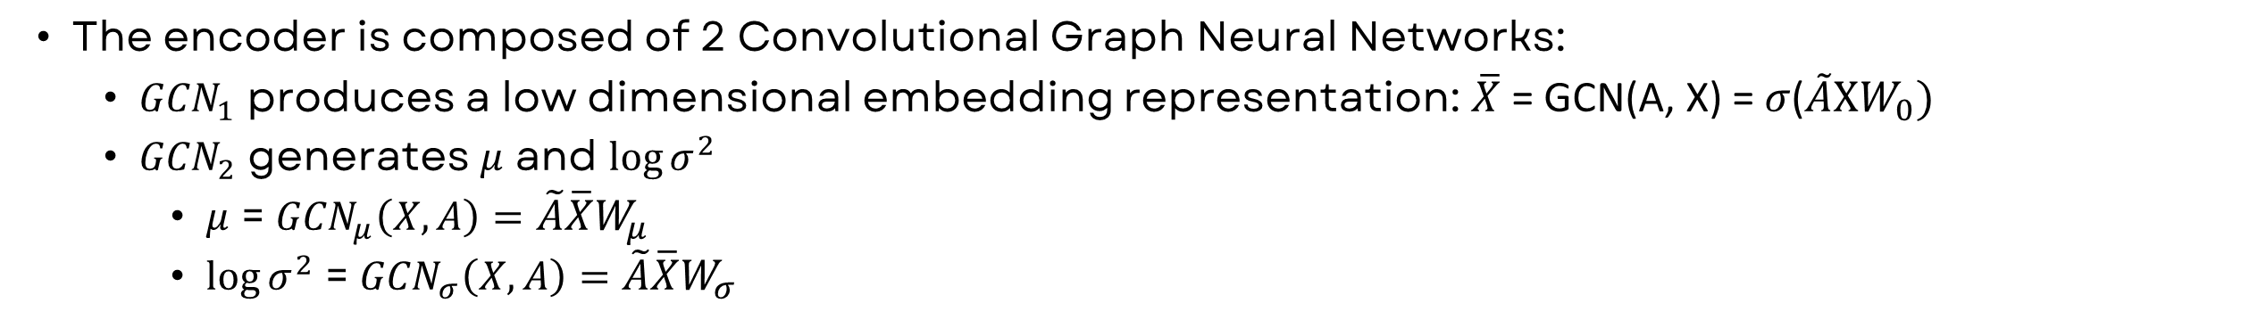
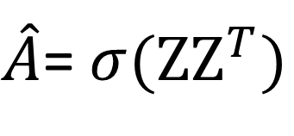
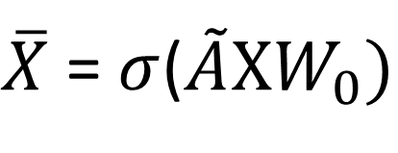

VARIATIONAL GRAPH AUTOENCODERS (1/6)
Introduction
The encoder is composed of 2 Convolutional Graph Neural Networks:
${GCN}_{1}$ produces a low dimensional embedding representation: $\overline{X}$ = GCN(A, X) = $σ$($\tilde{A}XW_{0})$
${GCN}_{2}$ generates $μ$ and $\log{σ^{2}}$
$μ$ = ${GCN}_{μ}\left(X,A\right)=\tilde{A}\overline{X}W_{μ}$
$\log{σ^{2}}$ = ${GCN}_{σ}\left(X,A\right)=\tilde{A}\overline{X}W_{σ}$
It produces latent representations $Z$ by using the reparameterization trick: $Z$ = $μ+σ \text{⊙} ϵ, where ϵ ≈Norm(0,1)$
It calculates the Inner product between latent variable $Z$
Encoder
Embedding
Decoder
$\overline{X}$ = $σ$($\tilde{A}XW_{0})$
$μ$ =$\tilde{A}\overline{X}W_{μ}$
$Z$ = $μ+σ \text{⊙} ϵ$
$\hat{A}$= $σ(ZZ^{T})$
$$\log{σ^{2}}\text{ = }\tilde{A}\overline{X}W_{σ}$$
9

Slide 13
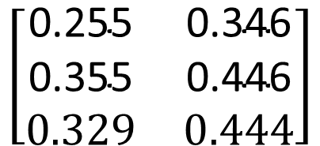

VARIATIONAL GRAPH AUTOENCODERS (2/6)
Example (1/3)
$$A$$
$$X$$
$$W_{0}$$
$$X∗W_{0}$$
A
0 | 0 | 1
0 | 0 | 1
1 | 1 | 0
1 | 0 | 0
0 | 1 | 0
0 | 0 | 1
0.1 | 0.2
0.3 | 0.4
0.5 | 0.6
0.1 | 0.2
0.3 | 0.4
0.5 | 0.6
C
*
=
B
$${GCN}_{1}$$
$$A$$
$$A+I$$
$$D$$
$$D^{−1/2}$$
Encoder
0 | 0 | 1
0 | 0 | 1
1 | 1 | 0
1 | 0 | 1
0 | 1 | 1
1 | 1 | 1
2 | 0 | 0
0 | 2 | 0
0 | 0 | 3
$$\frac{1}{\sqrt{2}}$$ | 0 | 0
0 | $$\frac{1}{\sqrt{2}}$$ | 0
0 | 0 | $$\frac{1}{\sqrt{3}}$$
$$\left[\begin{matrix}\text{0.255} & \text{0.346} \\ \text{0.355} & \text{0.446} \\ 0.329 & 0.444\end{matrix}\right]$$
$\overline{X}$ = $σ$($\tilde{A}XW_{0})$
$$\frac{1}{\sqrt{2}}$$ | 0 | 0
0 | $$\frac{1}{\sqrt{2}}$$ | 0
0 | 0 | $$\frac{1}{\sqrt{3}}$$
0 | 0 | 1
0 | 0 | 1
1 | 1 | 0
$$\frac{1}{\sqrt{2}}$$ | 0 | 0
0 | $$\frac{1}{\sqrt{2}}$$ | 0
0 | 0 | $$\frac{1}{\sqrt{3}}$$
$$0.5$$ | 0 | 0.41
0 | $$0.5$$ | 0.41
0.41 | 0.41 | $$0.33$$
$\tilde{A}$=
*
*
=
* With $σ\left(x\right)=ReLU\left(x\right)= \left\{\begin{aligned}x if x>0, \\ 0 if x ≤0\end{aligned}\right.$
12

Slide 14
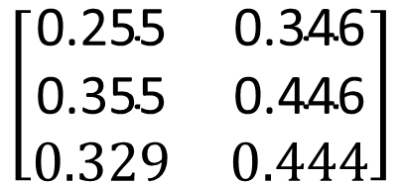
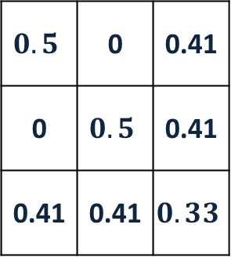

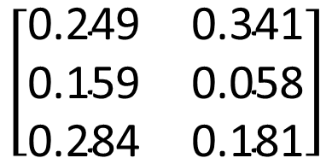




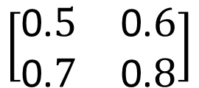
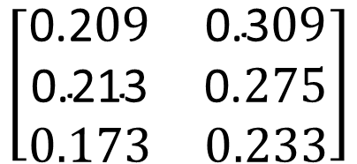
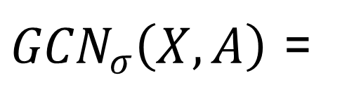

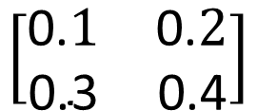

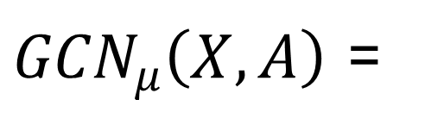

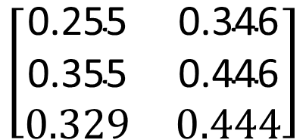



VARIATIONAL GRAPH AUTOENCODERS (3/6)
Example (2/3)
$$\tilde{A}$$
$${GCN}_{1}$$
$$W_{μ}$$
$$μ$$
$$0.5$$ | 0 | 0.41
0 | $$0.5$$ | 0.41
0.41 | 0.41 | $$0.33$$
$$\left[\begin{matrix}\text{0.255} & \text{0.346} \\ \text{0.355} & \text{0.446} \\ 0.329 & 0.444\end{matrix}\right]$$
$$\left[\begin{matrix}\text{0.2}09 & \text{0.3}09 \\ \text{0.}\text{21}\text{3} & \text{0.}275 \\ 0.173 & 0.233\end{matrix}\right]$$
${GCN}_{μ}\left(X,A\right)$ =
*
*
$$\left[\begin{matrix}\text{0.}1 & \text{0.}2 \\ \text{0.3} & \text{0.4}\end{matrix}\right]$$
=
$$W_{σ}$$
$$σ$$
$$Z$$
$$0.5$$ | 0 | 0.41
0 | $$0.5$$ | 0.41
0.41 | 0.41 | $$0.33$$
$$\left[\begin{matrix}\text{0.255} & \text{0.346} \\ \text{0.355} & \text{0.446} \\ 0.329 & 0.444\end{matrix}\right]$$
$$\left[\begin{matrix}\text{0}.511 & \text{0.}625 \\ \text{0.}505 & \text{0.}617 \\ 0.409 & 0.501\end{matrix}\right]$$
$$\left[\begin{matrix}\text{0.249} & \text{0.34}\text{1} \\ \text{0.159} & \text{0.05}\text{8} \\ \text{0.284} & \text{0.181}\end{matrix}\right]$$
${GCN}_{σ}\left(X,A\right)$ =
*
*
$$\left[\begin{matrix}\text{0.}5 & \text{0.}6 \\ \text{0.}7 & \text{0.}8\end{matrix}\right]$$
=
$$ε$$
$$\left[−\begin{matrix}\text{0}.155 & \text{0.}081 \\ \text{0.}\text{208} & −\text{0.}\text{573} \\ 0.665 & \text{−}0.207\end{matrix}\right]$$
12
$$∗μ\text{ = }{GCN}_{μ}\left(X,A\right)=\tilde{A}\overline{X}W_{μ} , \log{σ^{2}}\text{ = }{GCN}_{σ}\left(X,A\right)=\tilde{A}\overline{X}W_{σ} and Z\text{ = }μ+σ \text{⊙} ϵ$$
Notes:
ϵ represents a random noise vector sampled from a standard normal distribution:

Slide 15







VARIATIONAL GRAPH AUTOENCODERS (4/6)
Example (3/3)
We reconstruct $\hat{A}$ = $σ(ZZ^{T})$ in the decoder.
Calculate the loss between $A$ and $\hat{A}$​. In our example the loss is 12.57 (binary cross-entropy reconstruction loss and KL- Divergence are approximately 6.43 and is 6.34)
We should update the learnable weight matrices ​ using gradient descent to minimize the loss.
A
$$Z$$
$$Z^{T}$$
$$ZZ^{T}$$
C
$$\left[\begin{matrix}\text{0.249} & \text{0.34}\text{1} \\ \text{0.159} & \text{0.05}\text{8} \\ \text{0.284} & \text{0.181}\end{matrix}\right]$$
$$\left[\begin{matrix}\text{0.2}49 & \text{0.}159 & 0.284 \\ \text{0.34}1 & \text{0.}058 & 0.181\end{matrix}\right]$$
$$\left[\begin{matrix}\text{0.1}\text{7}8 & \text{0.}\text{059} & \text{0.}\text{133} \\ \text{0.}\text{059} & \text{0.}\text{029} & \text{0.}\text{056} \\ \text{0.}\text{133} & \text{0.}056 & \text{0.}\text{114}\end{matrix}\right]$$
*
=
B
Decoder
$$\hat{A}$$
With $σ\left(x\right)= \frac{1}{1+ e^{−x}}$ (The sigmoid function),
Loss = $−\sum_{i,j}{(A_{i,j}log⁡({\hat{A}}_{i,j})+(1−A_{i,j})\log{(1−{\hat{A}}_{i,j}))}}$
KL-Divergence = $−\frac{1}{2}\sum_{i=1}^{N}{\sum_{j=1}^{d}{\left(\log\left(σ_{ij}^{2}\right) − μ_{ij}^{2} − σ_{ij}^{2} \right)}}$
$\hat{A}$= $σ(ZZ^{T})$
=
$$\left[\begin{matrix}\text{0.54}5 & \text{0.5}15 & \text{0.5}33 \\ \text{0.5}15 & \text{0.5}07 & \text{0.5}14 \\ \text{0.5}33 & \text{0.5}14 & \text{0.5}28\end{matrix}\right]$$
12
* N: Number of nodes in the graph,
* d: Latent dimension size.

Slide 16


VARIATIONAL GRAPH AUTOENCODERS (5/6)
Pytorch Geometric Implementation
Name | #nodes | #edges | #features | #classes
Cora | 2,708 | 10,556 | 1,433 | 7
CiteSeer | 3,327 | 9,104 | 3,703 | 6
PubMed | 19,717 | 88,648 | 500 | 3
x=[3327, 3703] represents the node feature matrix.
train_pos_edge_index=[2, 7740] represents the positive edges (existing edges) used in the training set.
10

Slide 17



VARIATIONAL GRAPH AUTOENCODERS (6/6)
Pytorch Geometric Implementation
Epoch: 001, AUC: 0.3784, AP: 0.4405, Loss: 1.7697
Epoch: 002, AUC: 0.3956, AP: 0.4670, Loss: 1.7302
Epoch: 003, AUC: 0.6037, AP: 0.6402, Loss: 1.7229
.
.
.
Epoch: 298, AUC: 0.7645, AP: 0.7788, Loss: 1.1017
Epoch: 299, AUC: 0.7642, AP: 0.7784, Loss: 1.0985
Epoch: 300, AUC: 0.7638, AP: 0.7780, Loss: 1.1078

Slide 18
THANK
YOU
13

Slide 19


Appendix (1/2)
TensorBoard Interface
Installation: (if needed) "pip install tensorboard"

Slide 20
Appendix (2/2)
Comparison Table
We Choose GAE for simpler tasks where computational efficiency and deterministic outputs are more important.
We Choose VGAE if we need better generalization, want to avoid overfitting, or need probabilistic embeddings and uncertainty quantification.
Feature | GAE | VGAE
Complexity | Low | High
Generalization | Limited | Better
Overfitting | More prone | Less prone (due to KL)
Computational Cost | Low | Higher
Deterministic Outputs | Yes | No
Latent Space Representation | Deterministic | Probabilistic
Use Cases | Small datasets, simple tasks | Large datasets, uncertainty modelling

