Slide 1
Next Up:
Bruce Payette

Slide 2
3
3

Slide 3
2

Slide 4
1

Slide 5
Runspaces and Modules and Closures Oh My!
Bruce Payette

Slide 6
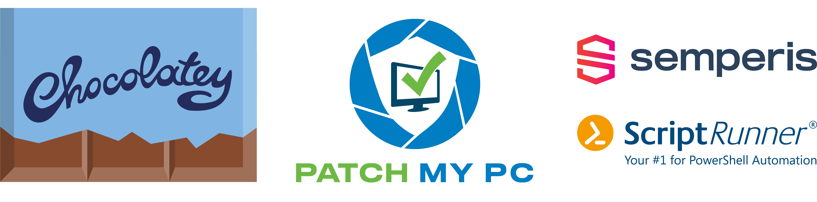
Many thanks to our sponsors:

Slide 7

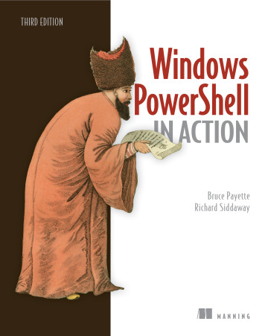
Bruce Payette
Founding member of the PowerShell team
Tech lead/architect on the language and engine design
Inventor of PowerShell DSC
Wrote some books
Formerly:
Principal Software Engineer at Microsoft
Principal Software Engineer at Amazon AWS
Where I also worked on PowerShell

Slide 8
Goals…
Definitions : what the heck is a closure?
Where/How is script state managed/implemented/exposed in PowerShell
Look at the types used
Look at how things fit together
Look at some of the APIs
What can you do with closures…
Warning – this is a NerdFactor(10) talk…

Slide 9
Definitions
Runspace
[System.Management.Automation.Runspaces.Runspace]
A place to run PowerShell code, local or remote
Created with […RunspaceFactory] class.
ICommandRuntime
[System.Management.Automation.ICommandRuntime]
A shim layer that directs how output is streamed
Needed to make standalone Cmdlet cmdlets work.
An API from the Political Layer
ExecutionContext (not public)
Inner class wrapped by RunSpace

Slide 10
Definitions cont’d
Session
[System.Management.Automation.Runspaces.PSSession]
A connection to a Runspace
Public wrapper around Runspaces to make them « simpler »
SessionState
[System.Management.Automation.SessionState]
Is part of a Runspace/ExecutionContext
Represent a scoped set of bindings within a runspace

Slide 11
Definitions cont’d again
Scope
Linked data structures inside a SessionState object
Holds the active set of bindings in a function call.
Module
[System.Management.Automation.PSModuleInfo]
A programmer-focused wrapper around a [SessionState] object that acts like a lens.
Modules can be linked together

Slide 12
Definitions cont’d last time.
Lambda
An anonymous function in a programming system.
Closure (from Wikipedia)
A closure is a record storing an anonymous function together with an environment.
ScriptBlock
A lambda in in the PowerShell system.
Can be afinitized to a SessionState/Module in which case it’s a closure.

Slide 13
All Together Now…
PSSession
Runspace/ExecutionContext
SessionState
Module
Scope Chain
Module SessionState
Scope
Scope

Slide 14
ScriptBlock Redux.
ScriptBlock
[System.Management.Automation.ScriptBlock]
Has an associated Module member. If this member is not $null, then you have a bound scriptblock i.e. a closure
Active engine bindings are maintained using thread-local storage
On entry to a function with an environment, the current environment is saved and the new environment is assigned to thread-local storage

Slide 15
ScriptBlock APIs.
PSModuleInfo.NewBoundScriptBlock()
Clones a ScriptBlock and sets the ExecutionContext of the ScriptBlock from to the current exécution context.
public ScriptBlock NewBoundScriptBlock(
ScriptBlock scriptBlockToBind)
{
var context =
LocalPipeline.GetExecutionContextFromTLS();
return NewBoundScriptBlock(scriptBlockToBind, context);
}

Slide 16
ScriptBlock APIs.
GetNewClosure()
Creates a new bound ScriptBlock copying the variables from the current scope into the session state associated with the ScriptBlock
public ScriptBlock GetNewClosure()
{
PSModuleInfo m = new PSModuleInfo(true);
m.CaptureLocals();
return m.NewBoundScriptBlock(this);
}

Slide 17
Demos
We love Demos!

Slide 18
What are closures good for?
Stateful functions
Encapsulate private state in a function: function generators
New-Counter example.
Simplified concurrency
Instead of $using:foo just use a closure:
$foo = "Hi there"
Start-ThreadJob {
start-sleep 1;
[console]::writeline("foo: $foo")
}.GetNewClosure()
But unfortunately this doesn’t work…

Slide 19
Demos
We love Demos!

Slide 20
In Summary...
Closures are neat but not very useful as currently implemented
But they could be fixed…
Everybody (JS, Python, Java, C#, …) else has them so maybe it would be worth the effort.
Talks etc, available at:
https://github.com/BrucePay/PSConfEU2024

Slide 21
Q&A
15 minutes

