Slide 1
Next Up:
Bruce Payette

Slide 2
3
3

Slide 3
2

Slide 4
1

Slide 5
Braid: One Year In
Bruce Payette

Slide 6

Many thanks to our sponsors:

Slide 7

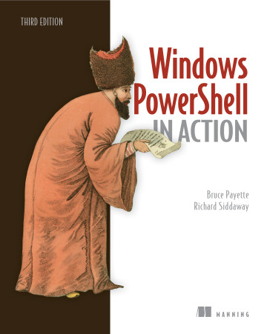
Bruce Payette
Founding member of the PowerShell team
Tech lead/architect on the language and engine design
Invented PowerShell DSC
Wrote a book
Formerly:
Principal Software Engineer at Microsoft
Principal Software at AWS
Also worked on PowerShell

Slide 8
From last year…
Braid: a Post-PowerShell Shell
An Experiment in Shell Language Experiences
A new shell language that builds on the themes pioneered by PowerShell
Object-oriented pipelines
“real” programmability

Slide 9
Demos
We love Demos!

Slide 10
Q&A
15 minutes

