Slide 1
Next Up:
Bruce Payette

Slide 2
3
3

Slide 3
2

Slide 4
1

Slide 5
Runspaces and Modules and Closures Oh My!
Bruce Payette

Slide 6
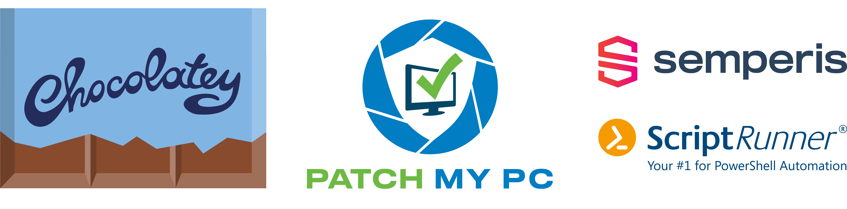
Many thanks to our sponsors:

Slide 7
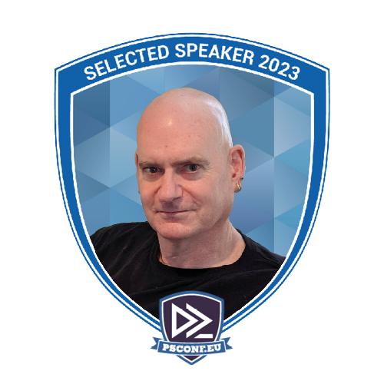
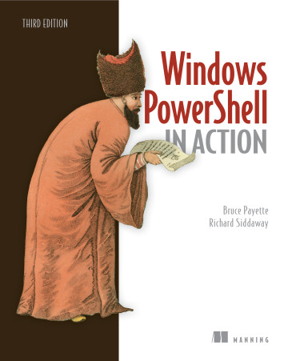
Bruce Payette
Founding member of the PowerShell team
Tech lead/architect on the language and engine design
Invented PowerShell DSC
Wrote a book
Formerly:
Principal Software Engineer at Microsoft
Principal Software at AWS
Also worked on PowerShell

Slide 8
Definitions
Runspace
A place to run PowerShell code, local or remote
Runspaces contain Modules
Created with [RunspaceFactory] class.
Session
Public wrapper around Runspaces to make them « simpler »
SessionState
Part of a Runspace
Represent a scoped set of bindings within a runspace

Slide 9
Definitions cont’d
Module
A programmer-focused wrapper around a [SessionState] object.
Modules can be linked together
Scope
Linked data structures inside a SessionState object
Holds the active set of bindings
SessionState
Part of a runspace
Scoped set of bindings within a runspace

Slide 10
Definitions cont’d again.
Lambda
An anonymous function in a programming system.
ScriptBlock
A lambda in in the PowerShell system.
Afinitized to a SessionState/Module
Closure
A closure is a record storing an anonymous function together with an environment.

Slide 11
All Together Now…
Session
Runspace
Runspace SessionState
Module
Scope Chain
Module SessionState
Scope
Scope

Slide 12
Lambda/ScriptBlock.
Lambda
An anonymous function in a programming system.
ScriptBlock
A lambda in in the PowerShell system.
Afinitized to a SessionState/Module
Closure (From Wikipedia)
A closure is a record storing an anonymous function together with an environment.

Slide 13
Demos
We love Demos!

Slide 14
Q&A
15 minutes

