Slide 1
Next Up: Braid: One Year In
Bruce Payette

Slide 2
3
3

Slide 3
2

Slide 4
1

Slide 5
Braid: One Year In
Bruce Payette

Slide 6

Many thanks to our sponsors:

Slide 7

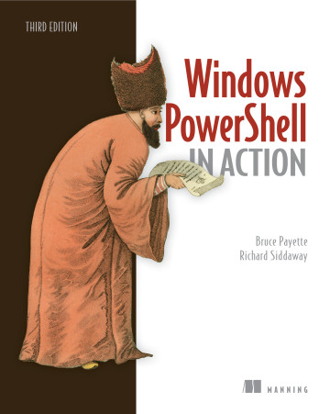
Bruce Payette
Founding member of the PowerShell team
Tech lead/architect on the language and engine design
Invented PowerShell DSC
Wrote a book
Formerly:
Principal Software Engineer at Microsoft
Principal Software at AWS
Also worked on PowerShell

Slide 8
Status last year…
Braid: a Post-PowerShell Shell
An Experiment in Shell Language Experiences
Function-oriented shell
A new shell language that builds on the themes pioneered by PowerShell
Object-oriented pipelines
“real” programmability
direct support for functional idioms

Slide 9
Status 2023 (last year)
Runtime needs semantic validation
Do I have the right idiom?
Number of users: 1
No ci/cd setup
No binary releases
No high-level documentation
Only builds with .NET desktop

Slide 10
Status 2024
Validated runtime semantics
Explored many functional scenarios
Number of users: 1.5
Have a PR for a ci/cd setup
Once the ci/cd pipeline we will have binary releases
Still no high-level documentation
There’s so much to document!

Slide 11
Braid Basics
Minimal “language”
No expression-mode. Only command mode. No keywords, no operators, only functions)
So yes – it is a LISP varient
Syntax
(println “The sum is” (+ 2 3) “so there”)
(function arg1 (nested call) arg3)
Essentially a LISP varient
Lexically scoped with closures
Macros (e.g. for loop)
Mix of lazy and strict semantics (perf, experience)
Internally uses slices for deconstructing list (perf)

Slide 12
Demos
We love Demos!

Slide 13
Some Enhancements
Can use a dictionary in assignments
(let { “extension” “txt” “length len} (ls | !! 1))
with function
(with [x 1 y 2] (println “Hi”) (+ x y))
Dictionary in foreach loop
(foreach {"extension" #"text" "length" len} (ls)
(print len)
)
Also some new functions, bug fixes, some performance for

Slide 14
Q&A
15 minutes

