Slide 1
Next Up: Braid One Year In
Bruce Payette

Slide 2
3
3

Slide 3
2

Slide 4
1

Slide 5
Braid: One Year In
Bruce Payette

Slide 6

Many thanks to our sponsors:

Slide 7

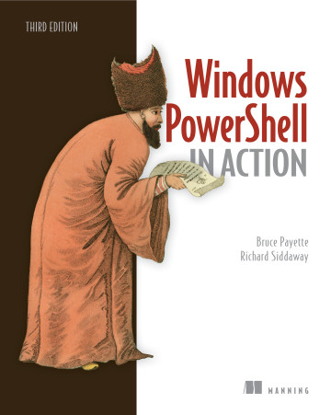
Bruce Payette
Founding member of the PowerShell team
Tech lead/architect on the language and engine design
Invented PowerShell DSC
Wrote a book
Formerly:
Principal Software Engineer at Microsoft
Principal Software Engineer at AWS
Where I also worked on PowerShell

Slide 8
Braid: a Post-PowerShell Shell
An Experiment in Shell Language Experiences
Function-oriented shell
Direct support for functional idioms
A new shell language that builds on the themes pioneered by PowerShell
Object-based pipelines
“real” programmability

Slide 9
Status 2023 (last year)
Runtime needs semantic validation
Do I have the right idiom?
Number of users: 1
No ci/cd setup
No binary releases
No high-level documentation
Only builds with .NET desktop (but it runs everywhere)

Slide 10
Status 2024
Validated runtime semantics
Explored many functional scenarios
Number of users: 1.5
Have a PR from JamesBru for a ci/cd setup
Once the ci/cd pipeline exists we be able to have binary releases
Still no high-level documentation
There’s so much to document!

Slide 11
Braid Basics
Minimal “language”
No expression-mode. Only command mode. No keywords, no operators, only prefix functions)
Syntax
(println “The sum is” (+ 2 3) “so there”)
(function arg1 (nested call) arg3)
So yes – it is a LISP variant…
Lexically scoped with Closures and Macros (expressiveness)
Mix of lazy and strict semantics (perf, experience)
Internally uses slices for deconstructing list (perf)

Slide 12
Braid Basics cont’d
Many literals:
^int ; type literal
"hello" """foo""" ; string literals
#”[a-z][a-z0-9]” ; regex literal
123, 1.45, 0xf3_fe ; numeric literals
:hello ; “keyword”
-path ; parameters literal
{ “a” 1 “b” 2} ; dictionary literal
#{“red” “blue” “green”} ; set literal
[1 2 3] ; vector literal

Slide 13
Braid Basics cont’d
JSON compatible. The following is a valid Braid script:
[
{
"a" : 1,
"b" : 2
},
{
"foo" : "bar"
},
[1, 2, 3],
4
]

Slide 14
Demos
We love Demos!

Slide 15
Some Enhancements
Can use a dictionary in assignments (object patterns)
(let {“extension” “txt” “length len} (ls | !! 1))
with function (kind of like C# using)
(with [x 1 y 2] (println “Hi”) (+ x y))
Dictionary in foreach loop
(foreach {"extension" #"text" "length" len} (ls)
(print len)
)
Also some new functions, bug fixes, some performance work

Slide 16
Summary
Braid is a work in progress.
What is it good for?
Actually not too concerned about that…
Painters gotta paint, programmers gotta program
The code:
https://github/brucepay/braidlang
The talk + examples:
https://github/brucepay/PSConfEU2024

Slide 17
Q&A
15 minutes

