Slide 1
Managing a Large PowerShell Application
Bruce Payette

Slide 2

Many thanks to our sponsors:

Slide 3

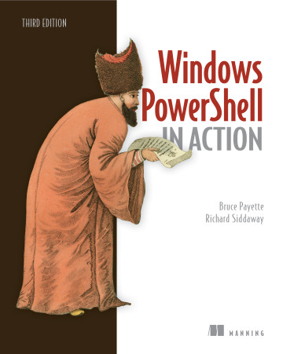
Bruce Payette
Founding member of the PowerShell team
Tech lead/architect on the language and engine design
Invented PowerShell DSC
Wrote a book
Formerly:
Principal Software Engineer at Microsoft
Principal Software at AWS
Also worked on PowerShell
This is all personal
Because “dog-fooding” experiences is good

Slide 4
What does « Managing a Large Application » mean?
Application:
Non-trivial end-user focused experience (as opposed to a library of functions)
The user does not know or care about how it’s implemented.
Examples: text editor, database, programming language
Large:
greater than 10,000 lines of code
Maintain:
Work with and update the code over a period of, at least, years.

Slide 5
A Tiny Project
Wanted to choose something that is traditionally considered a « program » as opposed to a script
My choice was to implement a programming language interpreter using PowerShell
Introducing the Tiny Programming language
Currently 11925 lines of PowerShell code and documentation (too big for VSCode)
13394 lines of Tiny code
Built and maintained over the last 3 years.

Slide 6
Some Tiny Examples
2 + 2 ; 3*(4+5) # basic math works as expected
ls("*.tiny" ) # calling a function
ls("*.tiny" ) {recurse: true} # call with named parameters
ls("*.tiny" ).Count # properties and methods
ls("*.tiny" ) *. Name # access members in a collection
ls("*.tiny" ) |> map {readfile(it) |> count} |> sum; # use pipelines
fn foo x y -> x+y; # define a 1-expression function
fn foo x y { # define a multi-line function
println("I’m a Tiny function!");
true
}
foo(2, 3) # call the user function
[1,2,3,4,5,6] / 2 # partition a list

Slide 7
Demos
We love Demos!

Slide 8
Tiny Tools
Unit tests & tests directory
Embedded unit tests in the tiny source file
Directory containing more complex tests
Documentation
Tinydoc tool and HTML file.
Modules

Slide 9
Challange 1
Source code organization
A large amount of code requires organization
PowerShell provides modules but the module mechanism is designed for sharing libraries; not really appropriate for program-level abstractions
Mitigations
Dot-sourcing?
Concatenate component files into 1 large file?
Just deal with a single large file (sigh)

Slide 10
Challange 2
Namespace management
An application contains a lot of named entities (functions, data structures)
The module mechanism is designed for sharing code; not really appropriate for program-level abstractions
Dynamic modules and closures are not sufficient
Solution
PowerShell introduce user-defined classes in V5.0. Classes are well-suited for namespace management

Slide 11
Looking at the code…
Enums…
Isolated namespace for constants
Static methods instead of functions
Op classes …
Subclassing…
Class AddOp
Embedded tests and documentation

Slide 12
Challange 3
Cardinality and Type Conversions
You can’t tell if you’ve passing a singleton or a collection into a pipeline
Output types of functions are just documentation
Mitigation
Use set-strictmode –latest
Methods in classes are strongly typed and return types are enforced

Slide 13
Challange 4
Performance
PowerShell function invocation is *slow*
The same parameter binder logic is used for all functions.
Mitigation
Use Static methods

Slide 14
Example: fib function
function psfib
{
[CmdletBinding()]
param ( $num )
if ($num -lt 2) {
return 1
}
# decrement operator means second
# call is $num-2
(psfib ($num-1)) + (psfib ($num-2))
}

Slide 15
Example: fib() static method
class fibclass
{
static [int] fib($n)
{
if ($n -lt 2)
{
return 1
}
else
{
return [fibclass]::fib($n-1)+[fibclass]::fib($n-2)
}
}
}

Slide 16
Relative performance
Running the function:
{main}PSCore (1:125) > time {psfib 20} | foreach totalmilliseconds
1563.247
Running the static method implementation:
{main}PSCore (1:124) > time {[fibclass]::fib(20)} | foreach totalmilliseconds
455.7558

Slide 17
Challange 5:
Testing
Could have used Pester but it was simpler to use a Tiny DSL and embedded tests in the source file.
tinytest.tiny extracts and runs the tests
Documentation
Documentation is embedded in the tiny.ps1 source file
tinydoc.tiny extracts and builds the « Tiny Documentation.html » file.

Slide 18
Summary:
Within performance constraints, it is reasonable to write a large application in PowerShell
Most of the challanges involved can be mitigated to a significant degree
Packaging however is a problem
At one point, we were investigating ‘PowerShell in Application Mode’ (PAM) however that never went anywhere ☹

Slide 19
The code is available at:
https://github.com/brucepay/tinylang
Thanks for coming to my talk!

Slide 20
Q&A
15 minutes

