Slide 1



IE: 7275 Data Mining
CASE STUDY
Credit Card Fraud
Detection
GROUP 17
Tanay Parikh(002768693)
Preetham Reddy Gollapalli (002929066)

Slide 2

Credit CARD FRAUD DETECTION
Problem
Credit card fraud can happen in a number of ways, including phishing scams, card-not-present transactions, skimming devices, and data breaches.
Credit card frauds can also harm the reputation of businesses and financial institutions, leading to decreased customer trust and loyalty.
Why is it interesting ?
It also has applications and effects in the real world and helps make people and businesses financially secure.
What is the response variable?
Classification problem- We can forecast new, previously unobserved data thanks to classification issues, which is one of the main reasons why they are significant.
What is the significance of your model prediction? We wanted to make people’s life easier, we don’t want them to suffer financial losses and also it will help Banks and reducing credit card frauds

Slide 3
Where/how did you get the data? We got the data from following website : https://www.kaggle.com/datasets/kartik2112/fraud-detection
#Description
Number Of Records- 1048574
Number Of Features- 20
Predictors- There were total 19 predictors
Outcome- Is_Fraud (1)
Missing Values: There were no missing values as well as duplicate values.
Outliers: The variables amount, city population and timedelta_last_trans have an outlier issue

Slide 4
Data preprocessing
How the variables are correlated?
The variable unix_time is positively correlated with the cc_num and has a very high negative correlation with the is_fraud. This suggests that there may be some relationship between the time of the transaction and the credit card number used, and that fraudulent transactions tend to occur at specific times.
How the missing values are handled?
There were no missing values or Duplicate values in our Dataset, so we didn’t had to handle any.
How the outliers are handled?
For handling the outliers we used the function Winsorizer from the open-source library called feature-engine. Winsorizer replaces extreme values in a variable with a predefined value, which is either the maximum or minimum value within a certain range.
The amt variable has a moderate positive correlation with the is_fraud variable, which suggests that the amount of the transaction may be a useful predictor of fraudulent activity.
The lat and long variables have a weak correlation with the is_fraud variable, while they are highly correlated with merch_lat and merch_long. This suggests that the location of the merchant may be more important in predicting fraudulent activity than the location of the transaction.
How are the categorical variables handled?
We handled the categorical variables using two encoding techniques, those are one hot encoding and target guided mean encoding. Initially we checked the cardinality of the categorical variables and dropped the one’s with higher cardinality in order to avoid overfitting, we were left with 5 variables are three of them were encoded using target guided mean encoding and two of them by one-hot encoding.

Slide 5
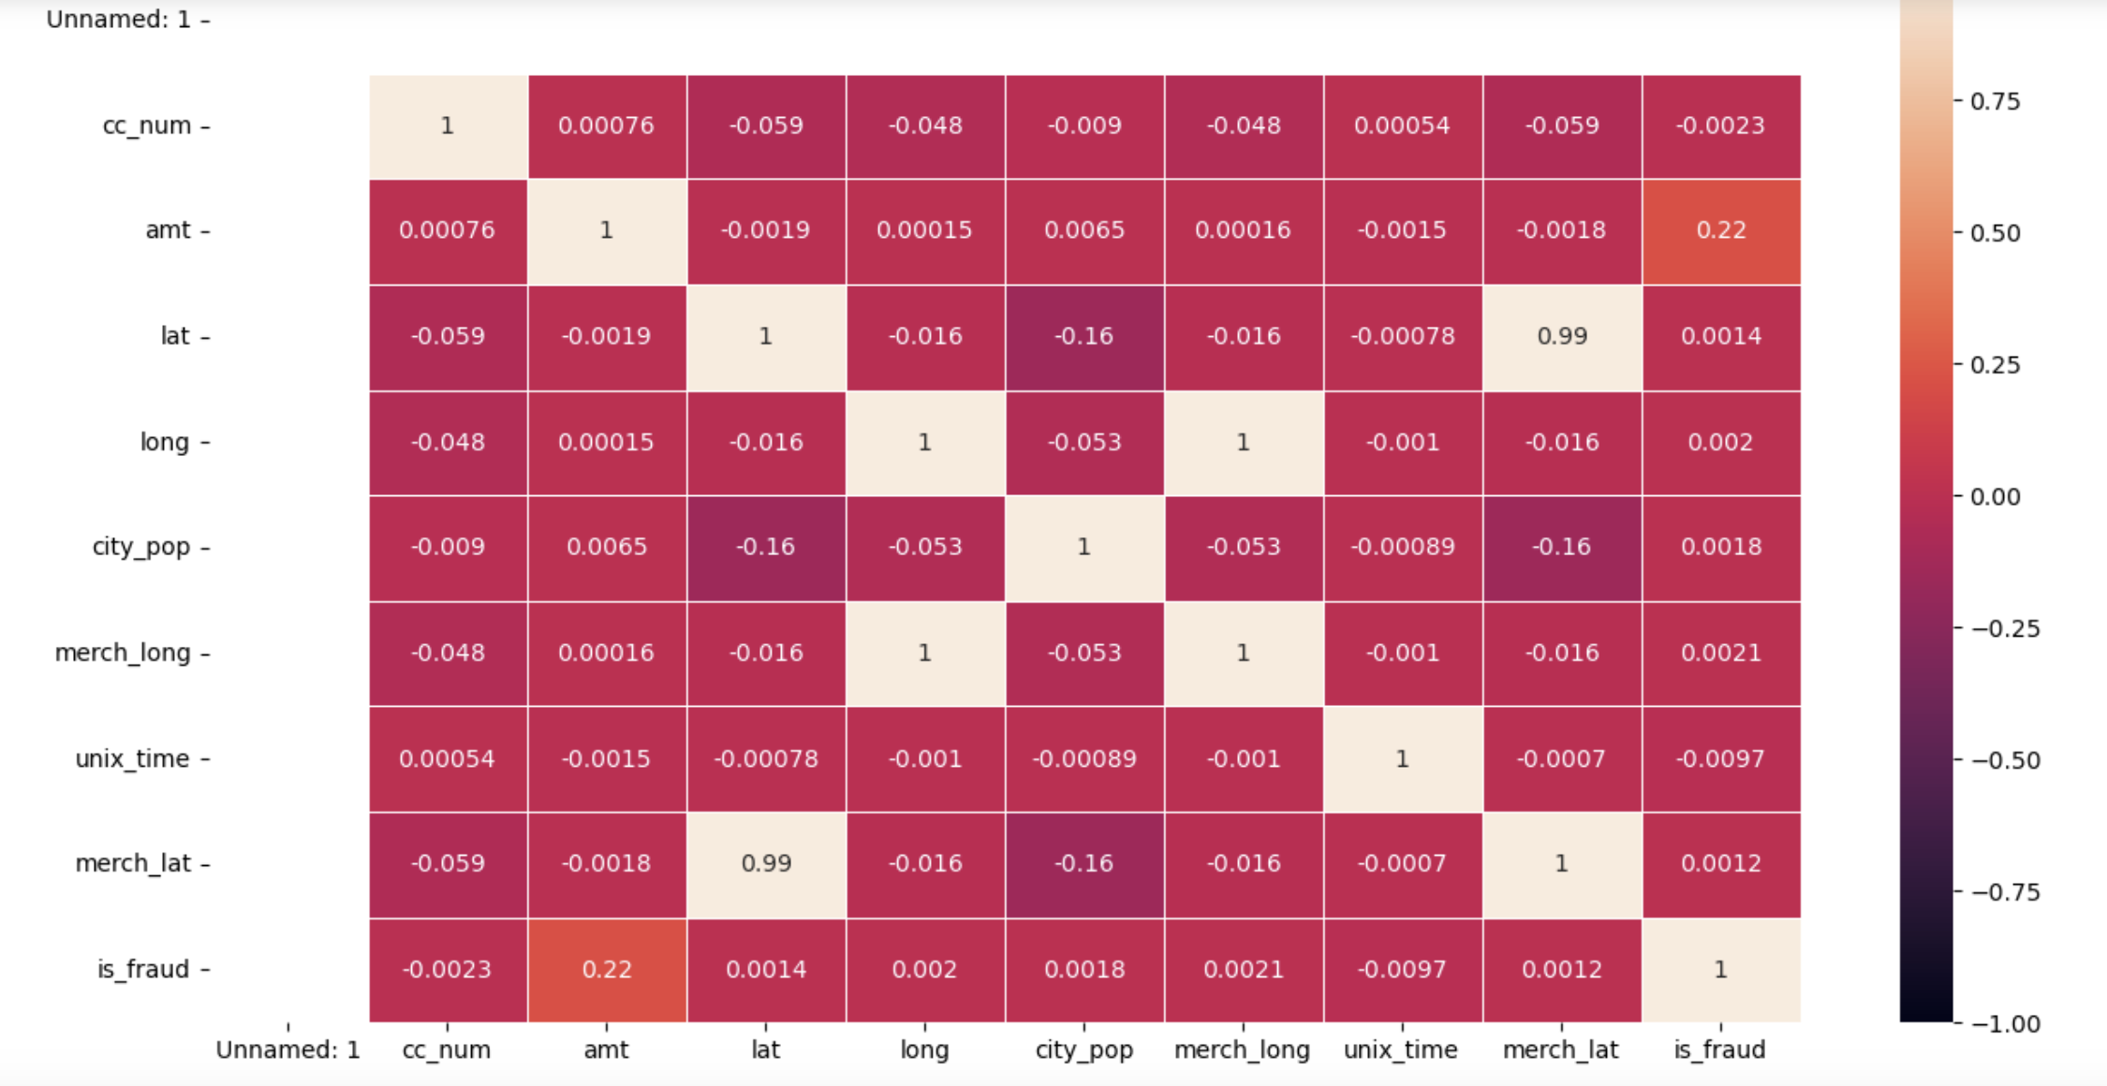
Visulization Graphs
1) Heatmaps

Slide 6
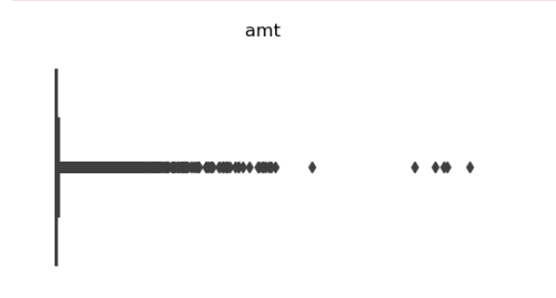
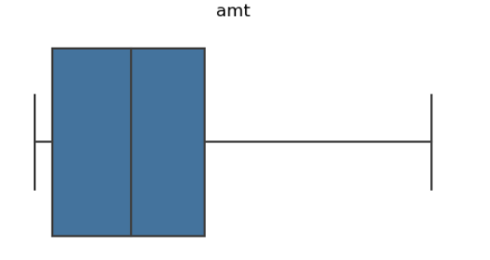
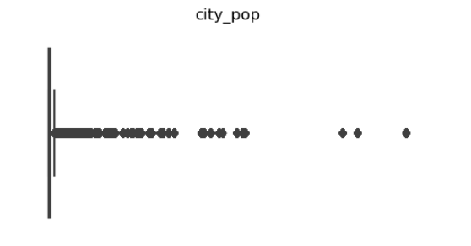
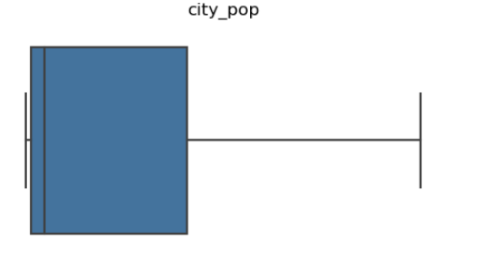
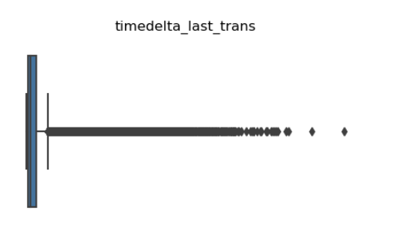
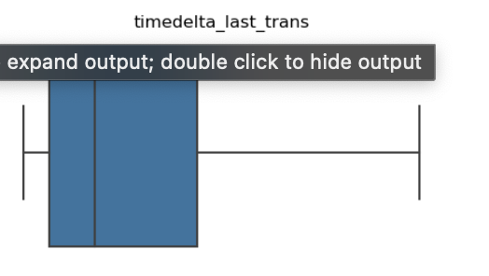
Before:
After:

Slide 7
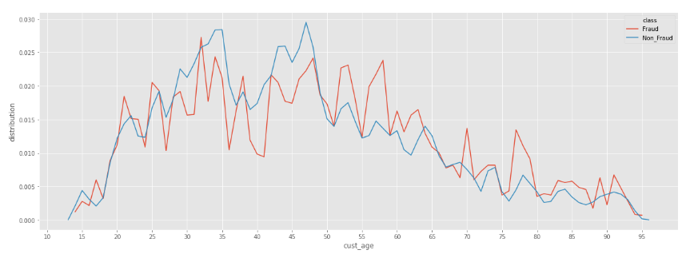
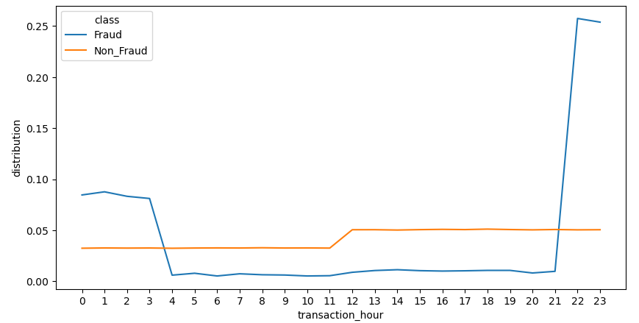

Slide 8
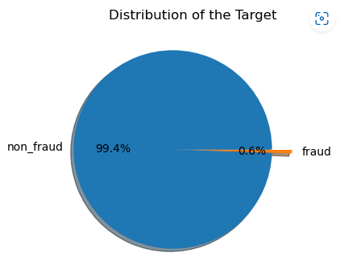
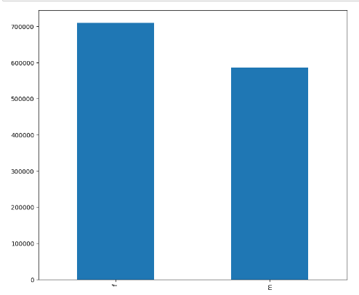

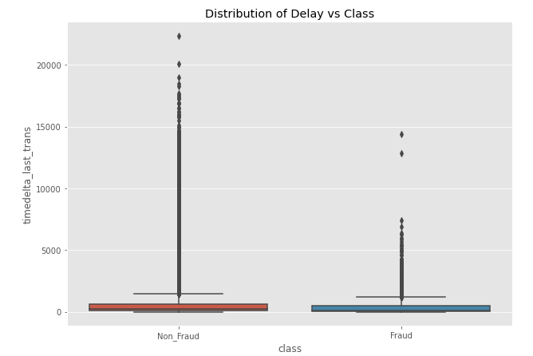

Slide 9
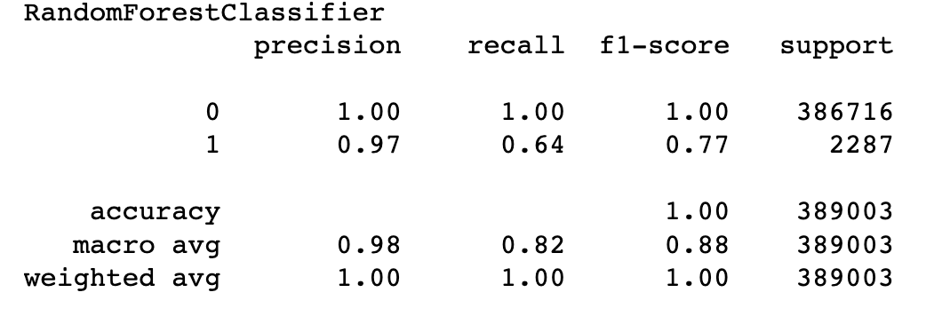
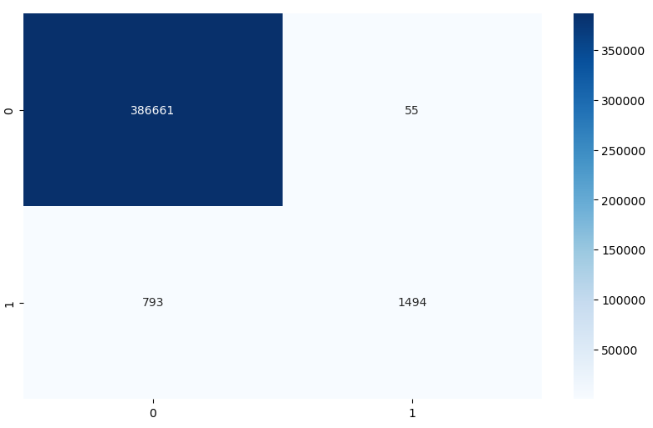
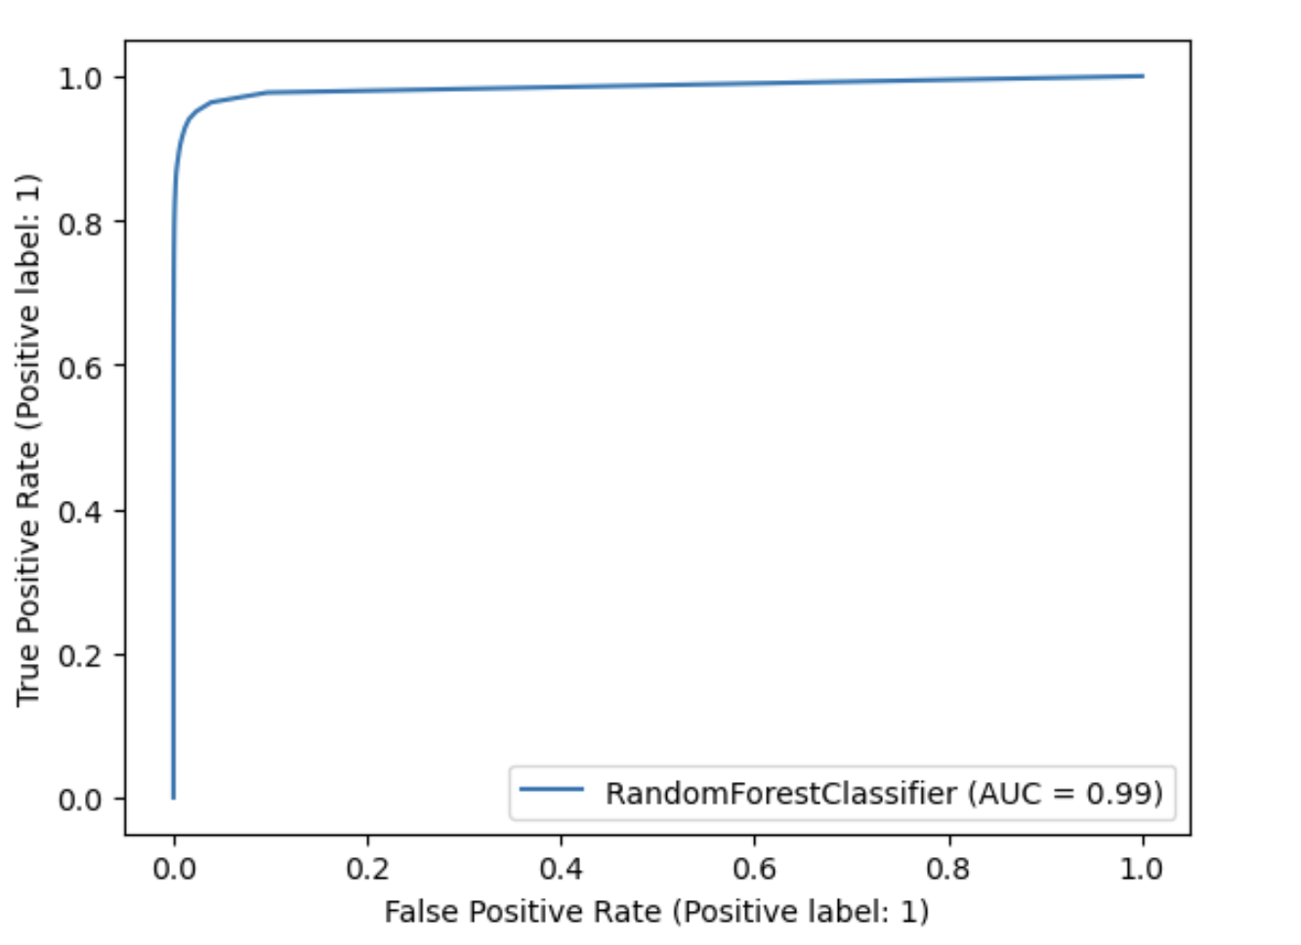

Slide 10
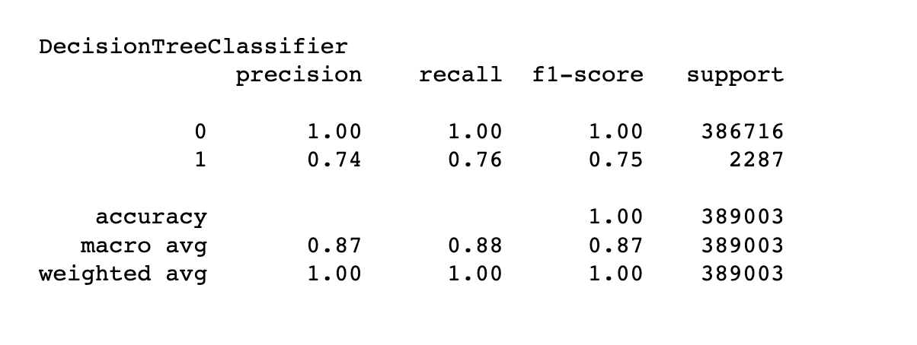
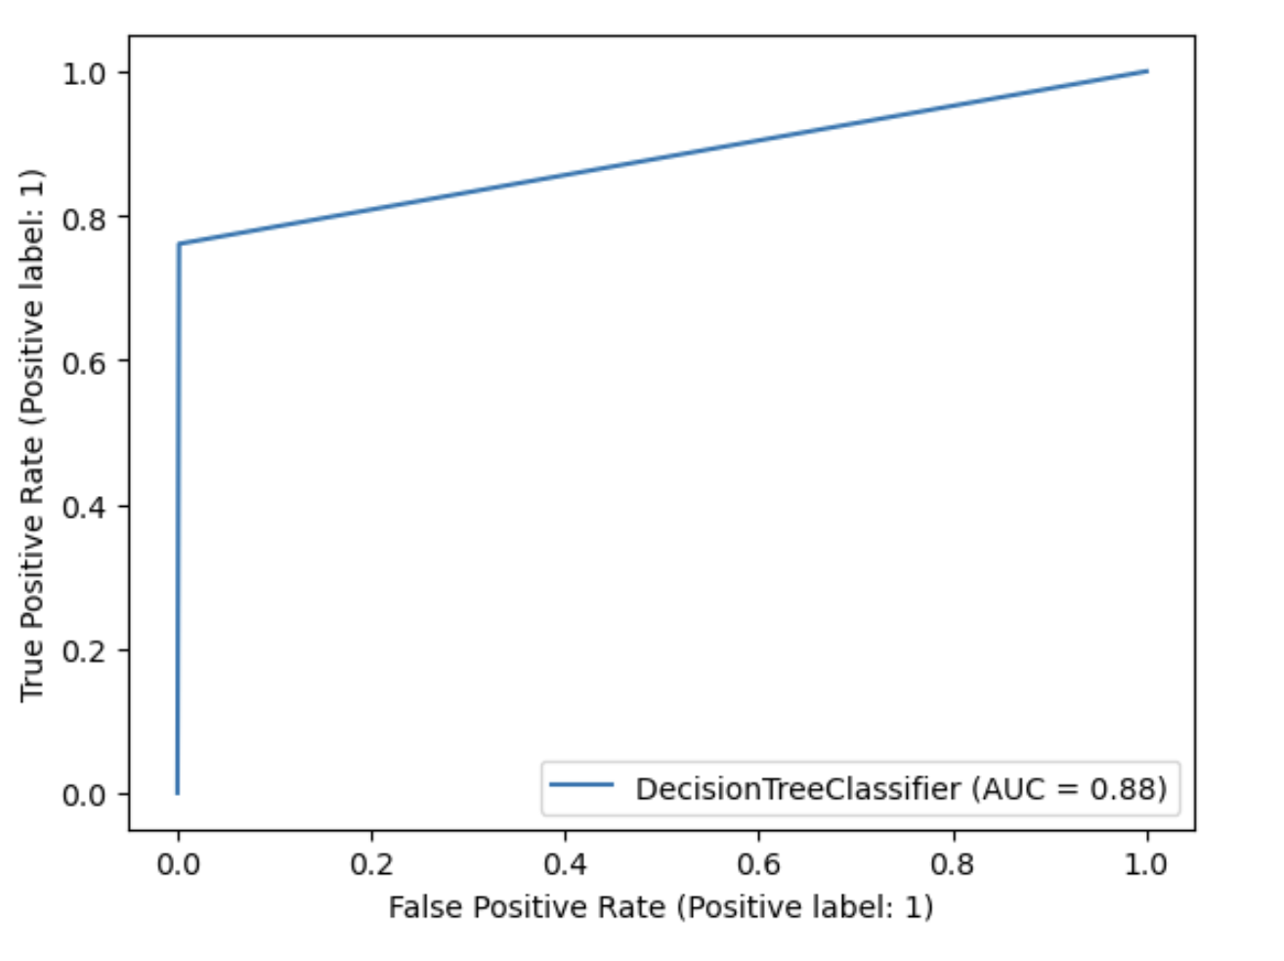
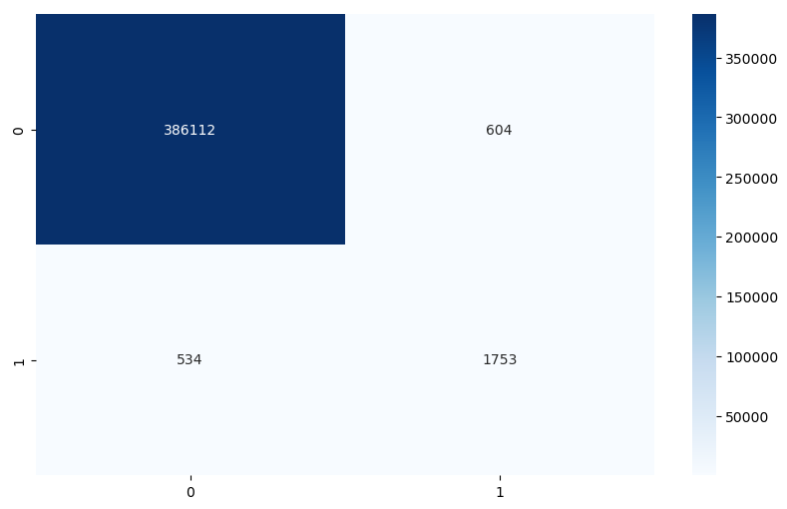

Slide 11
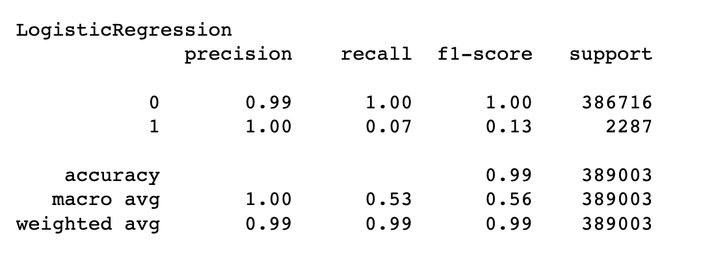
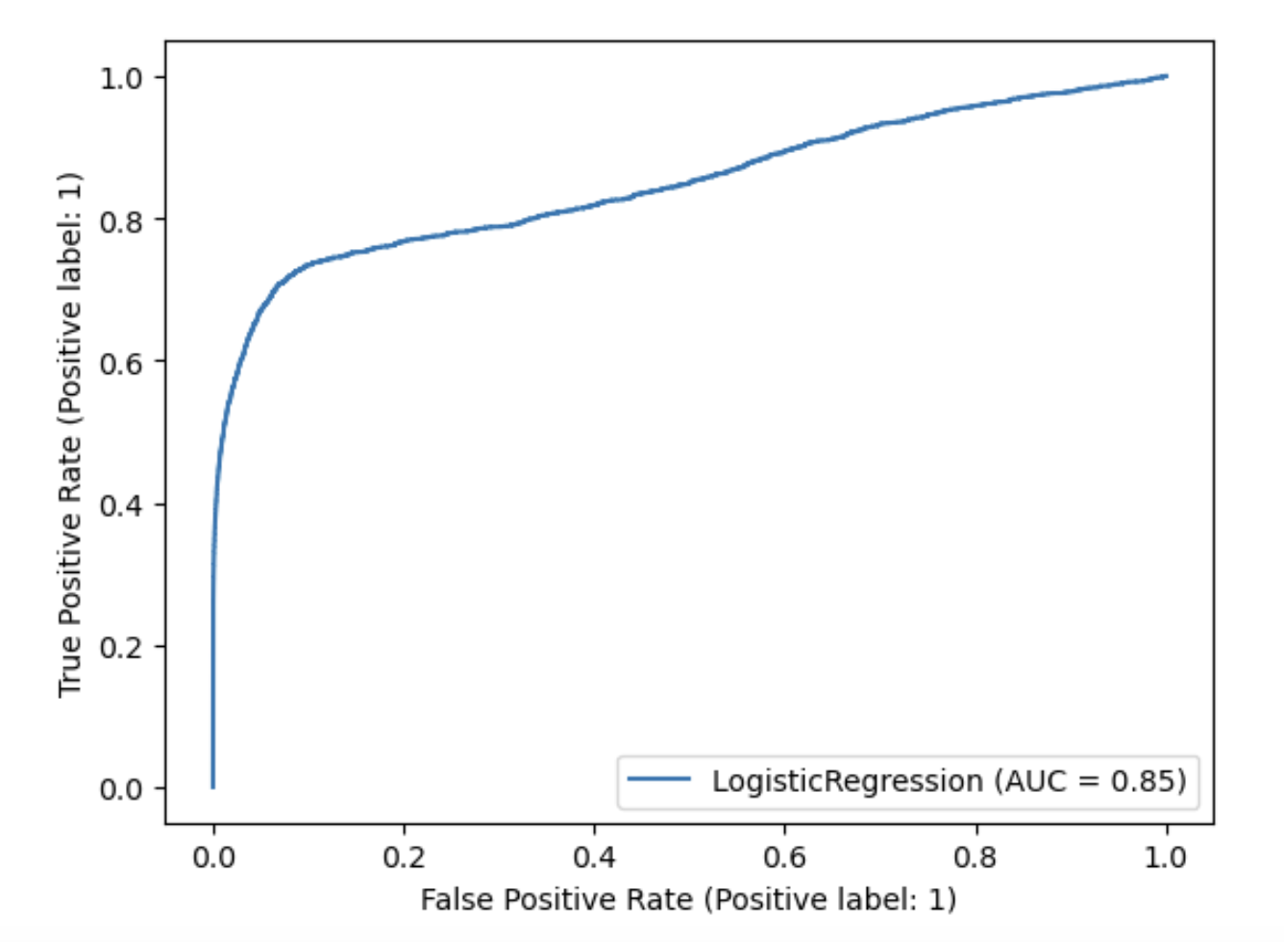
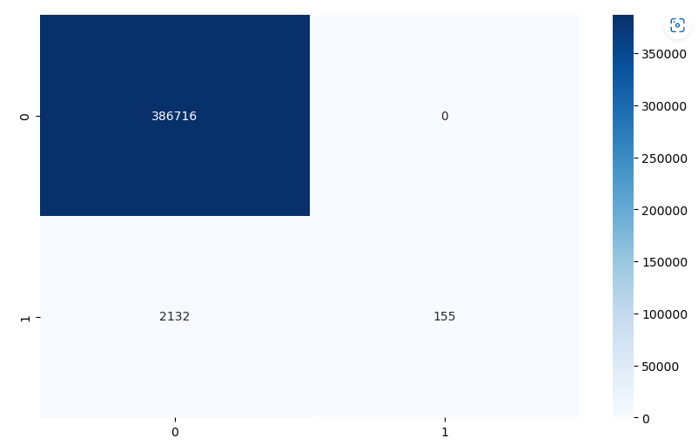

Slide 12
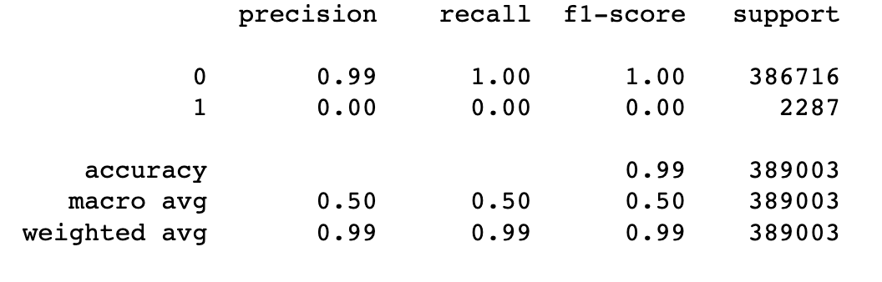
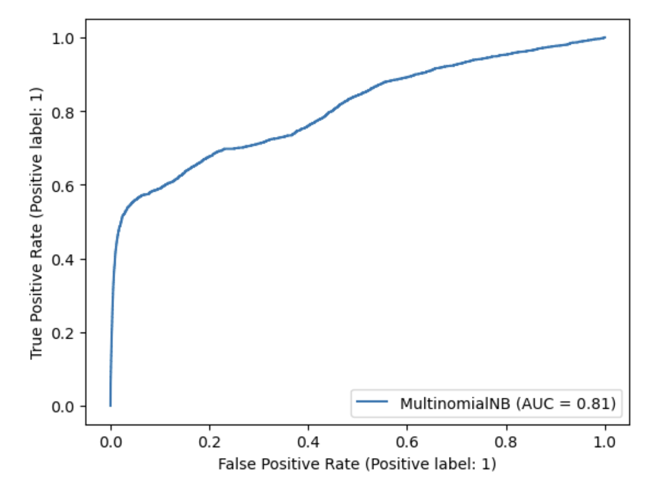
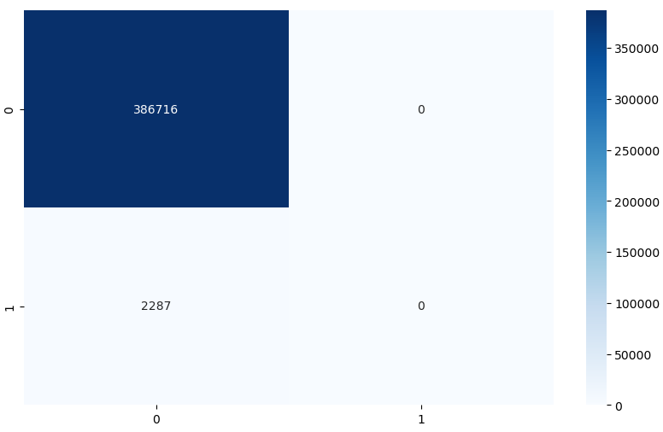
MultinomialNB

Slide 13
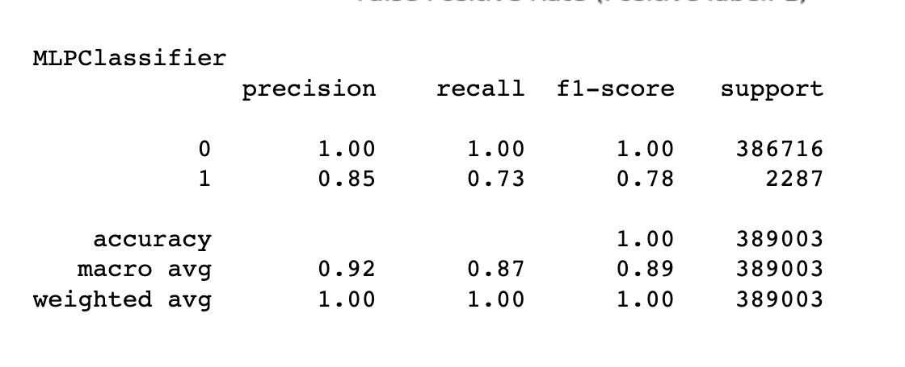
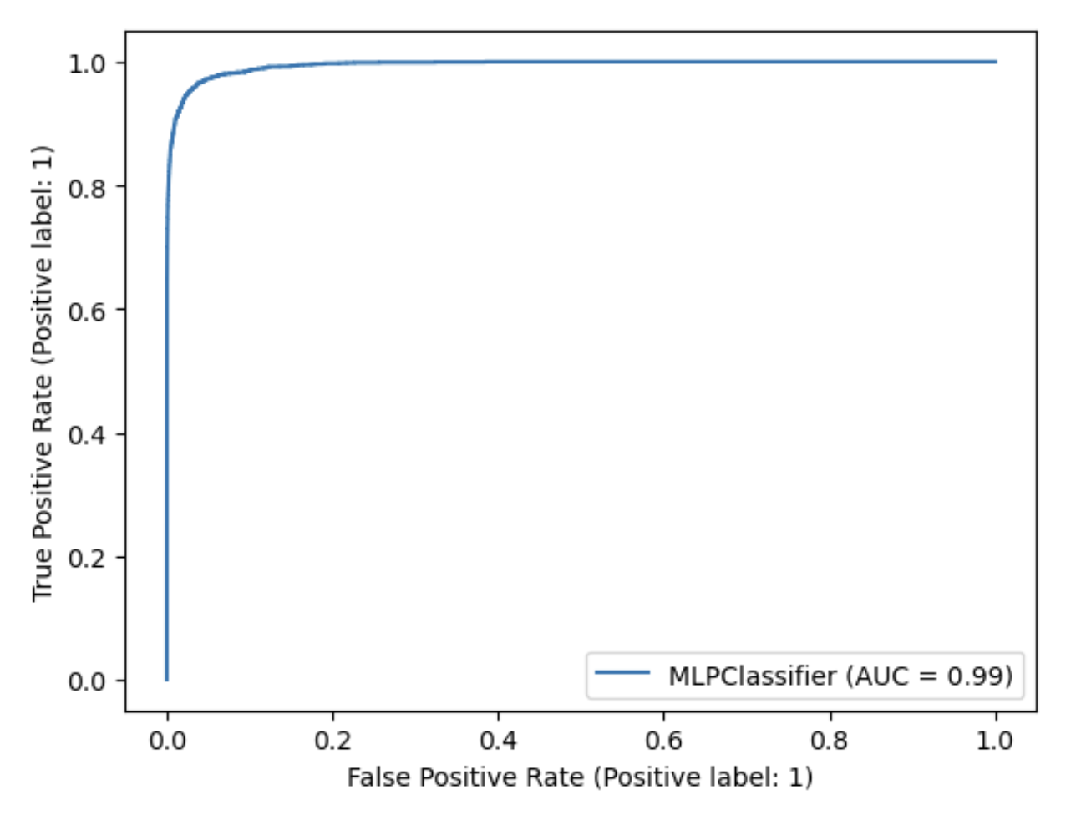
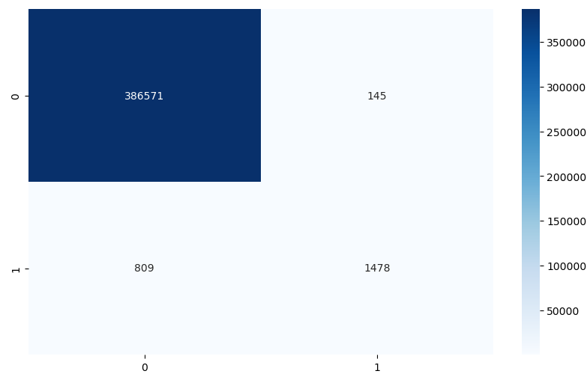

Slide 14
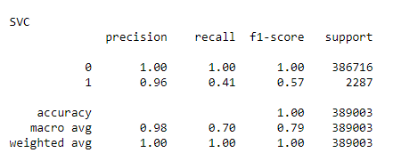
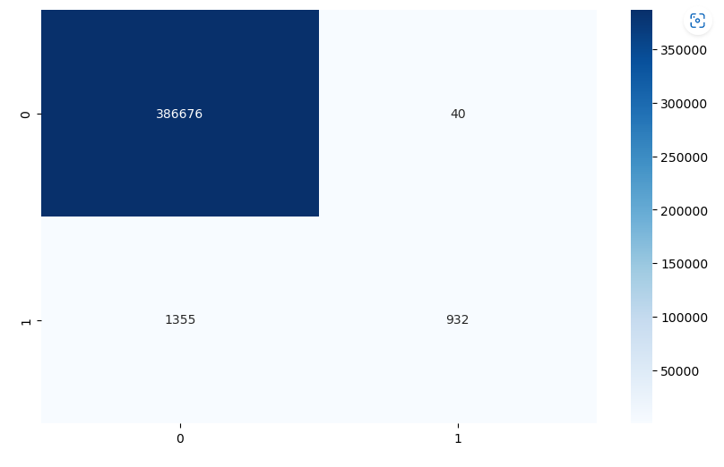
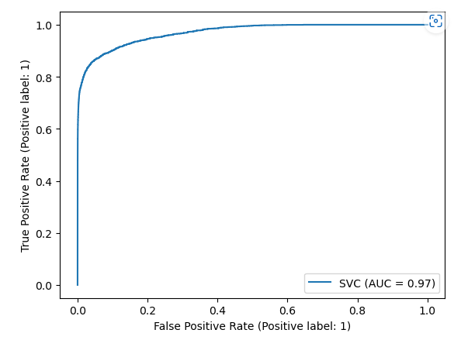

Slide 15
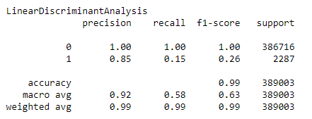
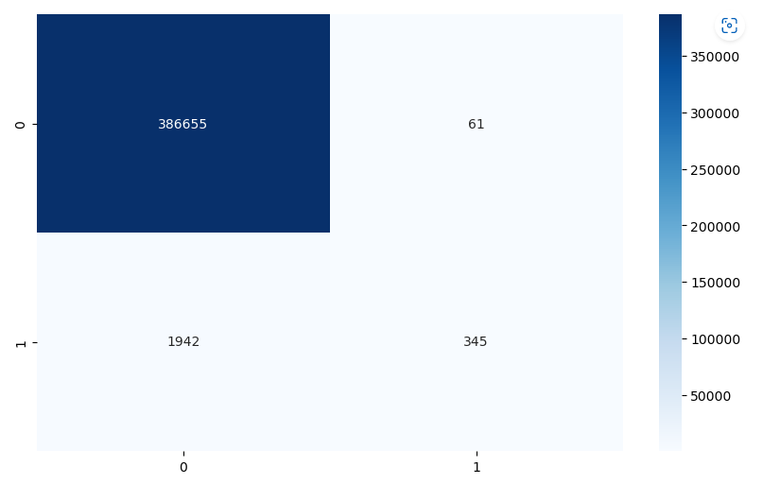
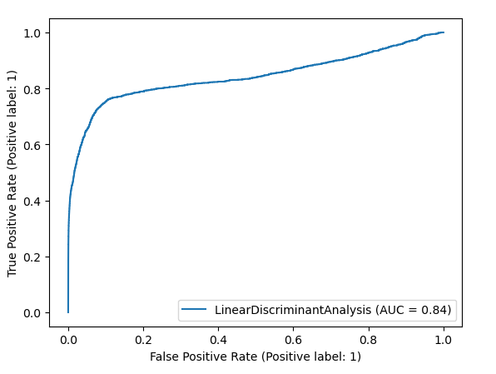

Slide 16
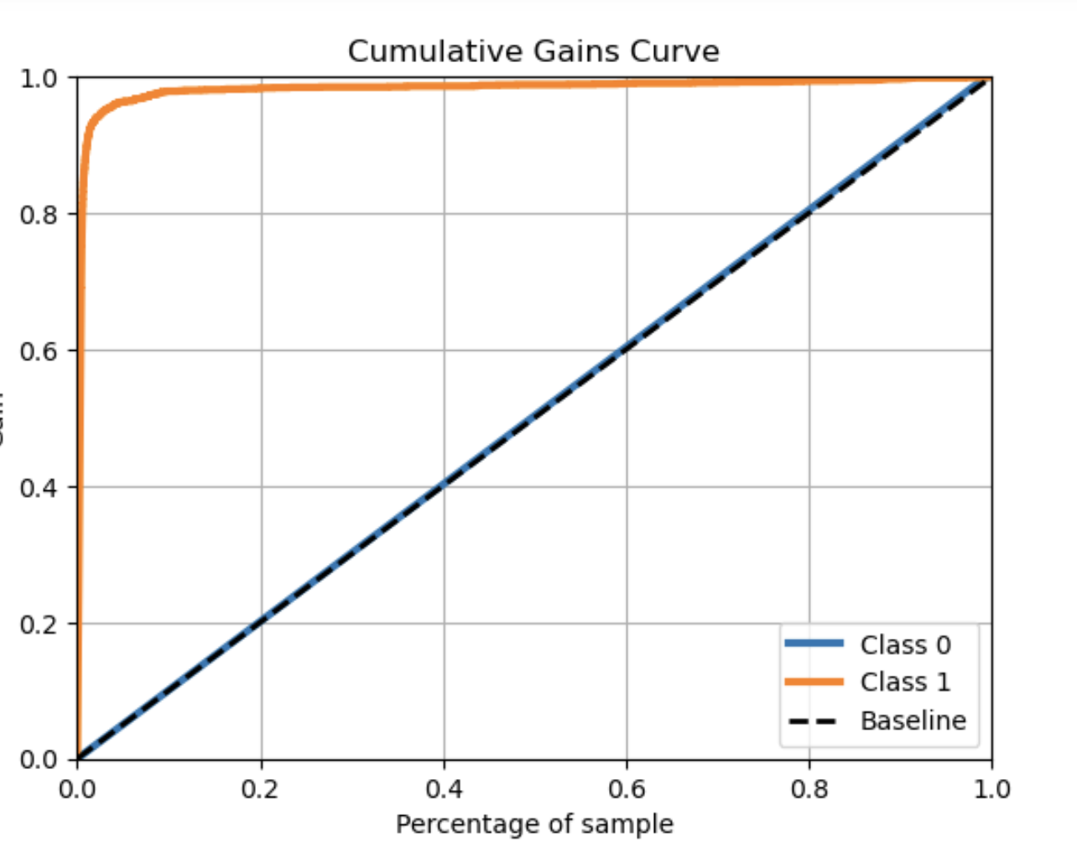
Evaluating Performance of Top Model
Random Forest
Sensitivity: 0.8841276781810232
Specificity: 0.9924388957270969

Slide 17
Conclusion
Fraud detection systems use a variety of techniques, including machine learning algorithms and rule-based systems, to identify potentially fraudulent transactions.
Some common features of fraud detection systems include real-time monitoring, transaction pattern analysis, and anomaly detection.
Advanced techniques like deep learning and artificial intelligence are also being used to improve the accuracy and efficiency of fraud detection systems.
Effective fraud detection requires a multi-layered approach that involves both technology and human expertise.
Ongoing monitoring and analysis of transaction data is critical to identifying new and evolving types of fraud.
While no fraud detection system is foolproof, implementing a robust fraud detection strategy can significantly reduce the risk of financial losses from credit card fraud.

Slide 18
Improving the Model
Data preprocessing:
Feature selection:
Model selection:
Ensemble methods:
Real-time detection:
Improved training data:
Human expert input

Slide 19
Thank you

